Slide 1
Introduction

Slide 2
Framework
Core
Integration
Logging
Stage Navigation
Multiplay
Chat
Third party
VContainer
UniRx
UniTask
Vivox
Unity
Addressable Asset System
Netcode for GameObjects

Slide 3
Title screen
Avatar selection screen
Space selection screen
Virtual space
TitleStage
AvatarSelectionStage
SpaceSelectionStage
VirtualStage
Framework
App
App
App
App
CameraControl
CameraControl
CameraControl
CameraControl
Core
InputControl
InputControl
InputControl
InputControl
TitleScreen
NetworkControl
NetworkControl
NetworkControl
Stage
Navigation
PlayerControl
PlayerControl
PlayerControl
AvatarSelectionScreen
LobbyControl
TextChatControl
SpaceSelectionScreen
VoiceChatControl
Stage
ReactionControl
VirtualSpace
Scene

Slide 4
Scene
Third party
VContainer
View
event
Presenter
call
Model
call
event
UniRx

Slide 5
TextChatControl
Framework
Third party
TextChatView
TextChatPresenter
TextChatModel
Integration
<<GameObject>>
TextChatUI
Chat
Vivox

Slide 6
Stage Navigatoin

Slide 7
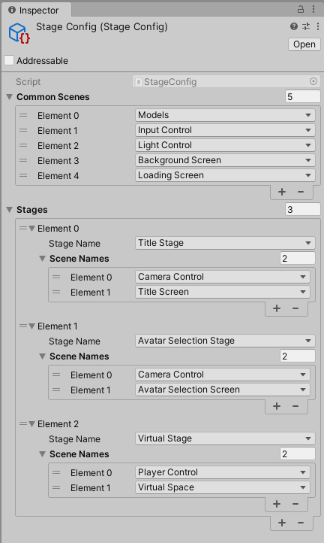

Slide 8
Sample Applicaiton

Slide 9
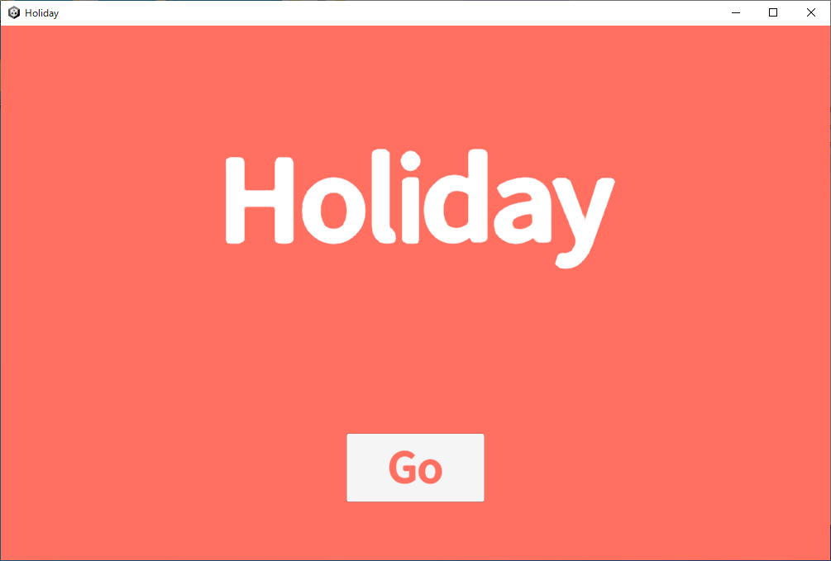
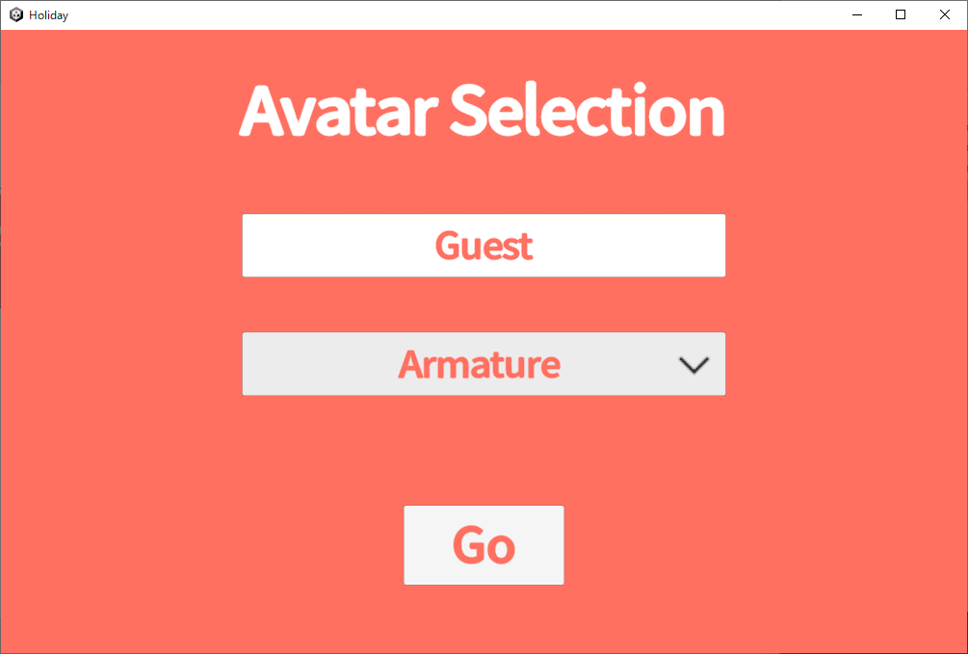
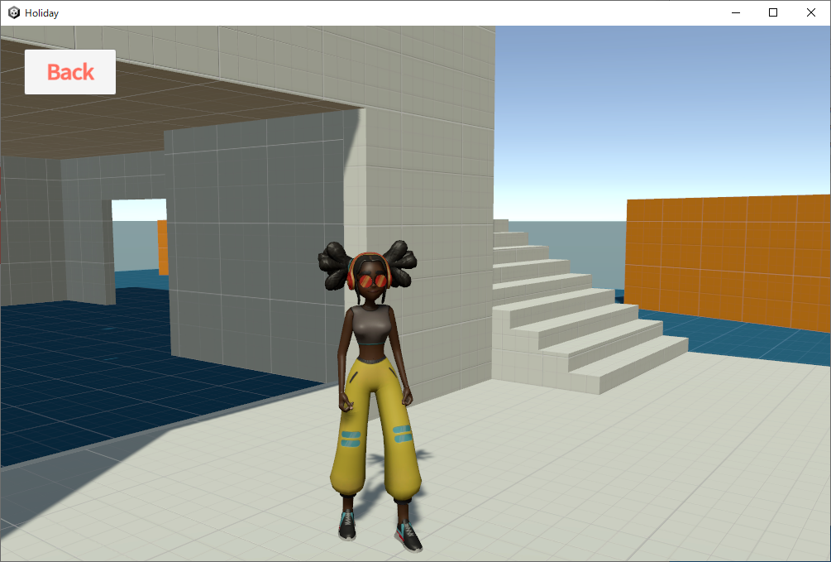

Slide 10
Apple Store
User
download
Google Play
AWS S3
upload
use
setup
Developer
Vivox
(SaaS)
text/voice chat
setup
Holiday
(PC or Mobile)
play, reaction
Multiplay
(AWS EC2)

Slide 11
TitleStage
AvatarSelectionStage
VirtualStage
App
App
App
Entry point
CameraControl
CameraControl
CameraControl
InputControl
InputControl
InputControl
LightControl
LightControl
LightControl
Common scenes
BackgroundScreen
BackgroundScreen
BackgroundScreen
LoadingScreen
LoadingScreen
LoadingScreen
TitleScreen
AvatarSelectionScreen
MultiplayControl
TextChatControl
VoiceChatControl
Scenes by stage
VirtualSpace
Stage
Scene

Slide 12
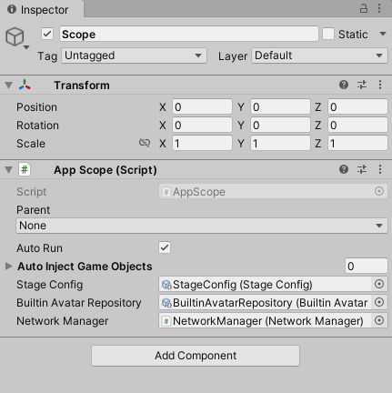
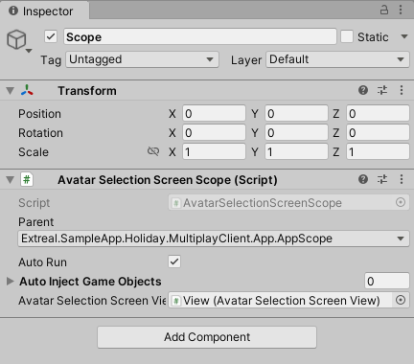
App scene
AvatarSelectionScreen scene

Slide 13
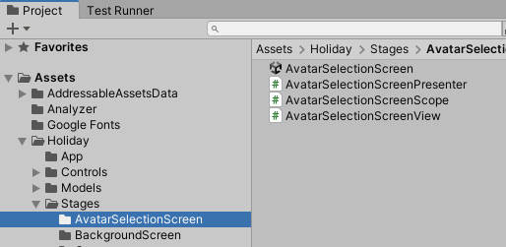
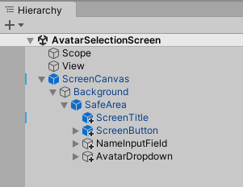
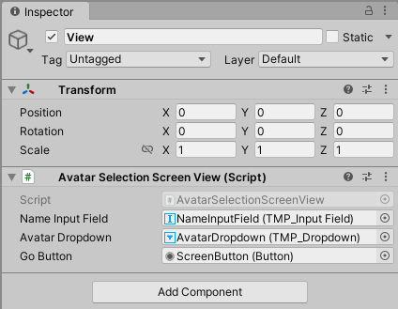

Slide 14
Learning＞Core

Slide 15
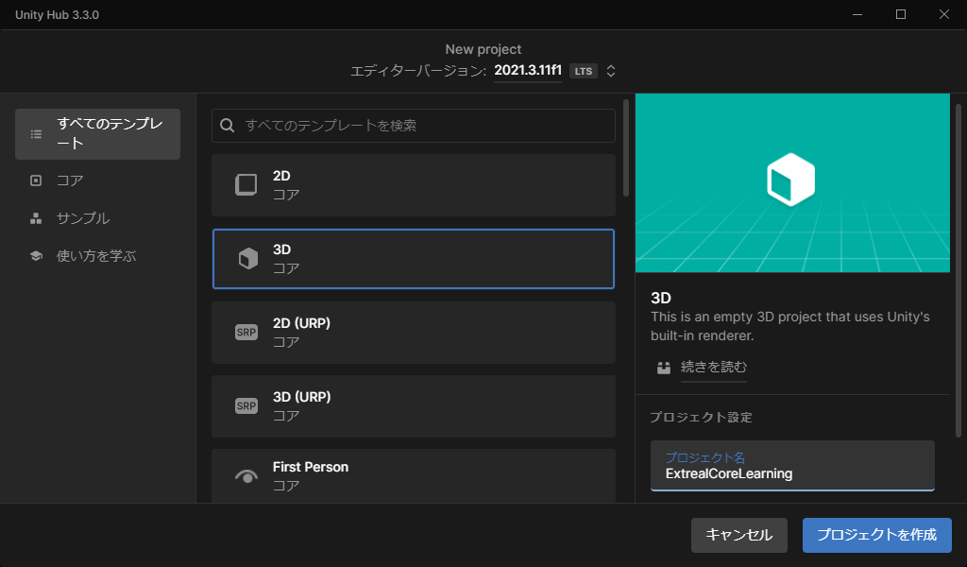

Slide 16
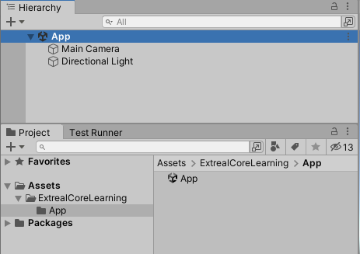

Slide 17
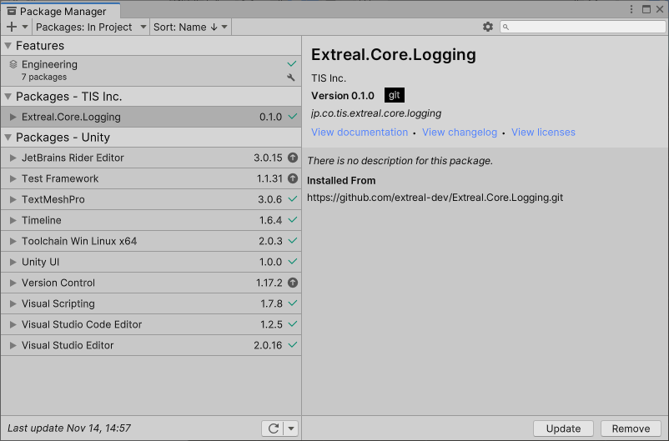

Slide 18
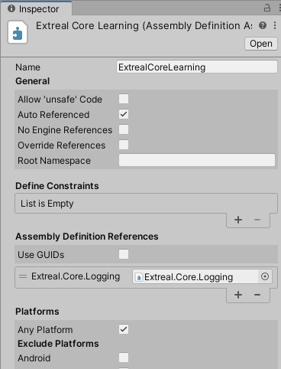
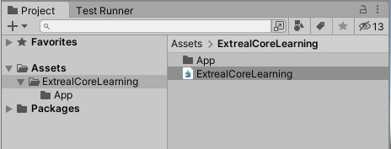

Slide 19
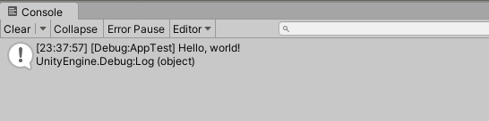

Slide 20
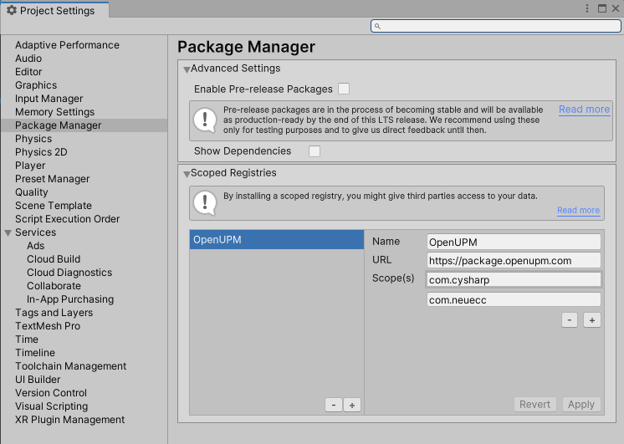

Slide 21
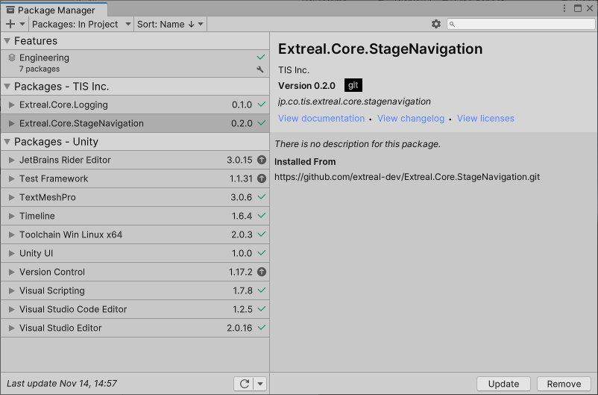
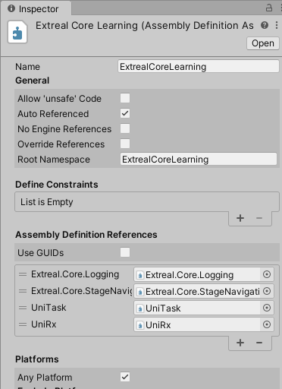

Slide 22
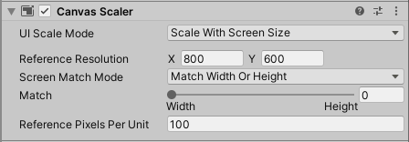

Slide 23
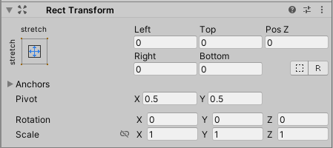
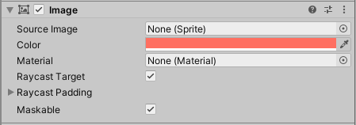

Slide 24
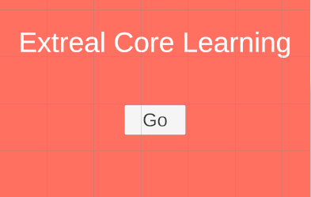

Slide 25
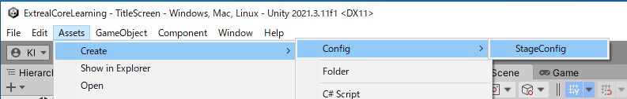
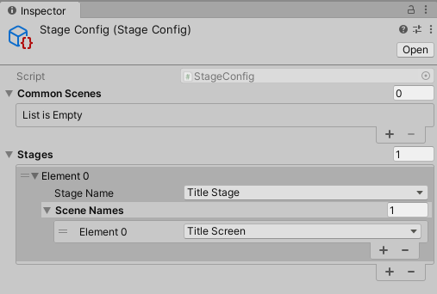
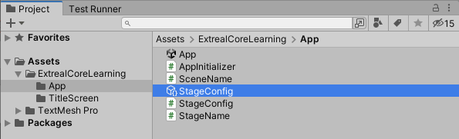

Slide 26
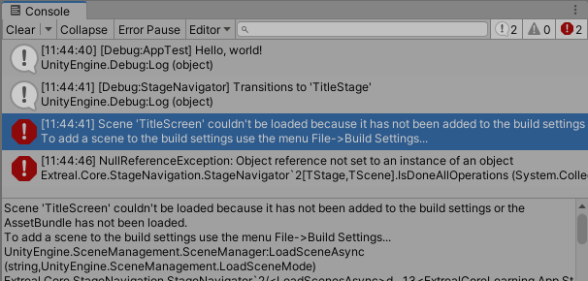

Slide 27
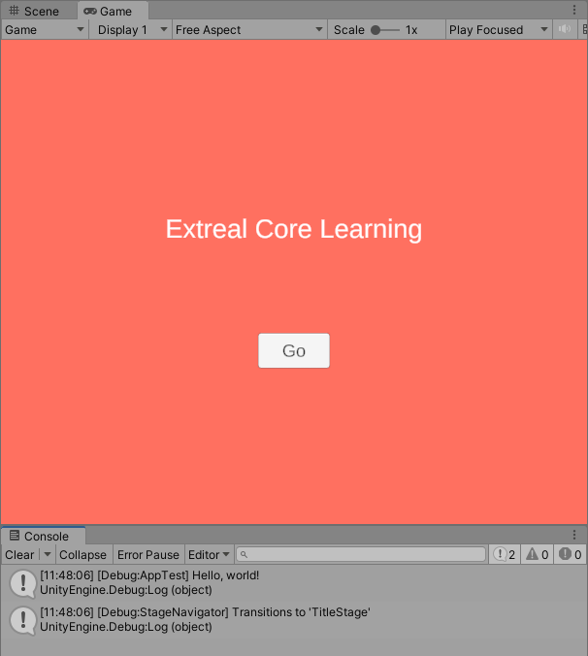

Slide 28
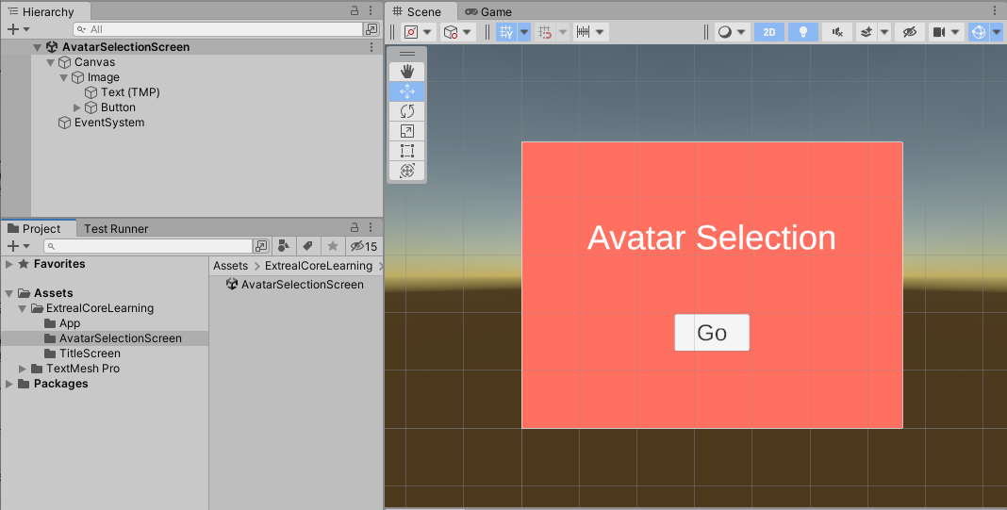

Slide 29
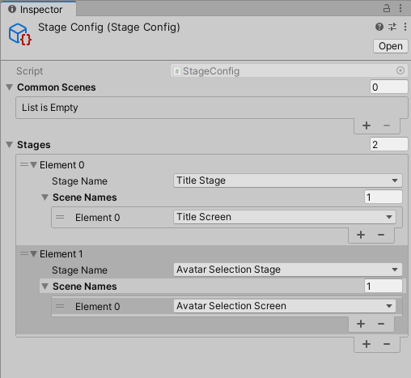

Slide 30


Slide 31
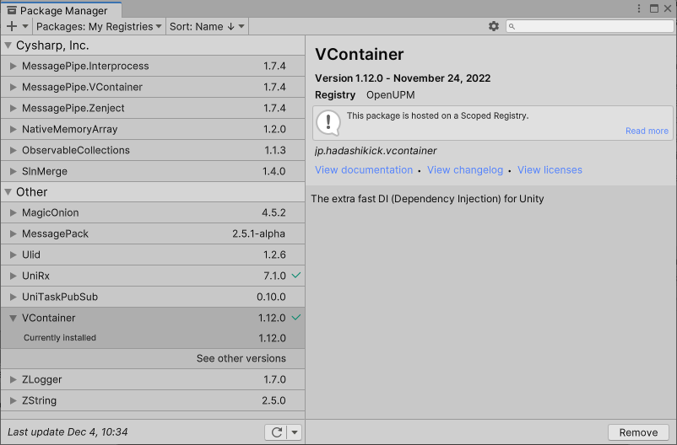
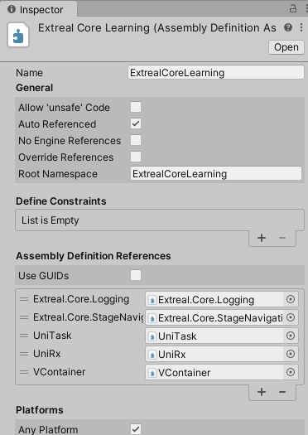

Slide 32
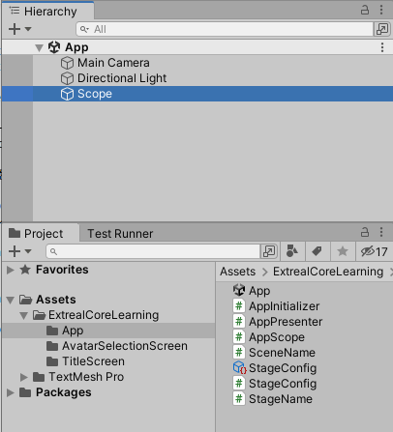
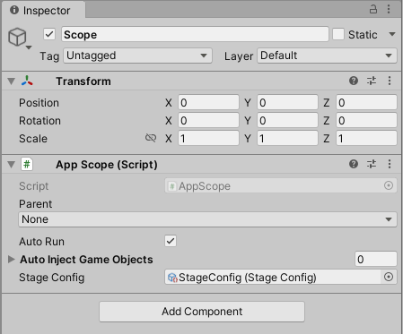

Slide 33
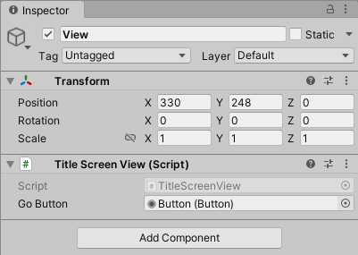
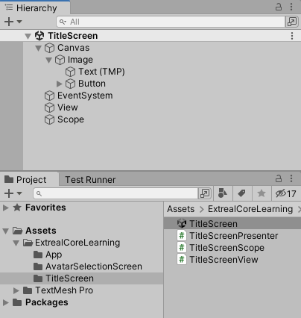
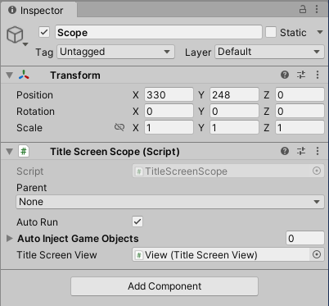

Slide 34
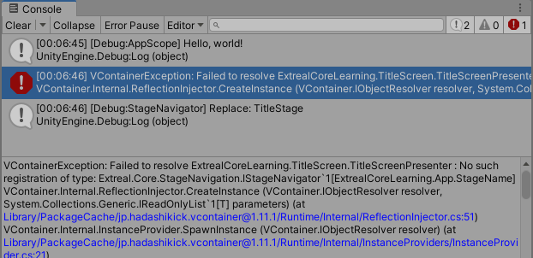

Slide 35
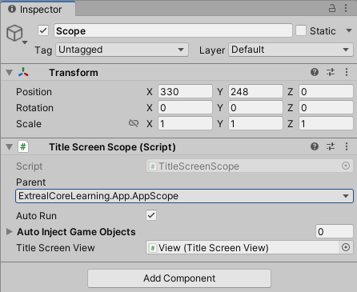

Slide 36
Learning＞Multiplay.NGO

Slide 37
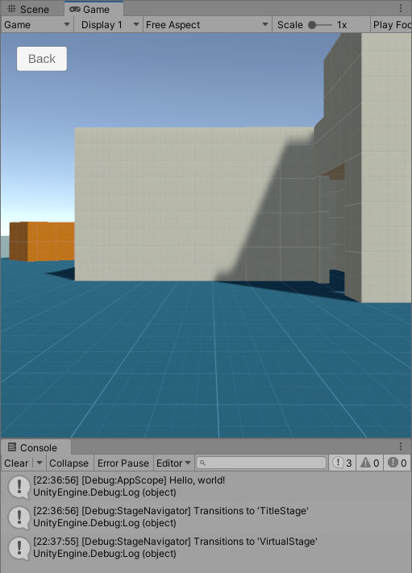
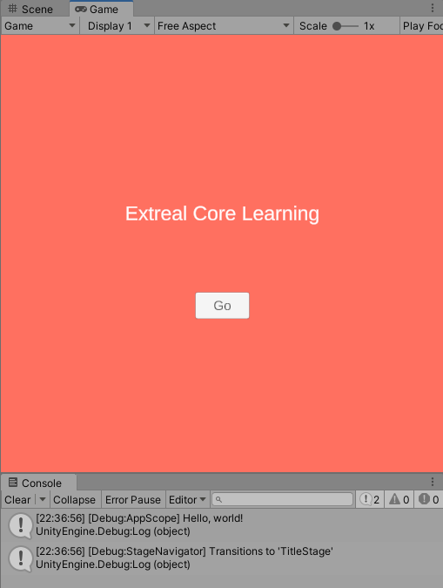

Slide 38
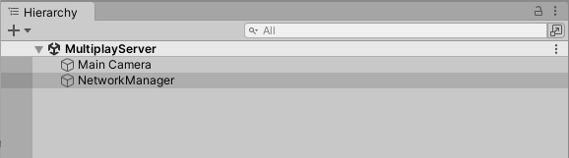
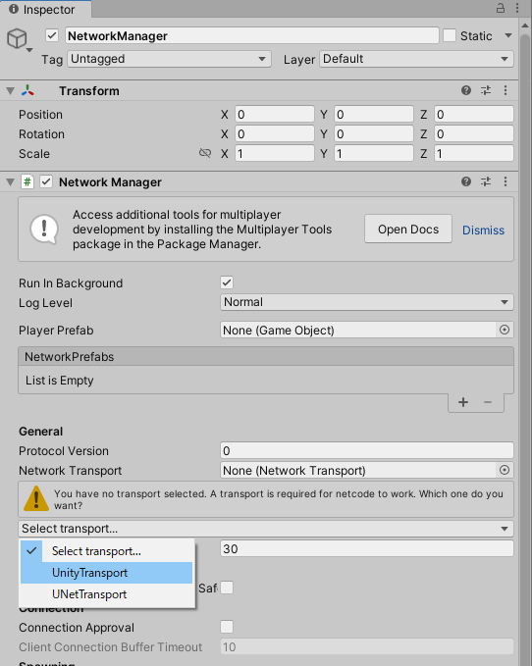
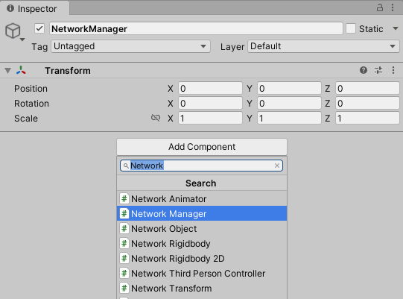

Slide 39
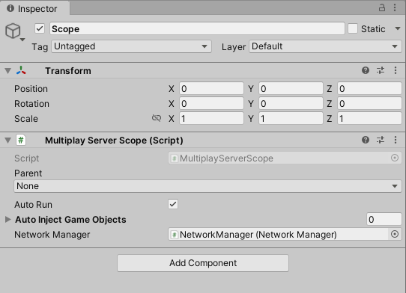
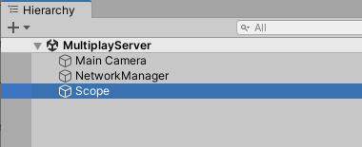

Slide 40
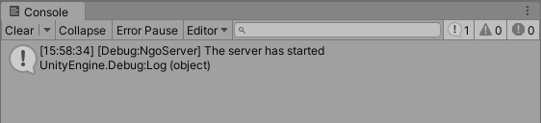

Slide 41
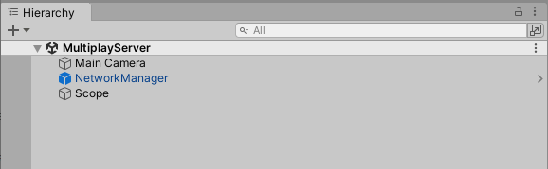
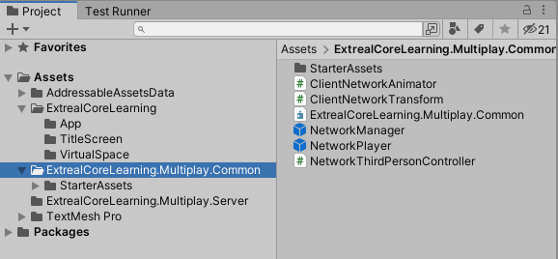

Slide 42
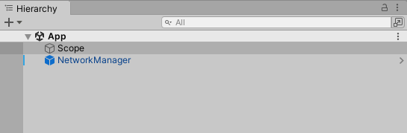
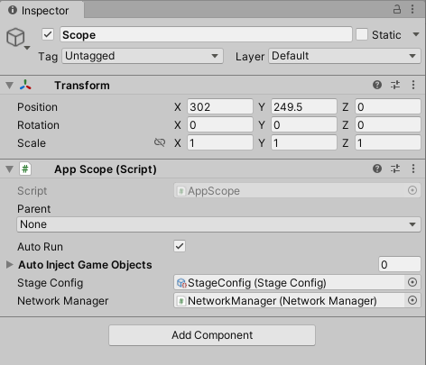


Slide 43



Slide 44



Slide 45






Slide 46


