Slide 1
Building a Learning Organization
January 27, 2015
Marc Esher

Slide 2
Notes:
I’m going to talk about how organizations learn, through the lens of how the organization responds to failures.
If this circle represents all there is to know about how organizations learn…

Slide 3
Notes:
Then this topic represents one small fraction of ways to study organizational learning

Slide 4
Notes:
But its impact on organizational learning is so massive. In addition, it’s one of the easiest and most accessible ways that each and every one of us can contribute to the success of our teams and our organization

Slide 5
2014-10-07 3:52 AM: Uh-oh
Notes:
https://github.cfpb.gov/CFPB/DevOps/wiki/Public-data-platform-10-7-2014
I’m going to tell you a story about a time when our public data platform went down and became inaccessible to the public
AWS sends alert indicating the website is down

Slide 6
3:53 AM: Definitely Uh-oh
Notes:
Another production monitor sends alert that all PDP web servers are down

Slide 7
4:05 AM: Yoohoo… still uh-oh
Notes:
3rd monitoring system lets us know that, yup, nothing is working

Slide 8
7:16 AM: First responder
Notes:
James from SE tries to diagnose and troubleshoot and is unsuccessful. Emails small group of people in SE and dev

Slide 9
7:25 AM: Cavalry
Notes:
Marc responds to that small group, adding a bunch more people. Starts investigating as well.

Slide 10
7:46 AM: Bat signal
Notes:
Marc responds to everyone again, asking everyone for help

Slide 11
8:00 AM: First phone call
Notes:
Marc calls Keith. Learns Keith has started to investigate

Slide 12
8:10 AM: Bridge call… battlestations!
Notes:
We start up a conference call and ask everyone to join in

Slide 13
8:15 to 8:30 AM: A-ha!

Slide 14
8:30 to 9 AM: Fix rolled out

Slide 15
9:11 AM: All monitoring systems OK

Slide 16
@5 hours total time to recover

Slide 17
@2 hours from first response to recovery

Slide 18
@1 hour to recover after swarming

Slide 19
@30 minutes to recover after discovery
Notes:
Not Great

Slide 20

http://lifeisaforkintheroad.com/wp-content/uploads/2013/07/Fork-In-Forest-darker.jpg
Notes:
http://lifeisaforkintheroad.com/
Now, what happens next is the entire point of this talk.
2 choices:
Problem is fixed… just move on
Learn and improve the system

Slide 21
“Blameless post-mortems”
Notes:
What we have been doing – in concert with the linux sysadmins in Systems Engineering and the Delivery team team, in our AWS environment, is something that Etsy calls “Blameless post-mortems”
Now, here, we don’t actually talk about it that way. If you were to ask Keith in SE about it, he wouldn’t say “oh, yeah, we do what Etsy does”. But that is what we do.

Slide 22
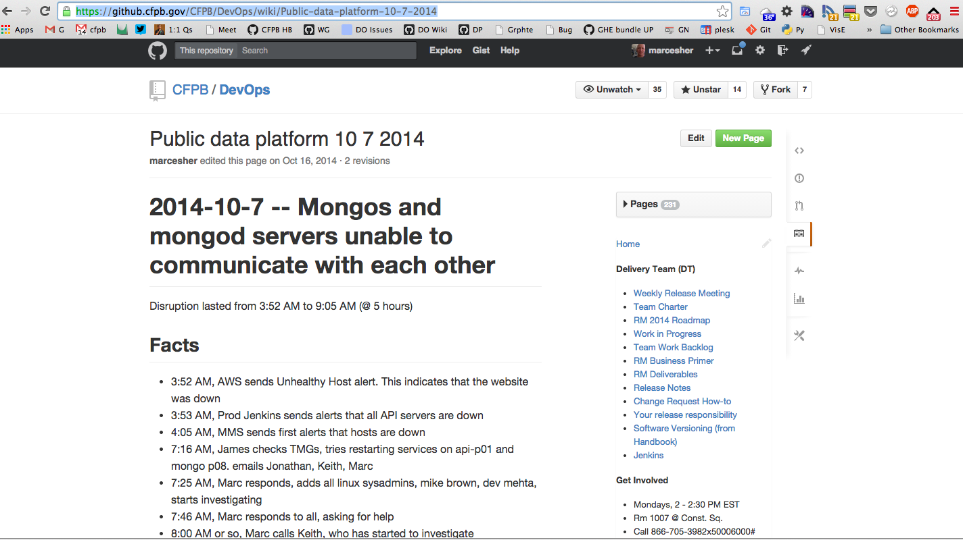
Notes:
First thing we do is start a wiki page

Slide 23
Accountability = Tell Your Account
Notes:
1. Fact find. Accountability == "Tell your account"
1. this is the single most important part. You can not solve problems if you don't fully understand their context
1. Uncover assumptions the team had... try to dig into multiple perspectives... that's the only way to more fully establish context

Slide 24
Identify systemic pressures
Notes:
Identify systemic pressures -- Where did the system increase the likelihood of a problem or prevent faster time to recovery

Slide 25
Team owns the solutions
Notes:
1. Team makes concrete suggestions for improvements, who's accountable, by when
1. Get those into an issue tracker for scheduling and implementation

Slide 26
Why blameless?
Notes:
### Why bother?
- Why not just fix the problem and move on
- Frankly... that's how it is in many organizations
- or a slight variant: Who screwed up, and how can we prevent him from screwing up again (or how can we get rid of this bad apple)
And, quite frankly, we still do this A LOT here with our technical systems. We have so much work to do here. But we’ve started it
- We work on complex, or at least nontrivial, systems:
- our hosting provider is the brainchild of thousands of architects, network engineers, and developers
- our operating system... tens of thousands
- our web and database servers... thousands
- our programming languages... hundreds to thousands
- our network... hundreds to thousands
- our configuration management and deployment tools... thousands
- our own custom software... hundreds
- Our systems are the result of perhaps 100+ thousand people, over decades
- To think that everything will generally "just work", all the time, is not only wishful thinking, it's also dangerous
- The best offense we have to tame that complexity is learning
- yes, more sophisticated automation and tooling is important.
- But nothing -- nothing! -- is more effective than our humans
- And the way we learn is to commit to learning as a goal, to create conditions for it (i.e. blameless postmortems),
and to implement its practices habitually, from the smallest disruption to the largest

Slide 27
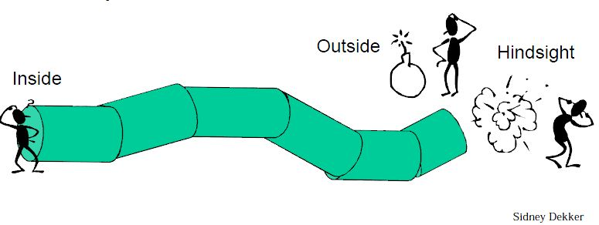

Slide 28
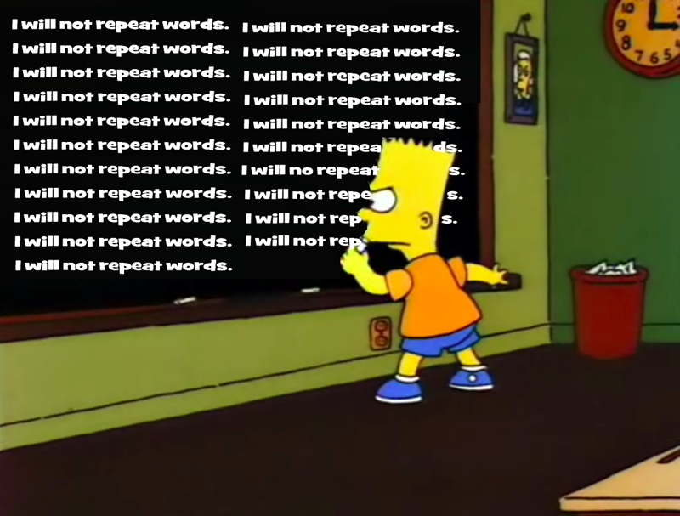
Notes:
http://www.spencerbrokaw.com/2012/06/guest-post-from-author-rob-guthrie.html
This pattern of failure, response, resolution plays out over and over again, every single day, in our organization and every other organization, in all manner of systems.
It’s obviously not isolated to technical systems.
This pattern applies to every single one of you in here because you work on a team, in an organization, with other humans and systems
The nice thing about technical incidents like this one is that they compress timelines very tightly so they’re useful as a way of exploring failure and response to failure

Slide 29
“Learning Culture” at the Sharp End
Notes:
It’s great to see things like the Annual Employee Survey where the organization seemingly honestly confronts its weaknesses. Fantastic.
If you want to see how well that message about building a learning organization is flowing down to the Sharp End of the organization – the boots on the ground, the implementers – look at how the sharp end approaches failure.
Some of us over the past half year or so have been trying to move in the right direction.
I implore all of you, when faced with what is surely inevitable failure, to commit as a team to respect one another, to learn from it, to share that learning, and feed it back into the organization so that we collectively get better.
The alternative, by the way, is terrible and heartbreaking: it’s learned helplessness. When the people at the sharp end are faced with a failure and their response, after it’s fixed, is “Oh, I don’t know what they did, but they fixed it, and I guess we’ll hope it doesn’t happen again”… that’s helplessness. Or when it’s “yeah, this thing was awful, but there’s nothing we can do”, that’s helplessness.
Learning from failure is a choice, and that choice rests with each of us

Slide 30
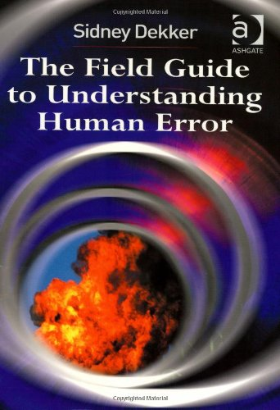

Slide 31
Credits and References
http://lifeisaforkintheroad.com/
http://www.spencerbrokaw.com/2012/06/guest-post-from-author-rob-guthrie.html
http://www.amazon.com/Field-Guide-Understanding-Human-Error/dp/0754648265
https://codeascraft.com/2012/05/22/blameless-postmortems/

