Slide 1
Cyber Trainer – Rafael
Industrial Project 234313
Dan Aaronson, Emil Barel
Supervisors: Moshe Pinto, Roei Goldblat

Slide 2
Introduction
Our project involves creating a website for teaching how to write secure applications that do not contain vulnerabilities.
This will be done by solving problems which include identification and possibly repairing of given code.
There are two types of problems:
Open Problems
Multiple-Choice Problems

Slide 3
Related Works
Hackerank(https://www.hackerrank.com/) – Website providing challenges for several different domains such as Algorithms, Mathematics, SQL, Functional Programming, AI, and more. You can solve all the challenges directly online. Also, provides a discussion and leaderboard for every challenge.
TopCoder - Website providing a list of algorithmic challenges from the past that you can complete on your own directly online using their code editor.
And more.

Slide 4
Project Structure
The app was written using:
Front End – Angular 8
Back End – Node.js using Express.js
Database – MongoDB

Slide 5
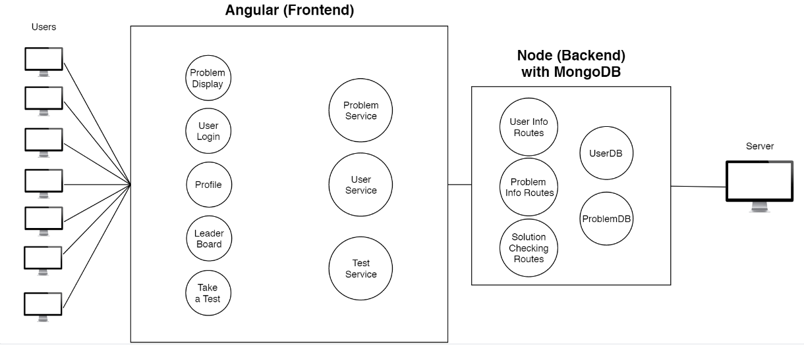
Project Structure

Slide 6
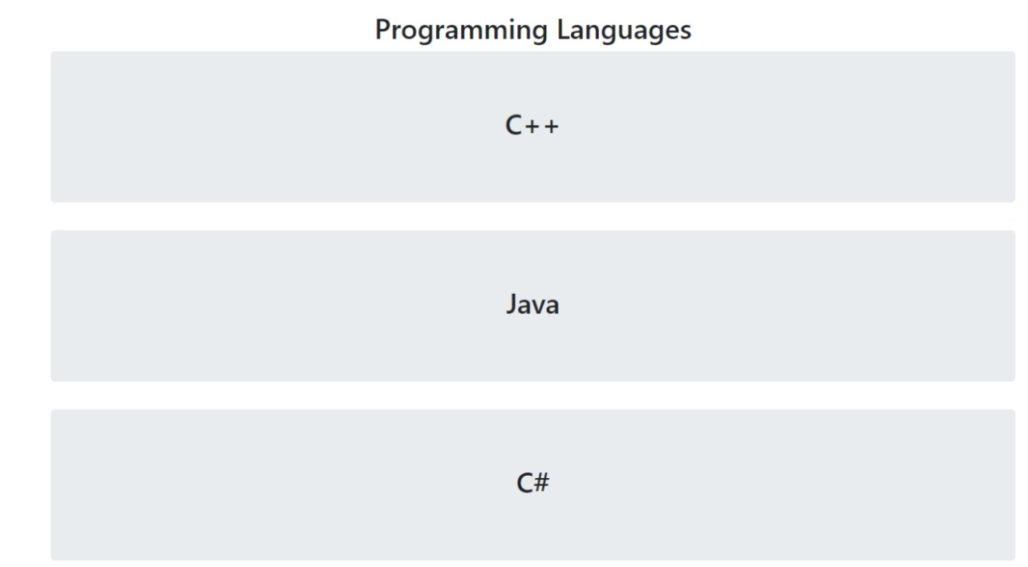
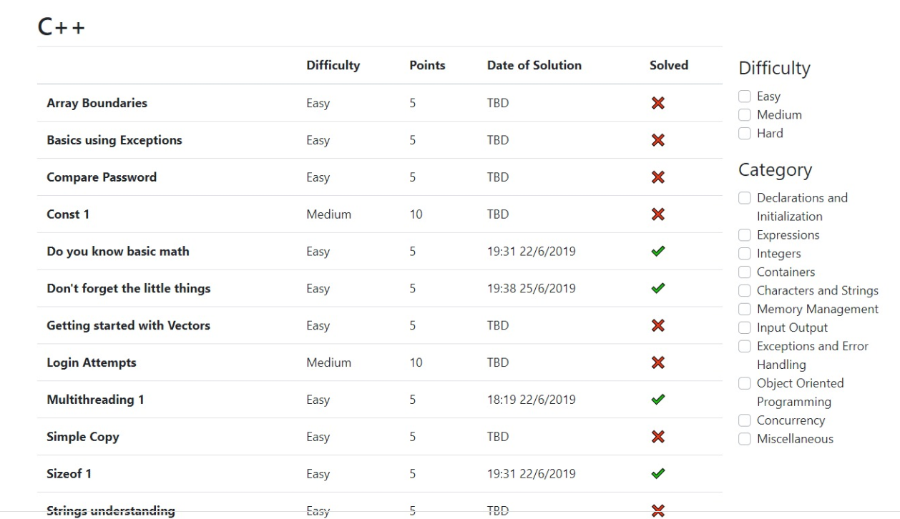
Application Features
Dashboard containing 30+ problems in C++

Slide 7
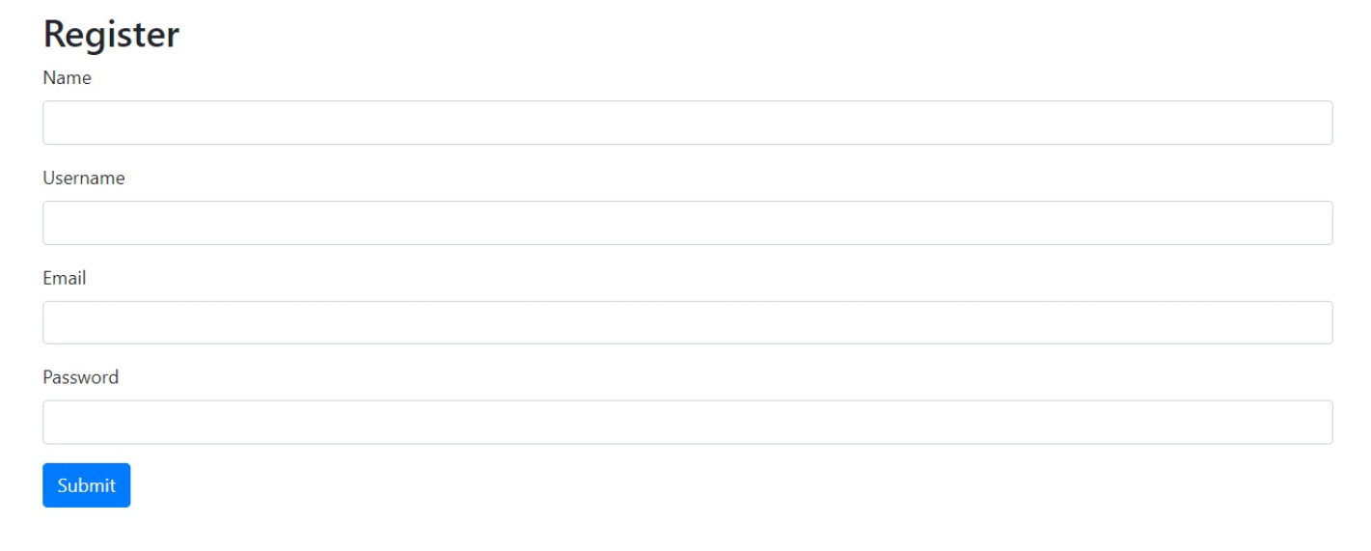
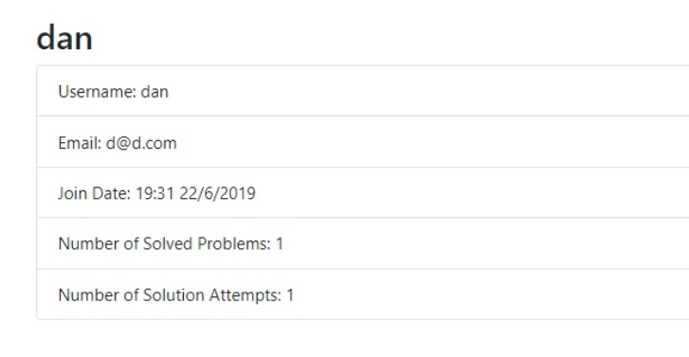
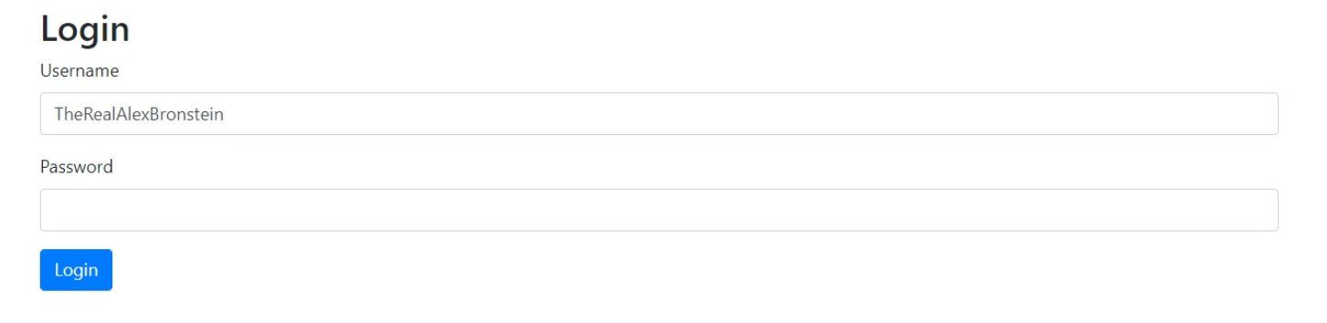
Application Features (cont.)
User Login/Registration + Profile

Slide 8
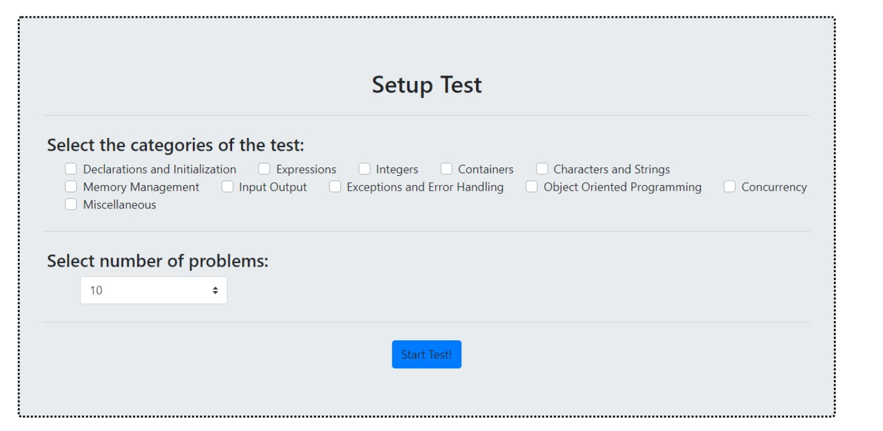
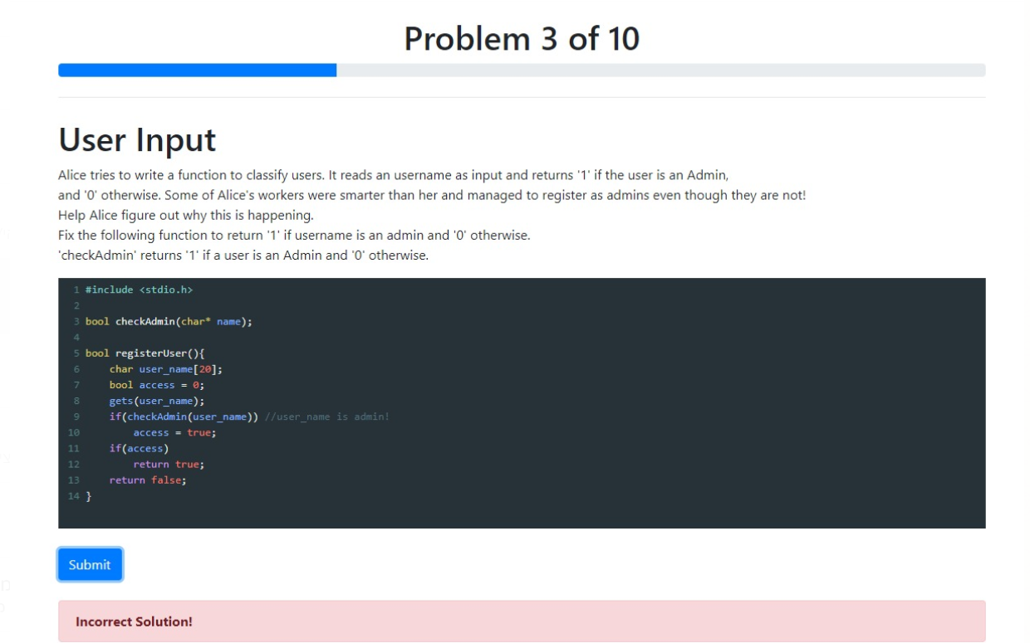
Application Features (cont.)
Take a Test Option

Slide 9
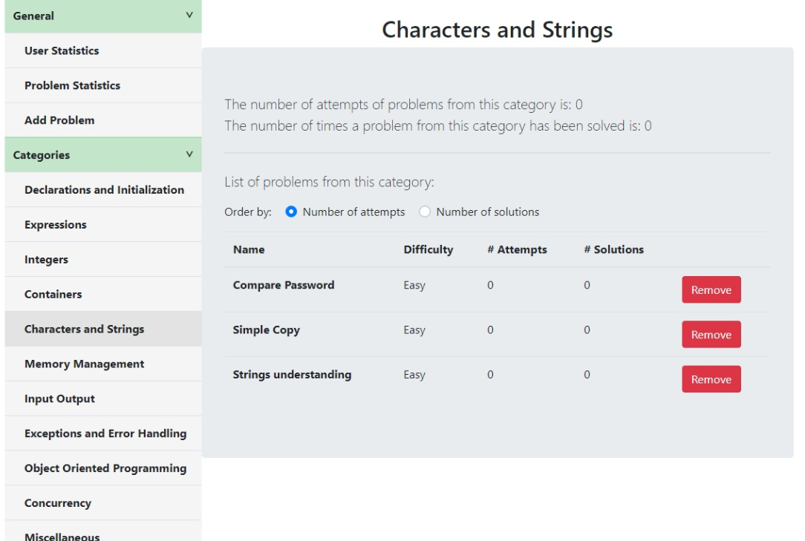
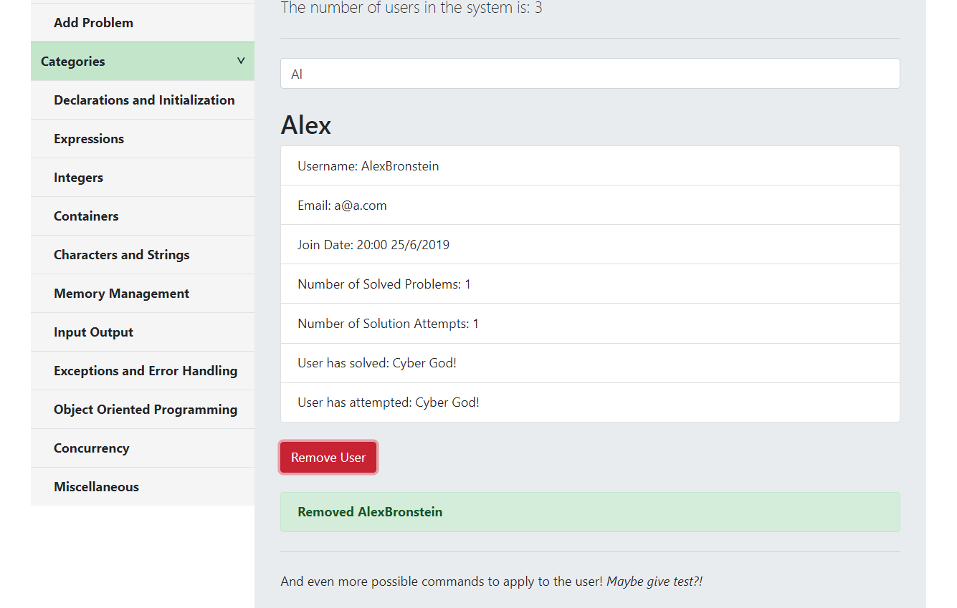
Application Features (cont.)
Administrative panel with various statistics and database modification capabilities

Slide 10
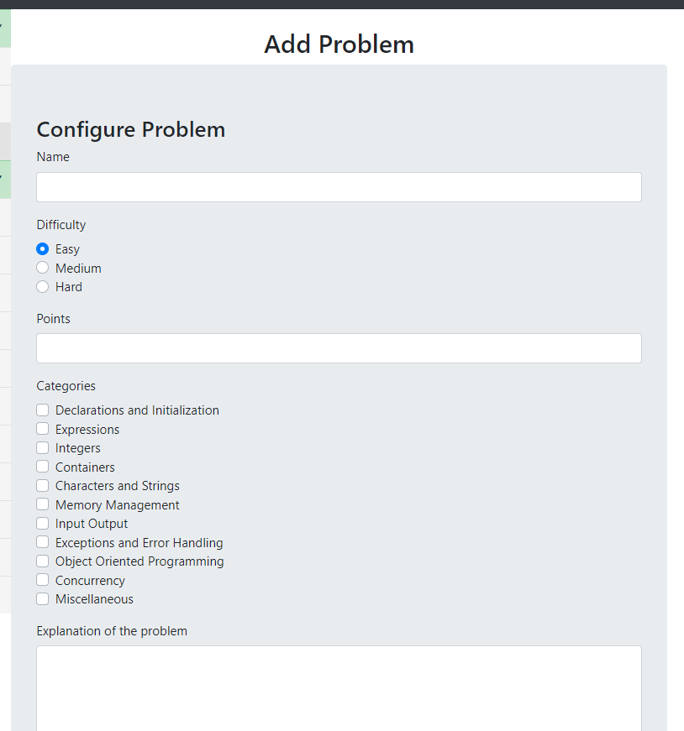
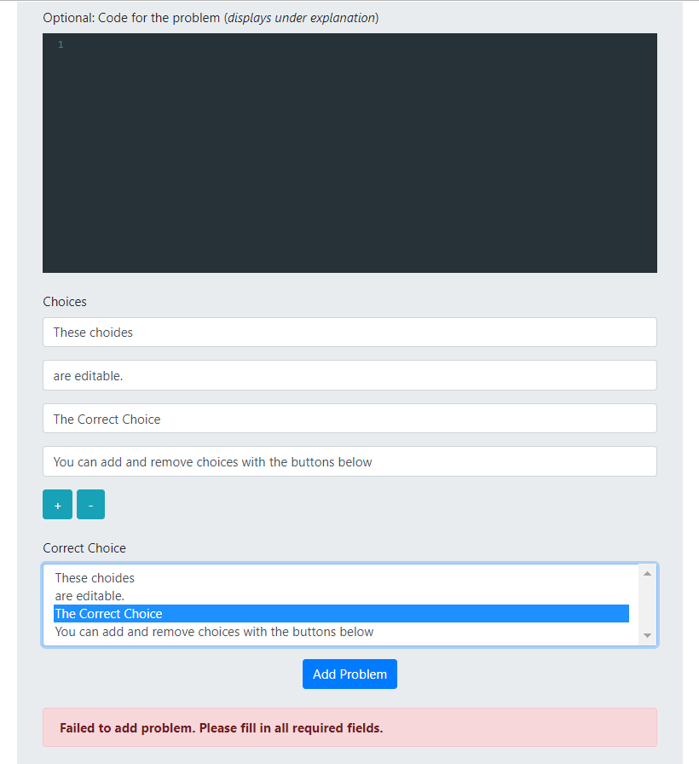
Application Features (cont.)
Admin window for adding multiple-choice problems

Slide 11
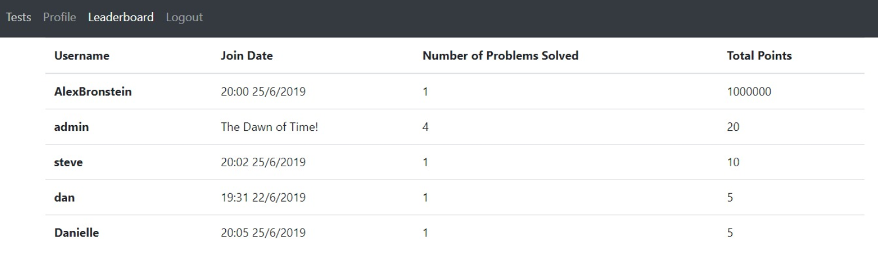
Application Features (cont.)
Leaderboard

Slide 12
Application Features (cont.)
In addition, we provide:
Access control with tokens: must have admin token to view admin statistics and must have token to view the contents of certain pages
Categorization of problems and filtering
Search bars for finding users/problems

Slide 13
Open Problems
This type of problems involve coding. Given some lines of code, the user is required to detect the weakness in the given code and edit it. The solution will then be checked in the backend by running a series of tests that check the correctness of the solution (code is valid and secure; the vulnerability can no longer be used).
User Submits Solution to Backend
Concatenate Solution to Test Code
Compile and Run Code
Result is sent to Frontend

Slide 14
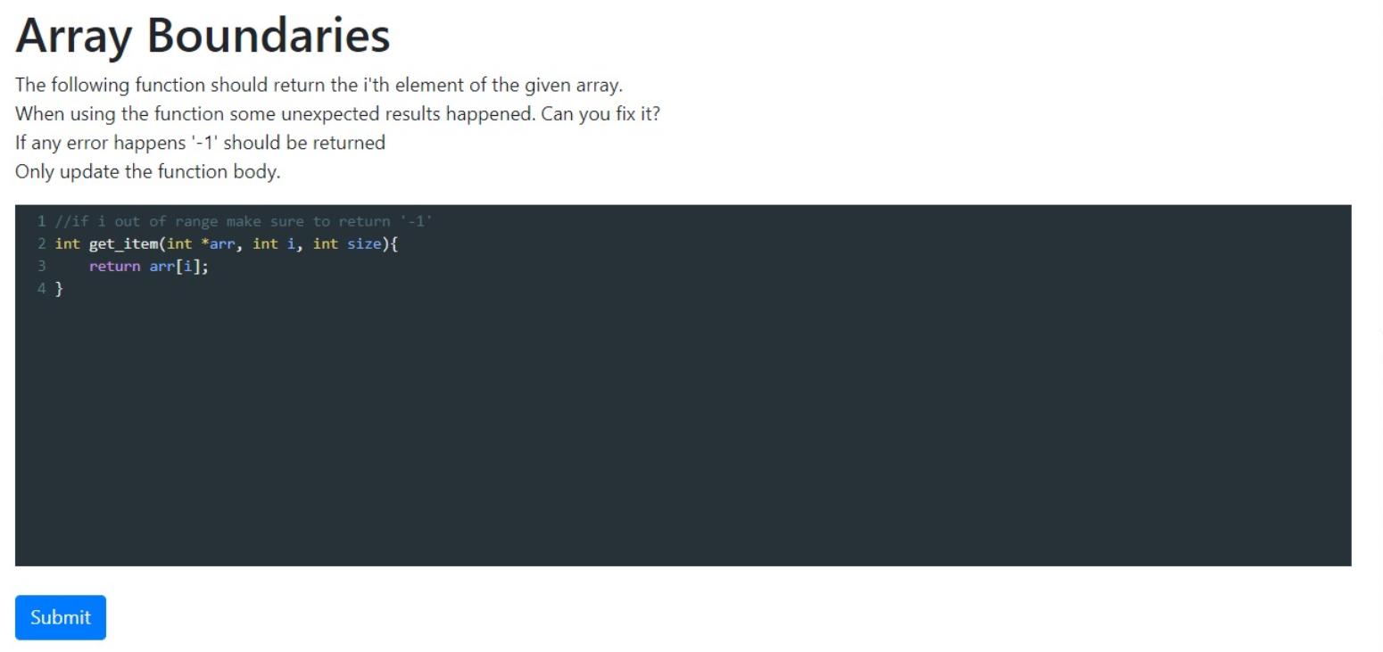
Open Problem Example

Slide 15
Multiple-Choice Problems
The user is introduced with an explanation of a problem that can involve analysis of vulnerable code, obscure C/C++ usage and more.
The user needs to choose one of multiple possible answers.

Slide 16
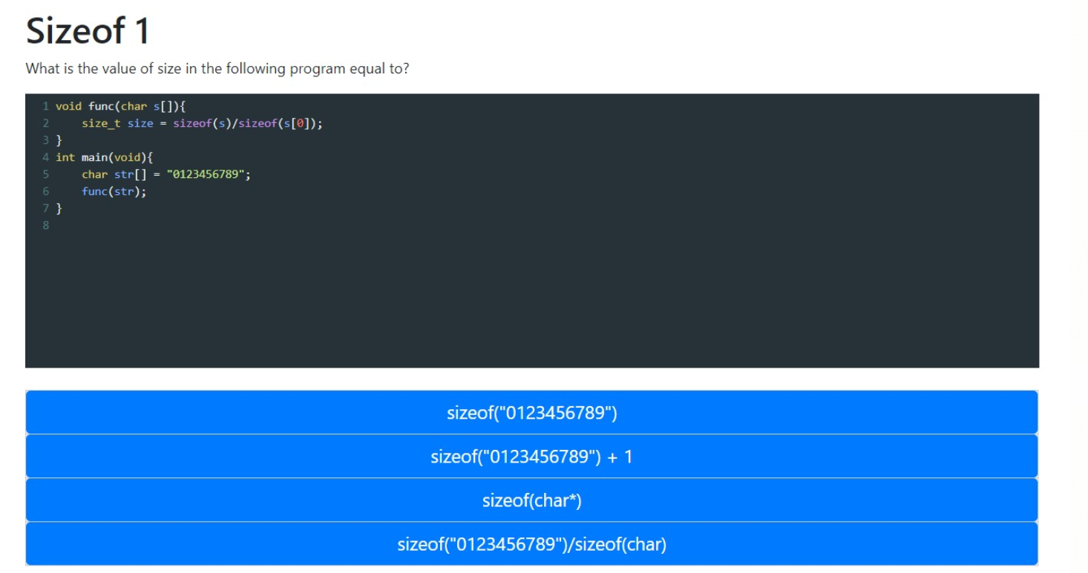
Multiple-Choice Problem Example

Slide 17
Problem Feedback
After submitting a solution, the user will be presented with a feedback message. If the code hasn’t compiled, “Compilation Error!” would appear, otherwise if the solution was wrong, “Incorrect!” would appear, and if the solution was correct, “Correct!” will be displayed.

Slide 18
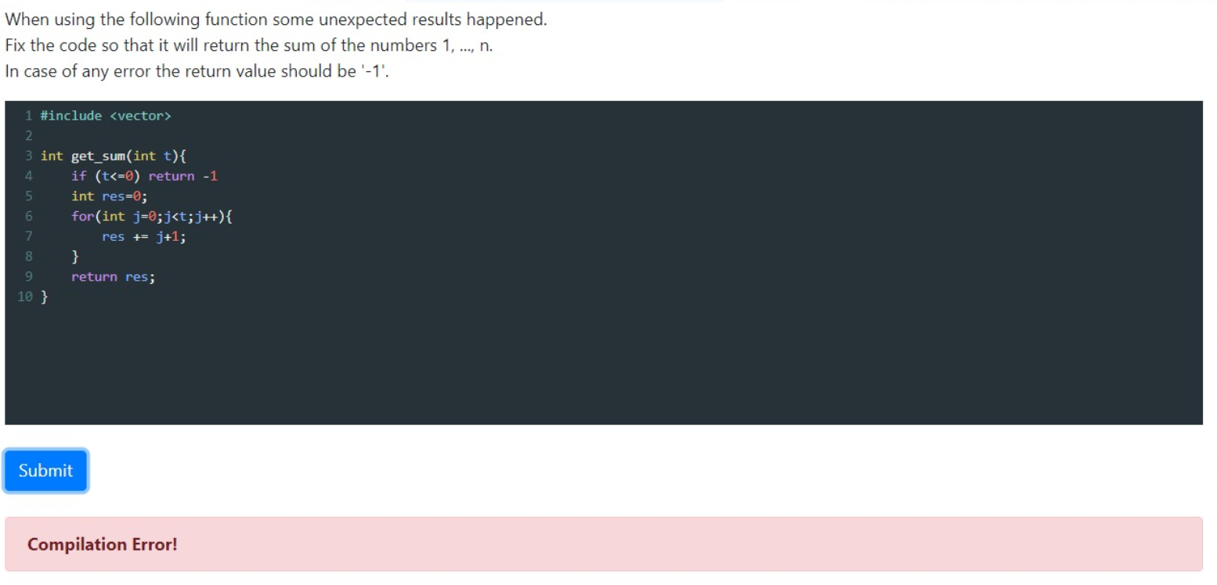
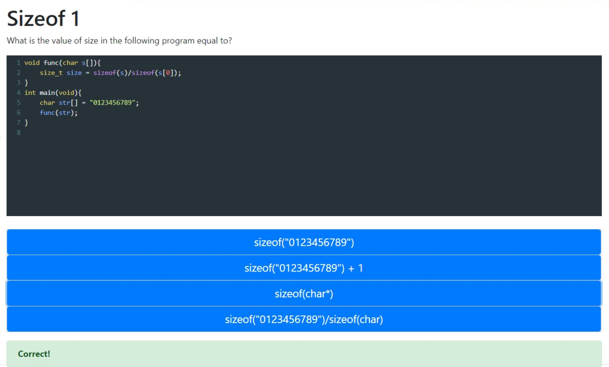
Problem Feedback

Slide 19
Full Timeline
Weeks 3-4: Studied the basics of new languages we are working with.
Week 5: Added user login and registration with a mongoDB database. Added Readme with installation instructions.
Week 6: Added problems menu and specific problem display. Added support for problems in the backend.
Week 7: Expanded the specific problem display. Added support for submission of solution (compilation of solution with tests).
Week 8: Reviewed code and added documentation. Fixing small issues, making the code neater.

Slide 20
Full Timeline (cont.)
Week 9: Adding administrative view of performance of all users and more problems.
Week 10: 20-30 problems including multiple choice and filter by categories.
Week 11: ‘Take a test’ option for user.
Week 12: Expanding admin statistics and adding modification capabilities. Fixing issues and adding small features (per supervisor request).
Week 13+: A total of 30+ problems. Wrote all the documentation and manuals for supervisors. Changed code compilation and running to be via sandbox (Docker). More small issues.

Slide 21
Interaction with Supervisors
Throughout the semester we had weekly talks over the phone with the supervisors and used screen sharing to show the progress. Also, the project was in a GitHub repository everyone had access to.
Additionally, in June 10th we went to Rafael facilities to display the project to the relevant managers in Rafael and received feedback on changes they believed were necessary for their use cases.
The meeting was successful, the participants were satisfied with the results and gave helpful feedback that we implemented in later weeks.

Slide 22
Work Methodology
The first couple weeks of the semester were focused on learning the new languages we would be using. Although our complete lack of experience using JavaScript/Node/Angular, we eventually managed to understand the tools they provided and understood how to create a RESTful API for the application.
Later, each meeting would discuss the features to be implemented that week (or sometimes over a two-week period) with bonus features to be implemented if we found time. This worked best for both us and the supervisors and we didn’t have any issues meeting the deadlines we set.
Moreover, writing the problems involved understanding a wide variety of vulnerabilities. We used a site given by the supervisors to get the ideas of certain problems, but it proved to be challenging to translate them into a coding problem we could give to users.

Slide 23
Conclusions
We managed to create a website that can be accessed concurrently by several users in which they can learn safe coding by solving problems and/or taking tests. Admins can use the website to learn the progress of users and update the website by adding/removing users and problems.
We supplied well documented code and various manuals to the supervisors, so that they may easily continue working on the project. They have the full code in the GitHub repository.

Slide 24
Possible Future Work
Adding more and more problems.
Making “sub-admins” that only have capabilities over their teams (Brought up in the meeting at Rafael by the managers)
Giving admins more capabilities, for example: giving users certain tests (Also from meeting)
Adding Rafael identification (that they use internally) – they never intended us to implement this
Docker isn’t intended for sandboxing (running arbitrary code) and it would be best to use more specialized tools, but it works well enough for their use case (direct quote – “The engineer that manages to write code that escapes docker will get a prize”)

