Slide 1
Optimal Binary Search Tree

Slide 2
1.Preface
OBST is one special kind of advanced tree.
It focus on how to reduce the cost of the search of the BST.
It may not have the lowest height !
It needs 3 tables to record probabilities, cost, and root.

Slide 3
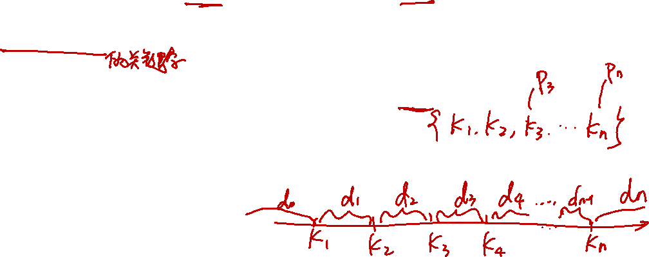
2.Premise
It has n keys (representation k₁,k₂,…,k_{n}) in sorted order (so that k₁<k₂<…<k_{n}), and we wish to build a binary search tree from these keys. For each k_{i} ,we have a probability p_{i} that a search will be for k_{i}.
In contrast of, some searches may be for values not in k_{i}, and so we also have n+1 “dummy keys” d₀,d₁,…,d_{n} representating not in k_{i}.
In particular, d₀ represents all values less than k₁, and d_{n} represents all values greater than k_{n}, and for i=1,2,…,n-1, the dummy key d_{i} represents all values between k_{i} and k_{i+1}.
＊The dummy keys are leaves (external nodes), and the data keys mean internal nodes.

Slide 4
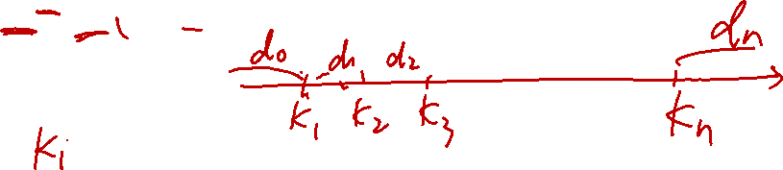
3.Formula & Prove
The case of search are two situations, one is success, and the other, without saying, is failure.
We can get :
Success
Failure

Slide 5
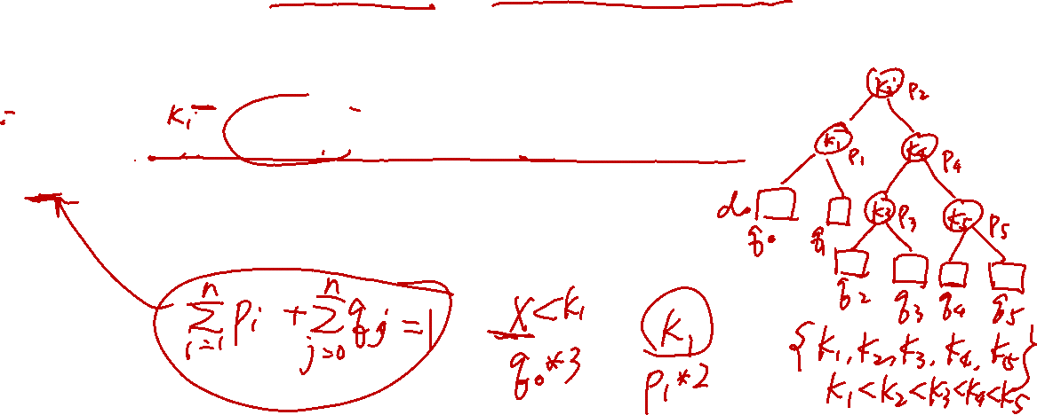
Because we have probabilities of searches for each key and each dummy key, we can determine the expected cost of a search in a given binary search tree T.
Assume that the actual cost of a search is the number of nodes examined, i.e., the depth of the node found by the search in T,plus1. Then the expected cost of a search in T is :
E[ search cost in T]
= (i=1~n) ∑ p_{i} ．(depth_{T}(k_{i})+1)+ (i=0~n) ∑ q_{i} ．(depth_{T}(d_{i})+1)
=1 + (i=1~n) ∑ p_{i} ．depth_{T}(k_{i}) + (i=0~n) ∑ q_{i} ．depth_{T}(d_{i})
Where depth_{T} denotes a node’s depth in the tree T.

Slide 6
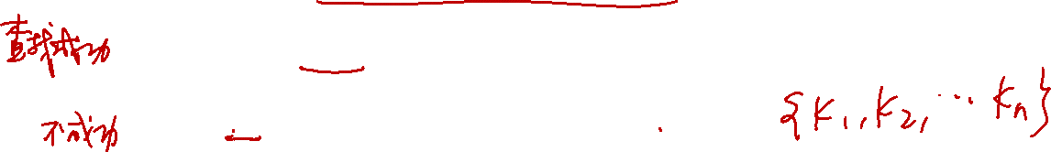
k2
k2
k1
k4
k1
k5
d0
d1
d0
d1
k4
d5
k3
k5
d2
d3
d4
d5
d4
k3
Figure (a)
i | 0 | 1 | 2 | 3 | 4 | 5
pi |  | 0.15 | 0.10 | 0.05 | 0.10 | 0.20
qi | 0.05 | 0.10 | 0.05 | 0.05 | 0.05 | 0.10
d2
d3
Figure (b)

Slide 7
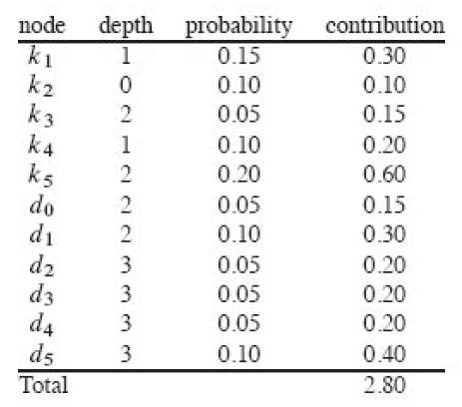
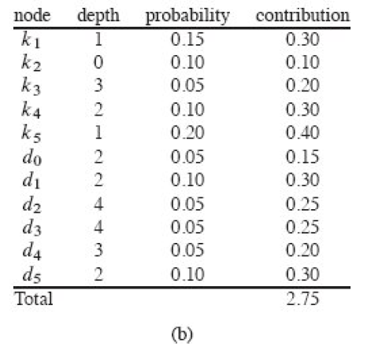
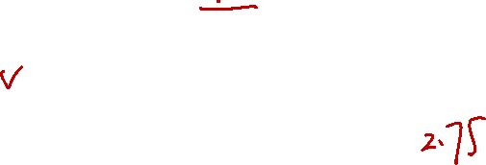
k2
Contribution=Probability * (Depth+1)
k1
k4
d0
d1
k3
k5
d2
d3
d4
d5
k2
k1
k5
d0
d1
d5
k4
d4
k3
d2
d3

Slide 8
So Figure (a) costs 2.80 ,on another, the Figure (b) costs 2.75, and that tree is really optimal.
We can see the height of (b) is more than (a) , and the key k₅ has the greatest search probability of any key, yet the root of the OBST shown is k₂.(The lowest expected cost of any BST with k₅ at the root is 2.85)
k2
k2
k1
k4
k1
k5
d0
d1
d0
d1
k4
d5
k3
k5
d2
d3
d4
d5
k3
d4
Figure (a)
i | 0 | 1 | 2 | 3 | 4 | 5
pi |  | 0.15 | 0.10 | 0.05 | 0.10 | 0.20
qi | 0.05 | 0.10 | 0.05 | 0.05 | 0.05 | 0.10
d2
d3
Figure (b)
Search cost=2.80
Search cost=2.75

Slide 9
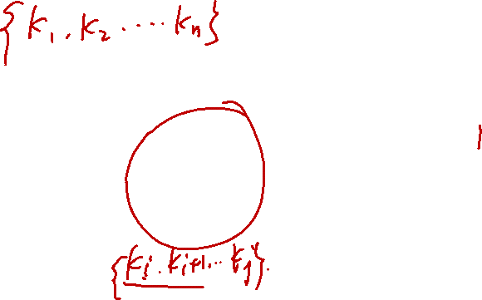
Step1:The structure of an OBST
To characterize the optimal substructure of Optimal Binary Search Tree(OBST), we start with an observation about subtrees. Consider any subtree of a BST. It must contain keys in a contiguous range k_{i},…,k_{j}, for some 1≦i ≦j ≦n. In addition, a subtree that contains keys k_{i},…,k_{j} must also have as its leaves the dummy keys d_{i-1} ,…,d_{j.}
51
14
72
06
33
53
97
13
25
43
64
84
99

Slide 10
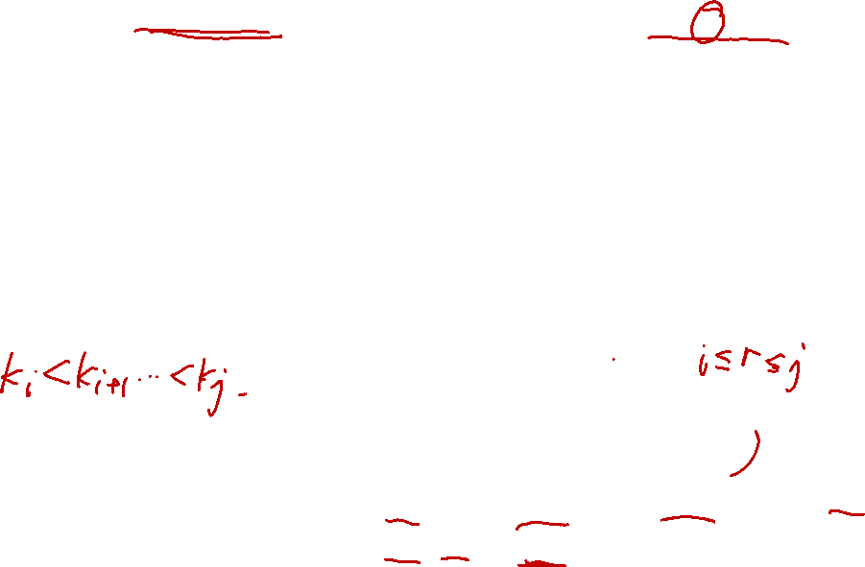
We need to use the optimal substructure to show that we can construct an optimal solution to the problem from optimal solutions to subproblems.
Given keys k_{i} ,…, k_{j}, one of these keys, say k_{r} (i ≦r ≦j), will be the root of an optimal subtree containing these keys.
The left subtree of the root k_{r} will contain the keys (k_{i} ,…, k_{r-1}) and the dummy keys( d_{i-1} ,…, d_{r-1}), and the right subtree will contain the keys (k_{r+1} ,…, k_{j}) and the dummy keys( d_{r} ,…, d_{j}).
As long as we examine all candidate roots k_{r}, where i≦r ≦j, and we determine all optimal binary search trees containing k_{i} ,…, k_{r-1} and those containing k_{r+1} ,…, k_{j} , we are guaranteed that we will find an OBST.
k_{r}
L
R
k_{i}, k_{i+1}, …, k_{r-1}
d_{i-1}, d_{i}, …, d_{r-1}
k_{r+1}, k_{r+2}, …, k_{j}
d_{r}, d_{r+1}, …, d_{j}

Slide 11
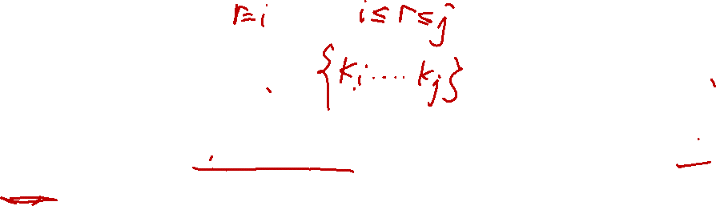
There is one detail worth nothing about “empty” subtrees.
Suppose that in a subtree with keys k_{i},...,k_{j}, we select k_{i} as the root. By the above argument, k_{i} ’s left subtree contains the keys k_{i},…, k_{i-1}. It is natural to interpret this sequence as containing no keys. It is easy to know that subtrees also contain dummy keys. The sequence has no actual keys but does contain the single dummy key d_{i-1}.
Symmetrically, if we select k_{j} as the root, then k_{j}’s right subtree contains the keys, k_{j+1} …,k_{j}; this right subtree contains no actual keys, but it does contain the dummy key d_{j}.
k_{i}
k_{j}
R
L
k_{i+1}, k_{i+2}, …, k_{j}
d_{i}, d_{i+1}, …, d_{j}
k_{i}, k_{i+1}, …, k_{j-1}
d_{i-1}, d_{i}, …, d_{j-1}
d_{j}
d_{i-1}

Slide 12
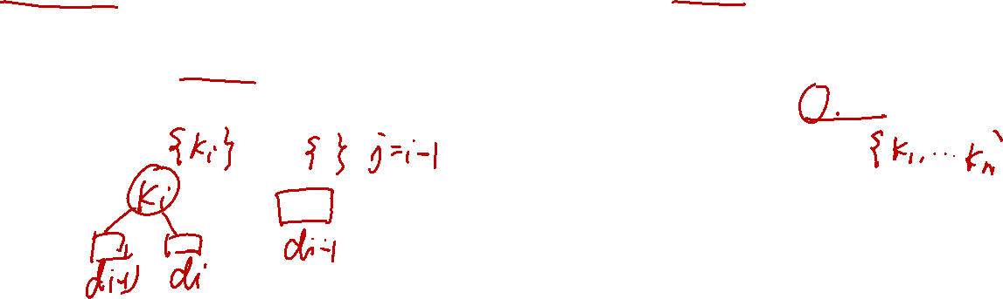
Step2: A recursive solution
We are ready to define the value of an optimal solution recursively. We pick our subproblem domain as finding an OBST containing the keys k_{i},…,k_{j}, where i≧1, j ≦n, and j ≧ i-1. (It is when j=i-1 that there are no actual keys; we have just the dummy key d_{i-1}.)
Let us define e[i,j] as the expected cost of searching an OBST containing the keys k_{i},…, k_{j}. Ultimately, we wish to compute e[1,n].

Slide 13
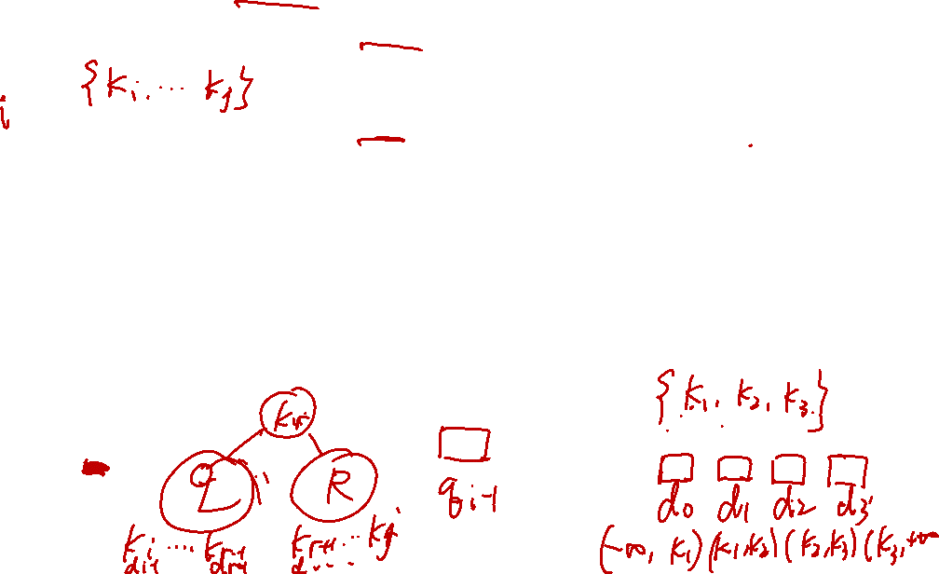
The easy case occurs when j=i-1. Then we have just the dummy key d_{i-1}. The expected search cost is e[i,i-1]= q_{i-1}.
When j≧1, we need to select a root k_{r} from among k_{i},…,k_{j} and then make an OBST with keys k_{i},…,k_{r-1} its left subtree and an OBST with keys k_{r+1},…,k_{j} its right subtree.
By the time, what happens to the expected search cost of a subtree when it becomes a subtree of a node? The answer is that the depth of each node in the subtree increases by 1.

Slide 14
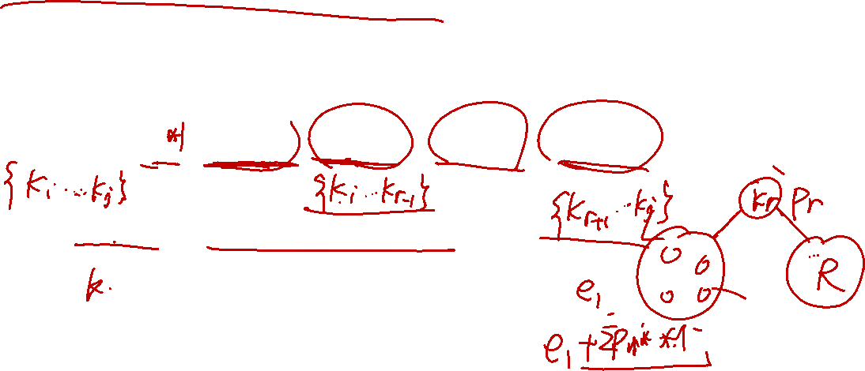
By the second statement, the excepted search cost of this subtree increases by the sum of all the probabilities in the subtree. For a subtree with keys k_{i},…,k_{j} let us denote this sum of probabilities as
w (i , j) = (l=i~j) ∑ p_{l} + (l=i-1~j) ∑ q_{l}
Thus, if k_{r} is the root of an optimal subtree containing keys k_{i},…,k_{j}, we have
E[i,j]= p_{r} + (e[i,r-1]+w(i,r-1))+(e[r+1,j]+w(r+1,j))
Noting that w (i , j) = w(i,r-1)+ p_{r} +w(r+1,j)

Slide 15
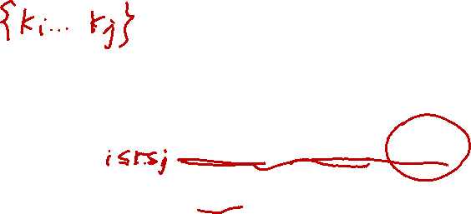
We rewrite e[i,j] as
e[i,j]= e[i,r-1] + e[r+1,j]+w(i,j)
The recursive equation as above assumes that we know which node k_{r} to use as the root. We choose the root that gives the lowest expected search cost, giving us our final recursive formulation:
E[i,j]=
case1: if i≦j,i≦r≦j
E[i,j]=min{e[i,r-1]+e[r+1,j]+w(i,j)}
case2: if j=i-1; E[i,j]= q_{i-1}

Slide 16
The e[i,j] values give the expected search costs in OBST. To help us keep track of the structure of OBST, we define root[i,j], for 1≦i≦j≦n, to be the index r for which k_{r} is the root of an OBST containing keys k_{i},…,k_{j}.

Slide 17
Step3: Computing the expected search cost of an OBST
We store the e[i.j] values in a table e[1..n+1, 0..n].
The first index needs to run to n+1rather than n because in order to have a subtree containing only the dummy key d_{n}, we will need to compute and store e[n+1,n].
The second index needs to start from 0 because in order to have a subtree containing only the dummy key d₀, we will need to compute and store e[1,0]. We will use only the entries e[i,j] for which j≧i-1.
We also use a table root[i,j], for recording the root of the subtree containing keys k_{i},…, k_{j}. This table uses only the entries for which 1≦i≦j≦n.

Slide 18

We will need one other table for efficiency. Rather than compute the value of w(i,j) from scratch every time we are computing e[i,j] ----- we store these values in a table w[1..n+1,0..n]. For the base case, we compute w[i,i-1] = q_{i-1} for 1≦i ≦n.
For j≧i, we compute :
w[i,j]=w[i,j-1]+p_{j+}q_{j}

Slide 19
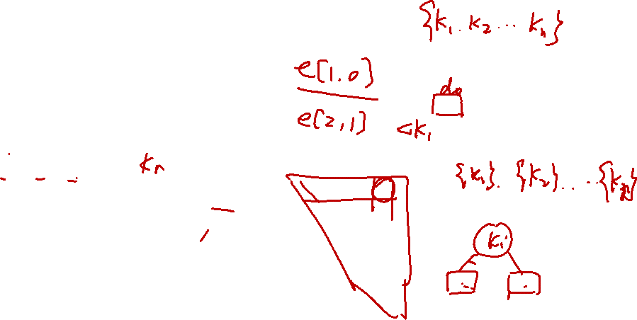
OPTIMAL—BST(p,q,n)
For i 1 to n+1
do e[i,i-1] q_{i-1}
do w[i,i-1] q_{i-1}
For l 1 to n
do for i 1 to n-l +1
do j i+l-1
e[i,j] ∞
w[i,j] w[i,j-1]+p_{j+}q_{j}
For r i to j
do t e[i,r-1]+e[r+1,j]+w[i,j]
if t<e[i,j]
then e[i,j] t
root [i,j] r
Return e and root

Slide 20
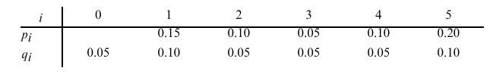
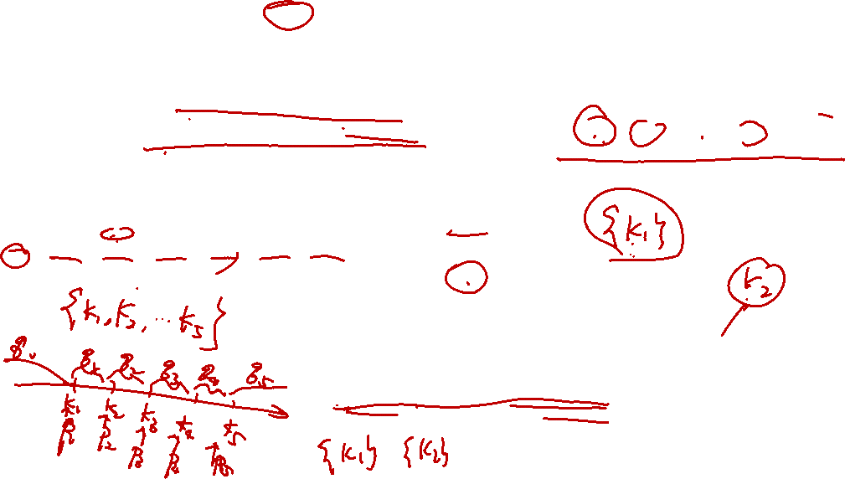
e
w
5
1
5
1
4
2.75
2
4
2
3
3
1.00
1.75
2.00
3
0.70
0.80
3
2
1.25
1.20
1.30
4
5
2
0.55
0.50
0.60
4
1
0.90
0.70
0.60
0.90
1
0.45
0.35
0.30
0.50
5
0
0.45
0.40
0.25
0.30
0.50
6
0
0.30
0.25
0.15
0.20
0.35
6
0.05
0.10
0.05
0.05
0.05
0.10
0.05
0.10
0.05
0.05
0.05
0.10
root
5
1
4
2
2
3
2
4
3
2
2
2
5
4
1
2
4
5
5
1
1
2
3
4
5
The tables e[i,j], w[i,j], and root [i,j]computed by Optimal-BST

Slide 21
Advanced Proof-1
All keys (including data keys and dummy keys) of the weight sum (probability weight) and that can get the formula:
+
Because the probability of k_{i} is p_{i} and d_{i} is q_{i};
Then rewrite that
+ =1 ……..formula (1)

Slide 22
Advanced Proof-2
We first focus on the probability weight ; but not in all, just for some part of the full tree. That means we have ki, …, kj data, and 1≦i ≦j ≦n, and ensures that ki, …, kj is just one part of the full tree. By the time, we can rewrite formula (1) into
w[i,j] = +
For recursive structure, maybe we can get another formula for w[i,j]=w[i,j-1]+p_{j}+q_{j}
By this , we can struct the weight table.

Slide 23
Advanced Proof-3
Finally, we want to discuss our topic, without saying, the cost, which is expected to be the optimal one.
Then define the recursive structure’s cost e[i,j],
which means k_{i}, …, k_{j}, 1≦i ≦j ≦n, cost.
And we can divide into root, leftsubtree, and rightsubtree.

Slide 24
Advanced Proof-4
The final cost formula:
E[i,j] = Pr + e[i,r-1] + w[i,r-1] + e[r+1,j] + w[r+1,j]
Noting that : Pr + w[i,r-1] + w[r+1,j] = w[i,j]
So, E[i,j] = (e[i,r-1] + e[r+1,j]) + w[i,j]
And we use it to construct the cost table!
P.S. Neither weight nor cost calculating, if k_{i},…, k_{j,} but j=i-1, it means that the sequence have no actual key, but a dummy key.
Get the minimal set

Slide 25
Exercise
i | 0 | 1 | 2 | 3 | 4 | 5 | 6 | 7
pi |  | 0.04 | 0.06 | 0.08 | 0.02 | 0.10 | 0.12 | 0.14
qi | 0.06 | 0.06 | 0.06 | 0.06 | 0.05 | 0.05 | 0.05 | 0.05

