Slide 1
COVID Case Rate <Choropleth Map>
County coordinates <shape>
Cases per 100k <value>
Population Data - county name
- population
Case Rate Vs Industry <Scatter Plot>
% of jobs <x-axis>
Cases per 100k <y-axis>
monthlyCases < Dataframe >
- County name <row>
- Month <column>
- Cases per 100k <value>
Cases / total population
Case-weighted Industry Workforce <Bar Plot>
% cases per 100k <y-axis>
Industry type + unemployed <x-axis>
Months <x-axis>
COVID Data - county name
- new cases
- date
industryTotalCase < Dataframe >
- Month <row>
- Industry type + unemployed <column>
- % cases per 100k <value>
Multiply by cases in each county
Employment Data - county name
- industry
- month
- jobs
monthlyEmployment < Dataframe >
- County name and month <row>
- Industry type <column>
- Number of jobs <value>
difference < Dataframe >
- Month <row>
- Industry type + unemployed <column>
- Diff % of jobs <value>
pivot by county name / month
Find difference
Jobs / total per county
industryTotal < Dataframe >
- Month <row>
- Industry type + unemployed <column>
- % of jobs <value>
Unemployment Data - county name
- month
- unemployed
Sum all counties
Add unemployment column
Difference <Bar Plot>
% difference <y-axis>
Industry type + unemployed <x-axis>
Months <x-axis>
percentEmployment < Dataframe >
- County name and month <row>
- Industry type + unemployed <column>
- % of jobs <value>
Industry Workforce <Bar Plot>
% of jobs <y-axis>
Industry type + unemployed <x-axis>
Months <x-axis>
Geospatial
Data - county name
- coordinates
Total Farm Labourforce <Choropleth Map>
County coordinates <shape>
% of jobs [Farm] <value>

Slide 2
Population Data - county name
- population
monthlyCases < Dataframe >
- County name <row>
- Month <column>
- Cases per 100k <value>
Cases / total population
COVID Data - county name
- new cases
- date
industryTotalCase < Dataframe >
- month <row>
- Industry type + unemployed <column>
- cases per 100k <value>
Multiply by cases in each county
Employment Data - county name
- industry
- month
- jobs
monthlyEmployment < Dataframe >
- County name and month <row>
- Industry type <column>
- Number of jobs <value>
difference < Dataframe >
- month <row>
- Industry type + unemployed <column>
- Diff % of jobs <value>
pivot by county name / month
Find difference
Jobs / total per county
industryTotal < Dataframe >
- month <row>
- Industry type + unemployed <column>
- % of jobs <value>
Unemployment Data - county name
- month
- unemployed
Sum all counties
Add unemployment column
percentEmployment < Dataframe >
- County name and month <row>
- Industry type + unemployed <column>
- % of jobs <value>
Geospatial
Data - county name
- coordinates

Slide 3
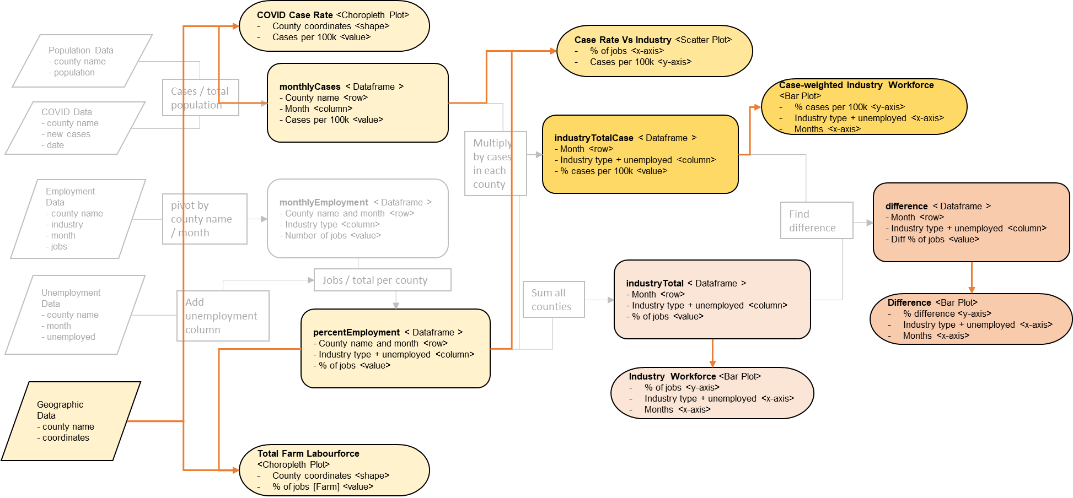

Slide 4
