Slide 1
Implementing BGP
Border Gateway Protocol

Slide 2
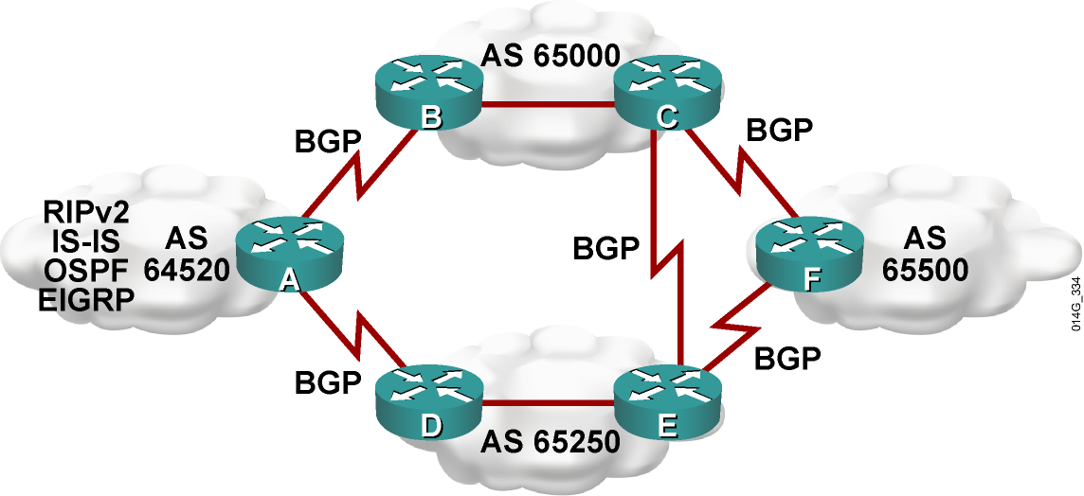
BGP Autonomous Systems
  An AS is a collection of networks under a single technical administration.
  IGPs operate within an AS.
  BGP is used between autonomous systems.
  Exchange of loop-free routing information is guaranteed.

Slide 3
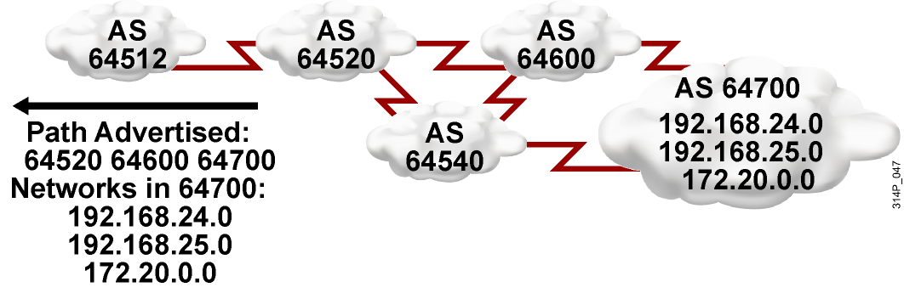
BGP Path-Vector Routing
  IGPs announce networks and describe the metric to reach those networks.
  BGP announces paths and the networks that are reachable at the end of the path. BGP describes the path by using attributes, which are similar to metrics.
  BGP allows administrators to define policies or rules for how data will flow through the autonomous systems.

Slide 4
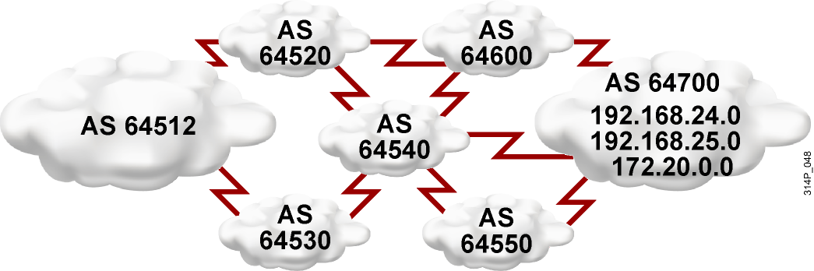
BGP Routing Policies
BGP can support any policy conforming to the hop-by-hop (AS-by-AS) routing paradigm.

Slide 5
BGP Characteristics
  BGP is most appropriate when at least one of the following conditions exists:
    An AS allows packets to transit through it to reach other autonomous systems (for example, it is a service provider).
    An AS has multiple connections to other autonomous systems.
    Routing policy and route selection for traffic entering and leaving the AS must be manipulated.
  BGP is not always appropriate. You do not have to use BGP if you have one of the following conditions:
    Limited understanding of route filtering and BGP path-
    selection process
    A single connection to the Internet or another AS
    Lack of memory or processor power to handle constant
    updates on BGP routers

Slide 6
BGP Characteristics (Cont.)
BGP is a path-vector protocol with the following enhancements over distance vector protocols:
  Reliable updates: runs on top of TCP (port 179)
  Incremental, triggered updates only
  Periodic keepalive messages to verify TCP connectivity
  Rich metrics (called path vectors or attributes)
  Designed to scale to huge internetworks (for example, the Internet)

Slide 7
BGP Databases
  Neighbor table
    List of BGP neighbors
  BGP table (forwarding database)
    List of all networks learned from each neighbor
    Can contain multiple paths to destination networks
    Contains BGP attributes for each path
  IP routing table
    List of best paths to destination networks

Slide 8
BGP Message Types
BGP defines the following message types:
  Open
    Includes hold time and BGP router ID
  Keepalive
  Update
    Information for one path only
    (could be to multiple networks)
    Includes path attributes and networks
  Notification
    When error is detected
    BGP connection closed after message is sent

Slide 9
Summary
  If your network is multihomed—has more than one connection to the Internet—then using BGP to connect to your ISPs may be appropriate.
  Multihoming options include having each ISP pass these:
    Only a default route
    A default route and provider-owned specific routes
    All routes
  BGP is the external routing protocol used between autonomous systems. Forwarding is based on policy and not on best path.

Slide 10
Summary (Cont.)
  BGP routers exchange network reachability information called path vectors, made up of path attributes. The path-vector information includes a list of the full path of BGP AS numbers necessary to reach a destination network.
  A router running BGP keeps its own tables to store BGP information that it receives from and sends to other routers, including a neighbor table, a BGP table (also called a forwarding database or topology database), and an IP routing table.
  There are four BGP message types: open, keepalive, update, and notification.

Slide 11


