Slide 1
Implementing BGP
Explaining EBGP and IBGP

Slide 2
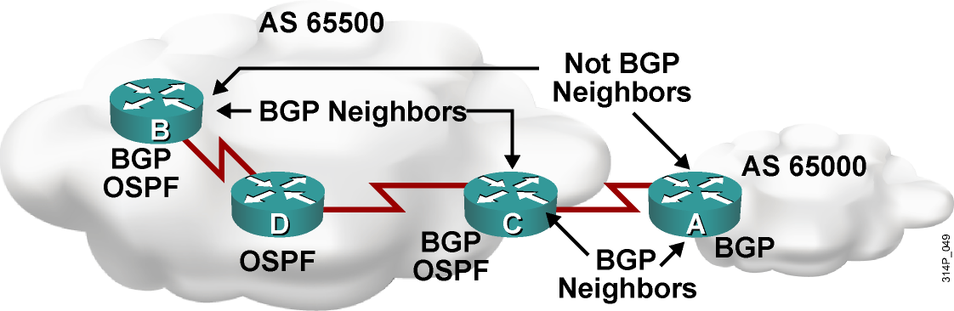
Peers = Neighbors
  A “BGP peer,” also known as a “BGP neighbor,” is a specific term that is used for BGP speakers that have established a neighbor relationship.
  Any two routers that have formed a TCP connection to exchange BGP routing information are called BGP peers or BGP neighbors.

Slide 3
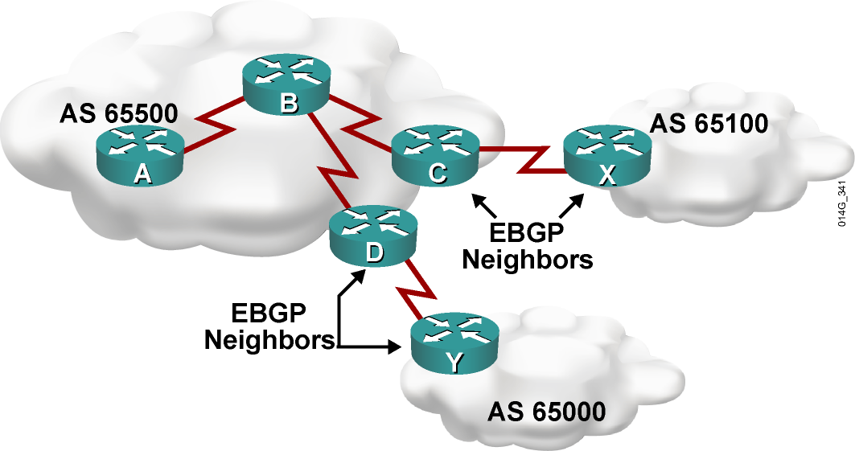
External BGP
  When BGP is running between neighbors that belong to different autonomous systems, it is called EBGP.
  EBGP neighbors, by default, need to be directly connected.

Slide 4
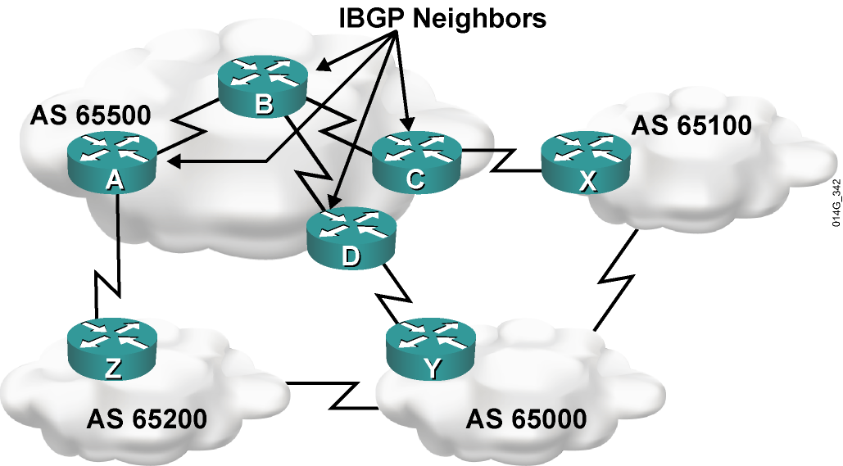
Internal BGP
  When BGP is running between neighbors within the same AS, it is called IBGP.
  The neighbors do not have to be directly connected.

Slide 5
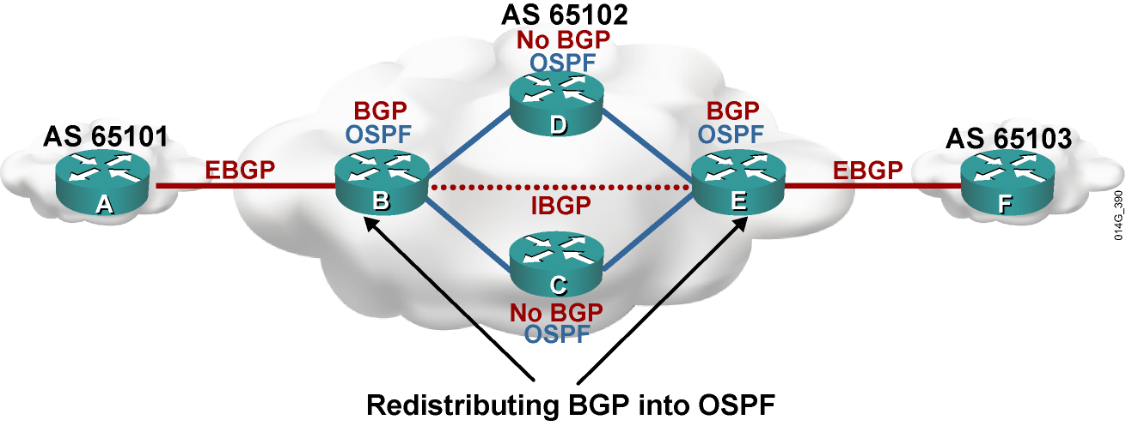
IBGP in a Transit AS (ISP)
  Redistributing BGP into an IGP (OSPF in this example) is not recommended.
  Instead, run IBGP on all routers.

Slide 6
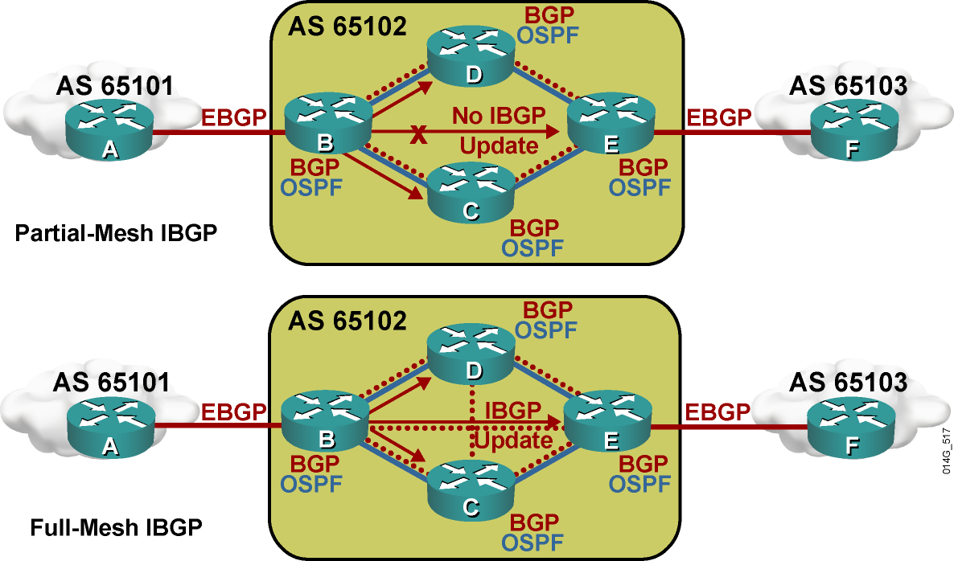
IBGP in a NonTransit AS
  Routes learned via IBGP are never propagated to other IBGP peers.

Slide 7
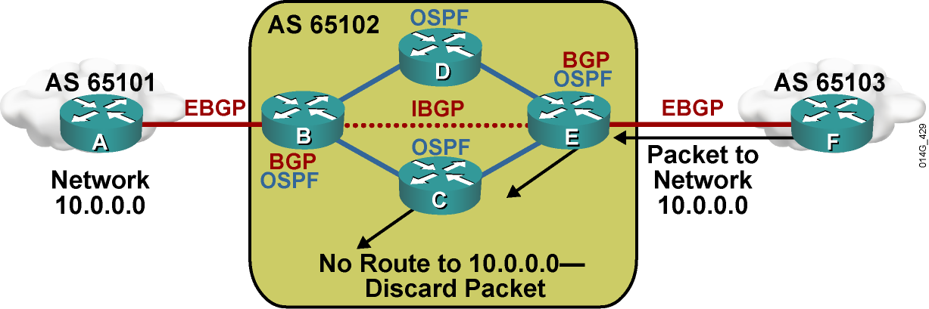
Routing Issues If BGP Not on in All Routers in Transit Path
  Router C will drop the packet to network 10.0.0.0. Router C is not running IBGP; therefore, it has not learned about the route to network 10.0.0.0 from router B.
  In this example, router B and router E are not redistributing BGP into OSPF.

Slide 8
Summary
  The key terms to describe relationships between routers running BGP are as follows:
    BGP speaker, or BGP router
    BGP peer, or neighbor
    IBGP and EBGP
  EBGP neighbors are directly connected routers in different autonomous systems.
  IBGP neighbors are routers in the same AS that are reachable by static routes or a dynamic internal routing protocol.
  All routers in the transit path within an AS should run
  fully meshed IBGP.

Slide 9


