Slide 1
Implementing BGP
Configuring Basic BGP Operations

Slide 2
BGP Commands
Router(config)#
router bgp autonomous-system
This command enters router configuration mode only; subcommands must be entered to activate BGP.
Only one instance of BGP can be configured on the router at a single time.
The autonomous system number identifies the autonomous system to which the router belongs.
The autonomous system number in this command is compared to the autonomous system numbers listed in neighbor statements to determine if the neighbor is an internal or external neighbor.

Slide 3
BGP neighbor remote-as Command
Router(config-router)#
neighbor {ip-address | peer-group-name}
remote-as autonomous-system
The neighbor command activates a BGP session with this neighbor.
The IP address that is specified is the destination address of BGP packets going to this neighbor.
This router must have an IP path to reach this neighbor
before it can set up a BGP relationship.
The remote-as option shows what AS this neighbor is in. This AS number is used to determine if the neighbor is internal or external.
This command is used for both external and internal neighbors.

Slide 4
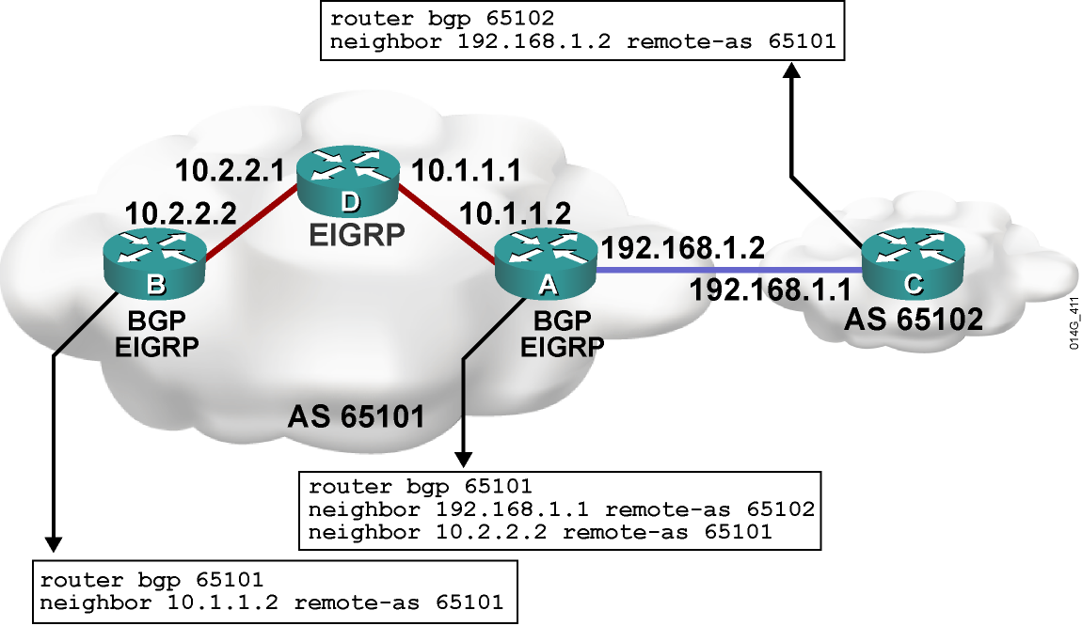
Example: BGP neighbor Command

Slide 5
BGP neighbor shutdown Command
Router(config-router)#
neighbor {ip-address | peer-group-name} shutdown
Administratively brings down a BGP neighbor
Used for maintenance and policy changes to prevent
route flapping
Router(config-router)#
no neighbor {ip-address | peer-group-name} shutdown
Re-enables a BGP neighbor that has been administratively shut down

Slide 6
BGP Issues with Source IP Address
  When creating a BGP packet, the neighbor statement defines the destination IP address and the outbound interface defines the source IP address.
  When a BGP packet is received for a new BGP session, the source address of the packet is compared to the list of neighbor statements:
    If a match is found, a relationship is established.
    If no match is found, the packet is ignored.
  Make sure that the source IP address matches the address that the other router has in its neighbor statement.

Slide 7
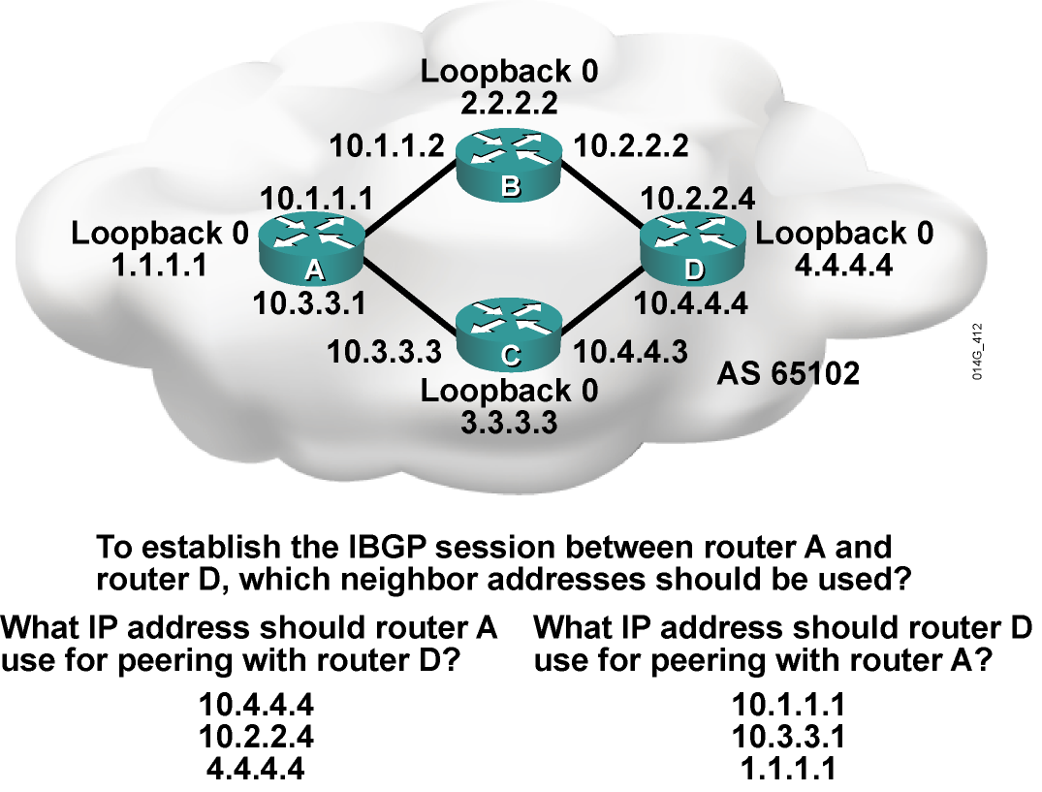
Example: IBGP Peering Issue

Slide 8
BGP neighbor update-source Command
Router(config-router)#
neighbor {ip-address | peer-group-name} update-source
interface-type interface-number
  This command allows the BGP process to use the IP address of a specified interface as the source IP address of all BGP updates to that neighbor.
  A loopback interface is usually used, because it will be available as long as the router is operational.
  The IP address used in the neighbor command on the other router will be the destination IP address of all BGP updates and should be the loopback interface of this router.
  The neighbor update-source command is normally used only with IBGP neighbors.
  The address of an EBGP neighbor must be directly connected by
  default; the loopback of an EBGP neighbor is not directly connected.

Slide 9
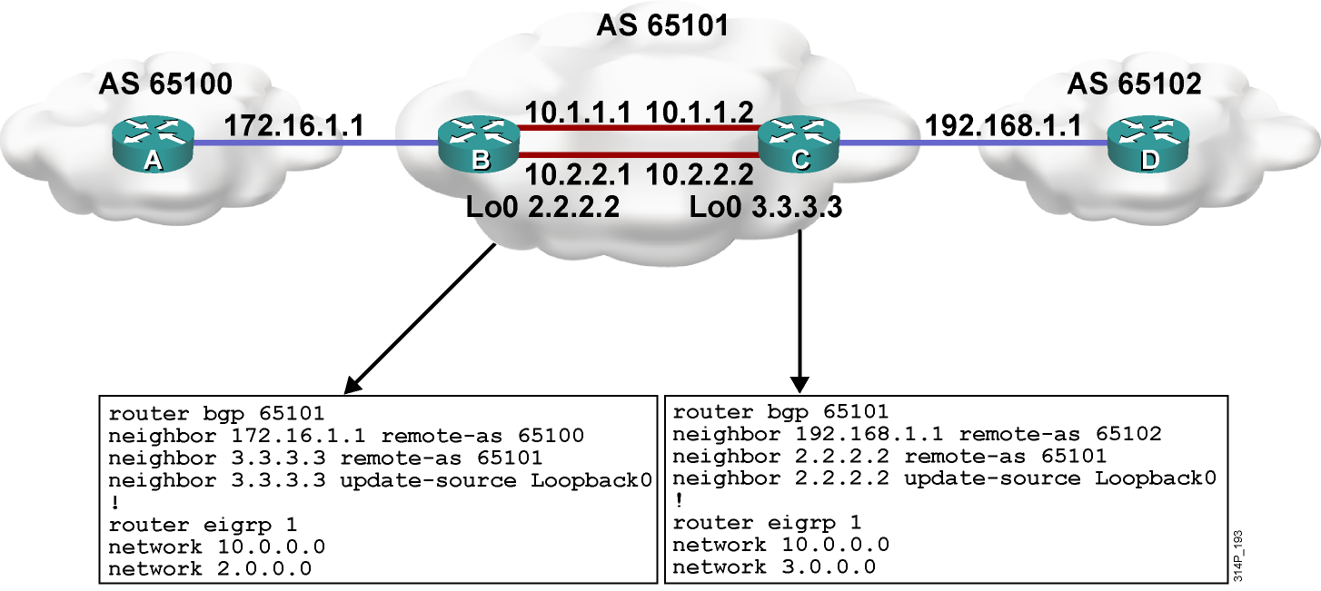
Example: BGP Using Loopback Addresses

Slide 10
BGP neighbor ebgp-multihop Command
Router(config-router)#
neighbor {ip-address | peer-group-name} ebgp-multihop [ttl]
  This command increases the default of one hop for EBGP peers.
  It allows routes to the EBGP loopback address
  (which will have a hop count greater than 1).

Slide 11
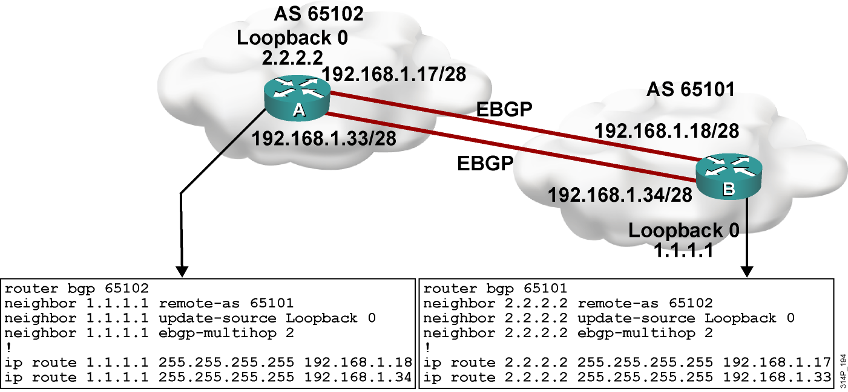
Example: ebgp-multihop Command

Slide 12
BGP network Command
Router(config-router)#
network network-number [mask network-mask] [route-map map-tag]
  This command tells BGP what network to advertise.
  The command does not activate the protocol on an interface.
  Without a mask option, the command advertises classful networks. If a subnet of the classful network exists in a routing table, the classful address is announced.
  With the mask option, BGP looks for an exact match in the local routing table before announcing the route.

Slide 13
Example: BGP network Command
Router(config-router)#
network 192.168.1.1 mask 255.255.255.0
  The router looks for exactly 192.168.1.1/24 in the routing table, but cannot find it, so it will not announce anything.
Router(config-router)#
network 192.168.0.0 mask 255.255.0.0
  The router looks for exactly 192.168.0.0/16 in the routing table.
  If the exact route is not in the table, you can add a static route to null0 so that the route can be announced.

Slide 14
BGP Synchronization
Synchronization Rule: Do not use or advertise to an external neighbor a route learned by IBGP until a matching route has been learned from an IGP
  Ensures consistency of information throughout the AS
  Safe to have it off only if all routers in the transit path in the AS are running full-mesh IBGP; off by default in Cisco IOS software release 12.2(8)T and later
Router(config-router)#
no synchronization
Disables BGP synchronization so that a router will advertise routes in BGP without learning them in an IGP
Notes:
从 IBGP 学到的路由.默认不会放进路由表也不会传给其他邻居.
直到此路由也从 IGP 学到.

Slide 15
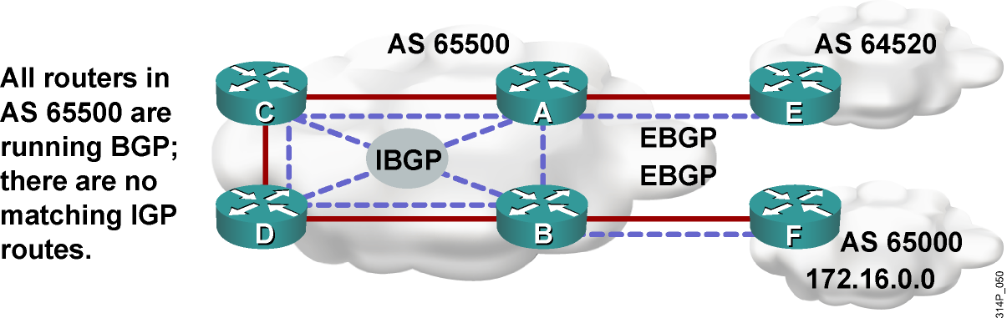
Example: BGP Synchronization
  If synchronization is on, then:
    Routers A, C, and D would not use or advertise the route to
    172.16.0.0 until they receive the matching route via an IGP.
    Router E would not hear about 172.16.0.0.
  If synchronization is off (the default), then:
    Routers A, C, and D would use and advertise the route that they
    receive via IBGP; router E would hear about 172.16.0.0.
    If router E sends traffic for 172.16.0.0, routers A, C, and D
    would route the packets correctly to router B.

Slide 16
Next-Hop Behavior
BGP is an AS-by-AS routing protocol, not a router-by-router routing protocol.
In BGP, the next hop does not mean the next router; it means the IP address to reach the next AS.
For EBGP, the default next hop is the IP address of the neighbor router that sent the update.
For IBGP, the BGP protocol states that the next hop advertised by EBGP should be carried into IBGP.

Slide 17
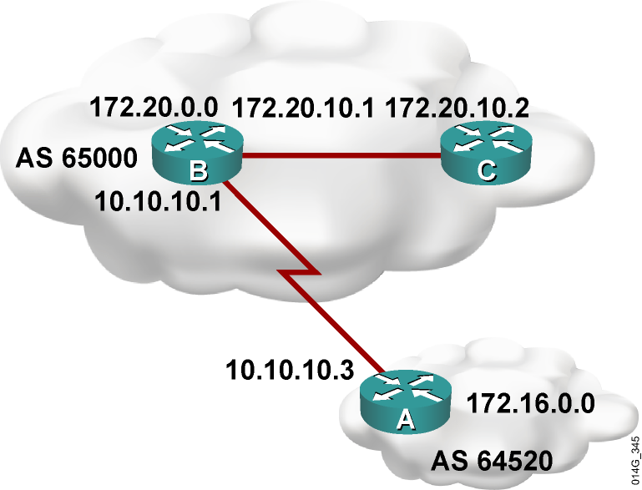
Example: Next-Hop Behavior
  Router A advertises
  network 172.16.0.0 to
  router B in EBGP, with
  a next hop of 10.10.10.3.
  Router B advertises
  172.16.0.0 in IBGP to
  router C, keeping 10.10.10.3
  as the next-hop address.

Slide 18
BGP neighbor next-hop-self Command
Router(config-router)#
neighbor {ip-address | peer-group-name} next-hop-self
  Forces all updates for this neighbor to be
  advertised with this router as the next hop.
  The IP address used for the next-hop-self option will be the same as the source IP address of the BGP packet.

Slide 19
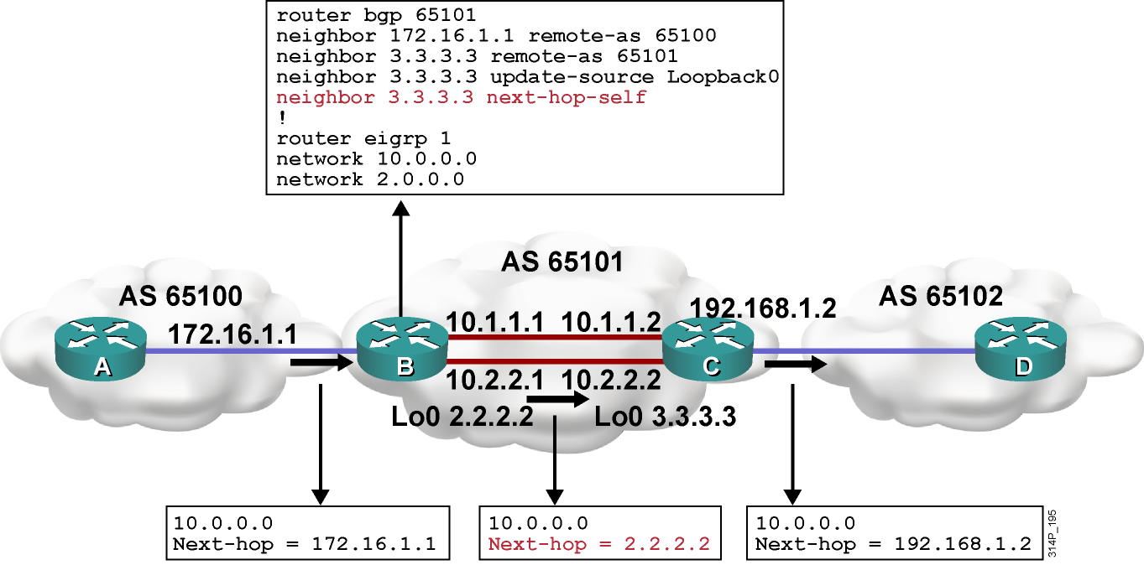
Example: next-hop-self Configuration

Slide 20
Using a Peer Group
Router(config-router)#
neighbor peer-group-name peer-group
This command creates a peer group.
Router(config-router)#
neighbor ip-address peer-group peer-group-name
This command defines a template with parameters set for a group of neighbors instead of individually.
This command is useful when many neighbors have the same outbound policies.
Members can have a different inbound policy.
Updates are generated once per peer group.
Configuration is simplified.
Notes:
1.减小Buffer.
2.减少命令行.

Slide 21
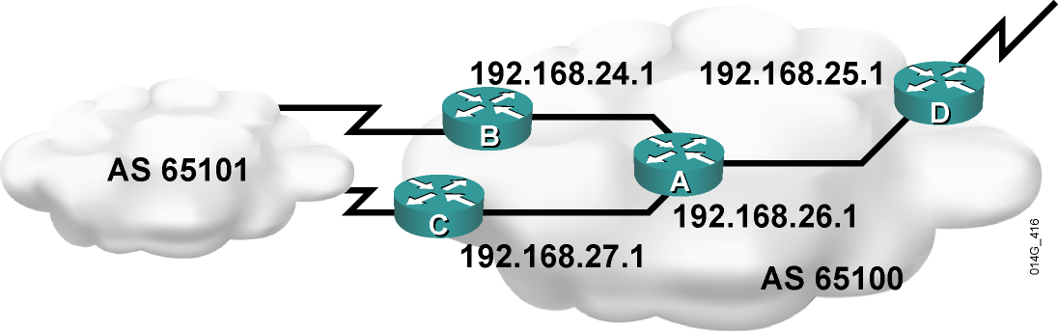
Example: Using a Peer Group
Router C Without a Peer Group
router bgp 65100
neighbor 192.168.24.1 remote-as 65100
neighbor 192.168.24.1 update-source Loopback 0
neighbor 192.168.24.1 next-hop-self
neighbor 192.168.24.1 distribute-list 20 out
neighbor 192.168.25.1 remote-as 65100
neighbor 192.168.25.1 update-source Loopback 0
neighbor 192.168.25.1 next-hop-self
neighbor 192.168.25.1 distribute-list 20 out
neighbor 192.168.26.1 remote-as 65100
neighbor 192.168.26.1 update-source Loopback 0
neighbor 192.168.26.1 next-hop-self
neighbor 192.168.26.1 distribute-list 20 out
Router C Using a Peer Group
router bgp 65100
neighbor internal peer-group
neighbor internal remote-as 65100
neighbor internal update-source Loopback 0
neighbor internal next-hop-self
neighbor internal distribute-list 20 out
neighbor 192.168.24.1 peer-group internal
neighbor 192.168.25.1 peer-group internal
neighbor 192.168.26.1 peer-group internal

Slide 22
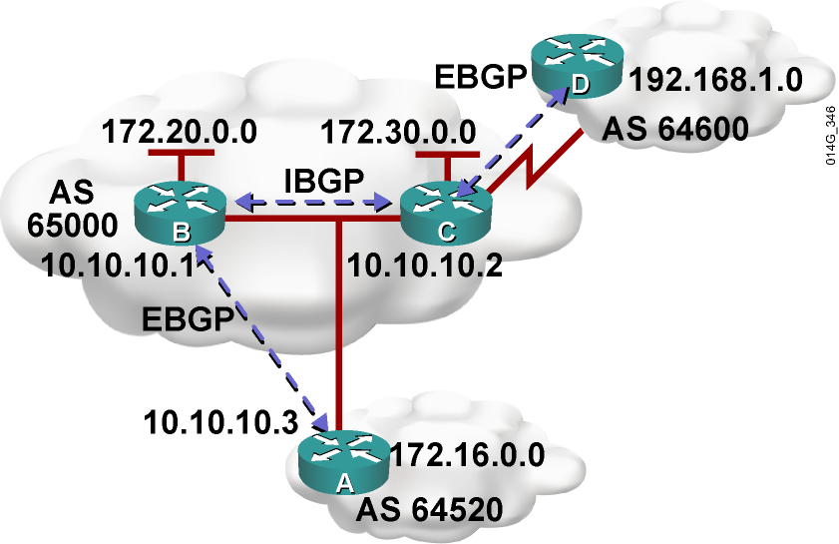
Next Hop on a MultiAccess Network
The following takes place in a multiaccess network:
  Router B advertises
  network 172.30.0.0 to
  router A in EBGP with
  a next hop of 10.10.10.2,
  not 10.10.10.1. This avoids
  an unnecessary hop.
  BGP is being efficient by
  informing AS 64520 of the
  best entry point into AS 65000
  for network 172.30.0.0.
  Router B in AS 65000 also advertises to AS 64520 that
  the best entry point for each network in AS 64600 is the
  next hop of router C because that is the best path to
  move through AS 65000 to AS 64600.

Slide 23
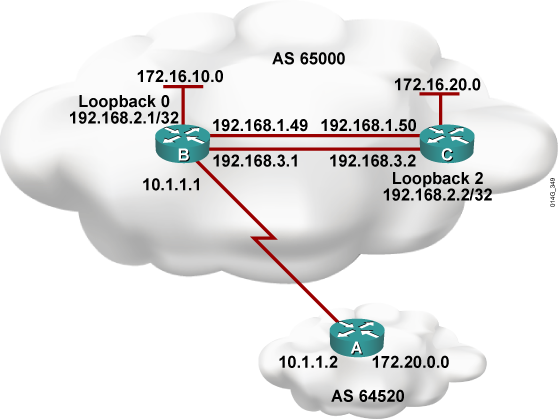
Example: BGP Configuration

Slide 24
BGP Example Configuration
1. RouterB(config)# router bgp 65000
2. RouterB(config-router)# neighbor 10.1.1.2 remote-as 64520
3. RouterB(config-router)# neighbor 192.168.2.2 remote-as 65000
4. RouterB(config-router)# neighbor 192.168.2.2 update-source Loopback 0
5. RouterB(config-router)# neighbor 192.168.2.2 next-hop-self
6. RouterB(config-router)# network 172.16.10.0 mask 255.255.255.0
7. RouterB(config-router)# network 192.168.1.0
8. RouterB(config-router)# network 192.168.3.0
9. RouterB(config-router)# no synchronization

Slide 25
BGP States
When establishing a BGP session, BGP goes through the following states:
  Idle: Router is searching routing table to see whether a route exists to reach the neighbor.
  Connect: Router found a route to the neighbor and has completed the three-way TCP handshake.
  Open sent: Open message sent, with the parameters for the BGP session.
  Open confirm: Router received agreement on the parameters for establishing session.
    Alternatively, router goes into active state if no response to open message
  Established: Peering is established; routing begins.

Slide 26
BGP Established and Idle States
  Idle: The router in this state cannot find the address of the neighbor in the routing table. Check for an IGP problem. Is the neighbor announcing the route?
  Established: The established state is the proper
  state for BGP operations. In the output of the show ip bgp summary command, if the state column has a number, then the route is in the established state. The number is how many routes have been learned from this neighbor.

Slide 27
Example: show ip bgp neighbors Command
RouterA#sh ip bgp neighbors
BGP neighbor is 172.31.1.3, remote AS 64998, external link
BGP version 4, remote router ID 172.31.2.3
BGP state = Established, up for 00:19:10
Last read 00:00:10, last write 00:00:10, hold time is 180, keepalive interval is 60 seconds
Neighbor capabilities:
Route refresh: advertised and received(old & new)
Address family IPv4 Unicast: advertised and received
Message statistics:
InQ depth is 0
OutQ depth is 0
Sent Rcvd
Opens: 7 7
Notifications: 0 0
Updates: 13 38
<output omitted>

Slide 28
BGP Active State Troubleshooting
Active: The router has sent an open packet and is waiting for a response. The state may cycle between active and idle. The neighbor may not know how to get back to this router because of the following reasons:
  Neighbor does not have a route to the source IP address of the BGP open packet generated by this router.
  Neighbor is peering with the wrong address.
  AS number is misconfiguration.
Notes:
1.邻居没有回本端的路由.
2.邻居指错了本端地址.
3.邻居没有配置和本端建邻居
4.AS号不匹配.

Slide 29
Example: BGP Active State Troubleshooting
  AS number misconfiguration:
    At the router with the wrong remote AS number:
    %BGP-3-NOTIFICATION: sent to neighbor 172.31.1.3 2/2 (peer in wrong AS) 2 bytes FDE6
    FFFF FFFF FFFF FFFF FFFF FFFF FFFF FFFF 002D 0104 FDE6 00B4 AC1F 0203 1002 0601 0400 0100 0102 0280 0002 0202 00
    At the remote router:
    %BGP-3-NOTIFICATION: received from neighbor 172.31.1.1 2/2 (peer in wrong AS) 2 bytes FDE6

Slide 30
Example: BGP Peering
RouterA# show ip bgp summary
BGP router identifier 10.1.1.1, local AS number 65001
BGP table version is 124, main routing table version 124
9 network entries using 1053 bytes of memory
22 path entries using 1144 bytes of memory
12/5 BGP path/bestpath attribute entries using 1488 bytes of memory
6 BGP AS-PATH entries using 144 bytes of memory
0 BGP route-map cache entries using 0 bytes of memory
0 BGP filter-list cache entries using 0 bytes of memory
BGP using 3829 total bytes of memory
BGP activity 58/49 prefixes, 72/50 paths, scan interval 60 secs
Neighbor V AS MsgRcvd MsgSent TblVer InQ OutQ Up/Down State/PfxRcd
10.1.0.2 4 65001 11 11 124 0 0 00:02:28 8
172.31.1.3 4 64998 21 18 124 0 0 00:01:13 6
172.31.11.4 4 64999 11 10 124 0 0 00:01:11 6

Slide 31
BGP Neighbor Authentication
Router(config-router)#
neighbor {ip-address | peer-group-name} password string
  BGP authentication uses MD5.
  Configure a key (password); router generates a message digest, or hash, of the key and the message.
  Message digest is sent; key is not sent.
  Router generates and checks the MD5 digest of every segment sent on the TCP connection. Router authenticates the source of each routing update packet that it receives

Slide 32
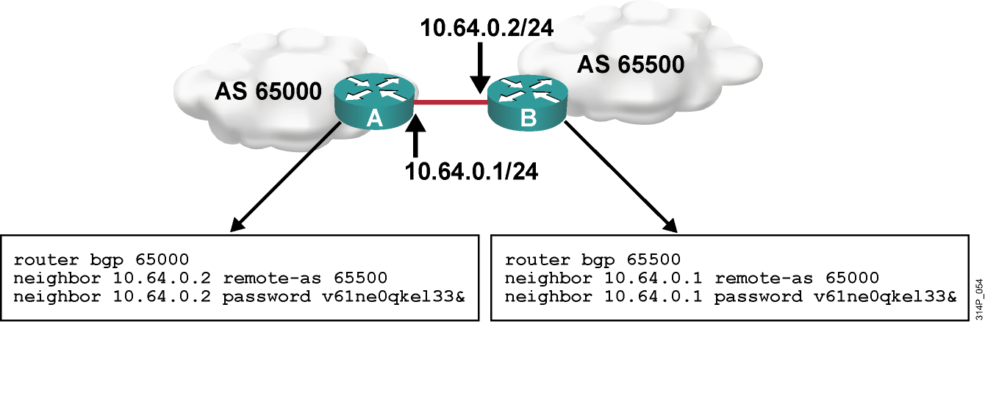
Example: BGP Neighbor Authentication

Slide 33
Example: show ip bgp Command
RouterA# show ip bgp
BGP table version is 14, local router ID is 172.31.11.1
Status codes: s suppressed, d damped, h history, * valid, > best, i - internal, r RIB-failure, S Stale
Origin codes: i - IGP, e - EGP, ? - incomplete
Network Next Hop Metric LocPrf Weight Path
*> 10.1.0.0/24 0.0.0.0 0 32768 i
* i 10.1.0.2 0 100 0 i
*> 10.1.1.0/24 0.0.0.0 0 32768 i
*>i10.1.2.0/24 10.1.0.2 0 100 0 i
*> 10.97.97.0/24 172.31.1.3 0 64998 64997 i
* 172.31.11.4 0 64999 64997 i
* i 172.31.11.4 0 100 0 64999 64997 i
*> 10.254.0.0/24 172.31.1.3 0 0 64998 i
* 172.31.11.4 0 64999 64998 i
* i 172.31.1.3 0 100 0 64998 i
r> 172.31.1.0/24 172.31.1.3 0 0 64998 i
r 172.31.11.4 0 64999 64998 i
r i 172.31.1.3 0 100 0 64998 i
*> 172.31.2.0/24 172.31.1.3 0 0 64998 i
<output omitted>
Displays networks from lowest to highest

Slide 34
Example: show ip bgp rib-failure Command
RouterA# show ip bgp rib-failure
Network Next Hop RIB-failure RIB-NH Matches
172.31.1.0/24 172.31.1.3 Higher admin distance n/a
172.31.11.0/24 172.31.11.4 Higher admin distance n/a
Displays networks that are not installed in the RIB and the reason that they were not installed

Slide 35
Clearing the BGP Session
  When policies such as access lists or attributes are changed, the change takes effect immediately, and the next time that a prefix or path is advertised or received, the new policy is used. It can take a long time for the policy to be applied to all networks.
  You must trigger an update to ensure that the policy is immediately applied to all affected prefixes and paths.
  Ways to trigger an update:
    Hard reset
    Soft reset
    Route refresh

Slide 36
Hard Reset of BGP Sessions
router#
clear ip bgp *
Resets all BGP connections with this router.
Entire BGP forwarding table is discarded.
BGP session makes the transition from established to idle; everything must be relearned.
router#
clear ip bgp [neighbor-address]
Resets only a single neighbor.
BGP session makes the transition from established to idle; everything from this neighbor must be relearned.
Less severe than clear ip bgp *.

Slide 37
Soft Reset Outbound
Router#
clear ip bgp {*|neighbor-address} [soft]
  Routes learned from this neighbor are not lost.
  This router resends all BGP information to the neighbor without resetting the connection.
  The connection remains established.
  This option is highly recommended when you are changing outbound policy.
  The soft out option does not help if you are changing inbound policy.

Slide 38
Inbound Soft Reset
Router(config-router)#
neighbor [ip-address] soft-reconfiguration inbound
  This router stores all updates from this neighbor in case the inbound policy is changed.
  The command is memory-intensive.
Router#
clear ip bgp {*|neighbor-address} soft in
  Uses the stored information to generate new inbound updates

Slide 39
Route Refresh: Dynamic Inbound Soft Reset
Router#
clear ip bgp {*|neighbor-address} [soft in | in]
  Routes advertised to this neighbor are not withdrawn.
  Does not store update information locally.
  The connection remains established.
  Introduced in Cisco IOS software release 12.0(2)S and 12.0(6)T.

Slide 40
debug ip bgp updates Command
RouterA#debug ip bgp updates
Mobile router debugging is on for address family: IPv4 Unicast
RouterA#clear ip bgp 10.1.0.2
<output omitted>
*Feb 24 11:06:41.309: %BGP-5-ADJCHANGE: neighbor 10.1.0.2 Up
*Feb 24 11:06:41.309: BGP(0): 10.1.0.2 send UPDATE (format) 10.1.1.0/24, next 10.1.0.1, metric 0, path Local
*Feb 24 11:06:41.309: BGP(0): 10.1.0.2 send UPDATE (prepend, chgflags: 0x0) 10.1.0.0/24, next 10.1.0.1, metric 0, path Local
*Feb 24 11:06:41.309: BGP(0): 10.1.0.2 NEXT_HOP part 1 net 10.97.97.0/24, next 172.31.11.4
*Feb 24 11:06:41.309: BGP(0): 10.1.0.2 send UPDATE (format) 10.97.97.0/24, next 172.31.11.4, metric 0, path 64999 64997
*Feb 24 11:06:41.309: BGP(0): 10.1.0.2 NEXT_HOP part 1 net 172.31.22.0/24, next 172.31.11.4
*Feb 24 11:06:41.309: BGP(0): 10.1.0.2 send UPDATE (format) 172.31.22.0/24, next 172.31.11.4, metric 0, path 64999
<output omitted>
*Feb 24 11:06:41.349: BGP(0): 10.1.0.2 rcvd UPDATE w/ attr: nexthop 10.1.0.2, origin i, localpref 100, metric 0
*Feb 24 11:06:41.349: BGP(0): 10.1.0.2 rcvd 10.1.2.0/24
*Feb 24 11:06:41.349: BGP(0): 10.1.0.2 rcvd 10.1.0.0/24

Slide 41
Summary
  BGP is configured with the following basic BGP commands:
    router bgp autonomous-system
    neighbor ip-address remote-as autonomous-system
    network network-number [mask network-mask]
  The neighbor command activates a BGP session with a neighboring router.
  The neighbor shutdown command administratively shuts down a BGP neighbor.
  When creating a BGP packet, the neighbor statement defines the destination IP address and the outbound interface defines the source IP address.
  When establishing a BGP session, BGP goes through the following states: idle, connect, open sent, open confirm, and established.
  You can configure MD5 authentication between two BGP peers, meaning that each segment sent on the TCP connection between the peers is verified.
  The show and debug commands are used to troubleshoot the BGP session.

Slide 42


