Slide 1
Implementing BGP
Selecting a BGP Path

Slide 2
Network Boundary Summarization
Router(config-router)#
no auto-summary
BGP, RIPv1 and RIPv2, IGRP, and EIGRP perform
network boundary summarization by default.
BGP, RIPv2, and EIGRP can disable network
boundary summarization.
CIDR has forced the IANA to begin using class
A addresses, like 64.0.0.0, in a classless manner.
If you are assigned a portion of a class A, B, or C
address, the no auto-summary command needs
to be implemented under the BGP process or you
risk claiming ownership of the whole class A, B,
or C address.

Slide 3
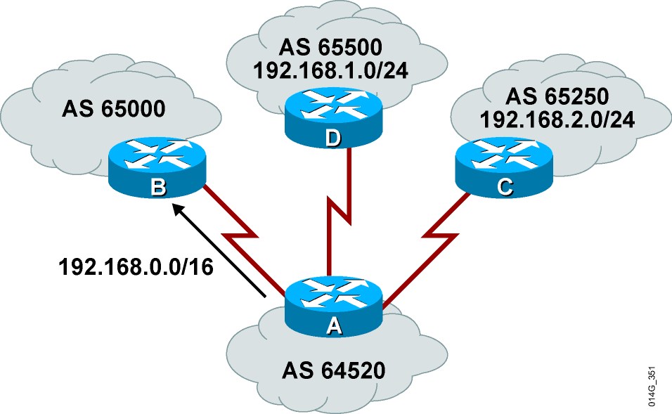
CIDR and Aggregate Addresses
With BGP4, routes can
be aggregated by any
AS on any BGP router.
BGP4 is classless,
supports VLSM and
longest match routing,
and carries a network
mask for each network
in the update.

Slide 4
BGP network Command
Router(config-router)#
network network-number [mask network-mask]
This command was not designed to perform summarization by itself. The aggregate-address command was designed for summarization.
Router(config)#
ip route prefix mask null0
To use the network statement for summarization, the network number and mask used must already exist in the routing table.
If the route was already summarized by EIGRP or OSPF, that summarization can be announced into BGP with the network and mask commands.
If the route was not already summarized, a null route must be created for BGP to announce this summarization.

Slide 5
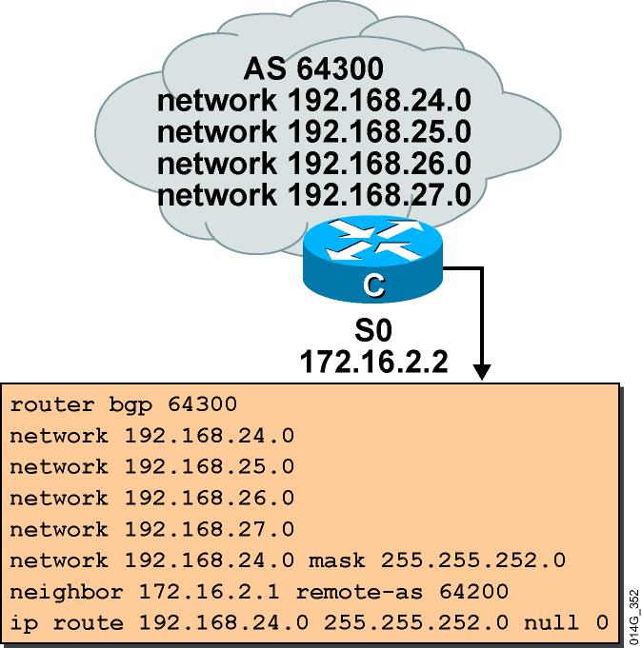
Cautions about Network Statement
If a network statement is
used for summarization,
do not use the more
specific entries and the
summarized route as
shown here.
If both are used, the
summarized route and the
more specific routes will
be announced.
192.168.24.0/22 does not
exist in the IP routing table
without the null route. BGP
will not announce the network
unless the summarized route
is already present in the
routing table.

Slide 6
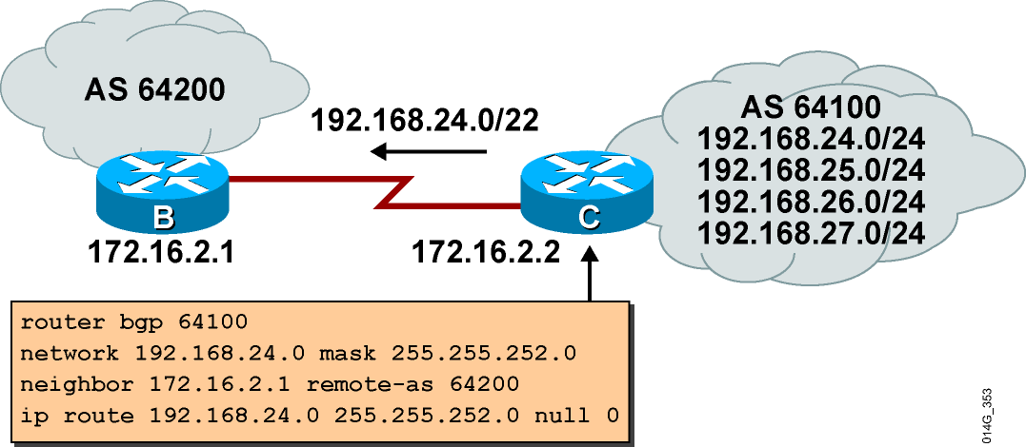
BGP Summarization Using the network Command and Static Route to Null0

Slide 7
Configuring BGP for Aggregate Addressing
Router(config-router)#
aggregate-address ip-address mask [summary-only]
[as-set]
  Creates an aggregate (summary) entry in the
  BGP table
  Uses the summary-only option to advertise only
  the summary and not the specific routes
  Adds the as-set option to include a list of all the
  autonomous system numbers that the more
  specific routes have passed through
  Recommended method of summarization for BGP
  Null static route not needed; BGP null route
  automatically generated

Slide 8
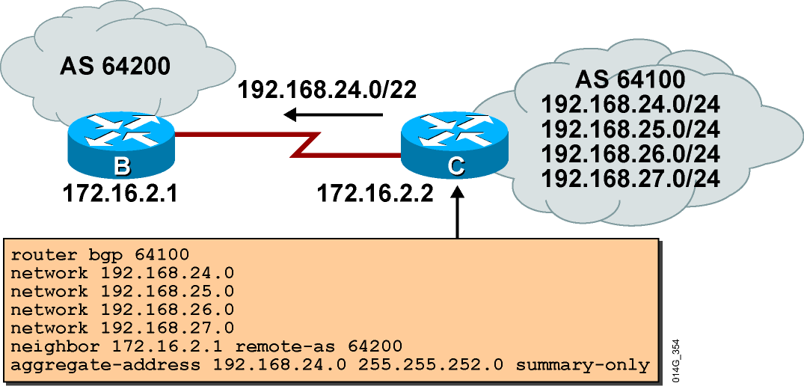
BGP Summarization Using the aggregate-address Command

Slide 9
BGP Aggregation
RouterC#
show ip bgp
routerC# show ip bgp
BGP table version is 28, local router ID is 172.16.2.1
Status codes: s = suppressed, * = valid, > = best, and i = internal
Origin codes : i = IGP, e = EGP, and ? = incomplete
*>
s> s> s> s>
Network 192.168.24.0/22 192.168.24.0 192.168.25.0 192.168.26.0 192.168.27.0
Next Hop 0.0.0.0 0.0.0.0 0.0.0.0 0.0.0.0 0.0.0.0
Metric
0
0
0
0
0
LocPrf
Weight 32768 32768 32768 32768 32768
Path i i i i i

Slide 10
BGP Path Attributes
  BGP metrics are called path attributes.
  Characteristics of path attributes include:
    Well-known versus optional
    Mandatory versus discretionary
    Transitive versus nontransitive
    Partial

Slide 11
Well-Known Attributes
  Well-known attributes
    Must be recognized by all compliant BGP implementations
    Are propagated to other neighbors
  Well-known mandatory attributes
    Must be present in all update messages
  Well-known discretionary attributes
    May be present in update messages

Slide 12
Optional Attributes
  Optional attributes
    They are recognized by some implementations (could be private); but expected not to be recognized by all BGP routers.
    Recognized optional attributes are propagated to other neighbors based on their meaning.
  Optional transitive attributes
    If not recognized, marked as partial and propagated to other neighbors
  Optional nontransitive attributes
    Discarded if not recognized

Slide 13
BGP Attributes
BGP attributes include the following:
  AS path *
  Next-hop *
  Origin *
  Local preference
  MED
  Others
* Well-known mandatory attribute

Slide 14
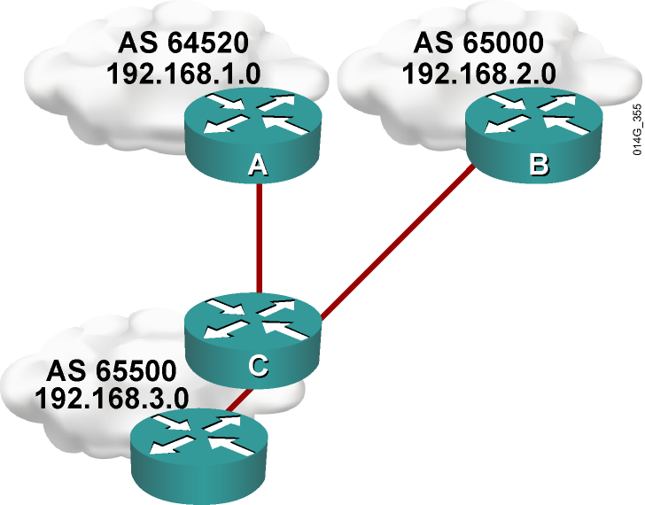
AS Path Attribute
  A list of autonomous systems that a route has traversed:
    For example, on router B, the path to 192.168.1.0
    is the AS sequence
    (65500, 64520).
  The AS path attribute is well-known, mandatory.

Slide 15
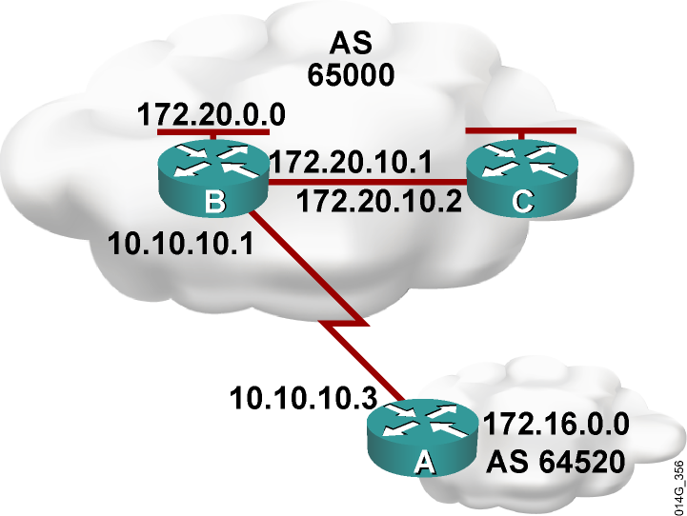
Next-Hop Attribute
The IP address of the next AS to reach a given network:
  Router A advertises network 172.16.0.0 to
  router B in EBGP, with a
  next hop of 10.10.10.3.
  Router B advertises
  172.16.0.0 in IBGP to
  router C, keeping 10.10.10.3
  as the next-hop address.
The next-hop attribute is
well-known, mandatory.

Slide 16
Origin Attribute
  IGP (i)
    network command
  EGP (e)
    Redistributed from EGP
  Incomplete (?)
    Redistributed from IGP or static
The origin attribute informs all autonomous systems in the internetwork how the prefixes were introduced into BGP.
The origin attribute is well-known, mandatory.

Slide 17
Example: Origin Attribute
RouterA# show ip bgp
BGP table version is 14, local router ID is 172.31.11.1
Status codes: s suppressed, d damped, h history, * valid, > best, i - internal, r RIB-failure, S Stale
Origin codes: i - IGP, e - EGP, ? - incomplete
Network Next Hop Metric LocPrf Weight Path
*> 10.1.0.0/24 0.0.0.0 0 32768 i
* i 10.1.0.2 0 100 0 i
*> 10.1.1.0/24 0.0.0.0 0 32768 i
*>i10.1.2.0/24 10.1.0.2 0 100 0 i
*> 10.97.97.0/24 172.31.1.3 0 64998 64997 i
* 172.31.11.4 0 64999 64997 i
* i 172.31.11.4 0 100 0 64999 64997 i
*> 10.254.0.0/24 172.31.1.3 0 0 64998 i
* 172.31.11.4 0 64999 64998 i
* i 172.31.1.3 0 100 0 64998 i
r> 172.31.1.0/24 172.31.1.3 0 0 64998 i
r 172.31.11.4 0 64999 64998 i
r i 172.31.1.3 0 100 0 64998 i
*> 172.31.2.0/24 172.31.1.3 0 0 64998 i
<output omitted>

Slide 18
BGP Path Selection
  The BGP forwarding table usually has multiple paths from which to choose for each network.
  BGP is not designed to perform load balancing:
    Paths are chosen because of policy.
    Paths are not chosen based on bandwidth.
  The BGP selection process eliminates any multiple paths through attrition until a single best path is left.
  That best path is submitted to the routing table manager process and evaluated against the methods of other routing protocols for reaching that network (using administrative distance).
  The route from the source with the lowest administrative distance is installed in the routing table.

Slide 19
Route Selection Decision Process
Consider only (synchronized) routes with no AS loops and a valid next hop, and then:
  Prefer highest weight (local to router).
  Prefer highest local preference (global within AS).
  Prefer shortest AS path.
  Prefer lowest origin code (IGP < EGP < incomplete).
  Prefer lowest MED (exchanged between autonomous systems).
  Prefer EBGP path over IBGP path.
  Prefer the path through the closest IGP neighbor.
  Prefer the path with the lowest neighbor BGP router ID.

Slide 20
Summary
  BGP metrics are called path attributes and describe the paths to reach each network. These attributes are categorized as well-known mandatory, well-known discretionary, optional transitive, and optional nontransitive.
  The AS path attribute is a well-known mandatory attribute that lists the AS numbers that a route has traversed to reach a destination.
  The BGP next-hop attribute is a well-known mandatory attribute that indicates the next-hop IP address to use to reach a destination.
  The origin attribute is a well-known mandatory attribute that defines the origin of the path information.
  The local preference attribute is a well-known discretionary attribute that provides an indication to routers in the AS about which path is preferred to exit the AS.

Slide 21


