Slide 1
Implementing BGP
Using Route Maps to Manipulate Basic BGP Paths

Slide 2
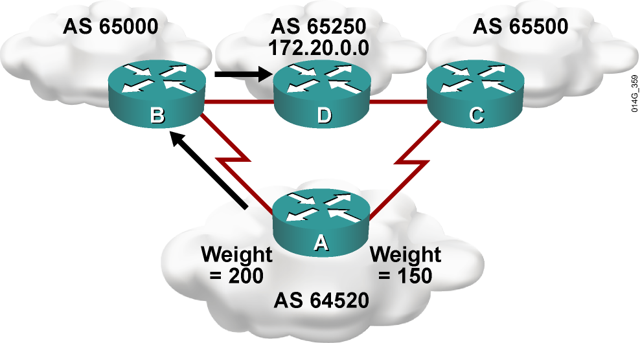
Weight Attribute (Cisco Only)
Paths with the highest weight value are preferred
  Weight not sent to any BGP neighbors; local to this
  router only

Slide 3
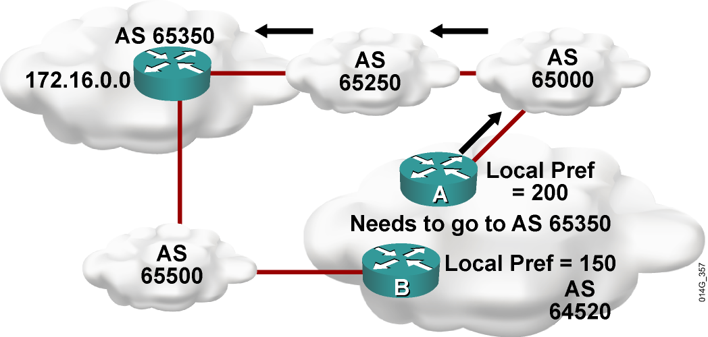
Local Preference Attribute
Paths with highest local preference value are preferred:
  Local preference is used to advertise to IBGP neighbors about how to leave their AS.
  The local preference is sent to IBGP neighbors only (that is, within the AS only).
  The local preference attribute is well-known and discretionary.
  Default value is 100.

Slide 4
Changing BGP Local Preference For All Routes
Local preference is used in these ways:
  Within an AS between IBGP speakers
  To determine the best path to exit the
  AS to reach an outside network
  Set to 100 by default; higher values preferred
Router(config-router)#
bgp default local-preference value
  This command changes the default local preference value.
  All routes advertised to an IBGP neighbor have the local preference set to the value specified.

Slide 5
Origin Attribute
  IGP (i)
    network command
  EGP (e)
    Redistributed from EGP
  Incomplete (?)
    Redistributed from IGP or static
The origin attribute informs all autonomous systems in the internetwork how the prefixes were introduced into BGP.
The origin attribute is well-known, mandatory.

Slide 6
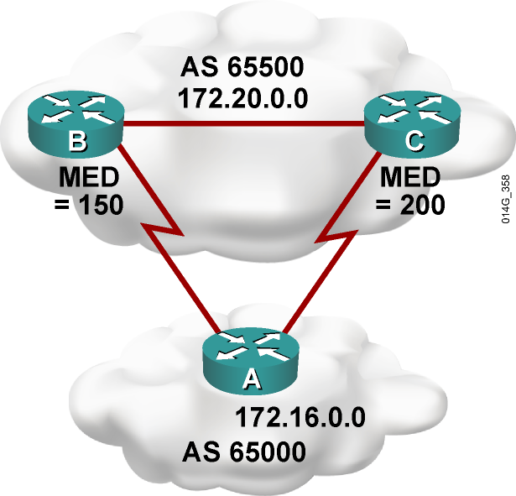
Multi Exit Discriminator
  The paths with the lowest MED (also called the metric) value are the most desirable:
    MED is used to advertise
    to EBGP neighbors
    how to enter local AS .

Slide 7
Changing BGP MED for All Routes
  MED is used when multiple paths exist between two autonomous systems.
  A lower MED value is preferred.
  The default setting for Cisco is MED = 0.
  The metric is an optional, nontransitive attribute.
  Usually, MED is shared only between two autonomous
  systems that have multiple EBGP connections with each other.
Router(config-router)#
default-metric number
  MED is considered the metric of BGP.
  All routes that are advertised to an EBGP neighbor are set to the value specified using this command.

Slide 8
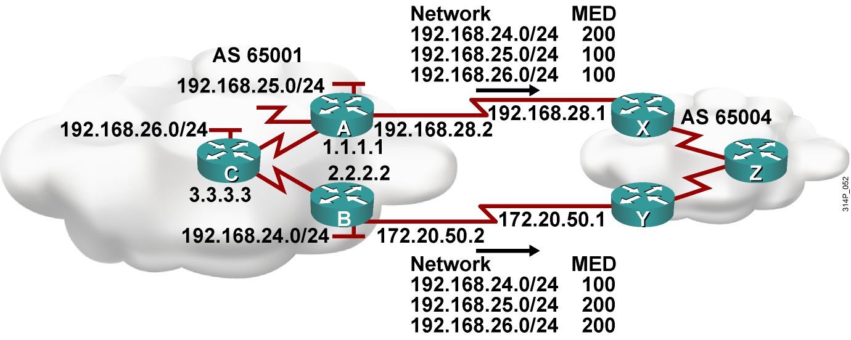
BGP Using Route Maps and the MED

Slide 9
Route Map for Router A
  Router A’s Configuration:
  router bgp 65001
  neighbor 2.2.2.2 remote-as 65001
  neighbor 3.3.3.3 remote-as 65001
  neighbor 2.2.2.2 update-source loopback0
  neighbor 3.3.3.3 update-source loopback0
  neighbor 192.168.28.1 remote-as 65004
  neighbor 192.168.28.1 route-map med_65004 out
  !
  access-list 66 permit 192.168.25.0.0 0.0.0.255
  access-list 66 permit 192.168.26.0.0 0.0.0.255
  !
  route-map med_65004 permit 10
  match ip address 66
  set metric 100
  !
  route-map med_65004 permit 100
  set metric 200

Slide 10
Route Map for Router B
  Router B’s Configuration:
  router bgp 65001
  neighbor 1.1.1.1 remote-as 65001
  neighbor 3.3.3.3 remote-as 65001
  neighbor 1.1.1.1 update-source loopback0
  neighbor 3.3.3.3 update-source loopback0
  neighbor 172.20.50.1 remote-as 65004
  neighbor 172.20.50.1 route-map med_65004 out
  !
  access-list 66 permit 192.168.24.0.0 0.0.0.255
  !
  route-map med_65004 permit 10
  match ip address 66
  set metric 100
  !
  route-map med_65004 permit 100
  set metric 200

Slide 11
MED Learned by Router Z
RouterZ# show ip bgp
BGP table version is 7, local router ID is 122.30.1.1
Status codes: s suppressed, d damped, h history, * valid, > best, i - internal, r RIB-failure, S Stale
Origin codes: i - IGP, e - EGP, ? - incomplete
Network Next Hop Metric LocPrf Weight Path
*>i192.168.24.0 172.20.50.2 100 100 0 65001 i
* i 192.168.28.2 200 100 0 65001 i
* i192.168.25.0 172.20.50.2 200 100 0 65001 i
*>i 192.168.28.2 100 100 0 65001 i
* i192.168.26.0 172.20.50.2 200 100 0 65001 i
*>i 192.168.28.2 100 100 0 65001 i
  Examine the networks that have been learned from AS 65001 on Router Z in AS 65004.
  For all networks: Weight is equal (0); local preference is equal (100); routes are not originated in this AS; AS path is equal (65001); origin code is equal (i).
  192.168.24.0 has a lower metric (MED) through 172.20.50.2 (100) than 192.168.28.2 (200).
  192.168.25.0 has a lower metric (MED) through 192.168.28.2 (100) than 172.20.50.2 (200).
  192.168.26.0 has a lower metric (MED) through 192.168.28.2 (100) than 172.20.50.2 (200).

Slide 12
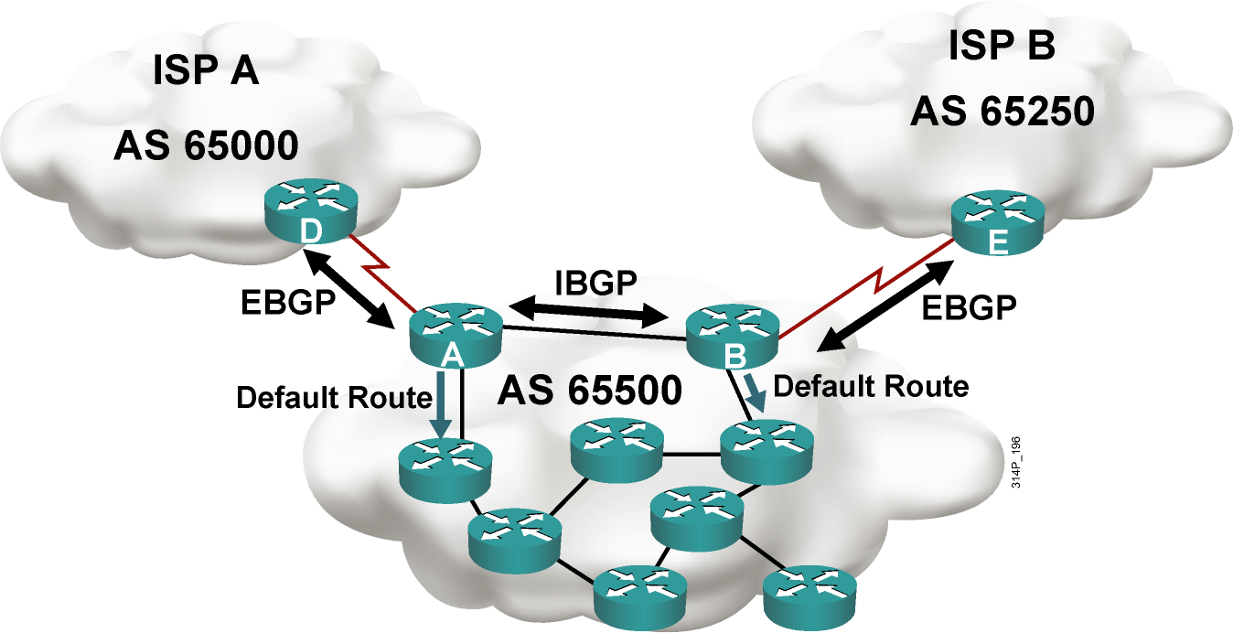
BGP in an Enterprise

Slide 13
Summary
  The BGP local preference attribute can be changed to manipulate the best-path decision process, either for all routes or for selected routes using route maps.
    Higher local preference values are preferred.
    Local preference is used only between IBGP speakers within the same AS.
  The MED values can be changed to manipulate packets
  returning to an AS, either for all routes or for selected routes, using route maps.
    Lower MED values are preferred.
    The MED is sent to EBGP neighbors; those routers propagate the MED within their AS. The routers within the AS use the MED but do not pass it on to the next AS.
  Routers in a typical enterprise BGP implementation multihome to two ISPs and pass default routes to other routers within the enterprise.

Slide 14


