Slide 1
Advanced BGP

Slide 2

Route Reflectors
© 2001, Cisco Systems, Inc.
www.cisco.com
BGP Route Reflectors-<number>

Slide 3
IBGP Transit AS - Problems
IBGP requires full-mesh between all BGP-speaking routers
  Large number of TCP sessions
  Unnecessary duplicate routing traffic
Solutions
  Route Reflectors modify IBGP split horizon rules
  BGP Confederations modify IBGP AS Path processing

Slide 4
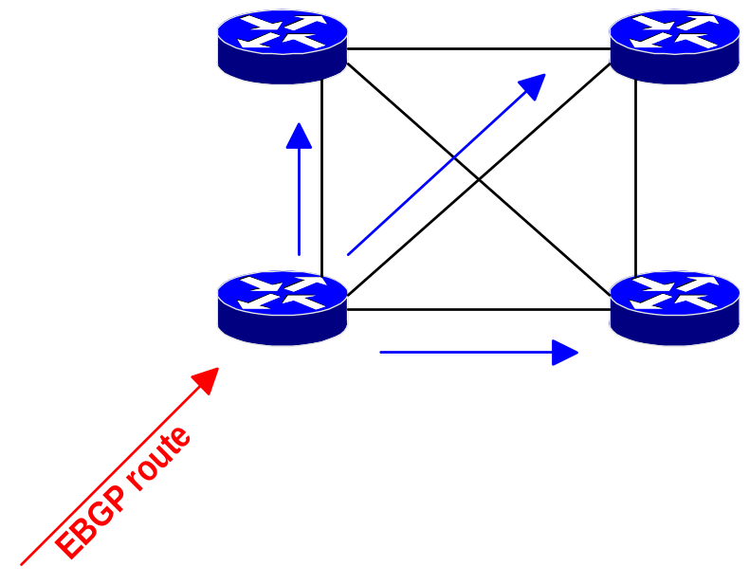
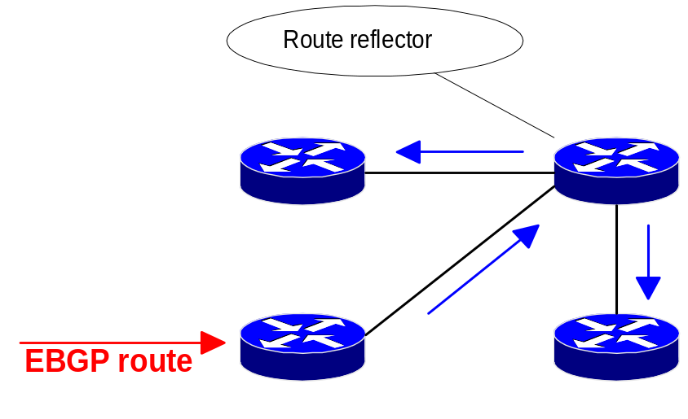
Route Reflectors - Modification of Split Horizon Rules
Classic BGP - IBGP routes are
not propagated to other IBGP
peers. Full mesh of IBGP peers is
therefore required
Route reflector can propagate
IBGP routes to other IBGP peers.
Full mesh of IBGP peers is no
longer required

Slide 5
Route Reflector Rules
Autonomous system
Client
EBGP peer
Client
Reflector
Client
EBGP peer
Routes received from a client are propagated to all other peers
EBGP peer
Client
Client
Client
Routes received from external peers are propagated to all peers

Slide 6
Redundant Route Reflectors
Redundant reflectors solve high availability requirement
Autonomous system
Client
Reflector
EBGP peer
Client
Reflector
Reflector
EBGP peer
Client
But they might also cause routing loops
EBGP peer
Client
Client
The concept of “clusters” is introduced to
prevent IBGP routing loops with route reflectors

Slide 7
Route Reflector Clusters
A group of redundant route reflectors and their clients form a cluster
Each cluster must have a unique cluster-ID
Each time a route is reflected, the cluster-ID is added to cluster-list BGP attribute
The route that already contains local cluster-ID in the cluster-list is not reflected

Slide 8
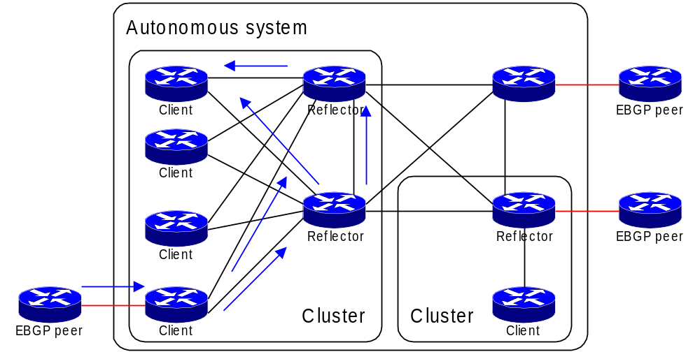
Redundant Route Reflectors in a Cluster
Route is rejected since the cluster-ID is already in cluster-list

Slide 9
Hierarchical Route Reflector Example
Autonomous
Cluster
system
27
Client
Client
Client
EBGP peer
This router is a reflector in Cluster 11 and client in Cluster 27
Reflector
Reflector
Cluster 11
Cluster
12
Reflector/
Reflector/
Reflector/
EBGP peer
Client
Client
Client
Client
Client
Client
Client
Client
Client
EBGP peer

Slide 10
Confederation
© 2001, Cisco Systems, Inc.
www.cisco.com
BGP Confederations-<number>

Slide 11
BGP Confederation - Split Transit AS in smaller AS
AS 12
AS 61
AS 62
Intra-confederation
EBGP session
real EBGP
session
AS 63
AS 64
IBGP session
AS 42
AS 14
Splitting the AS into smaller AS would reduce the number of
IBGP sessions, but we cannot get extra AS numbers
Confederations enable us to hide internal AS numbers and
announce only one (external) AS number to the EBGP neighbors

Slide 12
Community
© 2001, Cisco Systems, Inc.
www.cisco.com
Advanced BGP Configuration-<number>

Slide 13
What is a Community ?
The community attribute is a transitive, optional attribute. It’s value is a 32-bit number (range 0 to 4,294,967,200)
Each network in a BGP routing table can be tagged with a set of communities
The standards define several filtering-oriented communities
  no-advertise do not advertise routes to any peer
  no-export do not advertise routes to real EBGP peers
  local-AS do not advertise routes to any EBGP peers
Routers that don’t support communities pass them along unchanged
Notes:
“可选”：BGP路由默认不携带社团属性。
“传递”：社团属性只会传给指定的邻居，并只在此邻居上起效。
Router (config-router)# neighbor x.x.x.x send-community

Slide 14
Community Setting Through Route-Map
router(config)#
route-map name
match condition
set community value [ value … ]
Route tagging with communities is always done with a route-map
Any number of communities can be specified
Communities specified in the set keyword overwrites existing communities

Slide 15
BGP Filter
© 2001, Cisco Systems, Inc.
www.cisco.com
Route Filtering and Route Selection in BGP-<number>

Slide 16
Objectives
BGP Filters:
  Distribute-list
  Prefix-list
  Route-map
  Regular Expressions
Notes:
Lesson Aim
<Enter lesson aim here.>

Slide 17
AS Path Filtering
Several scenarios require BGP route filtering based on AS-path
  Announce only local routes to the ISP - AS-path needs to be empty
  Select routes based on a specific AS-number in the AS-path
  Accept routes for specific AS only from some BGP neighbors
AS-path filters use regular expressions

Slide 18
Regular Expressions
Matching Delimiters
^ matches beginning of string
$ matches end of string
_ matches any delimiter (beginning, end, whitespace, tab, comma)
. matches any string
* matches zero or more times

Slide 19
Sample Regular Expressions
_100_
_100$
^100$
.*
Going through AS 100
Originated in AS 100
Directly connected to AS 100
matches everything
Notes:
100
100 200
200 100
200 100 300
21003

Slide 20
Configuring BGP AS-path Filters
router(config)#
ip as-path access-list number permit|deny regexp
Configures AS-path access list
router(config-router)#
neighbor ip-address filter-list as-path-filter in|out
Configures inbound or outbound AS-path filter for specified BGP neighbor

Slide 21
BGP Default Route
© 2001, Cisco Systems, Inc.
www.cisco.com
Route Filtering and Route Selection in BGP-<number>

Slide 22
Method1
router(config)#
ip route 0.0.0.0 0.0.0.0 Null0
Configures default route
router(config-router)#
network 0.0.0.0
network default route
Notes:
Lesson Aim
<Enter lesson aim here.>

Slide 23
Method2
router(config-router)#
neighbor x.x.x.x default-originate
network default route
Notes:
Lesson Aim
<Enter lesson aim here.>

Slide 24
BGP Dampening
© 2001, Cisco Systems, Inc.
www.cisco.com
Advanced BGP Configuration-<number>

Slide 25
BGP Route Flap Dampening
(RFC 2439)
Goal: minimize the number of BGP updates
Tools:
  Batching of BGP updates
  Per-neighbor update timers
  Suppressing of unstable routes (route flap dampening)

Slide 26
Route Flap Dampening Implementation
Every time an EBGP route flaps it gets 1000 penalty points (IBGP routes are not dampened)
The penalty placed on a route is decayed using the exponential decay algorithm
When the penalty exceeds “suppress limit”, the route is dampened (no longer used or propagated to other neighbors)
A dampened route is propagated when the penalty drops below “reuse limit”

Slide 27
Default BGP Dampening
Parameter Values
The following default dampening parameter values are used if you don’t specify them:
  per-flap penalty 1000 (non-configurable)
  half-time 15 minutes
  suppress limit 2000
  reuse limit 750
  max-suppress-time 60 minutes

Slide 28
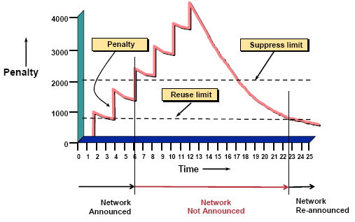
BGP Route Flap Dampening

Slide 29
Configuring Dampening Parameters for Individual Routes
router(config-route-map)#
set dampening [half-time [reuse-limit suppress-limit max-suppress]]
Sets the BGP dampening parameters for individual routes matched by a route-map entry
Apply this route-map to the bgp dampening command instead of specifying individual parameters
Applications:
  Less aggressive dampening of routes toward root DNS servers (or other servers)
  Dampen smaller prefixes more aggressively

Slide 30
Monitoring Route Flap Dampening
router#
show ip bgp dampened-paths
Displays the damped routes
router#
show ip bgp flap-statistics
Displays the flap statistics for all routes with dampening history
router#
show ip bgp flap-statistics regexp regexp
Display the flap statistics for routes matching a regular expression

Slide 31



© 2001, Cisco Systems, Inc.
Route Filtering and Route Selection in BGP-<number>

