Slide 1


Robotic Social Feedback for Object Specification
Brown University, H2R
Emily Wu, David Whitney, Horatio Han, John Oberlin,
James MacGlashan, Stefanie Tellex

Slide 2
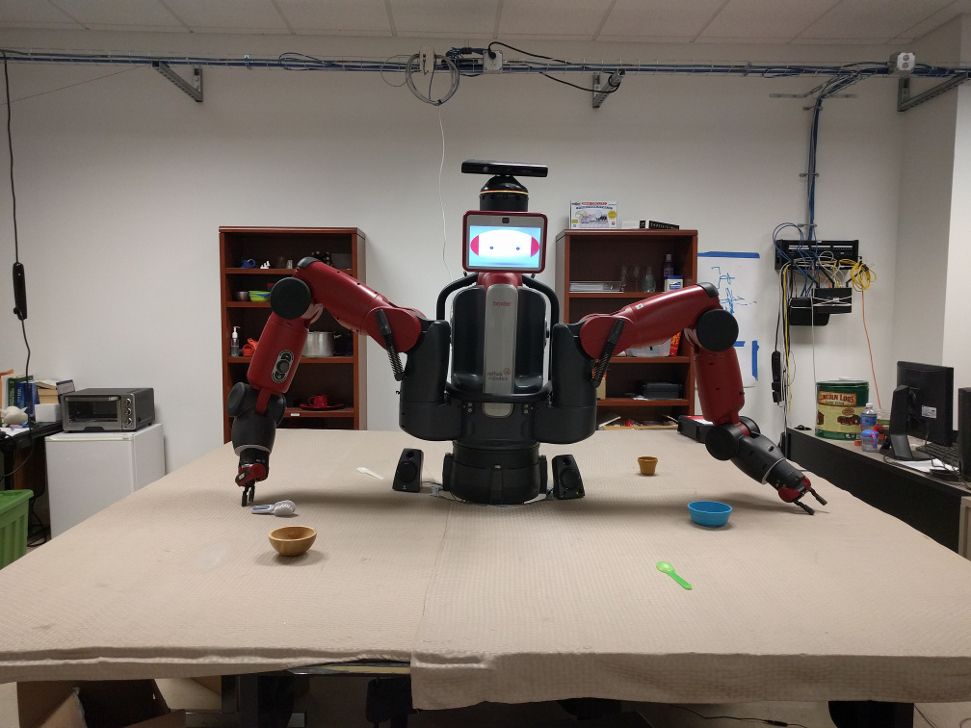
A Simple Task

Slide 3
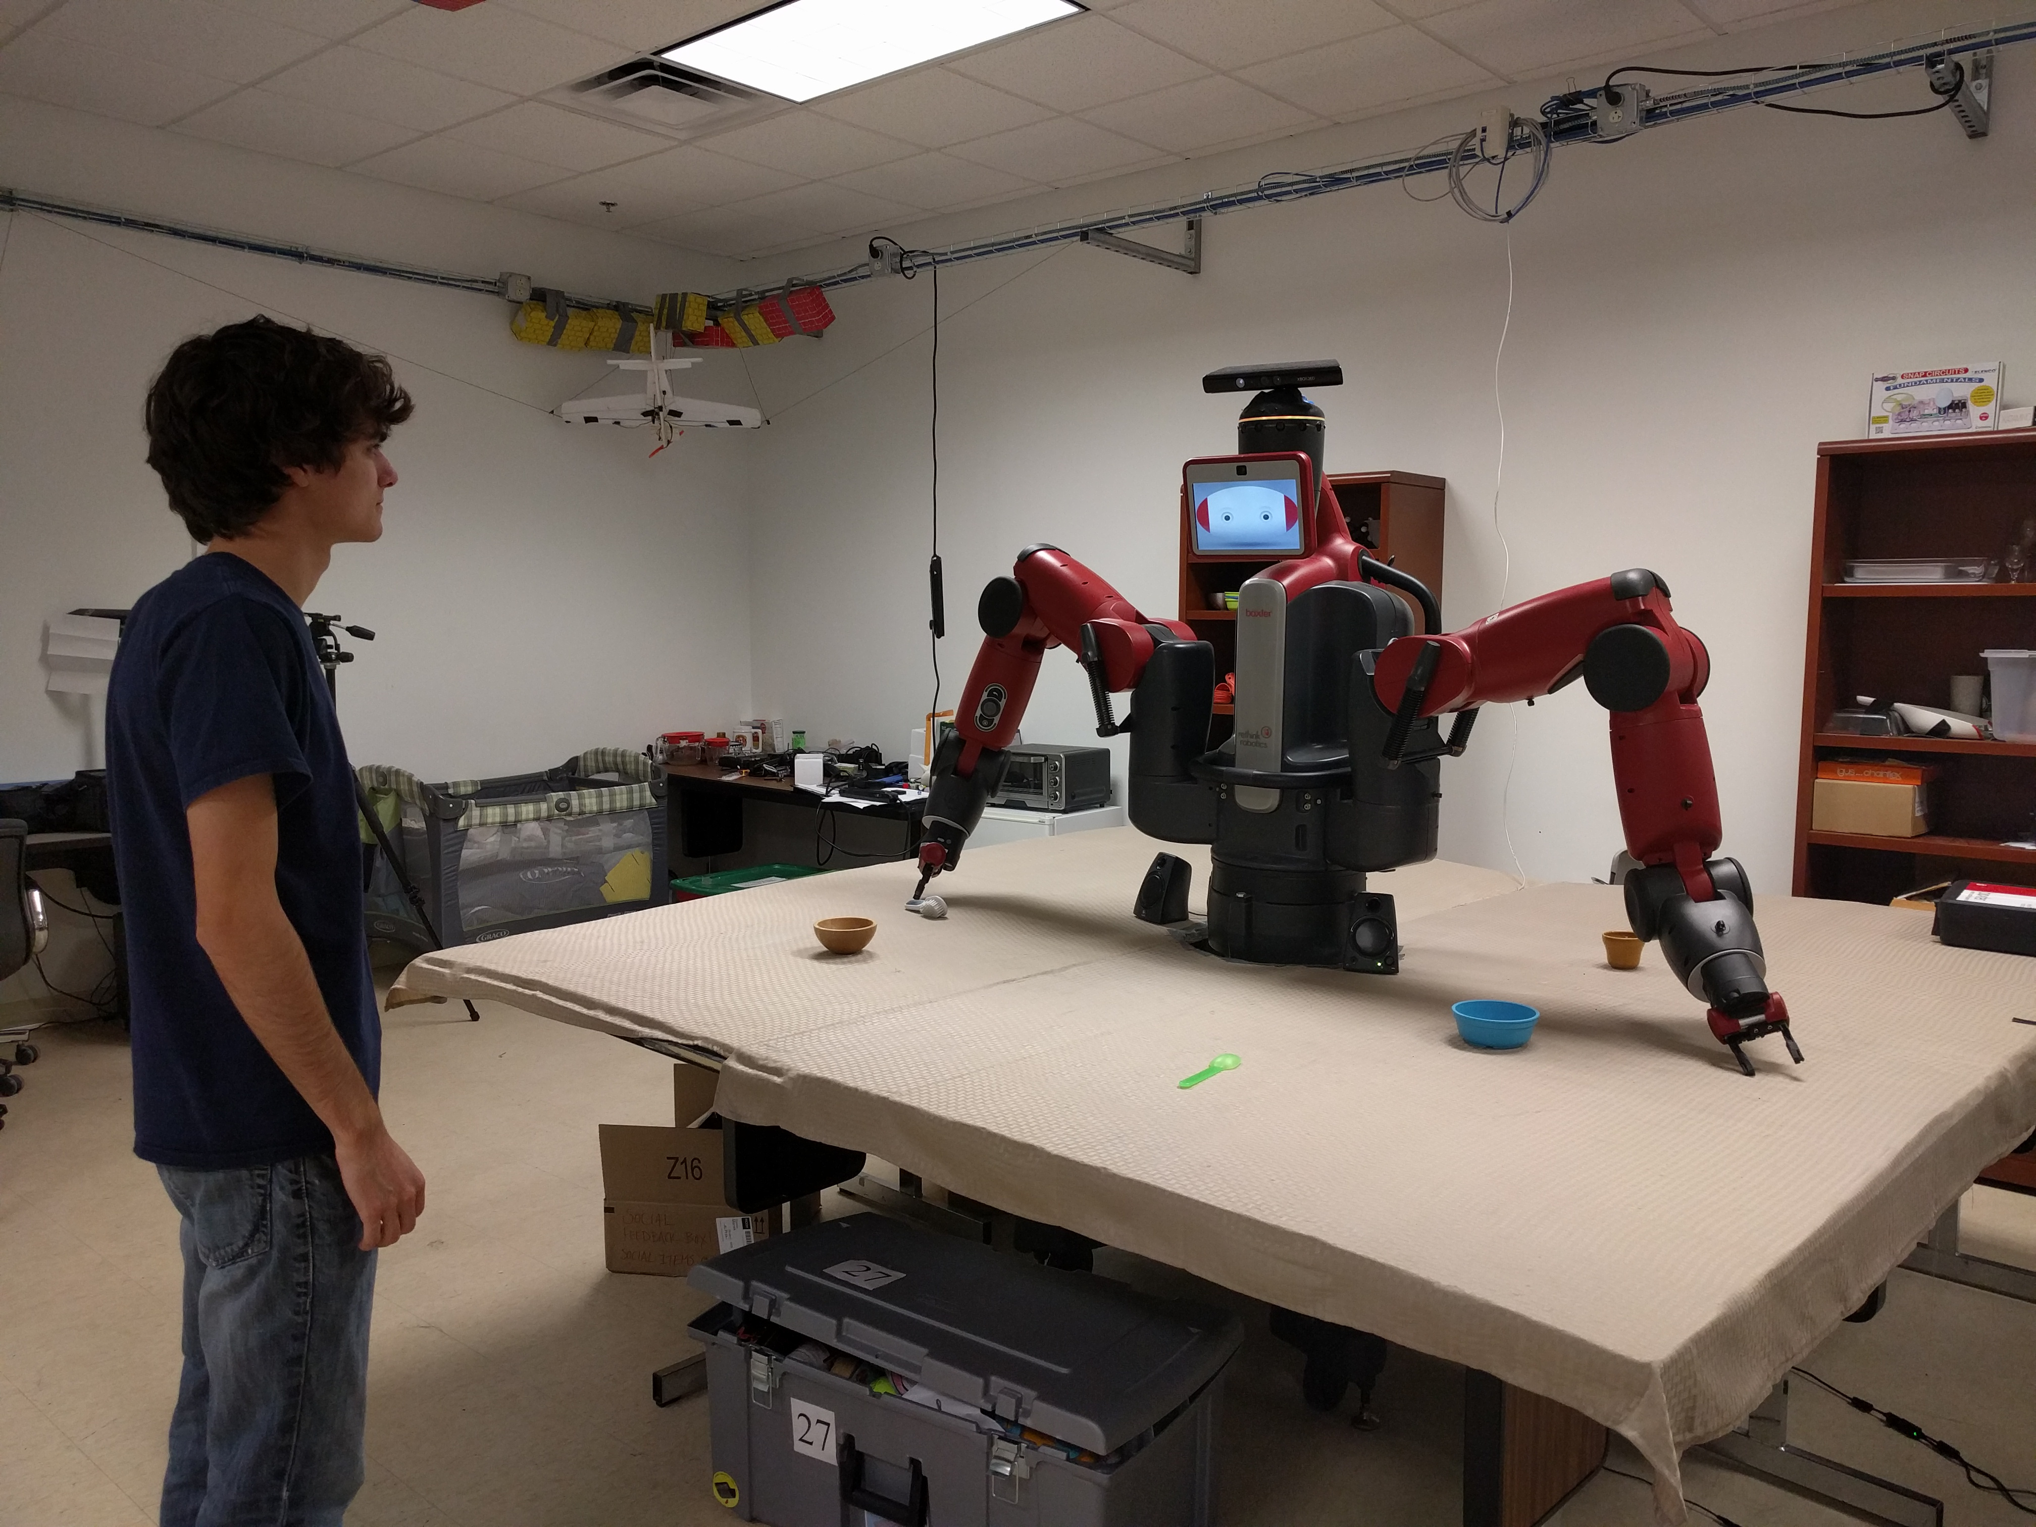
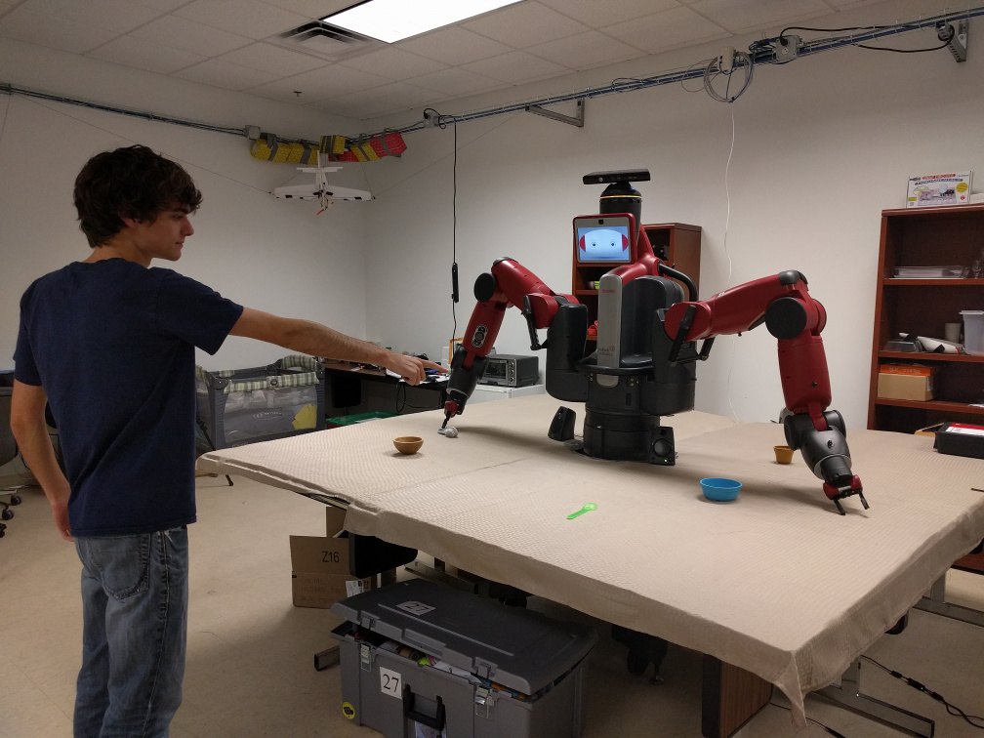
Hand me that bowl

Slide 4
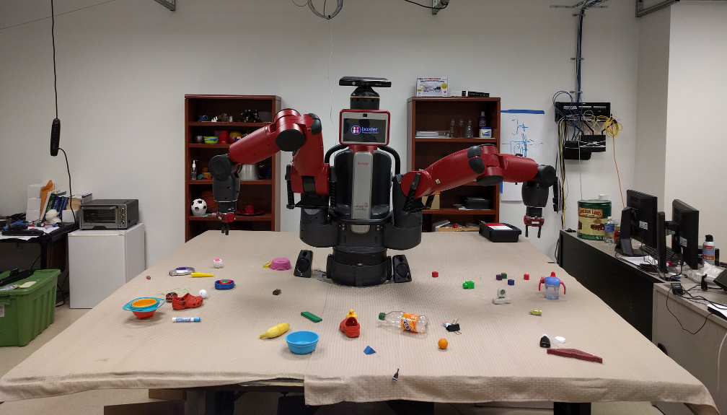
A More Complicated Task

Slide 5
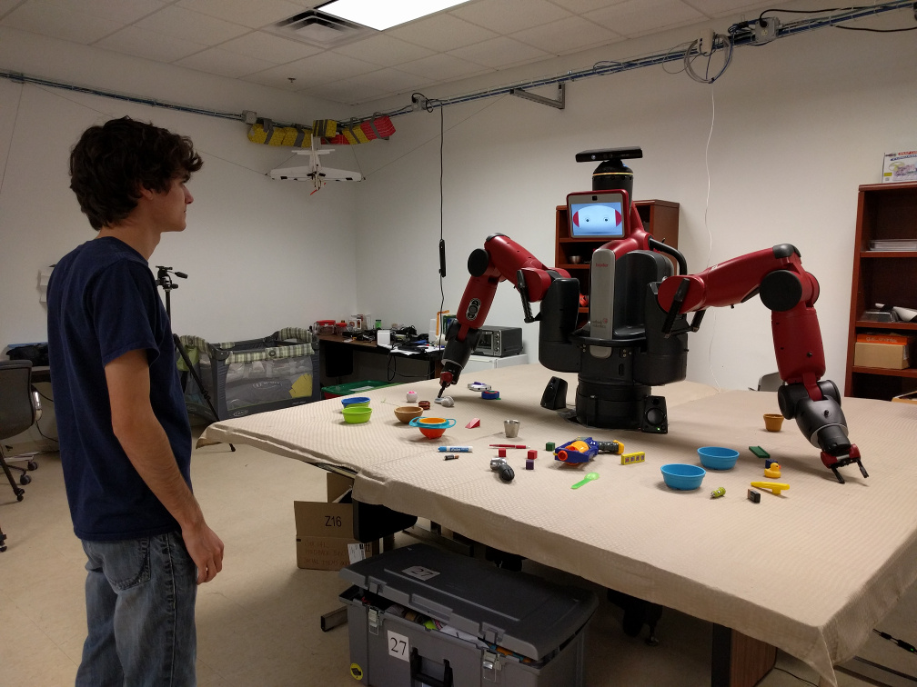
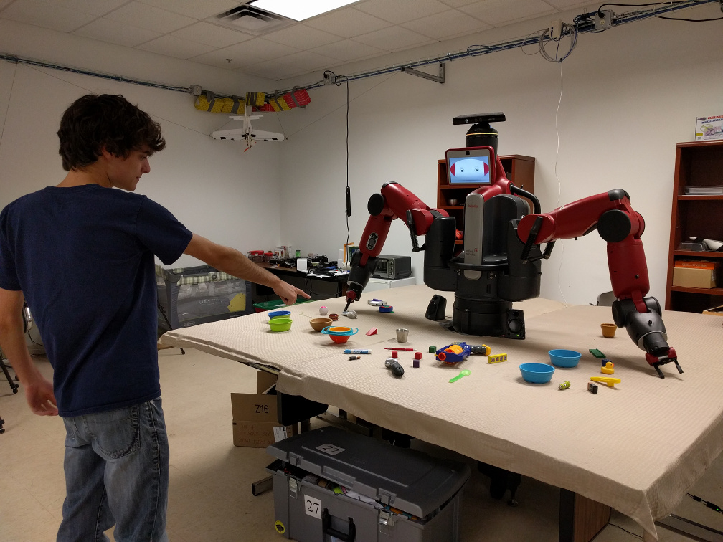
Hand me that bowl
...

Slide 6
Sorry, I didn't
understand

Slide 7
Did you want the
one in the back?

Slide 8
Existing Approaches

Slide 9
Social Feedback
Social feedback: Feedback for HRI task that is human-readable
Notable improvements in speed and accuracy in humans
  Clark 2001: Cutting off feedback results in 8-14x as many errors
  Removing workspace results in 2x time to complete
Goal: Demonstrate that allowing robots to do this will increase speed and accuracy

Slide 10
Producing Social Feedback
Solution: Human-robot Collaborative POMDP
Models uncertainty
Generalizable to other HRI tasks

Slide 11
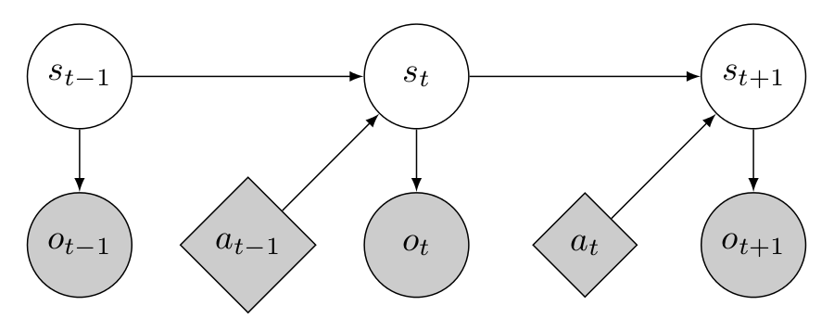

Slide 12
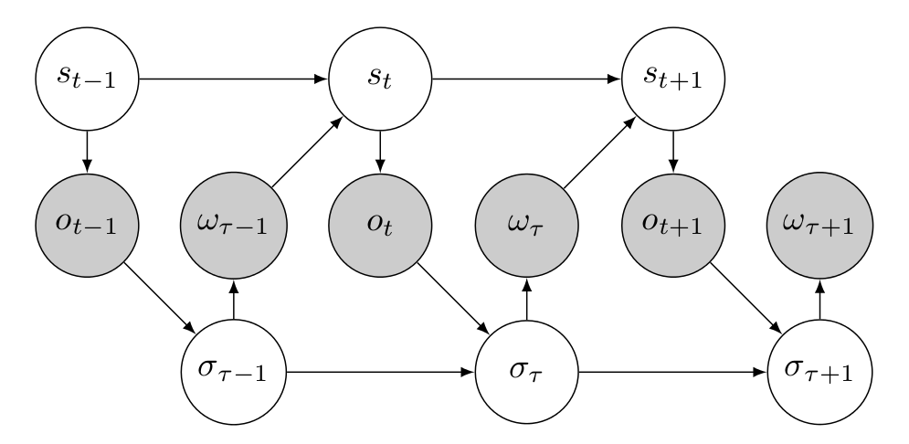

Slide 13
POMDP: Adding Social Feedback
S = (object)
A = {wait, pick}
O = {word Є objectVocab, gesture}
R = +10 correct pick
-80 incorrect pick
  -1 wait
S = (object, dialogState)
A = {wait, pick, ask(property)}
O = {word Є objectVocab, “yes/no”, gesture}
R = +10 correct pick
-80 incorrect pick
  -1 wait
Notes:
Communicating robot state:
- Looking, pointing, asking communicates the robot state
- The human participant can notice failure and point it out
- The robot can communicate its own failures/ask appropriate information gathering questions
Monitoring State:
- adding humanBelief allows the robot to estimate the human's belief about its own state by treating its actions as observations
- Rewarded if its belief matches the human's belief

Slide 14
Transition Function
Simplified: the human does not change their mind, objects on the table are stationary unless picked.
Picking the correct object redistributes the probability among all remaining objects

Slide 15
Language Model
Language is interpreted according to a unigram model
Asking a question changes the probability the human will communicate

Slide 16
Language Model
Yes and no are handled specially

Slide 17
Gesture Model
All gestures are interpreted as straight-armed points

Slide 18
User Trials

Slide 19
Evaluation
Partial results where the robot can {wait, pick, ask}
Metric | No Feedback | Feedback
Picks correct | 12/13 | 12/14
Time until correct delivery | 17.33s | 13.33s
Notes:
Failures:
Small sample size
Task too simple---people fully specified
Many failures are technological---speech rec.

Slide 20
Failure Analysis
Small sample size
Unreliable speech recognition
Stray gesture interpretation
Simplistic language model
Notes:
Failures:
Small sample size
Task too simple---people fully specified
Many failures are technological---speech rec.

Slide 21
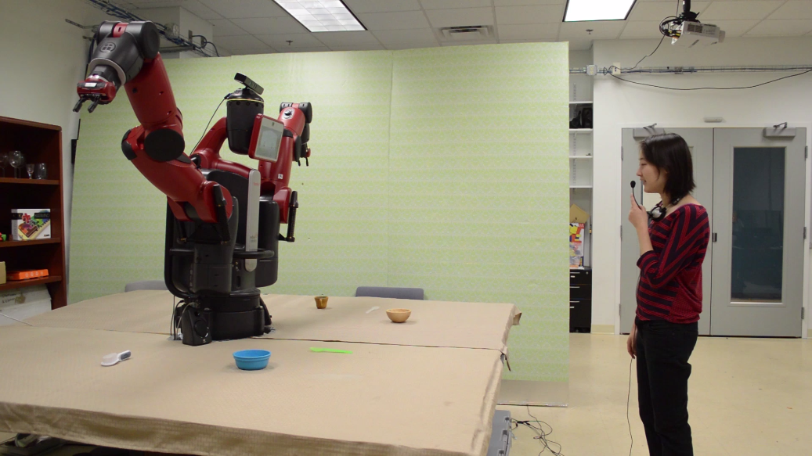
Notes:
Failures:
Small sample size
Task too simple---people fully specified
Many failures are technological---speech rec.

Slide 22
Notes:
Failures:
Small sample size
Task too simple---people fully specified
Many failures are technological---speech rec.

Slide 23
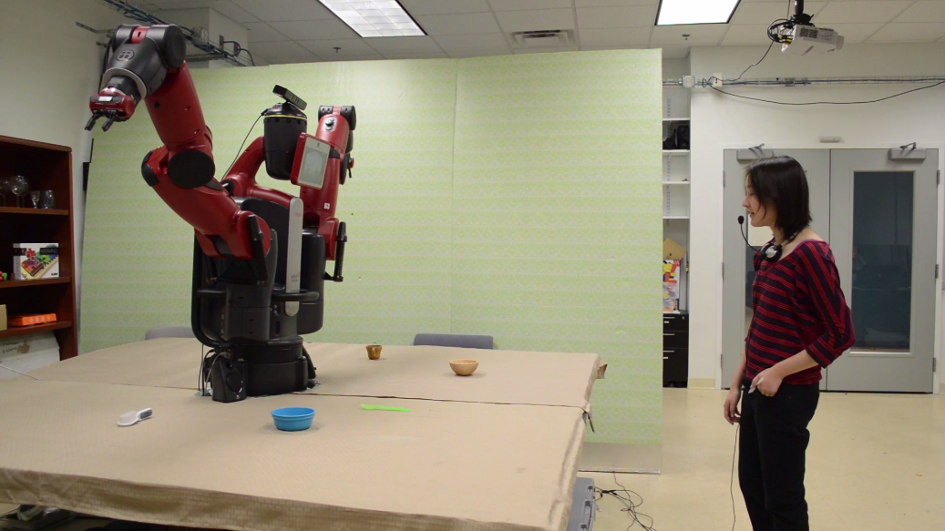
Notes:
Failures:
Small sample size
Task too simple---people fully specified
Many failures are technological---speech rec.

Slide 24
Notes:
Failures:
Small sample size
Task too simple---people fully specified
Many failures are technological---speech rec.

Slide 25
Future Work
Implementing human-state monitoring
Expanding to more sophisticated speech and gesture model
Incremental interpretation and response
More generalizable social feedback
Evaluation on more complicated domains

Slide 26

Contributions
Human-robot Collaborative POMDP for producing social feedback
Robotic demonstration of social feedback behaviors
Preliminary evaluation with human participants
Emily Wu, David Whitney, Horatio Han, John Oberlin, James MacGlashan, Stefanie Tellex

