Slide 1
Analysis of global natural resources
(1900–2024)

Slide 2
Foreword
Where is the limit? Do we understand the real rate of resource depletion given current consumption growth?
Who controls the market? How statistically significant is the gap between the leaders (the US, China, Russia)?
Where are the risk zones? Which regions will be the first to face energy collapse due to import dependence?

Slide 3
Data set selection
-Our World in Data (OWID)
- BP Energy Institute.

Slide 4
country
iso_code
region
year
resource
metric
value
unit
source

Slide 5
Information on the dataset
80,639 observations
11 columns

Slide 6
Resources and metrics
- Four resources are used: Oil, Gas, Coal, CO2.
- Metrics: Production, Consumption, Emission.
- By number of observations:
- Production — 47,406 rows (≈59%),
- Consumption — 28,083 rows (≈35%),
- Emissions — 5,150 rows (≈6%).
- The resource with the highest number of observations is Oil (26,214 rows), and the lowest is CO2 (5,150).

Slide 7
Geography and regions
- Data covers 217 countries, including regional aggregates.
- Major regions:
- Europe & Central Asia — 26,803 observations
- East Asia & Pacific — 13,875
- Latin America & Caribbean — 13,157
- Middle East & North Africa — 11,276
- Sub-Saharan Africa — 9,269
- South Asia — 3,797
- North America — 1,996

Slide 8
Time coverage
- Data by year: 1900–2024.
- This allows for long-term analysis of historical trends in consumption, production, and emissions.

Slide 9
Preliminary conclusions
1. The dataset is qualitative.
2. There are few CO2 observations — this should be taken into account when analyzing emissions.
3. Most of the data is concentrated in Europe, Asia, and Latin America; North America is less represented.

Slide 10
Analytical report on energy consumption data visualization

Slide 11
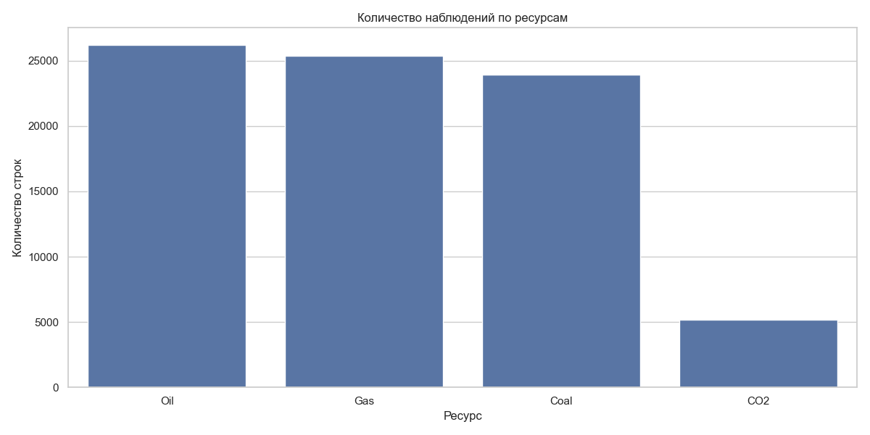
Exploratory data analysis (EDA)

Slide 12
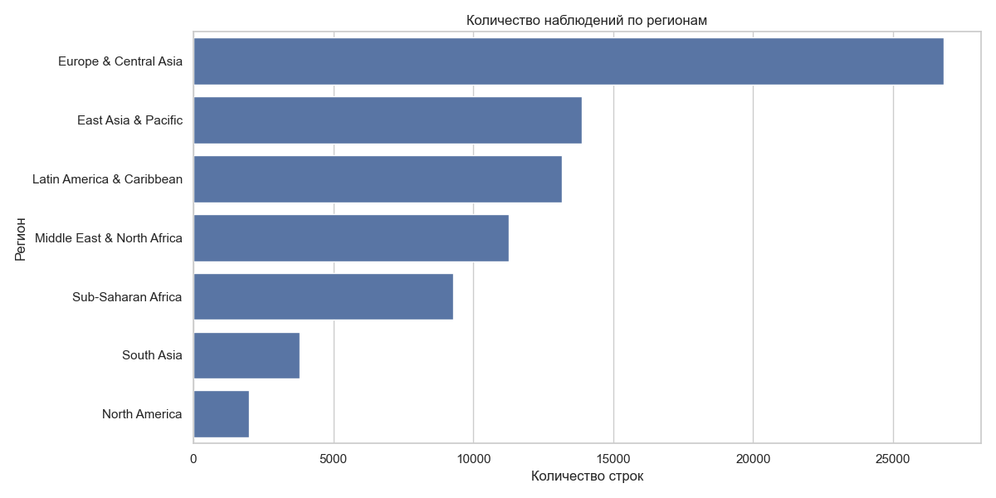
Geography

Slide 13
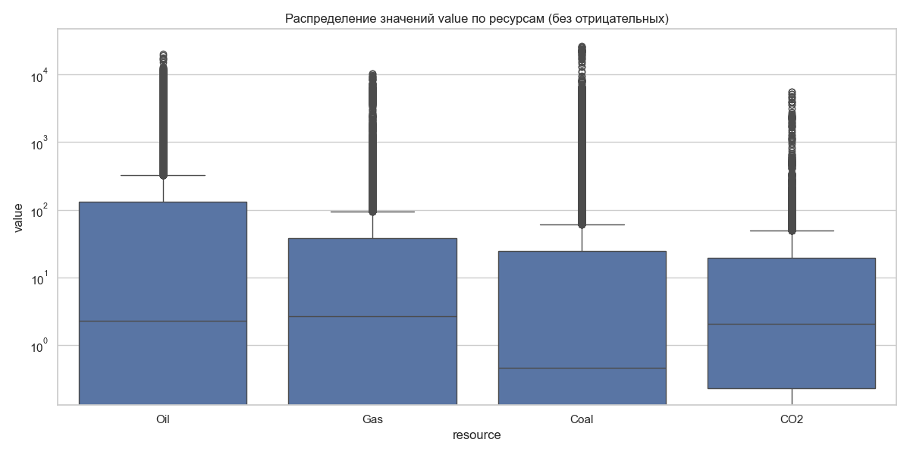
Value distribution analysis

Slide 14
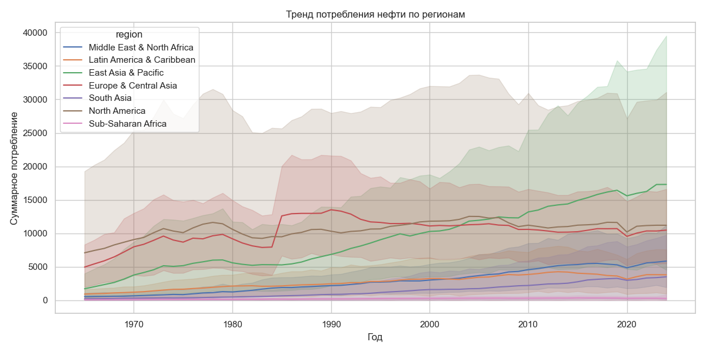
Historical trends: Oil consumption (1965–2024)

Slide 15
Report on testing statistical hypotheses in the energy sector

Slide 16
Regional differences
p-value = 0.000

Slide 17
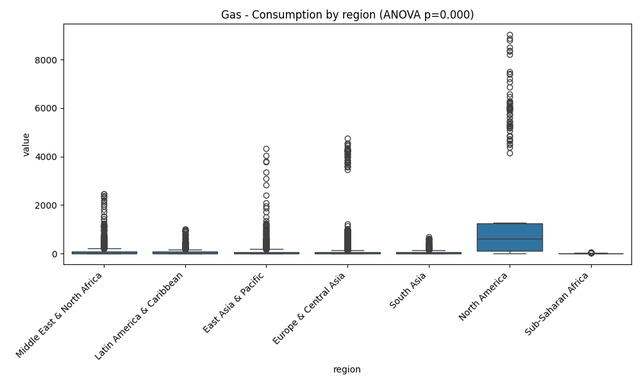
Gas Consumption

Slide 18
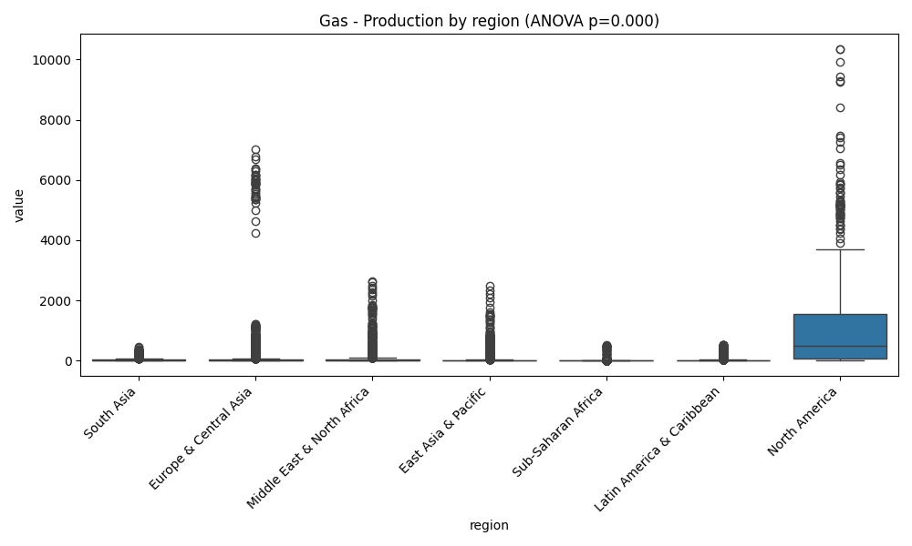
Gas production

Slide 19
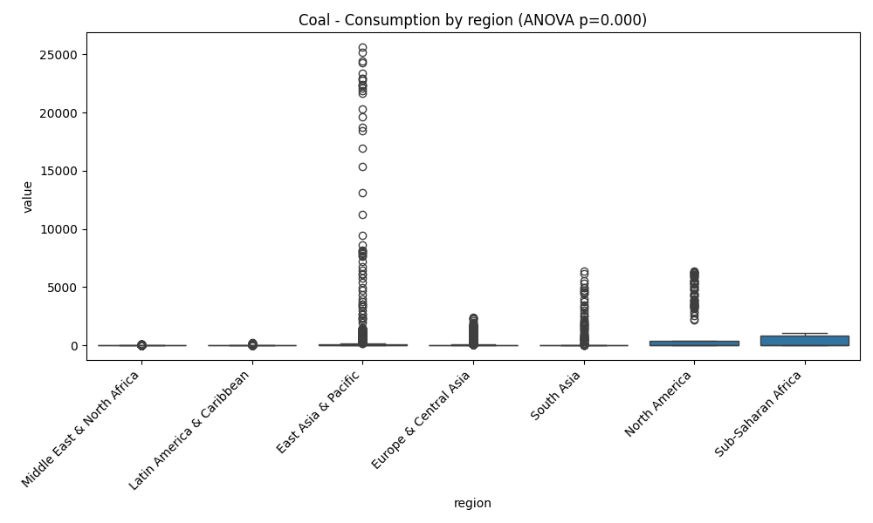
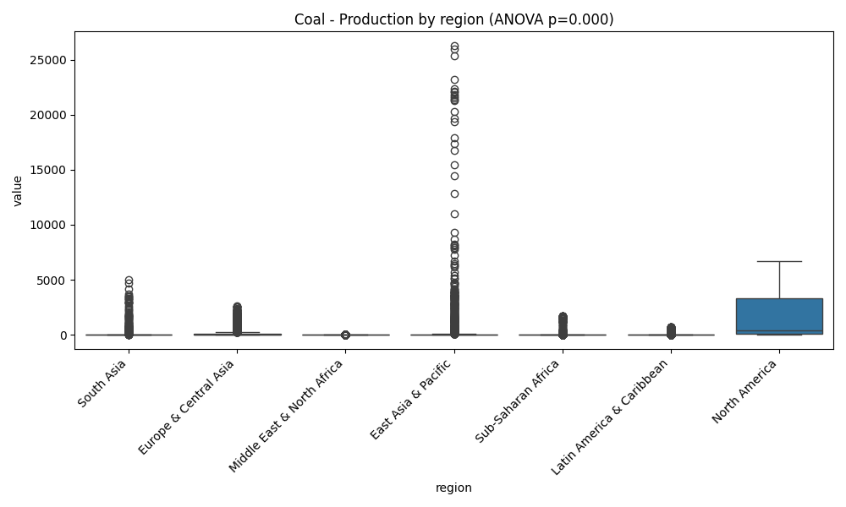
Coal

Slide 20
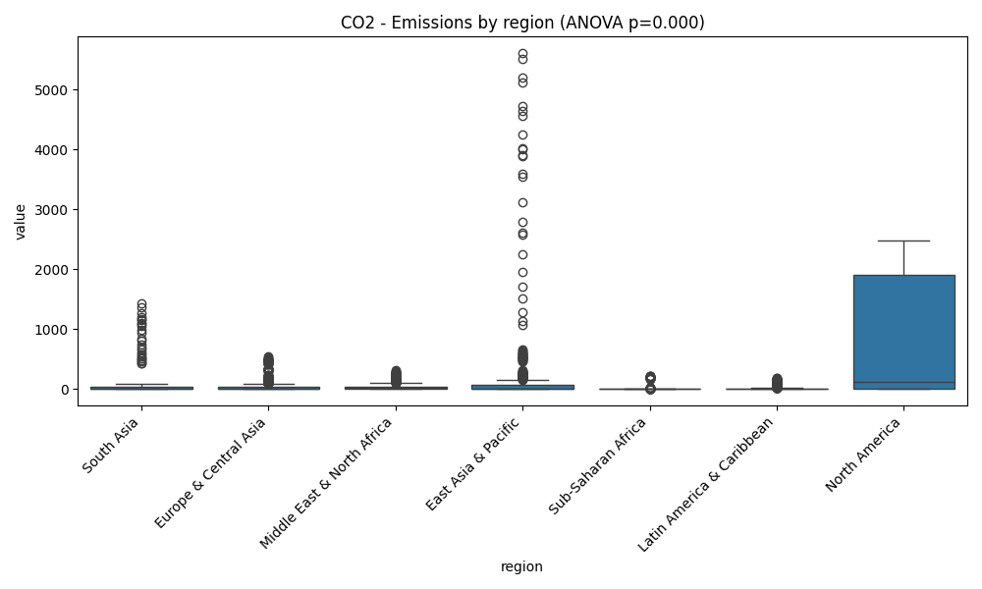
CO2 emissions

Slide 21
Comparison of market leaders (T-tests)

Slide 22
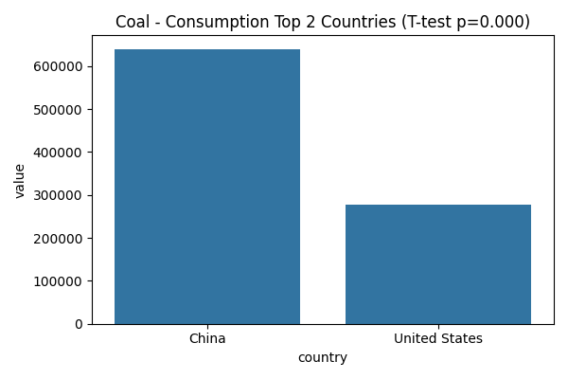
Coal industry (China vs USA)

Slide 23
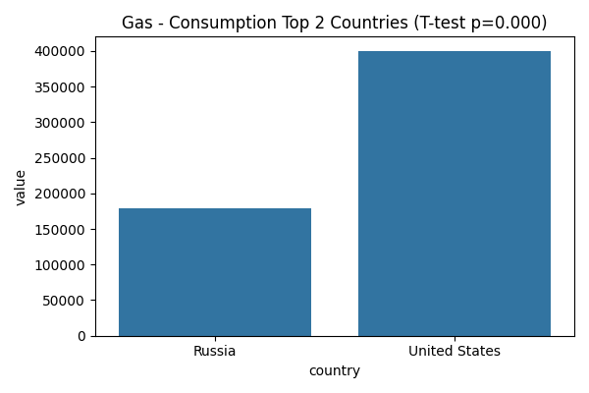
Gas industry (Russia vs USA)

Slide 24
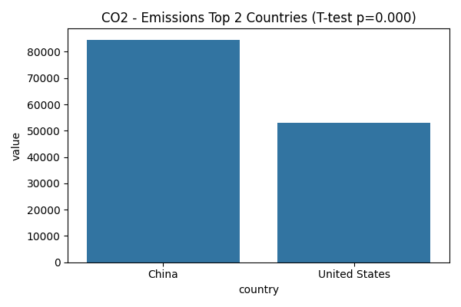
Emissions (China vs. USA)

Slide 25
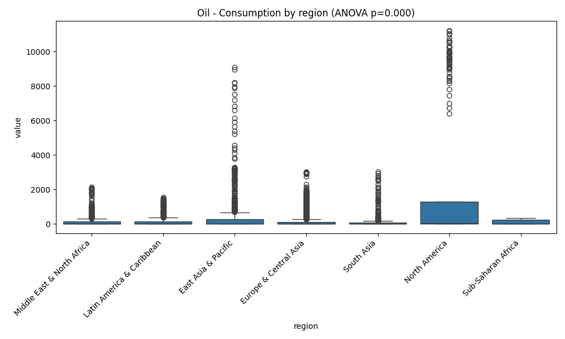
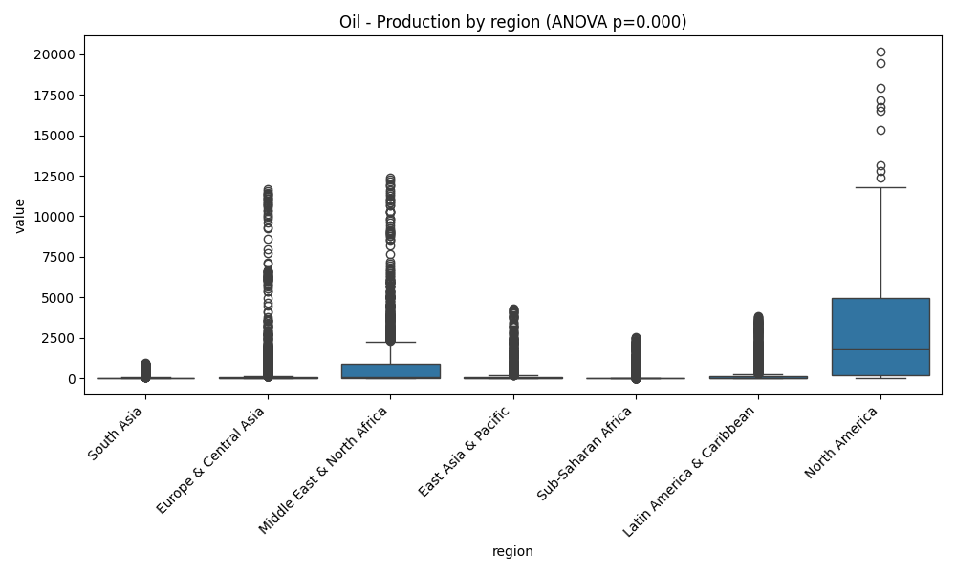
Oil industry

Slide 26
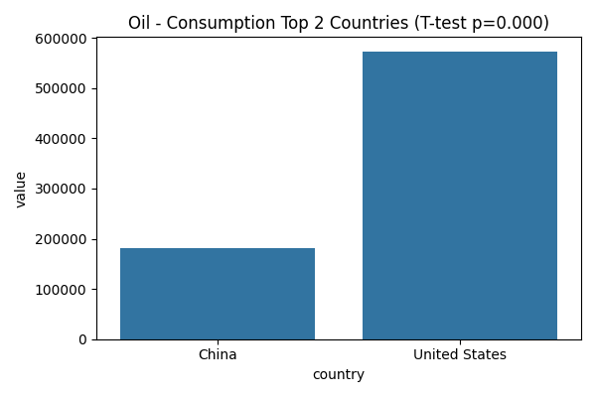
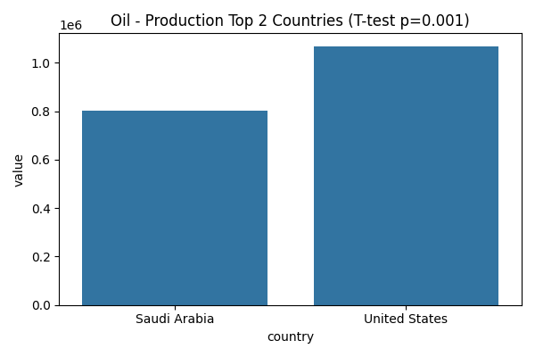
Comparison of leaders (T-tests)

Slide 27
Final conclusion on the hypotheses

Slide 28
Multivariate data analysis

Slide 29
Principal component analysis
Explained variance:
PC1 - Scale axis
PC2 - Structure axis
(PCA)

Slide 30
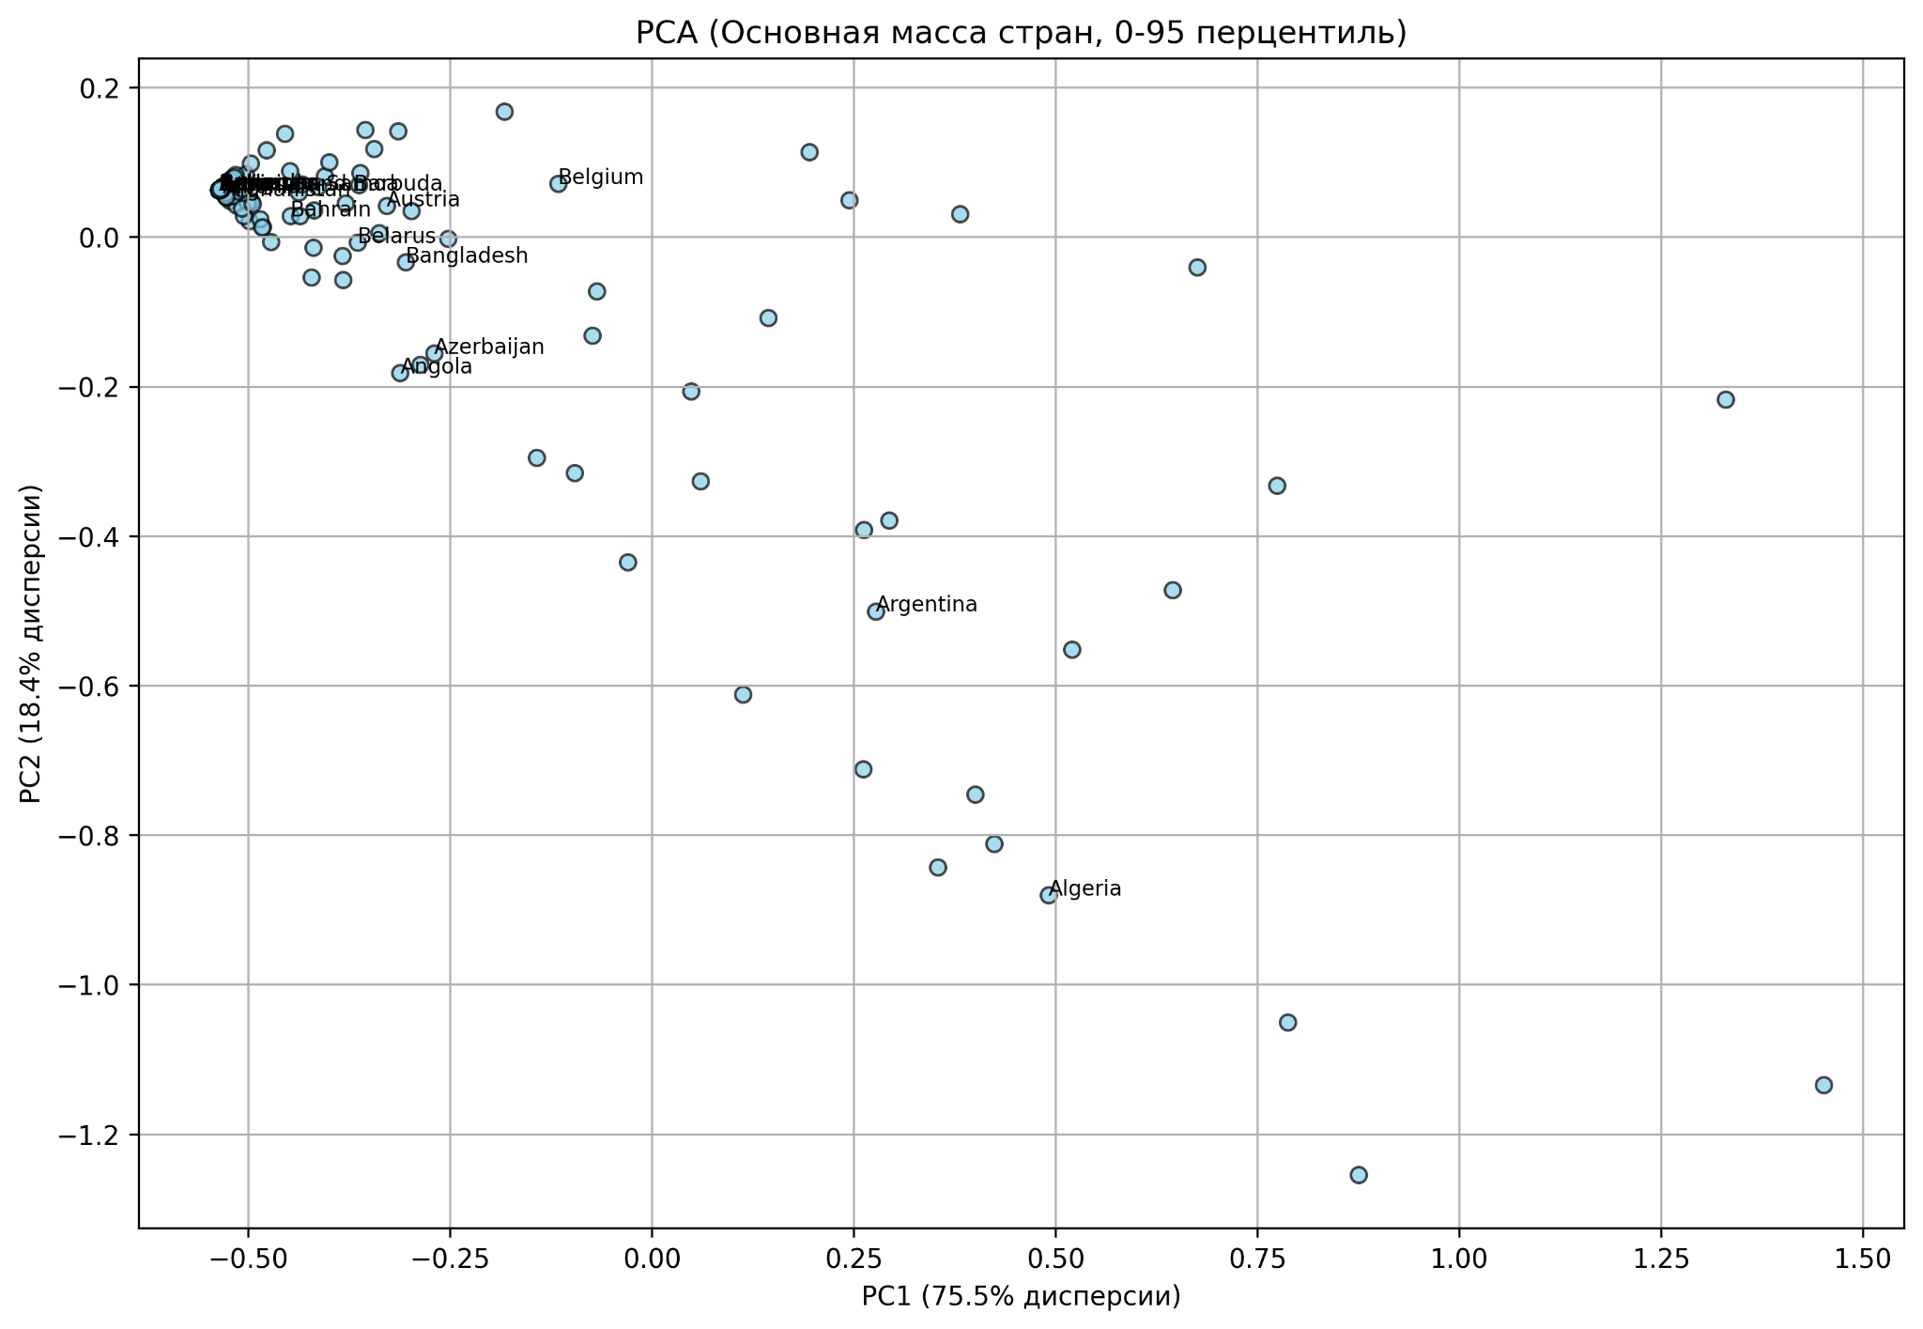
The majority of countries

Slide 31
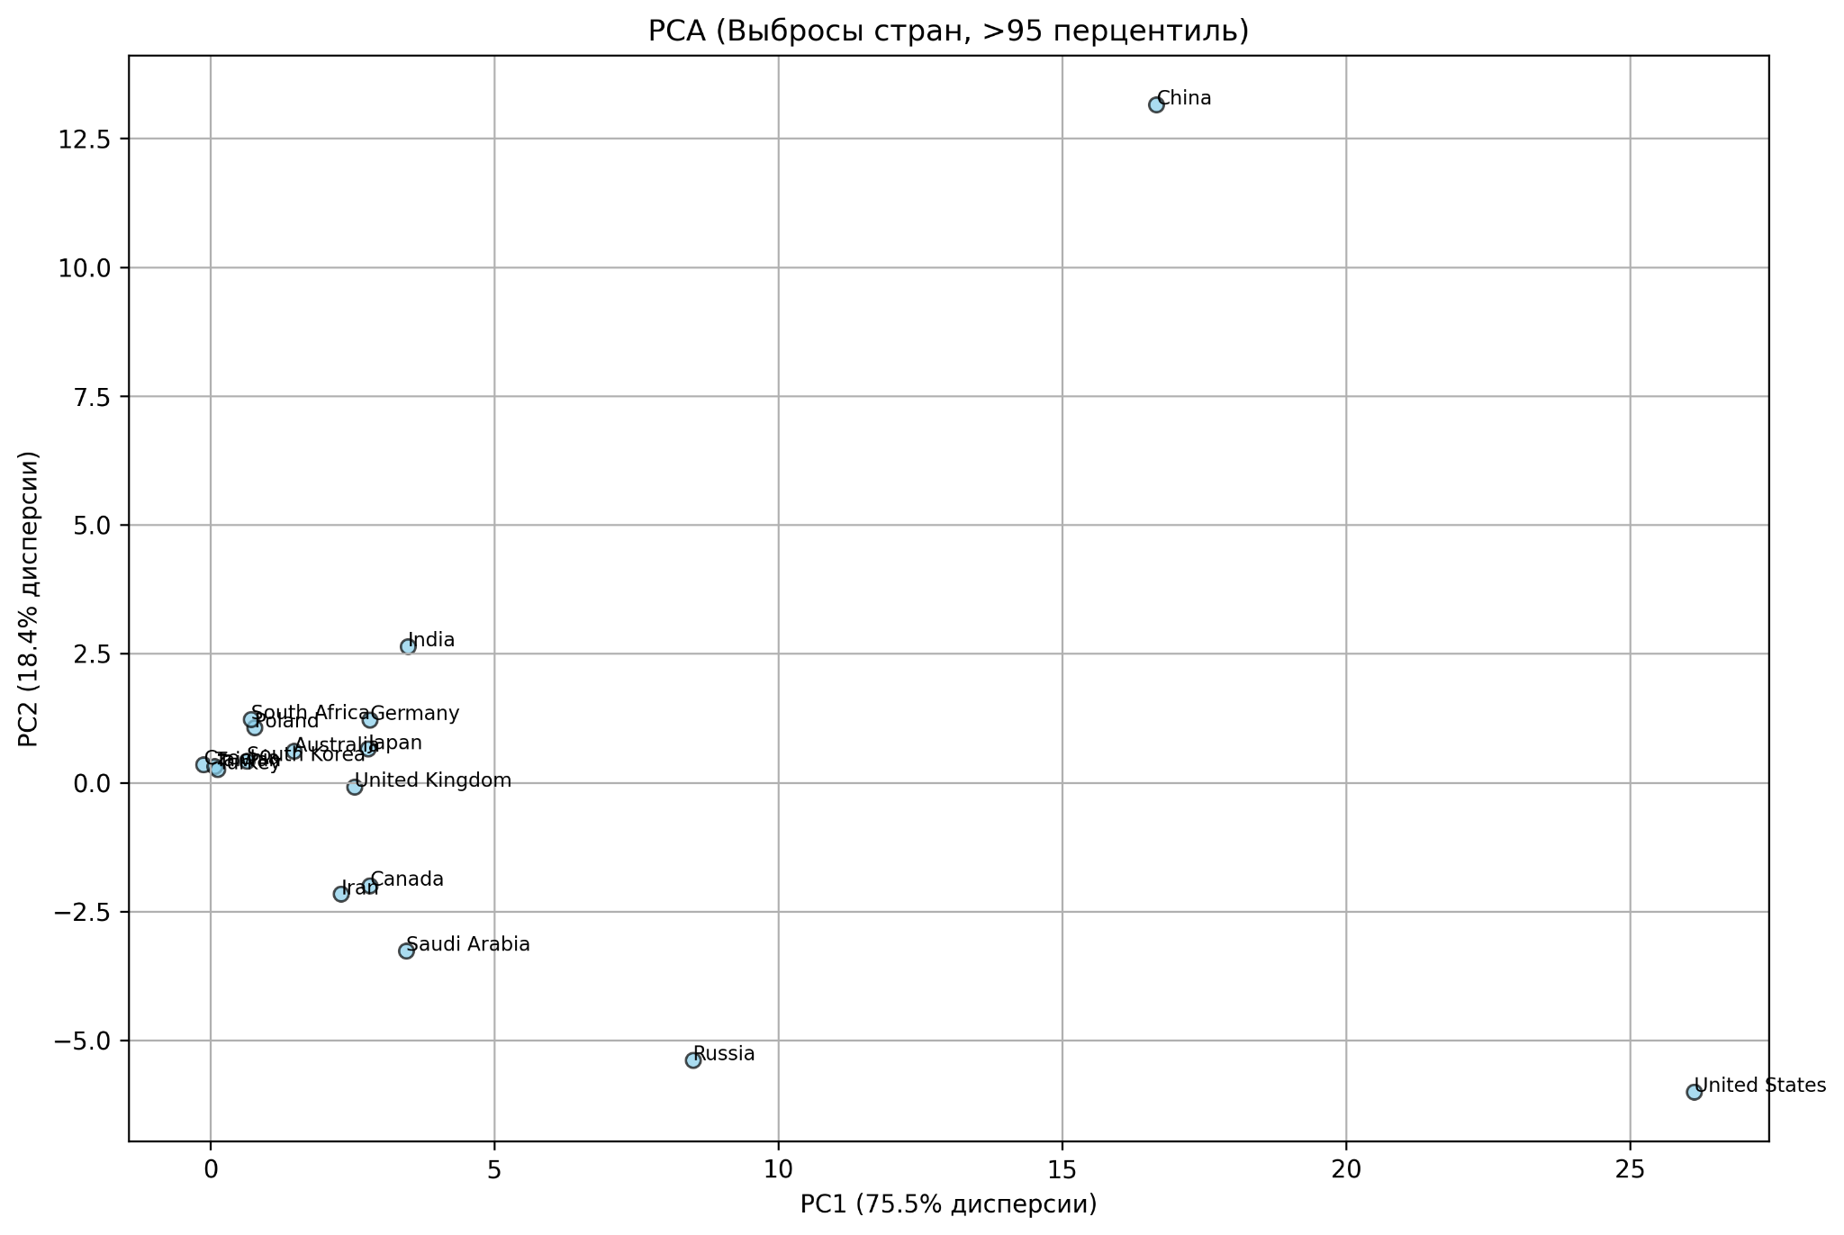
Outliners

Slide 32
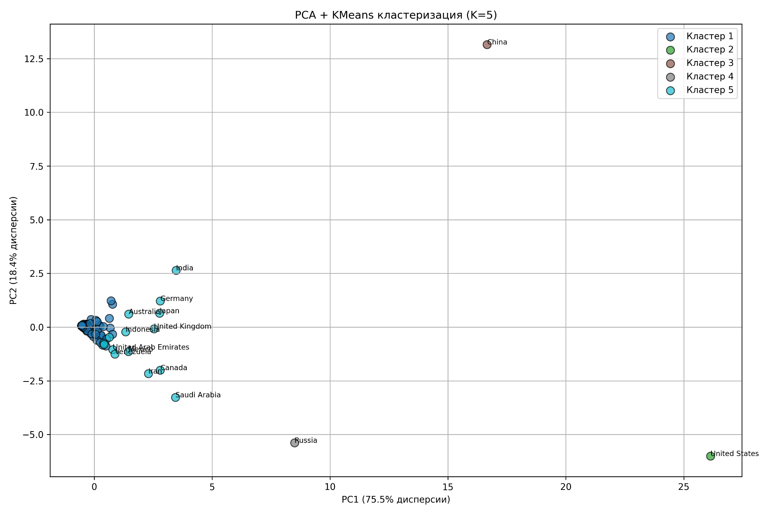
K-Means Clustering

Slide 33
Key findings of multidimensional analysis

Slide 34
Forecast of energy sustainability and depletion risks

Slide 35
Depletion Risk Index (DRI)
DRI = Consumption - Production

Slide 36
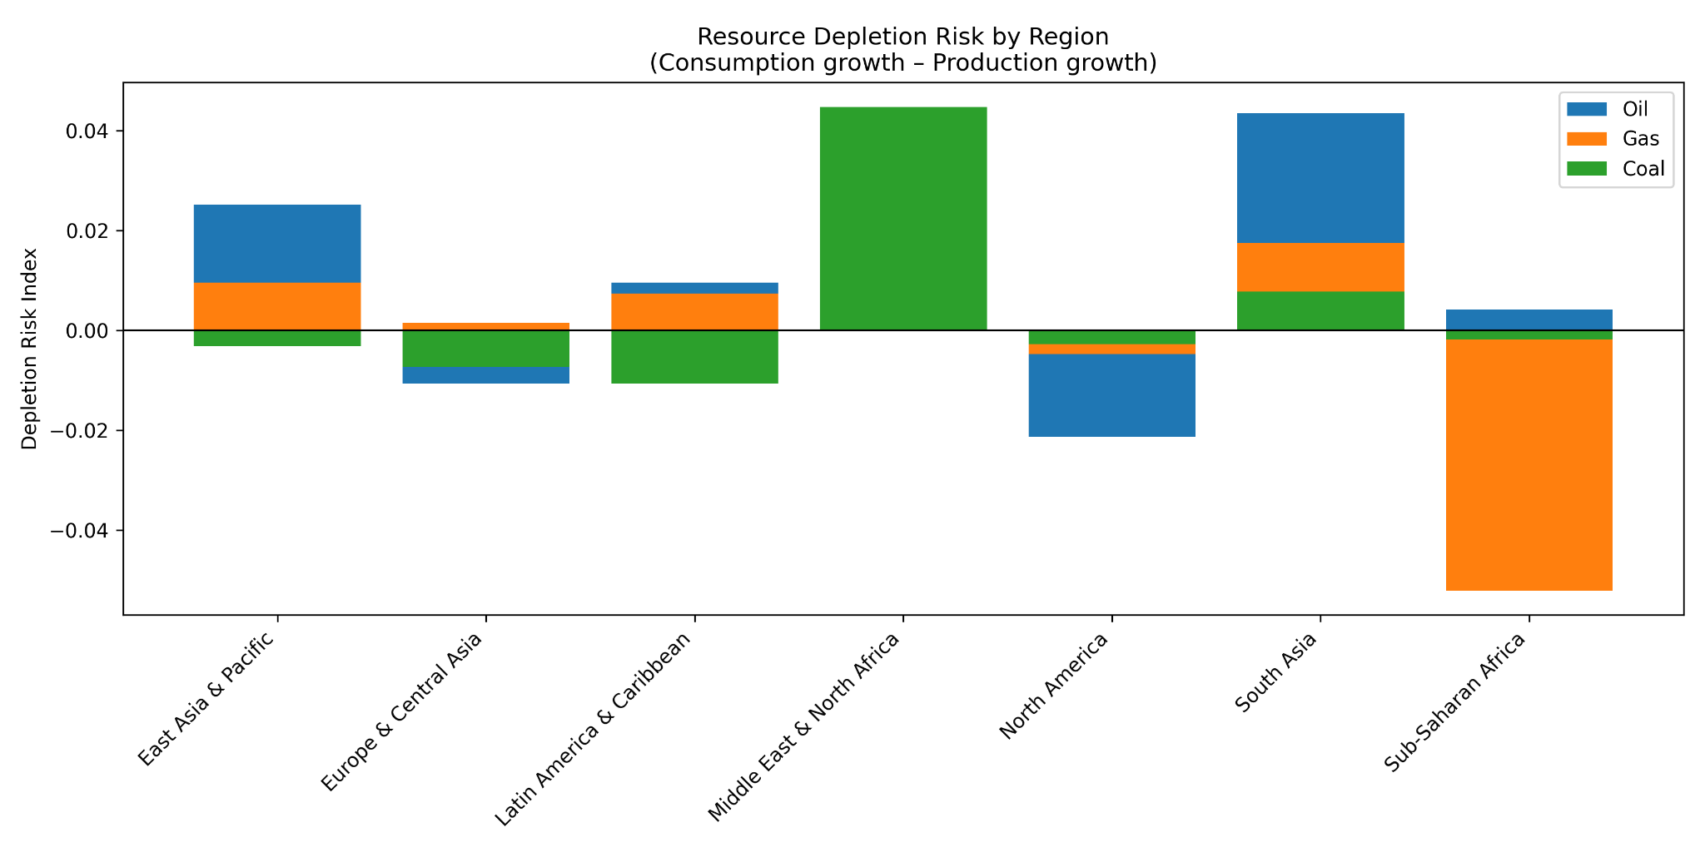
Regional risk analysis

