Slide 1
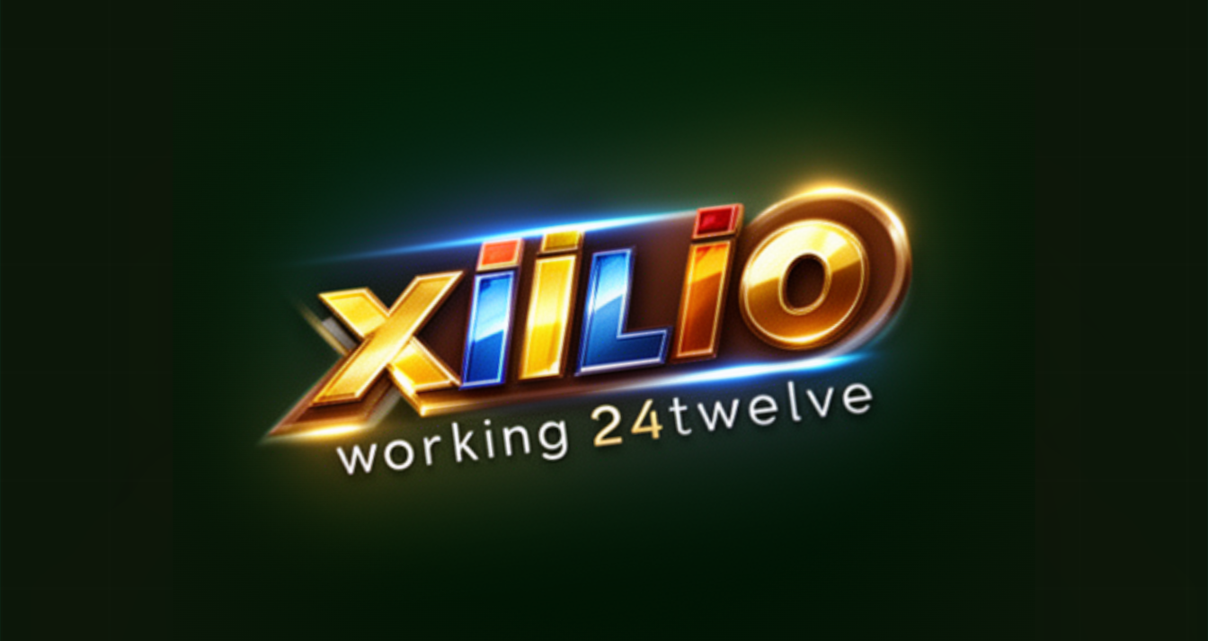

24/7
Autonomous AI operation
AES-256
CRM Security &
Encryption standard
Data Protection
UK + USA
UK & USA Compliance Guide · March 2026
letsgo@xillio.io
Compliance coverage

Slide 2





OVERVIEW
Executive Summary
Xiilio.ai is an AI-driven lead generation and autonomous growth platform operating 24/7. As a platform that processes sensitive customer and prospect data, robust security and data protection are foundational to sustainable growth and client trust.
End-to-End Encryption
Zero-Trust Access
AI Threat Detection
All data protected in transit and at rest with AES-256 & TLS 1.3
MFA, RBAC, and adaptive authentication across all accounts
Real-time anomaly monitoring and automated incident response
Dual-Market Compliance
Independent Assurance
Privacy by Design
Full UK GDPR/DPA 2018 and US CCPA/state law compliance
SOC 2 Type II, ISO 27001, Cyber Essentials, annual pen testing
Security built into architecture — not bolted on afterwards
XIILIO.AI · CRM Security & Data Protection · Confidential · 2026
letsgo@xillio.io

Slide 3



ABOUT
Xiilio.ai & the CRM Ecosystem
What Xiilio.ai Does
24/7 Autonomous
Xiilio.ai combines AI agents, performance marketing, and intelligent CRM connectivity to deliver a continuous pipeline of qualified leads — autonomously, around the clock.
AI agents operate around the clock with no human intervention required
CRM Integration
Data Processed Daily:
Seamless, scoped connection to leading CRM platforms with data minimisation controls
Prospect & lead contact data
Behavioural & engagement data
CRM records (Salesforce, HubSpot, Pipedrive)
Third-party enriched data
Client business & sales strategy information
Targeted Outreach
AI analyses thousands of prospects per minute, delivering precision-targeted campaigns
XIILIO.AI · CRM Security & Data Protection · Confidential · 2026
letsgo@xillio.io

Slide 4
SECURITY ARCHITECTURE
Encryption & Access Control
TLS 1.3
AES-256
E2E Pipelines
Key Rotation
Transport
At Rest
AI Workflows
Management
All data in transit encrypted with TLS 1.3. Older protocol versions disabled.
All stored data encrypted to financial/government-grade AES-256 standard.
AI agent sequences operate within encrypted channels end-to-end.
Keys stored separately from data, rotated on defined schedules.
Access Control Architecture
Multi-Factor Auth
Role-Based Access
Adaptive Auth
Session Controls
MFA required for all accounts. Hardware security keys for privileged users.
Least-privilege RBAC enforced. Each role accesses only what the job requires.
AI assesses login risk by device, location, time & behaviour — adds steps when needed.
Time-limited sessions, auto-expiry on inactivity, concurrent session prevention.
XIILIO.AI · CRM Security & Data Protection · Confidential · 2026
letsgo@xillio.io

Slide 5

SECURITY ARCHITECTURE
AI-Powered Threat Detection & DLP
Threat Detection Capabilities
Data Loss Prevention
Real-Time Anomaly Detection
Admins define sensitivity classification rules to prevent unauthorised data export
AI monitors all data movement in real time
Export and download activity logged with full audit trails
AI agents access only the CRM fields required for each specific task
Suppression lists enforced automatically across all outreach campaigns
AI monitors user behaviour, API calls & access logs continuously. Suspicious activity triggers automated alerts.
Fraud Prevention
Transaction patterns and login sequences are analysed to detect and block fraudulent activity instantly.
Prompt Injection Protection
Specific controls prevent malicious inputs from hijacking AI agents to exfiltrate data.
Supply-Chain Security
All third-party integrations are assessed; contractual data-handling requirements enforced on every partner.
Automated Incident Response
Confirmed threats trigger automatic isolation, credential revocation & security team alerts within seconds.
XIILIO.AI · CRM Security & Data Protection · Confidential · 2026
letsgo@xillio.io

Slide 6
UK COMPLIANCE
United Kingdom: UK GDPR & DPA 2018
Regulated by the Information Commissioner's Office (ICO)
Lawful Basis
Data Minimisation
Legitimate interest for B2B prospecting; consent available where required. Documented per activity.
AI agents collect only the personal data necessary for the specific task at hand.
Purpose Limitation
Storage Limitation
Data not repurposed without appropriate disclosure and, where necessary, fresh consent.
Automated retention policies ensure data is held only as long as operationally necessary.
Data Subject Rights
DPIA Requirement
Access, rectification, erasure, portability & objection — exercisable via self-service portal.
Data Protection Impact Assessments conducted for all high-risk AI processing activities.
International Transfers
ICO Registration
UK IDTAs or adequacy decisions govern all transfers of UK personal data outside the UK.
Xiilio.ai maintains appropriate ICO registration as controller and/or processor.
XIILIO.AI · CRM Security & Data Protection · Confidential · 2026
letsgo@xillio.io

Slide 7
USA COMPLIANCE
United States: CCPA & State Privacy Laws
A patchwork of state laws plus sector-specific federal regulations
CCPA / CPRA Rights
Opt-Out Mechanisms
Consumers may know, opt-out & delete. Xiilio.ai never sells personal data without disclosure.
Where AI processes customer PII, opt-out rights are clearly disclosed and technically enforced.
Privacy Notices
Expanding State Laws
Clear, plain-language notices explain all data collection and AI-driven processing practices.
Ongoing monitoring of VA, CO, CT, TX and other state privacy laws as they come into force.
CAN-SPAM / TCPA
Sector-Specific Rules
All AI outreach configured with required opt-out links; suppression lists enforced automatically.
Additional HIPAA or GLBA controls available for healthcare and financial services clients.
FTC AI Guidance
Federal Privacy Watch
Fairness, transparency and explainability principles applied to all AI lead scoring models.
Xiilio.ai monitors emerging federal privacy legislation to adapt proactively ahead of enactment.
XIILIO.AI · CRM Security & Data Protection · Confidential · 2026
letsgo@xillio.io

Slide 8
COMPLIANCE
UK vs USA: Side-by-Side Comparison
Requirement | UK (UK GDPR / DPA 2018) | USA (CCPA / State Laws)
Lawful Basis | Legitimate interest, consent, or contract | Business purpose; sector consent where required
Individual Rights | Access, rectify, erase, port, object | Right to know, delete, opt out of sale
Data Transfers | UK IDTA or adequacy decision required | SCCs for EU; state laws evolving
Breach Notification | ICO within 72 hrs; individuals without undue delay | State AG: 30–90 days; sector rules apply
AI Processing | DPIA required; AI Act alignment considered | FTC guidance on fairness; sector rules emerging
Data Retention | Defined schedule; automated deletion enforced | Purpose-limited; deletion within 45–90 days
XIILIO.AI · CRM Security & Data Protection · Confidential · 2026
letsgo@xillio.io

Slide 9


GOVERNANCE
Data Governance & Privacy by Design
Privacy by Design
Consent & Transparency
Privacy impact review before every deployment
Data minimisation enforced at architecture level
Most privacy-protective defaults configured by default
Consent withdrawal technically enforced
AI explainability traces every prediction
Plain-language processing notices for all individuals
Audit Trails
Vendor Management
Tamper-evident logs of all data access & changes
Retained per UK and USA regulatory minimums
Exportable for compliance investigations
Pre-engagement security assessments mandatory
Data processing agreements per GDPR Art. 28
Regular compliance review of all sub-processors
XIILIO.AI · CRM Security & Data Protection · Confidential · 2026
letsgo@xillio.io

Slide 10
INCIDENT RESPONSE
Incident Response & Business Continuity
01
Detect
02
Contain
03
Notify
04
Recover
AI monitoring flags anomaly instantly. Incident classified by severity.
Automated isolation of affected systems. Compromised credentials revoked.
Clients, regulators (ICO / State AGs) and individuals notified within required timelines.
Tested BCP & DR plans invoked. RTO / RPO targets met. Full post-incident review.
Regulatory Notification Timelines
UK ICO
UK Individuals
US State AGs
Clients
72 hours
No undue delay
30–90 days
Immediately
After becoming aware of breach
If high risk to rights & freedoms
Varies by state and sector
Ahead of or alongside regulatory notice
XIILIO.AI · CRM Security & Data Protection · Confidential · 2026
letsgo@xillio.io

Slide 11
ASSURANCE
Security Certifications & Independent Assurance
SOC 2 Type II
ISO 27001
Penetration Testing
Annual independent assessment of security, availability, integrity, confidentiality & privacy controls.
Systematic, risk-based approach to protecting all information assets via certified ISMS.
Regular third-party pen tests simulate real-world attack scenarios to identify and remediate vulnerabilities.
GDPR Readiness
Cyber Essentials (UK)
Annual UK GDPR compliance assessment covering DPIAs, data flows, and sub-processor agreements.
UK Government certification confirming fundamental cyber hygiene controls are in place and verified.
XIILIO.AI · CRM Security & Data Protection · Confidential · 2026
letsgo@xillio.io

Slide 12
CLIENT GUIDE
Shared Responsibility Model
Xiilio.ai Secures
Client Configures
Platform infrastructure & AI agent pipelines
End-to-end encryption in transit and at rest
Zero-trust authentication architecture
Real-time AI threat monitoring & DLP
Regulatory compliance framework
Security certifications & audits
Incident detection & response
Maintain accurate user account records
Enforce MFA for all staff accounts
Review RBAC configurations regularly
Keep privacy notices up to date
Conduct DPIAs for high-risk activities
Maintain Article 30 processing register
Train staff on social engineering threats
XIILIO.AI · CRM Security & Data Protection · Confidential · 2026
letsgo@xillio.io

Slide 13

Security. Compliance. Trust.
Xiilio.ai's security framework is built for the most rigorous data protection environments in the world — the United Kingdom and the United States. Because the next top performer isn't just capable. It's trustworthy.
Get in touch:
letsgo@xillio.io
xiilio.ai · © 2026 · Confidential

