Slide 1

Programming Data Science
NextBike in Dortmund
SS 2020

Slide 2
Team Members
Emre Yildiz
Erkin Altuntas
Mostapha Ahaduch
Marco Kurka

Slide 3
Table of contents
Data Preparation
Feature Engineering
Data Visualization
Statistics
Maps
Prediction and Results
Trip duration
Trip direction
Evaluation on test data
Conclusion

Slide 4
Data Preparation

Slide 5

Trip Creation
Trip type as a column
Values are „first“, „last“, „start“ and „end“
Rows with trip type „first“ and „last“ are dropped
unlikely long trip duration
start and end positions are most times the same
A trip consists of two consecutive rows
„start“ and „end“ as the trip type

Slide 6
Feature Engineering
Feature | Description
tripDuration | Duration of a trip
tripLabel | Direction of a trip (with regards to the university)
temperature | Weather at the start of a trip
precipitation (boolean) | Rain (yes/no) at the start of a trip
precipitation (in mm) | Rain (in mm) at the start of a trip
distanceToUniversity | Distance of the start position to the university
distanceToCentralStation | Distance of the start position to the central station
area_start | Cluster/Localization of the start position (with KMeans++)
weekday | 0 = Monday, …, 4 = Friday, etc.
weekend | 0 for weekdays, 1 for weekday
dayOfYear | Index of a day (1 to 365)
minute, hour, day, month | Minute, hour, day, month at start of a trip

Slide 7
Data visualization

Slide 8
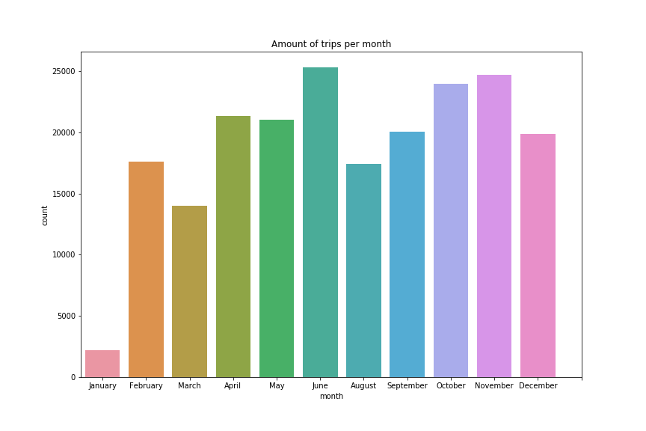
Amount of trips per month
Most trips in Spring and Fall
July missing for testdata
Low amount of trips in January
Data for January only partly usable

Slide 9
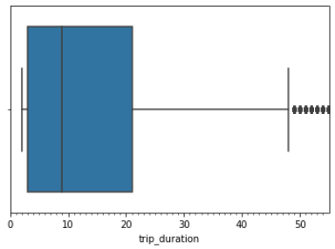
Trip duration – Outlier detection
Outliers are trips with a duration of more than 48 minutes
Dropping outliers makes a significant difference
Mean Drop
Std. Drop
We continued with the full dataset
Data with outliers
Data without outliers
Count | 179877.000000
Mean | 10.510465
Std | 9.854895
Min | 2.000000
25% | 3.000000
50% | 7.000000
75% | 14.000000
Max | 48.000000
Count | 207476.000000
Mean | 33.376010
Std | 83.413993
Min | 2.000000
25% | 3.000000
50% | 9.000000
75% | 21.000000
Max | 1399.000000

Slide 10
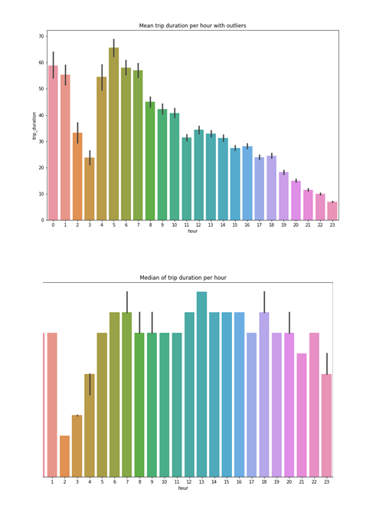
Trip duration per hour
Mean:
Shorter trips the later it gets
No trips over night
Median:
1AM peak
“Day-Trips”
Steady over the day
Short trips in the day

Slide 11
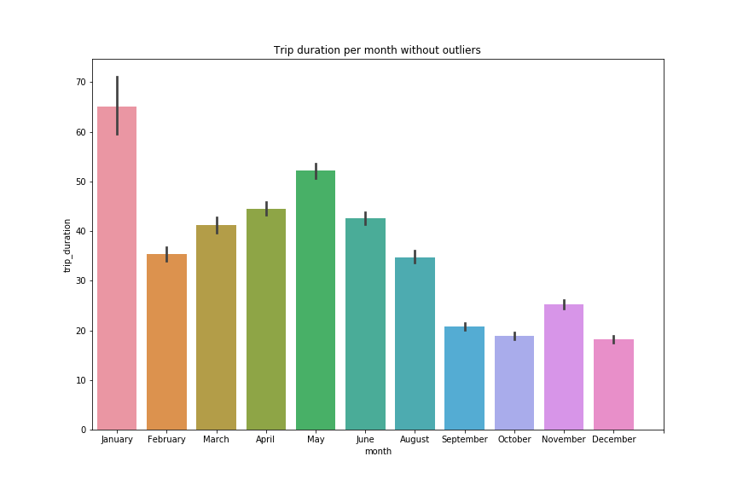
Trip duration per month
Peak in January
Low amount of data
Increasing towards summer
Decreasing from May
Average of ~ 30 minutes

Slide 12
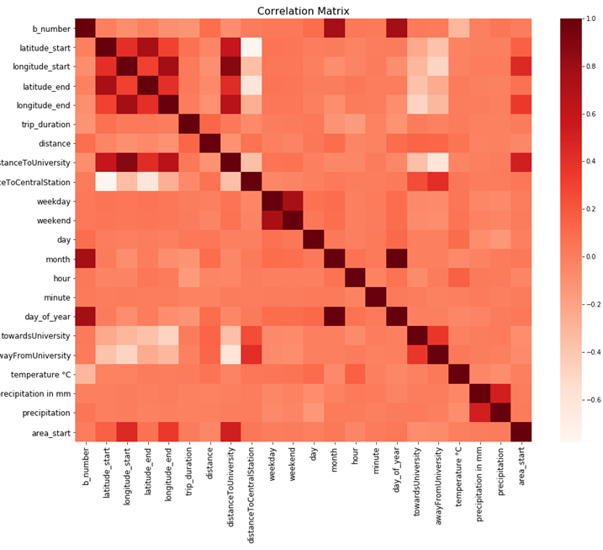
Correlation Matrix
Almost no correlations with trip duration
towardsUniversity and awayFromUniversity have some correlations
Better results for prediction expected

Slide 13
Demand per station
Red circle = station
The size of a station represents its demand
Bigger circle → more demand
Click on stations to get information
Station in the center have a higher demand than in the periphery

Slide 14
Bikes per station
Visualized for one moment in time
31/12/2019, 11’0 clock
Center has a slightly higher amount of bikes
The difference between center and periphery is not as high as the differences in the demand
Number of bikes has to be considered relatively
Center has higher capacity, but also higher demand

Slide 15
Demand per area (June)
Many areas without stations
Brown areas
The more centered an area, the more demand
44227 has a high demand although it is at the edge
This area covers parts of the center aswell as the university

Slide 16
Daily demand
Daily progress between four time periods
5 to 9, 10 to 15, 16 to 20, 21 to 4
Center has a high demand at all time periods
From 10 to 15 there is also a high demand at the university
Decreases slightly in the next periods

Slide 17
prediction

Slide 18
Prediction of trip duration
Target value: trip_duration
Only using start-information of a trip
Date/Time | Weather | Position
Month | Temperature in °C | Latitude_start
Weekday | Precipitation (0/1) | Longitude_start
Day_of_year/day |  | Area_start
Hour |  | DistanceToUniversity
Minute |  | DistanceToCentralStation

Slide 19
Process of Prediction Models
Linear Models
Linear Regression, Ridge, Lasso
Low complexity
Polynomial Regression
Higher complexity through higher degrees
Much better results
Support Vector Regression
Bad performance and hard to optimize the hyperparameters
Random Forest Regressor
This is chosen because of the results on the metric R2, RMSE and MAE

Slide 20
Model performance
Training Data
Why do we get worse result on test data?
Random Forest is overfitted
July is unknown for Random Forest
Random Forest uses several Decision Trees to predict the target value
It is an issue if the Random Forest gets values on the test data that were not used within the training data
in this case: the whole data for July
If the training and test data would contain trips that are distributed over the whole year the result could be better
In retrospect it would have been better if a Polynomial Regression were used
R2 | 0.20
RMSE | 74.35
MAE | 32.00
Test Data
R2 | -0.14
RMSE | 89.58
MAE | 53.11

Slide 21
Prediction of trip direction
Model that predicts the feature tripLabel
indicates whether a trip was made towards/away from University or in a complete other direction
Similar procedure as the first prediction
Only start-information
approached multiple models with different features
LogisticRegression, SVM, Random Forest Classifier
Due to performance and execution-time reasons, a Random Forest Classifier was chosen with following attributes:
Date/Time | Position
Month | Area_start
Hour | DistanceToUniversity

Slide 22
Model performance
On Training Data
On Test Data
 | precision | recall | f1-score | support
awayFromUniversity | 0.70 | 0.86 | 0.77 | 3142
noUniversityRide | 0.95 | 1.00 | 0.97 | 53964
towardsUniversity | 0.69 | 0.26 | 0.37 | 5137
accuracy |  |  | 0.93 | 62243
macro avg | 0.78 | 0.70 | 0.71 | 62243
weighted avg | 0.92 | 0.93 | 0.91 | 62243
 | precision | recall | f1-score | support
awayFromUniversity | 0.58 | 0.78 | 0.67 | 1391
noUniversityRide | 0.95 | 1.00 | 0.97 | 25378
towardsUniversity | 0.54 | 0.15 | 0.23 | 2469
accuracy |  |  | 0.92 | 29238
macro avg | 0.69 | 0.64 | 0.62 | 29238
weighted avg | 0.90 | 0.92 | 0.90 | 29238
noUniversityRide dominated the dataset
awayFromUniversity easy to predict
When start position is at the university
Underpopulated label towardsUniversity is difficult to predict
Precision, recall and f1-score decreased by about 10% for awayFrom- and towards-University
Macro avg. F1 decreased by 10%
Random Forest is vulnerable for a whole missing value in an attribute which is the basis of the test afterwards

Slide 23
Conclusion
Provided insight into trips of NextBike in Dortmund
Developed a prediction model for the trip duration
Performance of Trip Duration model is rather bad
RMSE: 89.58, MAE: 53.11
Limitations:
Random factors affect the trip duration
High deviations
Big influence of day trips
Almost no correlation with features
Missing trips from one day to the other of data make pattern recognition difficult
Random Forest has difficulties with missing month

Slide 24
Conclusion
Developed a solid prediction model for the trip direction
Performance of Trip Direction model is acceptable
Not affected by random factors
Clear patterns
No University dominates the trips
Macro Average f1: 0.62
Weighted Average f1: 0.9

Slide 25

Thanks for your attention!
Any questions or comments?

