Slide 1

More in depth research
A summary

Slide 2
On the Performance of One-Stage and Two-Stage Object Detectors
We evaluate several one-stage (RetinaNet, FCOS, and YOLOv3) and two-stage (Faster R-CNN) deep learning meta-architectures under different image resolutions and feature extractors (ResNet, ResNeXt, Res2Net, DarkNet, and MobileNet).
These models are trained using transfer learning and compared in terms of both precision and efficiency, with special attention to the real-time requirements of this context.

Slide 3
On the Performance of One-Stage and Two-Stage Object Detectors
For the experimental study, we use the Waymo Open Dataset, which is the largest existing benchmark.
Despite the rising popularity of one-stage detectors, our findings show that two-stage detectors still provide the most robust performance.

Slide 4
On the Performance of One-Stage and Two-Stage Object Detectors
Faster R-CNN models outperform one-stage detectors in accuracy, being also more reliable in the detection of minority classes.
Faster R-CNN Res2Net-101 achieves the best speed/accuracy tradeoff but needs lower resolution images to reach real-time speed.
Furthermore, the anchor-free FCOS detector is a slightly faster alternative to RetinaNet, with similar precision and lower memory usage.

Slide 5
Two-Stage Detectors
Two-stage frameworks divide the detection process into the region proposal and the classification stage.
These models first propose several object candidates, known as regions of interest (RoI), using reference boxes (anchors).

Slide 6
Two-Stage Detectors
Later, Faster-RCNN proposed a scheme in which features are shared between both stages, achieving a significant efficiency improvement.

Slide 7
Two-Stage Detectors
Faster R-CNN has inspired many follow-up works that have tried to improve detection accuracy with different approaches, such as designing better backbones that can obtain richer representations.

Slide 8
Two-Stage Detectors
Other studies have enhanced the quality of detection by proposing modifications to the existing Faster R-CNN framework.
This architecture can achieve more reliable detections, but increases the required computation, hence being less convenient for real-time applications.

Slide 9
Two-Stage Detectors
I tested some famous codesourses from GitHub to see how the Faster R-CNN method works on the MOT17 Dataset:
https://colab.research.google.com/github/hardik0/Multi-Object-Tracking-Google-Colab/

Slide 10
One-Stage Detectors
On the other hand, one-stage detectors contain a single feed-forward fully convolutional network that directly provides the bounding boxes and the object classification.
The Single Shot MultiBox Detector (SSD) and YOLO (You Only Look Once) were among the first to propose a single unified architecture, without requiring a per-proposal computation.

Slide 11
One-Stage Detectors
However, the extreme foreground-background imbalance in the images prevented these one-stage models from achieving high accuracy.
RetinaNet tried to solve this problem by modifying the loss function used in the SSD architecture.
RetinaNet also uses FPN and proposes a novel focal loss function that down-weights the importance of easy samples in order to focus on difficult objects.

Slide 12
One-Stage Detectors
YOLO detectors are another anchor-based alternative that divides the image into regions and predict bounding boxes and probabilities for each region.
YOLO networks have proved to achieve faster inference rates than RetinaNet, although not being as accurate.

Slide 13
One-Stage Detectors
More recently, another popular approach has been to design anchor-free one-stage detectors that do not rely on pre-defined anchor boxes.
For instance, FCOS aims to simplify the object detection problem by using the center point of objects to define positives and then predicts the four distances that build the bounding box.

Slide 14
One-Stage Detectors
FCOS can outperform RetinaNet while being simpler and more flexible, eliminating the need for carefully designing anchor boxes for each problem.

Slide 15
One-Stage Detectors
https://colab.research.google.com/github/hardik0/Multi-Object-Tracking-Google-Colab/blob/main/YOLOv4-DeepSORT.ipynb
This script helped me tackle the One-Shot detectors on a video-based training approach

Slide 16
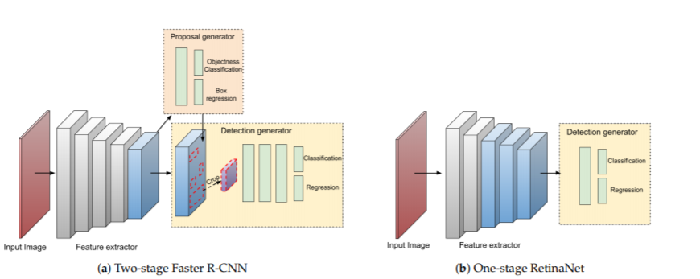

Slide 17
Object Detection in Autonomous Vehicles
In recent years, the interest in autonomous vehicles has risen.
Many datasets have been publicly released, which provides a unique opportunity for researchers to improve the state-of-the-art.
The focus is on maximizing accuracy, ignoring the computational efficiency of the proposals, which is extremely important in this context.

Slide 18
Object Detection in Autonomous Vehicles
Besides these challenges, there are several works that addressed detection tasks in the context of autonomous vehicles.
However, there is the need to find out general guidelines on which models are best suited for 2D on-board object detection, in which real-time speed is crucial.

Slide 19
Materials and Methods
In this section, I will present the Waymo dataset, and the methodology proposed for the experimental study.
I selected the recently released Waymo Open Dataset, which contains more than a thousand driving scenes recorded across different urban areas.
It is the most diverse dataset of this field up to date, in terms of both different locations and weather conditions.

Slide 20
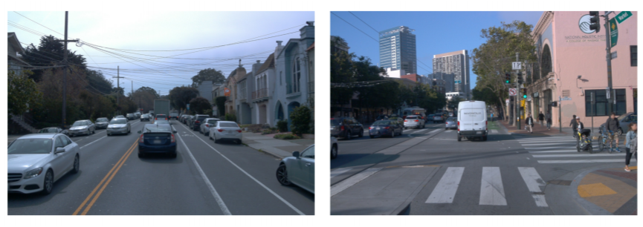

Slide 21
Materials and Methods
The 2D object detection task in this dataset is a multi-class problem with three different types of objects: vehicles, pedestrians, and cyclists.
The dataset contains around 100,000 images in total with almost one million manually annotated objects.
The number of pedestrians and cyclists is significantly lower than the number of vehicles.
As can be seen, the distribution of objects is highly imbalanced.

Slide 22
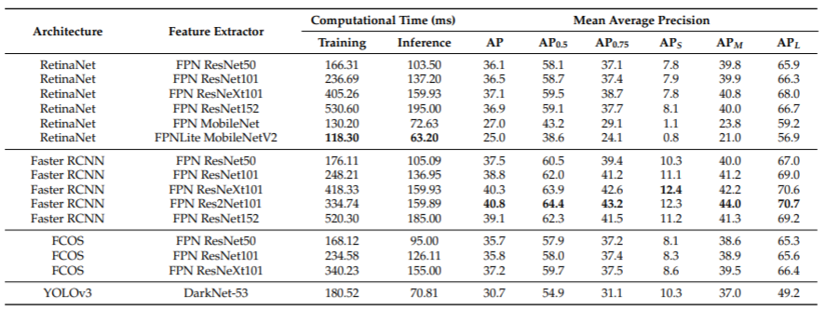
Results and Discussion

Slide 23
Evaluation Metrics
The metric used to evaluate the detection accuracy of the models in the images from the cameras of the autonomous vehicle is the Average Precision (AP).
AP is the most widely used performance metric in the object-detection literature.

Slide 24
Evaluation Metrics
We focus the discussion mainly on the inference speed since it is the most important aspect of this scenario.
We consider real-time speed to be 10 frames per second (FPS), given that the input video comes at 10 Hz in the Waymo data.

Slide 25
Evaluation Metrics
However, we also discuss the performance under harder requirements, given that video cameras traditionally record at 30 Hz.
Besides speed, we report other metrics such as memory usage, floating-point operations, and the number of parameters.
These factors allow comparing the models independently from the hardware used in the experiments.

Slide 26
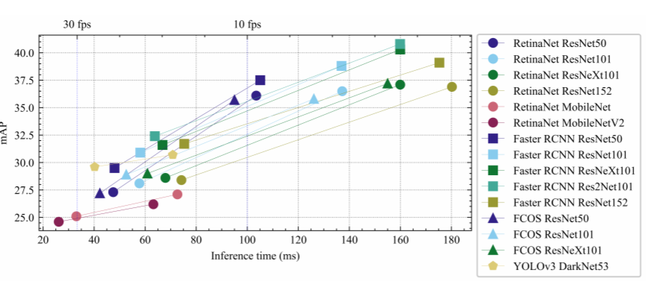

Slide 27
Results
Among all the studied models, the Faster R-CNN Res2Net-101 strikes the best balance between accuracy and speed but needs smaller images to reach real-time rates.
It achieves an AP of 32.4 and can process a low-resolution image in 74.20 ms (15.7 FPS).
The only models that achieve 30 FPS are the RetinaNet MobileNets with low resolution, which obtain around 25 AP points.

Slide 28
Results
However, YOLOv3 nearly reaches that speed (25 FPS) with a significant improvement in accuracy (29.6 AP).
It is also worth mentioning that the inference times in low-resolution models are more similar when comparing increasingly complex feature extractors.
As can be seen, the points at the left part of the plot are closer to each other, while the points at the right are sparser.

Slide 29
Results
This indicates that the impact on the speed of the feature extractor is more important as the size of the image increases.
Moreover, RetinaNet and FCOS seem to be less reliant on the selected feature extractor.
Another important aspect to consider is the difference in processing time between one-stage and two-stage meta-architectures.

Slide 30
Results
We cannot claim that RetinaNet and FCOS models using ResNet have significantly faster inference speed than Faster R-CNN models.
This fact is only true when considering the low-resolution images, and the difference is practically minimal.
The only one-stage alternative that is more efficient than Faster R-CNN is the YOLOv3 detector.

Slide 31
Results
The reason for the other one-stage detectors not being faster may lie in the fact that, in this study, we are using images that are considerably larger than those used in existing works.
It can be observed that increasing the image size reduces the differences between one-stage and two-stage meta-architectures, which present a very similar speed.
The extreme case is RetinaNet that provides the worst performance in terms of efficiency, reaching only 5 FPS.

Slide 32
Results
The competitive inference speed of Faster R-CNN is supported by the fact that the number of proposals provided by the RPN in the Faster R-CNN is fixed to 1000 and not a higher number.
Overall, these findings suggest that RetinaNet and FCOS with high-resolution images and ResNet backbones do not provide an advantage in this scenario and should be avoided by practitioners.

Slide 33
Other Useful Metrics
Besides the precision and time efficiency metrics, we have also studied other aspects that are important in this application.
In this section, we report the memory usage, the number of parameters, and the number of floating-point operations of all the studied models.
They provide useful information that is independent of the hardware employed in this study.

Slide 34
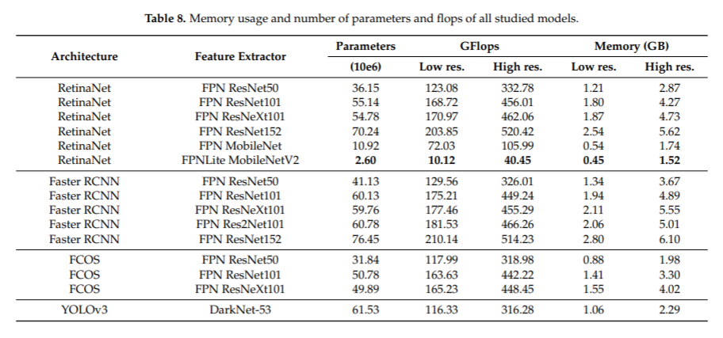

Slide 35
Conclusions
The conclusions obtained from this experimental study can be summarized as follows:
• The most accurate detection models were obtained using high-resolution images and do not reach real-time speed.
Therefore, in this context, it is necessary to sacrifice some accuracy by using smaller input images to improve the inference rate.

Slide 36
Conclusions
• Faster R-CNN obtains the best speed/accuracy trade-off but needs lower resolution images to achieve real-time inference speed.
• Two-stage Faster R-CNN models can achieve speeds comparable to one-stage detectors with higher detection accuracy.

Slide 37
Conclusions
• The anchor-free FCOS detector is a slightly faster one-stage alternative to RetinaNet, with similar precision and lower memory usage.
• RetinaNet MobileNet is the only model reaching 30 FPS, but with low precision.
YOLOv3 or FCOS at 25 FPS are more convenient options for on-board applications, although not as accurate as Faster R-CNN.

Slide 38
Conclusions
• Increasing the image resolution significantly degrades the computational efficiency of RetinaNet models, hence becoming impractical for this application.
• One-stage models fail to achieve good results over the minority class in this problem.
Faster R-CNN models proved to be more robust to the presence of imbalanced data.

Slide 39

Comparison
YOLOv4 vs. YOLOv5

Slide 40
The Origins of YOLOv5
On May 29, 2020, Glenn Jocher created a repository called YOLOv5 that didn't contain any model code, and on June 9, 2020, he added a commit message to his YOLOv3 implementation titled "YOLOv5 greetings."
Jocher's YOLOv5 implementation differs from prior releases in a few notable ways. First, Jocher did not (yet) publish a paper to accompany his release.

Slide 41
The Origins of YOLOv5
Second, Jocher implemented YOLOv5 natively in PyTorch whereas all prior models in the YOLO family leverage Darknet.
Notably, Jocher is also credited with creating mosaic data augmentation and including it in his YOLOv3, which is one of the many novel data augmentation in YOLOv4.
He is given an acknowledgement in the YOLOv4 paper.

Slide 42

Is YOLOv5 the Correct Name?

Slide 43
Comparing YOLOv4 and YOLOv5 Training Time
In YOLOv4 Darknet, you set training length based on number of iterations max_batches (not epochs).
The recommendation in the repository for custom objects is 2000 x num_classes.
With this setting YOLOv4 Darknet takes a whopping 14hrs on our example dataset.
However, it reaches max validation eval well before that; we saw max validation evaluation at 1300 iterations, which took about 3.5 hrs to reach.
YOLOv5s, on the other hand, took 14.46 minutes to train on 200 epochs.

Slide 44
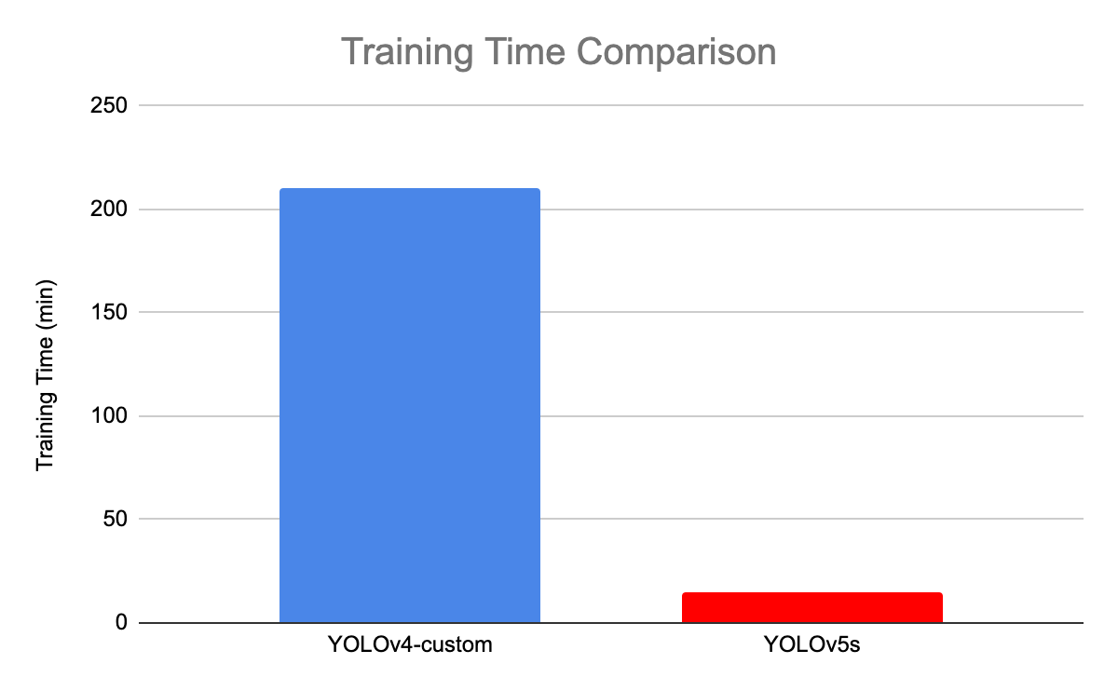

Slide 45
Comparing YOLOv4 vs YOLOv5 Evaluation
For both networks, we look at the max validation mAP @0.5.
We find that they perform similarly in this metric (0.91 mAP) for our task.
This does not reflect the networks' performance on the COCO dataset. The reality is that both networks are probably approaching maximum performance for this custom task, based on this custom dataset.

Slide 46
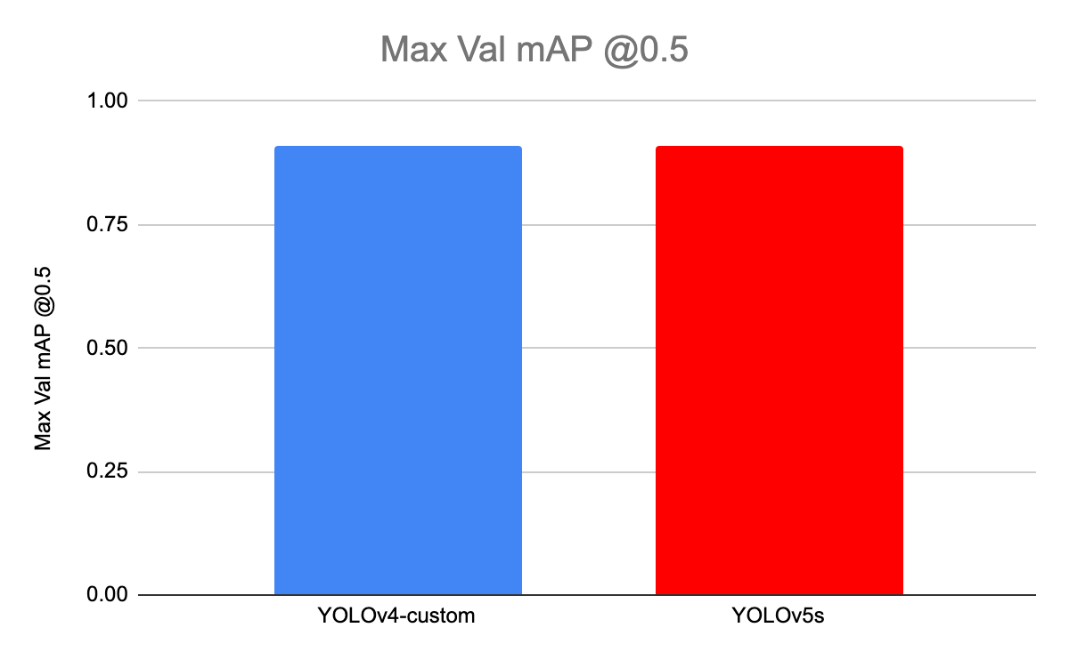

Slide 47
comparing YOLOv4 vs YOLOv5 Evaluation
Bochkovskiy alluded to how we might expect these two models to perform on Microsoft COCO as well:
They compared size of models of small ultralytics-YOLOv5-version YOLOv5s (27 MB) with very low accuracy 26-36% AP on Microsoft COCO with big YOLOv4 (245 MB) with very high accuracy 41-43% AP on Microsoft COCO.

Slide 48
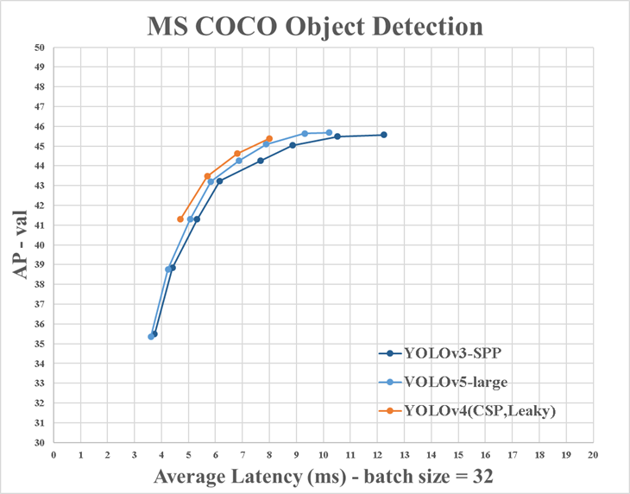

Slide 49
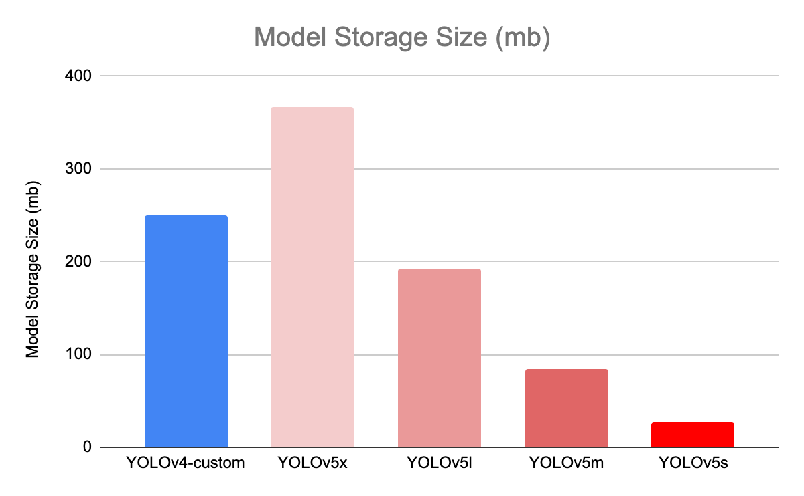

Slide 50
Comparing YOLOV4 and YOLOv5s Inference Time
Lastly, we compare inference time run under both networks with the environment configurations specified (Tesla P100).
On single images (batch size of 1), YOLOv4 inferences in 22 ms and YOLOv5s inferences in 20ms.

Slide 51
Comparing YOLOV4 and YOLOv5s Inference Time
YOLOv5s inferences in 7 ms (140 FPS) when you infer in batch.
The output divides total inference time by the number of images being processed. The Ultralytics YOLOv5 implementation defaults to this setting, so if you implement from the repository, you will have batch inference at 140 FPS by default.

Slide 52
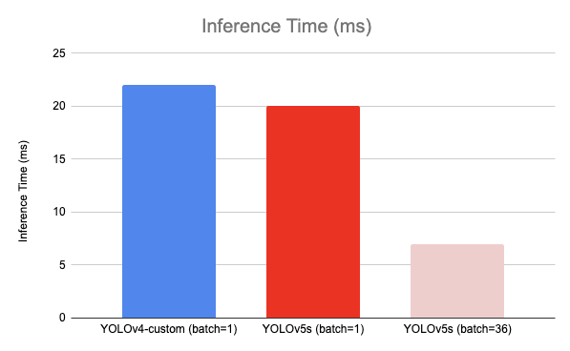

Slide 53
Conclusion
So, it said to be that YOLO v5 is extremely fast and lightweight than YOLO v4, while the accuracy is on par with the YOLO v4 benchmark.
But the major question raised by the community was: Are these benchmarks accurate and reproducible?

Slide 54
Some practical examples
https://colab.research.google.com/drive/1gDZ2xcTOgR39tGGs-EZ6i3RTs16wmzZQ
https://colab.research.google.com/drive/1mzL6WyY9BRx4xX476eQdhKDnd_eixBlG#scrollTo=GNVU7eu9CQj3

