Slide 1
EXPLAINABLE DEEP LEARNING FOR MEDICAL IMAGING
NeuroScan
Brain-Tumor MRI Classifier — ResNet50 → GradCAM → Local-LLM Report
Educational & research prototype — not a medical device

Slide 2
01
The Problem & The Idea
Why a classifier alone is not enough

Slide 3
Why this project
Brain tumors are diagnosed from MRI scans — a slow, expert-dependent read.
• Deep learning can flag the likely tumor type in seconds.
• But a bare prediction is a black box — clinicians won't trust a number.
• So NeuroScan adds two trust layers: a visual explanation and a written report.
• Everything runs locally — no cloud, no API keys, full privacy.

Slide 4
What NeuroScan does
One upload drives a four-step experience:
• ① Upload an MRI image in the browser.
• ② Get the predicted class + confidence for all four classes.
• ③ See a GradCAM heatmap of exactly where the model looked.
• ④ Read an auto-generated, structured clinical report.
Two front-ends: a Next.js web app (primary) and a legacy Gradio UI.

Slide 5
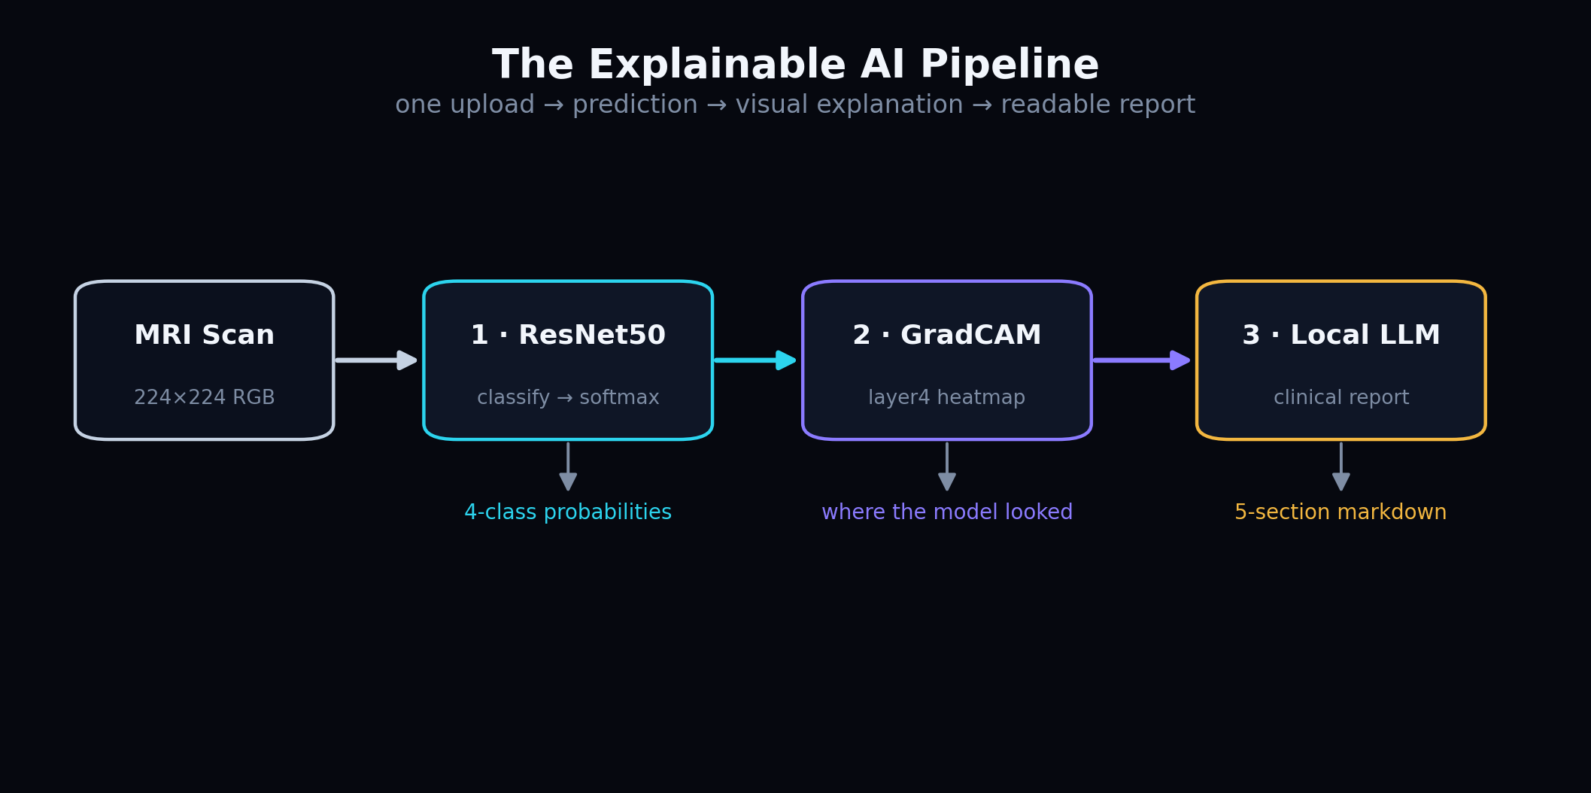
The explainable pipeline
Predict → explain → report: each stage adds trust.

Slide 6
02
The Data & The Classes
What the model sees and predicts

Slide 7
Four classes — a fixed index order
Index | Class | What it is
0 | Pituitary | Tumor of the pituitary gland; usually benign.
1 | No Tumor | Healthy / negative scan (note the space in the label).
2 | Meningioma | Tumor on the meninges around the brain.
3 | Glioma | Tumor in the brain's glial cells; can be malignant.
This order is identical in every file — the shipped weights depend on it.

Slide 8
Preprocessing — same maths as ImageNet
• Resize every scan to 224 × 224 pixels, RGB.
• Convert to a tensor (pixels scaled 0 → 1).
• Normalize with ImageNet mean [.485, .456, .406] and std [.229, .224, .225].
• Why ImageNet stats? The backbone was pretrained on ImageNet — inputs must match.

Slide 9
Data augmentation (training only)
Random transforms make the model robust to real-world variation:
• Horizontal + vertical flips → orientation invariance.
• Rotation ±15° → tolerate slight scan misalignment.
• ColorJitter → adapt to scanner brightness/contrast differences.
• GaussianBlur → simulate motion / out-of-focus artifacts.
Validation uses NO augmentation — evaluation must be deterministic.

Slide 10
03
The Model
ResNet50 + transfer learning

Slide 11
Why ResNet50 + transfer learning
• ResNet50: 50-layer residual CNN — deep but trainable thanks to skip connections.
• Start from ImageNet weights → reuse generic edge/texture detectors.
• Freeze the early layers; fine-tune only layer3 + layer4 (high-level features).
• Replace the 1000-class head with a custom 4-class head.
• Result: high accuracy from a small medical dataset, trained in minutes.

Slide 12
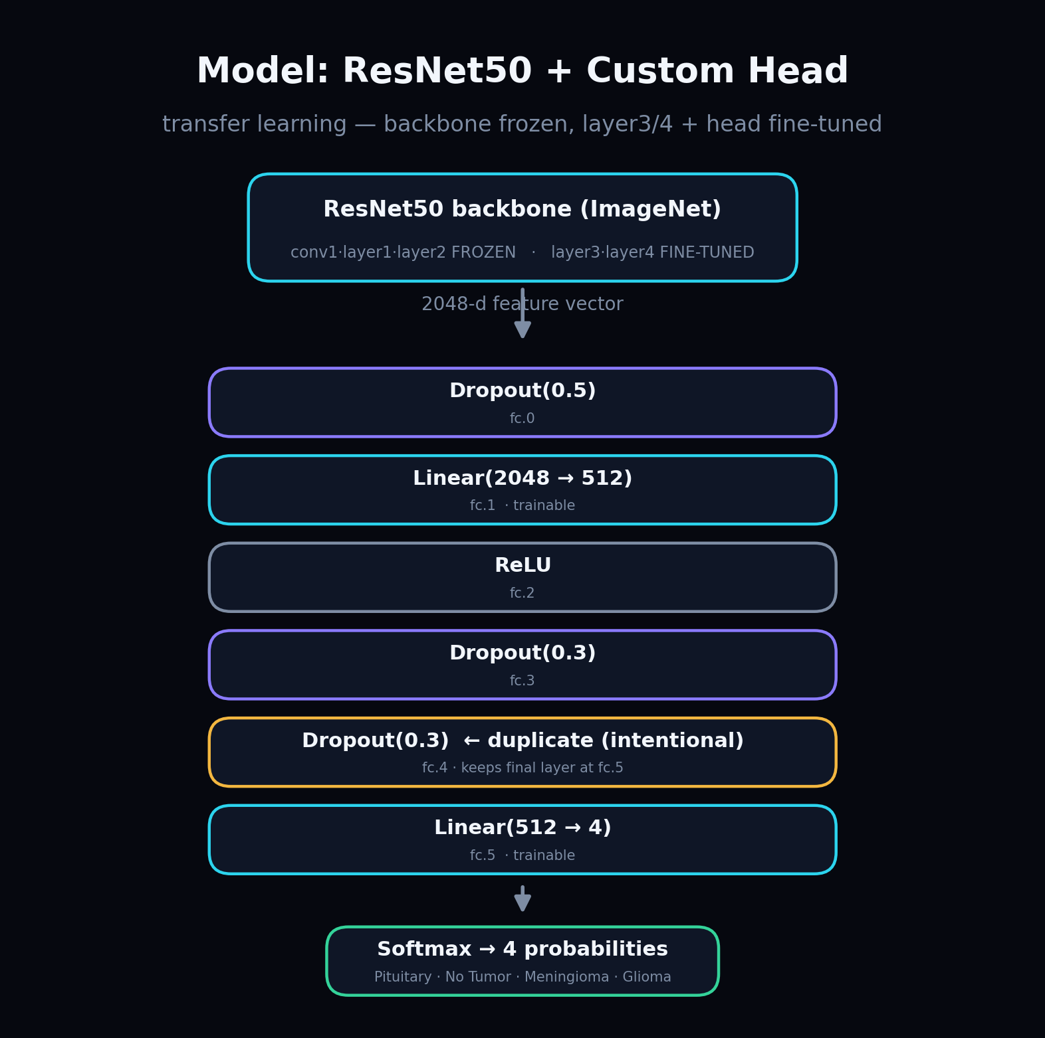
The classifier head
The duplicate Dropout(0.3) is intentional — it keeps the final layer at state-dict key fc.5 so the saved weights load strictly.

Slide 13
04
Training
How the weights were learned

Slide 14
Training recipe
Setting | Value | Why
Optimizer | Adam, lr 1e-4 | Adaptive, stable for fine-tuning.
Loss | CrossEntropy, smoothing 0.1 | Label smoothing curbs over-confidence.
Regularization | Weight decay 1e-4 + dropout | Fights overfitting.
Scheduler | ReduceLROnPlateau ×0.5 | Lower LR when val loss stalls.
Batch / Epochs | 32 / max 20 | Early-stop patience = 5.

Slide 15
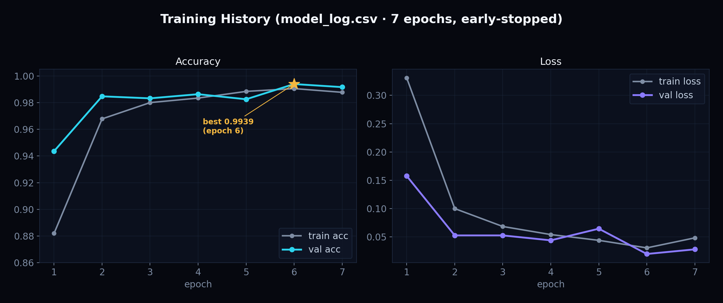
Training results (real log)
Converged fast; best validation accuracy 99.39% at epoch 6, then early-stopped.

Slide 16
99.39%
claimed validation accuracy
…but we call it “claimed” on purpose
train.py reuses the test set as the validation set (data leakage). So this is an optimistic figure, not a validated generalization estimate — and the app says so.

Slide 17
Honest limitations
Owning the flaws is part of good science:
• Data leakage → accuracy is optimistic; a true held-out test set is needed.
• Trained on one dataset → may not generalize to other scanners/populations.
• Image classification ≠ diagnosis; no segmentation or staging.
• Strictly educational/research — never a clinical decision tool.

Slide 18
05
Explainability & Reporting
Turning a number into trust

Slide 19
GradCAM — where the model looked
• Gradient-weighted Class Activation Mapping on the last conv block (layer4).
• Gradients of the predicted class flow back → weight the feature maps.
• Produces a heatmap overlaid on the MRI (red = most influential regions).
• aug_smooth + eigen_smooth reduce noise for a cleaner map.
• If grad-cam isn't installed → graceful fallback to the resized original.

Slide 20
Local-LLM clinical report
• A local Ollama model (default qwen2.5:1.5b) writes the report — no cloud, no key.
• A structured prompt forces exactly 5 sections, < 230 words, temperature 0.3.
• Diagnosis summary · about the tumor · what the heatmap shows · next steps · disclaimer.
• Why local? Privacy of medical data, offline use, zero cost.
• If Ollama is down → the UI shows clear setup instructions, app keeps working.

Slide 21
06
The Engineering
Backend · Frontend · Deployment

Slide 22
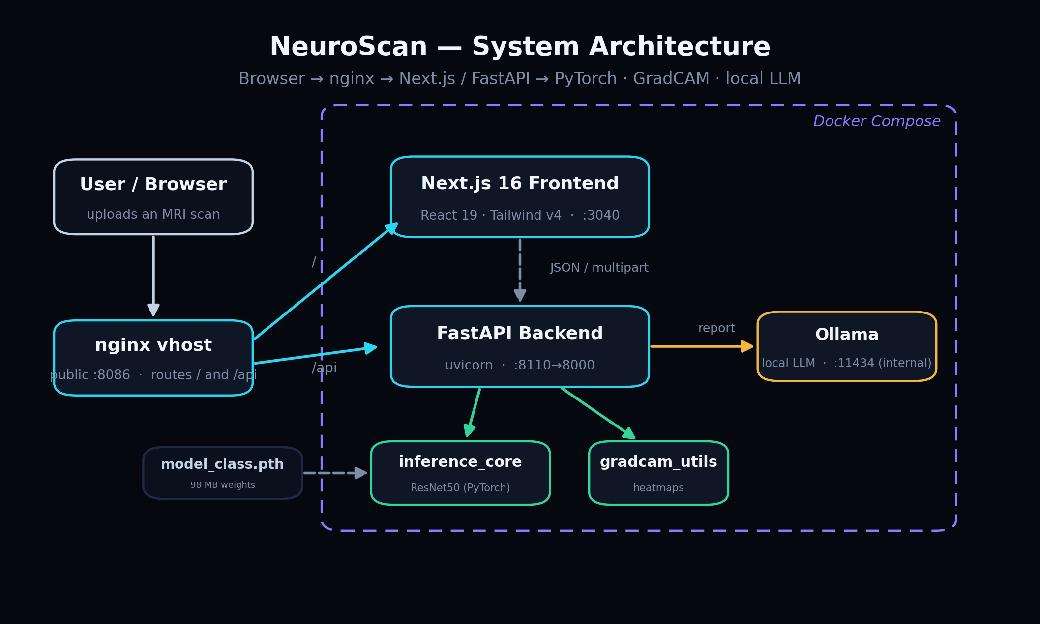
System architecture
nginx splits traffic: the page from Next.js, /api from FastAPI; PyTorch, GradCAM and Ollama sit behind the backend.

Slide 23
Backend — FastAPI
Design
Endpoints
• Model loads once at startup (lifespan).
• If load fails, API stays up and reports via /health.
• INFERENCE_LOCK serializes the model (GradCAM hooks aren't thread-safe).
• Runs inference in a threadpool to stay async.
• GET /api/health — capabilities & device.
• POST /api/predict — image → class, probs, GradCAM.
• POST /api/report — scores → markdown report.
• GET /api/metrics — training history.
• Uploads validated: ≤15 MB, PNG/JPEG/WEBP/BMP.

Slide 24
Frontend — Next.js 16
Stack
API seam
• Next.js 16, React 19, TypeScript.
• Tailwind v4 (CSS-first) design tokens.
• Pages: / · /analyze · /metrics · /about.
• Dark/light “reading-room” theme; smooth motion.
• lib/api.ts maps snake_case ↔ camelCase.
• Calls the backend directly, not the Next proxy…
• …because the proxy's ~30s timeout cuts off slow CPU reports.
• Hand-drawn SVG charts on /metrics (no chart library).

Slide 25
Deployment — Docker + nginx
• Three containers: backend, frontend, and an internal Ollama.
• Backend pins CPU PyTorch 2.6.0 to match the saved weights.
• Services bind to localhost; a host nginx vhost (:8086) is the public door.
• nginx routes /api → backend, everything else → frontend.
• Tuned for a shared box: 2 CPU threads, Ollama unloads after 2 min idle.
• Healthchecks + restart policies keep it alive. Live on a VPS today.

Slide 26
Full tech stack
Layer | Technology
ML / model | Python 3.12, PyTorch, torchvision (ResNet50)
Explainability | pytorch-grad-cam (GradCAM)
Report LLM | Ollama (qwen2.5:1.5b-instruct)
Backend | FastAPI + uvicorn, Pydantic
Frontend | Next.js 16, React 19, TypeScript, Tailwind v4
Deployment | Docker Compose + nginx on a VPS

Slide 27
07
Anticipated Questions
Answers ready for the panel

Slide 28
Q&A — be ready
Method
System
• “Is 99% real?” → No — data leakage; it's a claimed figure.
• “Why ResNet50, not a ViT?” → Strong, data-efficient, easy to fine-tune.
• “Overfitting?” → Dropout, weight decay, smoothing, augmentation.
• “Why a local LLM?” → Privacy, offline, no API cost.
• “How does GradCAM work?” → Gradients × activations at layer4.
• “Clinical use?” → No — research/education only, by design.

Slide 29
Thank you
Future work: a true held-out test set · segmentation · DICOM support · clinician study.
NeuroScan — explainable brain-tumor MRI analysis, fully local.

