Slide 1
Stroke Prediction

Slide 2
Stroke Prediction
Stroke is a serious disease.
Main goal is to Predict whether the patient will have stroke or not?
According to some features(Age,Gender,..,etc.).

Slide 3
Data Overviwe
The data is a public data from Kaggle
ID | Unique identifier
Gender | Male, female, other
Age | The age of the patient
hypertension | 0 if the patient doesn't have hypertension, 1 if the patient has hypertension
heart_disease | 0 if the patient doesn't have any heart diseases, 1 if the patient has a heart disease
ever_married | "No" or "Yes"
work_type | "children", "Govt_jov", "Never_worked", "Private" or "Self-employed"
Residence_type | "Rural" or "Urban"
avg_glucose_level | average glucose level in blood
bmi | body mass index
smoking_status | "formerly smoked", "never smoked", "smokes" or "Unknown"
Stroke | 1 if the patient had a stroke or 0 if not

Slide 4
Data Overview
Total Data :5109

Slide 5
Balance the data
Total Data :9719

Slide 6
Model Compersion

Slide 7
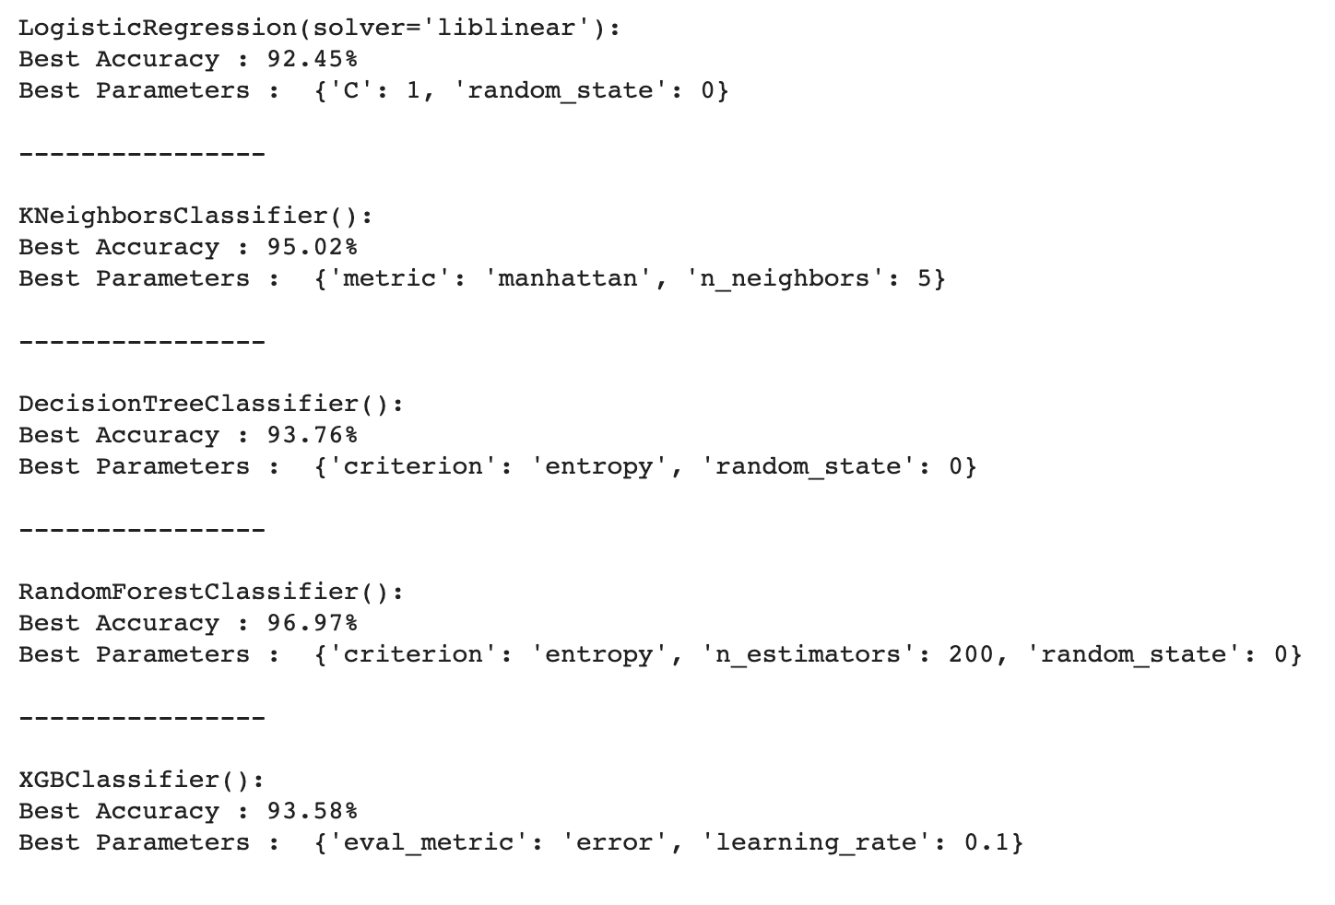
Hyperparameter Tuning

Slide 8
Cross Validation 10 cv fold

Slide 9
Conclusion
RFC is the best model for the dataset.
criterion= 'entropy', n_estimators= 200
Then KNN then the xgb

Slide 10
Thank you
Reference:
https://www.cdc.gov/stroke/types_of_stroke.htm#hemorrhagic
Project link: https://github.com/eyad718/T5-project/blob/main/project_T5.ipynb

