Slide 1


TRENDY
Trendy Shoe
Where Fashion Meets Footwear!

Slide 2
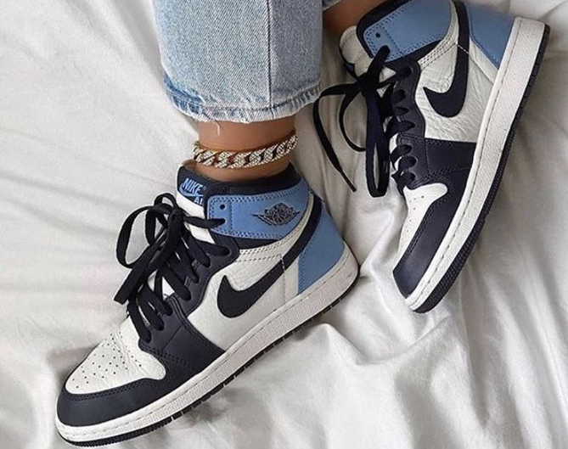
TRENDY is an E-commerce website for shoes lovers It aims to create a vibrant and interactive community where users can connect, discover, and buy their favorite shoes.

Slide 3
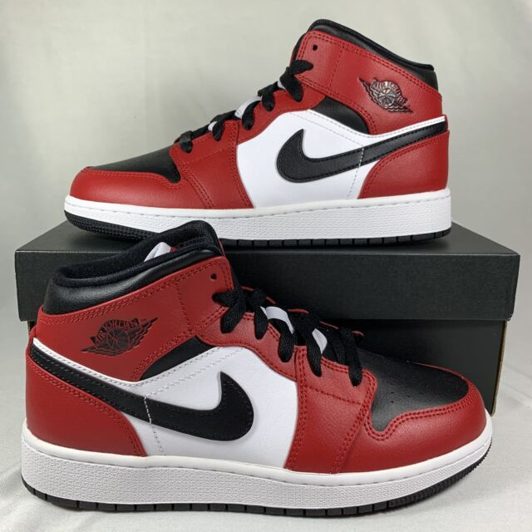
The app intends to have three main actors: admin, user, and visitor Admin: The admin is responsible for managing and maintaining the website User: Users are individuals who have registered and created an account on TRENDY. Visitor: Visitors are individuals who have not yet registered or logged in the website . They can browse the app's content

Slide 4
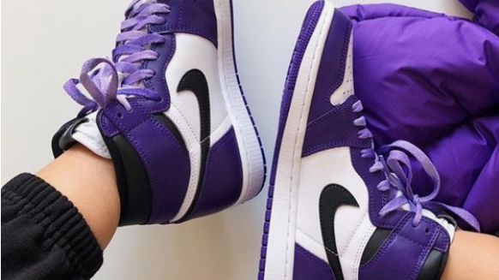
The primary purpose of TRENDY is to provide customers with a convenient and enjoyable online shopping experience for shoes. It aims to offer a wide selection of shoes Overall, the goal is to help customers find their desired footwear options and make confident purchases while enjoying the convenience of online shopping.

