Slide 1


Slide 2
What is SQL? SQL is a domain-specific language used to query and manage data. It works by allowing users to query, insert, delete, and update records in relational databases. SQL also allows for complex logic to be applied through the use of transactions and embedded procedures such as stored functions or views.

Slide 3
What is NoSQL? NoSQL stands for Not only SQL. It is a type of database that uses non-relational data structures, such as documents, graph databases, and key-value stores to store and retrieve data. NoSQL systems are designed to be more flexible than traditional relational databases and can scale up or down easily to accommodate changes in usage or load. This makes them ideal for use in applications

Slide 4
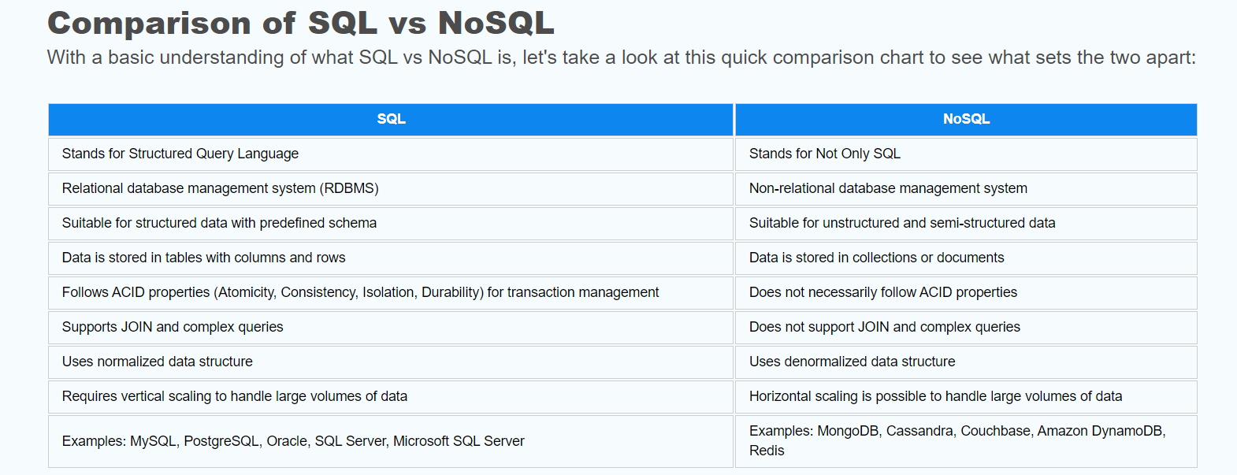

Slide 5
Database Architecture
At the most basic level, the biggest difference between these two technologies is that SQL databases are relational, while NoSQL databases are non-relational.
What are Relational Databases?
Relational databases use Structured Query Language (SQL) to store and retrieve data.
Relational databases (also called relational database management systems or RDBMSs) store data in rows and tables. These systems connect information from various tables with keys — unique identifiers that the database assigns to rows of data in tables. Primary keys and foreign keys facilitate this process.
What are Non-Relational Databases (NoSQL)?
Non-relational, or NoSQL databases are more flexible and don’t necessarily require the same rigid structure as SQL.
Non-relational databases store data just like relational databases. However, they don't contain any rows, tables, or keys. This type of database utilizes a storage model based on the type of data it stores

