Slide 1


WaveWatch – machine learning & wave analysis
Presenting: Lior Zucker Eyal Cohen
Supervisor : Dr. Reuven Cohen
1

Slide 2

WaveWatch
Table of contents
Introduction
▼
Problem And Solution
▼
Data Collection
▼
Process
▼
Research
▼
Data Gathering And Annotation
▼
Model Training
▼
product
▼
Testing plan
▼
Expected Achievements
▼
Conclusions
Introduction
Problem And Solution
Data Collection
Process
Research
Data Gathering And Annotation
Model Training
product
Testing plan
Expected Achievements
Conclusions
By Eyal Cohen
& Lior Zucker

Slide 3
WaveWatch
The problem
Introduction
▼
Problem And Solution
▼
Data Collection
▼
Process
▼
Research
▼
Data Gathering And Annotation
▼
Model Training
▼
product
▼
Testing plan
▼
Expected Achievements
▼
Conclusions
Introduction
Current Situation: Surfers face significant challenges in predicting wave conditions due to the limitations of manual observation.
Need for the Project: There's a need for an automated tool that can analyze sea conditions accurately, providing surfers with data for better decision-making.
Project Objectives: WaveWatch aims to provide surfers with insights on wave conditions using machine learning to analyze beach video footage.
By Eyal Cohen
& Lior Zucker

Slide 4
WaveWatch
Problem And Solution
Introduction
▼
Problem And Solution
▼
Data Collection
▼
Process
▼
Research
▼
Data Gathering And Annotation
▼
Model Training
▼
product
▼
Testing plan
▼
Expected Achievements
▼
Conclusions
Problem Definition: Current surf forecasting methods require manual interpretation. Surfers need precise data on factors like swell period, wave height, crowd density, wave count per swell period.
Proposed Solution: WaveWatch solves this by automating the analysis of beach videos through machine learning, focusing on key parameters mentioned above.
Project Goals: Improve safety and surfing experience.
By Eyal Cohen
& Lior Zucker

Slide 5
WaveWatch
Introduction
▼
Problem And Solution
▼
Data Collection
▼
Process
▼
Research
▼
Data Gathering And Annotation
▼
Model Training
▼
product
▼
Testing plan
▼
Expected Achievements
▼
Conclusions
Data Collection
Data Collection: WaveWatch’s model uses annotated beach videos that capture various sea conditions, including waves and crowd. These videos help train the YOLO-based model.
Data Handling Strategy: Efficient data processing pipelines and storage solutions are implemented to handle large video data.
By Eyal Cohen
& Lior Zucker
Notes:
Our solution is based on ‘computer vision’.
We will create an application that translates in real time HEBREW LETTERS SIGNS to written text.
The sign speaker will stand in front of a webcam and spell the word letter after letter (using the Hebrew signs)
Our application will show the user his detected hand, and the predicted letter.
While the user generates the word letter after letter, we will try to provide a prediction of the word (In order to make the spelling faster)
Our application will give the ability to pronounce any word in the Hebrew language easily and fast
with small amount of signs (one for every letter, instead of sign for every word).

Slide 6
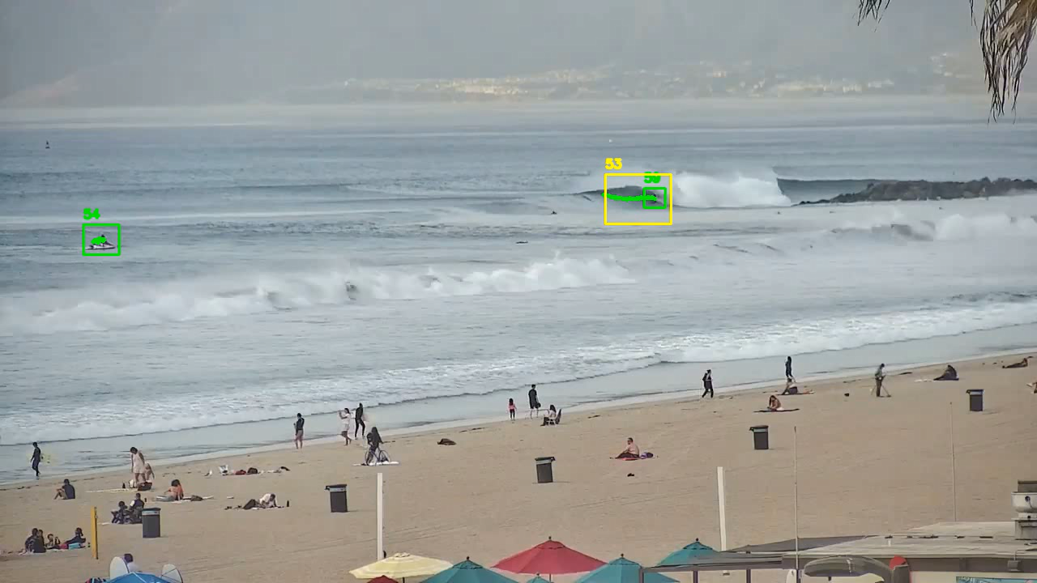
WaveWatch
Process
Introduction
▼
Problem And Solution
▼
Data Collection
▼
Process
▼
Research
▼
Data Gathering And Annotation
▼
Model Training
▼
product
▼
Testing plan
▼
Expected Achievements
▼
Conclusions
Challenges: Developing an accurate model to analyze sea conditions posed significant challenges, such as handling varying light conditions and camera angles in videos.
Research Approaches: The project used machine learning techniques, specifically the YOLO architecture, to address these challenges. Annotated datasets are critical for training the model.
By Eyal Cohen
& Lior Zucker
Notes:
The goals we expect to achieve in the project are:
Create a real-time translation tool that translates sign language spelling into Hebrew text.
Allow the user to compose complete sentences by hand signs only and without physical contact.
We aim to achieve 85% accuracy of detecting the sign.
Facilitate the use of the application by using a word suggestion tool that supports Hebrew.

Slide 7
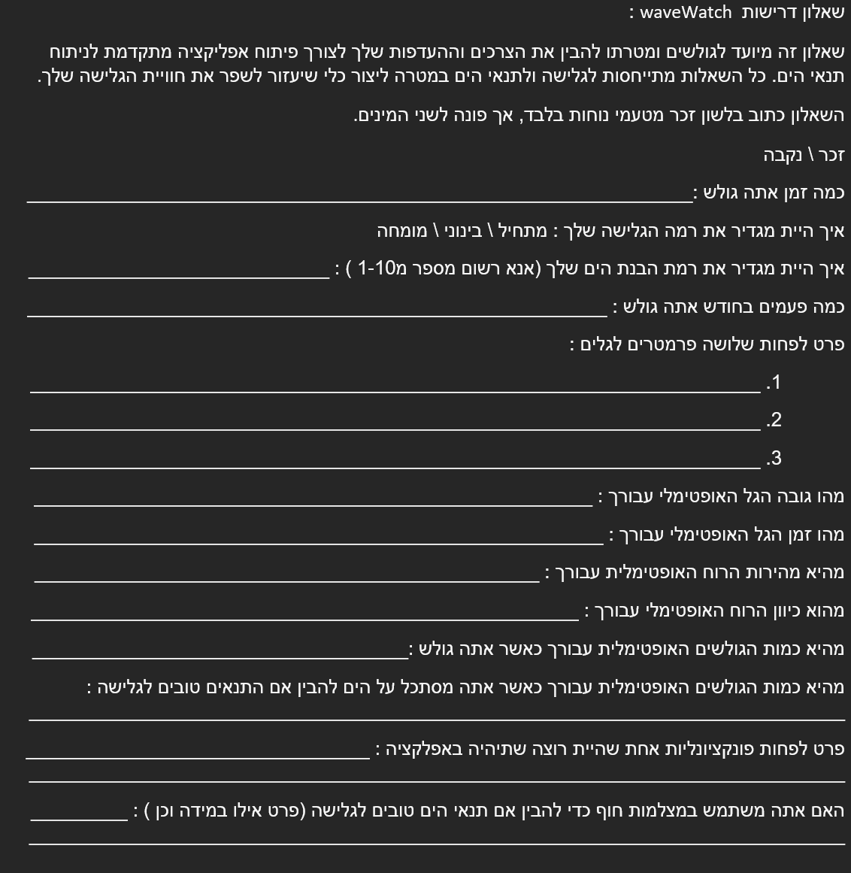
WaveWatch
Research
Introduction
▼
Problem And Solution
▼
Data Collection
▼
Process
▼
Research
▼
Data Gathering And Annotation
▼
Model Training
▼
product
▼
Testing plan
▼
Expected Achievements
▼
Conclusions
Studied academic papers on beach monitoring and wave analysis to understand the background.
Conducted a questionnaire with local surfing groups to gather feedback on desired app features and analysis parameters.
Used community insights to guide app functionality and parameter selection.
By Eyal Cohen
& Lior Zucker
Notes:
We will face several challenges that we will have to overcome:
Dataset - There is no available dataset of the Hebrew letters, and our model should handle 22 Hebrew letters, 10 digits, and 6 signs. We will need to create this dataset. * We will try to use other language datasets and try to find similar signs that we can use and change their label to the Hebrew one. For the signs that we wont found we will take pictures ourselves.
Letters that require hand movement - There are several letters whose representation in sign language demand movement of the hand (like final letters, or letters with punctuation).
We will try to implement it without the movement, and check the correction of the results.
Hardware - In order to train the model, we will need a powerful CPU (or also GPU). This can take a long time, and in case of errors, we might need to start again.
We are going to use Google Teachable Machine, which allows us to create and train a model without using our hardware.
Distinguish between unintended gestures- We don’t want the user to approve each letter that he represents. After consulting deaf people, we decided that the user will wait up to 1 second with his hand steady in front the camera.
Identity word endings - The user will close his hand (like a fist) or take his hand off the screen for 1.5 seconds.
Creating a full sentence - The text will appear in a text box, and we will provide the user signs that are used in sentences, like ‘dot’, ‘comma’, and more. We will also provide the user a special sign to delete a character from the text box. This will ensure that the user will not need to touch any device (like a keyboard or mouse) to write his text.
Working with word suggestions - The predicted word will appear on the screen near the text box, and we will create a special sign that allows the user to ‘accept’ and use this word.
We will use an existing tool called LightKey, which will talk about later.

Slide 8
WaveWatch
Data Gathering And Annotation
Introduction
▼
Problem And Solution
▼
Data Collection
▼
Process
▼
Research
▼
Data Gathering And Annotation
▼
Model Training
▼
product
▼
Testing plan
▼
Expected Achievements
▼
Conclusions
Ddevelopment starts with data collection from beaches, capturing various conditions (wave and weather conditions).
Annotate videos by labelling key objects like waves and surfers.
These annotations are crucial for building a strong dataset to train the YOLO model.
The accuracy of the annotations will directly impact the model's performance.
By Eyal Cohen
& Lior Zucker
Notes:
MediaPipe:
The Hand Tracking module in MediaPipe is a pre-built module that can be used to detect and track hands in real-time video streams. The module uses a combination of techniques such as color filtering, contour detection, and skin detection to pre-process the video frames and improve the accuracy of the hand detection model.
In the MediaPipe Hands module, a machine learning pipeline is used to detect and track the pose of a hand in an image or video. This pipeline consists of multiple models working together: a palm detection model and a hand landmark model. The palm detection model processes the full image and returns a bounding box that encloses the hand. The hand landmark model then operates on the cropped image region defined by the bounding box and returns 3D keypoints that accurately represent the pose of the hand.
We will cut the frames of the detected palm with the landmarks (as a picture) and pass it as input to the our signs detection model for classification.
The landmarks on the image will improve the accuracy of the model.

Slide 9
WaveWatch
Model Training
Introduction
▼
Problem And Solution
▼
Data Collection
▼
Process
▼
Research
▼
Data Gathering And Annotation
▼
Model Training
▼
product
▼
Testing plan
▼
Expected Achievements
▼
Conclusions
Train the YOLO model using annotated data to detect and track the selected parameters.
Chose YOLO for its ability to provide real-time detection with high accuracy.
Fine-tune the model to handle the unique challenges of beach environments.
By Eyal Cohen
& Lior Zucker
Notes:
Our training dataset will look like this.
For every sign we will have a folder with at least 300 pictures of the palm with the landmarks on it.
We will build this dataset with similar hand gestures that we will find online (Other languages), and the rest we will make ourselves.
We will use 80% of our data for Training, and 20% for testing.

Slide 10
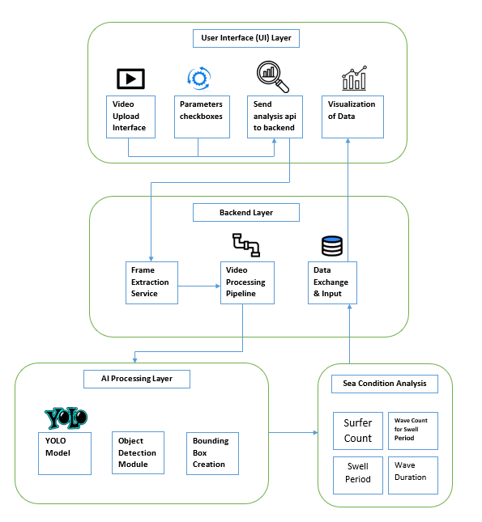
WaveWatch
Product
Introduction
▼
Problem And Solution
▼
Data Collection
▼
Process
▼
Research
▼
Data Gathering And Annotation
▼
Model Training
▼
product
▼
Testing plan
▼
Expected Achievements
▼
Conclusions
User uploads video and selects analysis parameters in the UI.
Backend extracts frames and processes video data.
YOLO model detects surfers and waves, creating bounding boxes.
Sea conditions like surfer count and wave duration are analysed and visualized.
By Eyal Cohen
& Lior Zucker
Notes:
LightKey- LightKey is a free text prediction software that uses artificial intelligence to predict the next word or phrase that a user is likely to type. It is designed to help users type faster and more accurately by providing suggestions for the next word or phrase as they are typing.
* We will use it in order to predict the user input and allow the user to use it.
* One possible solution for choosing the autocomplete option is by using the other hand. This solution might be tricky because it will make the detection harder. * Another possible solution is to create a new sign which means ‘Apply autocomplete’.
Existing solutions for word suggestions:
Gmail Smart Compose - This tool generates real-time interactive suggestions in Gmail that help users write emails by reducing retyping. The suggestion is shown following the letters or words written so far, and if the user wants to add it to his sentence, he can click on the TAB key on the keyboard, and the sentence will be added to his mail.
SwiftKey - A mobile keyboard that contains a word suggestion bar at the top of the keyboard, allowing the user to choose between 3 suggested words that he might use at the current state of the typing (considering the most used words or sentences).

Slide 11
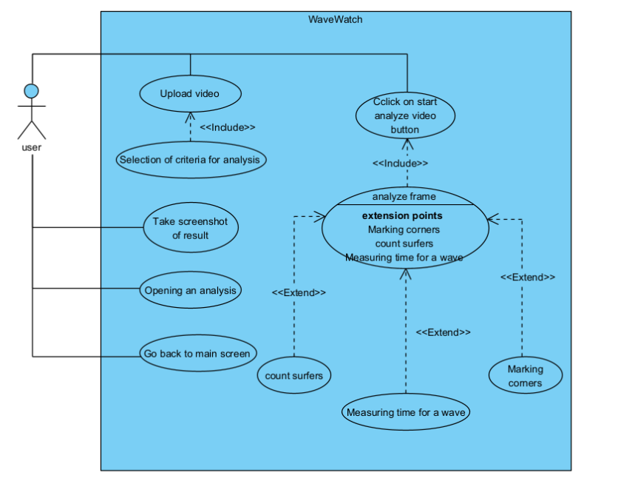
WaveWatch
Product-usecase
Introduction
▼
Problem And Solution
▼
Data Collection
▼
Process
▼
Research
▼
Data Gathering And Annotation
▼
Model Training
▼
product
▼
Testing plan
▼
Expected Achievements
▼
Conclusions
Upload video: The user uploads a video for analysis.
Select criteria for analysis: The user picks parameters for the video analysis.
Start analysis: The user clicks a button to begin analysing the video, which includes extensions like counting surfers, marking corners, and measuring wave time.
View results: The user can take a screenshot of the results, open a previous analysis, or return to the main screen.
By Eyal Cohen
& Lior Zucker
Notes:
Google Teachable Machine:
We will use Google Teachable Machine, which allows us to create and train our own machine learning models without using our hardware. The model we will use is based on MobileNet architecture, which was developed by Google and has been widely used for tasks such as object detection and classification.
Google Teachable Machine is using transfer learning with TensorFlow framework.
TensorFlow: TensorFlow is an open-source machine learning framework developed by Google that is widely used for training and deploying machine learning models.
Transfer learning: Transfer learning can be implemented by using a pre-trained model as a starting point and fine-tuning the model on a new dataset for the new task.

Slide 12
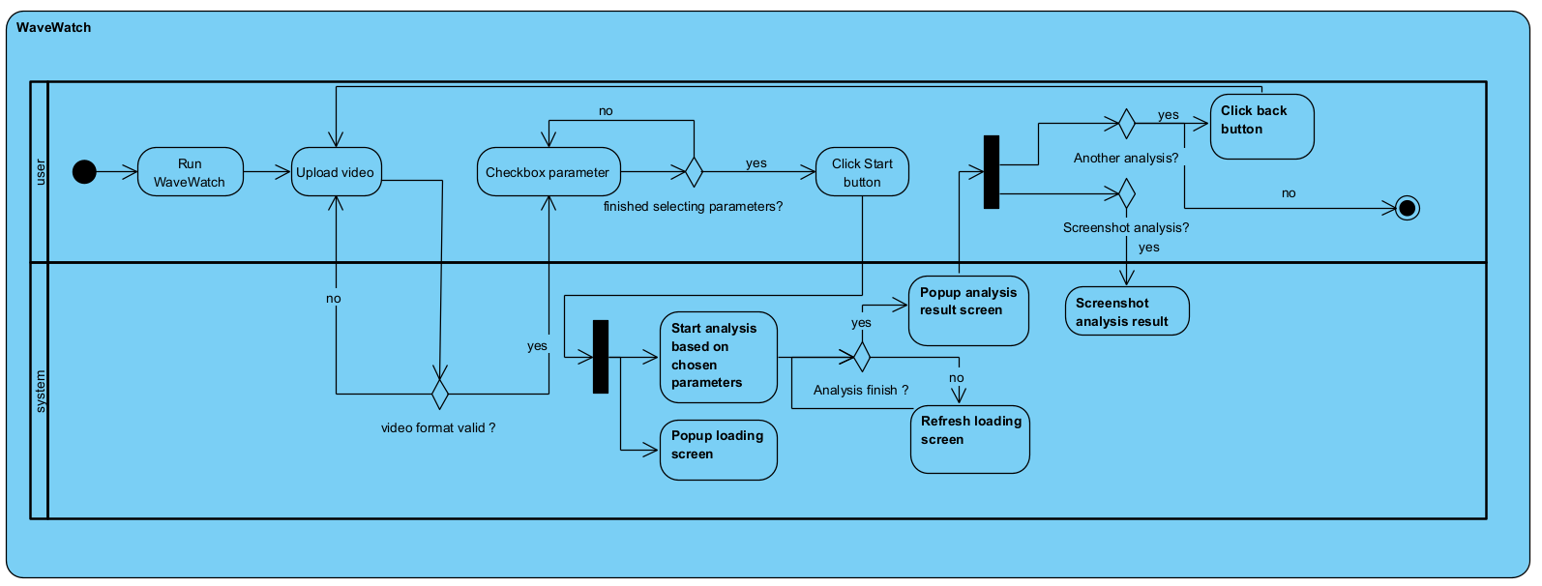
WaveWatch
Product-activity
Introduction
▼
Problem And Solution
▼
Data Collection
▼
Process
▼
Research
▼
Data Gathering And Annotation
▼
Model Training
▼
product
▼
Testing plan
▼
Expected Achievements
▼
Conclusions
By Eyal Cohen
& Lior Zucker

Slide 13
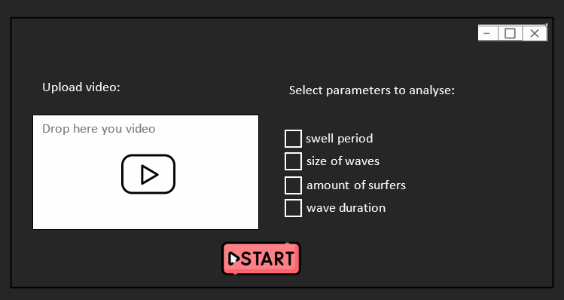
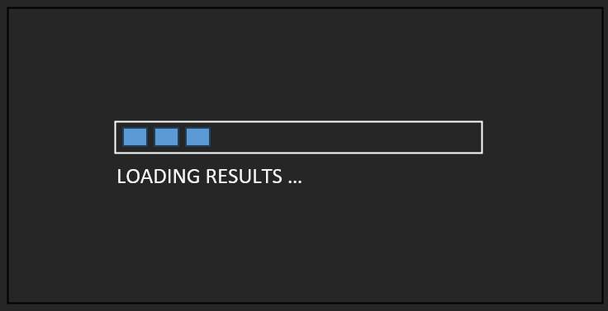
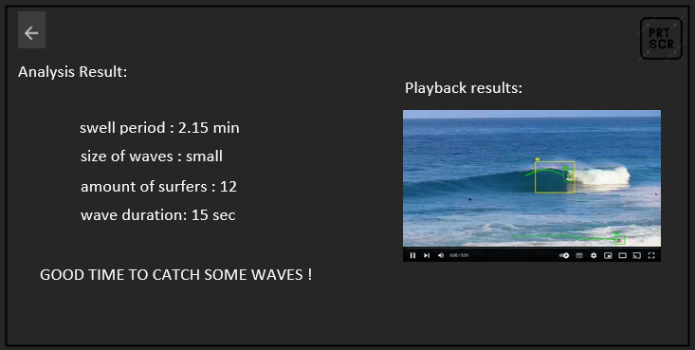
WaveWatch
Product-prototype
Introduction
▼
Problem And Solution
▼
Data Collection
▼
Process
▼
Research
▼
Data Gathering And Annotation
▼
Model Training
▼
product
▼
Testing plan
▼
Expected Achievements
▼
Conclusions
The application features a three-screen workflow: the first allows users to upload videos and select parameters for analysis, the second displays a progress indicator while processing, and the third presents the annotated results and metrics, with options to save or return to the dashboard.
By Eyal Cohen
& Lior Zucker
Notes:
This is the start screen of the application.
The user name will be used in order to show the speaker name when the text is ready.
The com port of the camera is the number of the camera connected to the system.

Slide 14
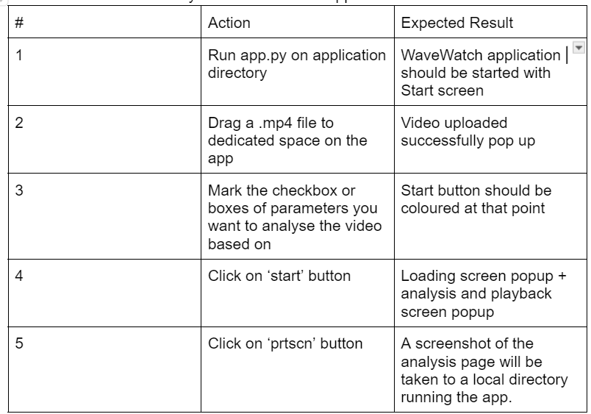
WaveWatch
Testing plan
Introduction
▼
Problem And Solution
▼
Data Collection
▼
Process
▼
Research
▼
Data Gathering And Annotation
▼
Model Training
▼
product
▼
Testing plan
▼
Expected Achievements
▼
Conclusions
Functional Testing: Verify key features using manual testing and automated scripts.
By Eyal Cohen
& Lior Zucker
Notes:
The action screen is the main screen of our app.
In the middle, the user will see a live stream of his camera.
When the hand tracking model detect a hand, we will show the bounding box on the screen.
Under the bounding box the user will see the predicted letter.
On the right side,
The ‘input box’ will show the current input letter after letter.
The ‘Autocomplete box’ will be updated as the input gets bigger and show the suggestion autocomplete option.
The ‘Last input words box’ will show the last input words of the user.
On the top,
‘Your text box’ will show the user sentences with a scroll option.
The stop button will stop tracking and return to the main page.
The ‘signs map’ button will open the Hebrew sign language picture, to help the user.
The ‘settings’ button will show the main page settings (Name, Cam - COM port)
The ‘Close’ button will close the app.

Slide 15
WaveWatch
Expected Achievements
Introduction
▼
Problem And Solution
▼
Data Collection
▼
Process
▼
Research
▼
Data Gathering And Annotation
▼
Model Training
▼
product
▼
Testing plan
▼
Expected Achievements
▼
Conclusions
AI-Driven Analysis: Delivers fast, accurate wave and sea condition insights.
User-Friendly Interface: Simplifies complex evaluations for all skill levels.
Versatile Applications: Optimizes surf sessions, ensures safety, and enhances all type of beach goers.
By Eyal Cohen
& Lior Zucker
Notes:
This diagram shows the main activities that the user performs in the system, and how the system shall react to these activities. We can refer to this diagram as the main flow chart of the application.
Explain the flow

Slide 16
WaveWatch
Conclusions
Introduction
▼
Problem And Solution
▼
Data Collection
▼
Process
▼
Research
▼
Data Gathering And Annotation
▼
Model Training
▼
product
▼
Testing plan
▼
Expected Achievements
▼
Conclusions
Currently, there are applications for forecasting sea conditions, but there are no tools for in-depth sea condition analysis. Our tool will be introducing a completely new aspect, making it easier for the surfing community. It will enhance the experience by providing a more enjoyable, safe, and enriching interaction with the sea.
By Eyal Cohen
& Lior Zucker
Notes:
We will first test the model itself:
The hand detection
Different angles
Different lights
Different hand sizes and colors

Slide 17

Thank you for listening.
Q&A ☺
17

