Slide 1


WaveWatch – machine learning & wave analysis
Presenting: Lior Zucker Eyal Cohen
Supervisor : Dr. Reuven Cohen
1

Slide 2
Introduction: Current Situation and Project Need
Current Situation: Surfers face significant challenges in predicting wave conditions due to the limitations of manual observation.
Need for the Project: There's a need for an automated tool that can analyze sea conditions accurately, providing surfers with data for better decision-making.
Project Objectives: WaveWatch aims to provide surfers with insights on wave conditions using machine learning to analyze beach video footage.
2

Slide 3
Problem Definition and Proposed Solution
Problem Definition: Current surf forecasting methods require manual interpretation. Surfers need precise data on factors like swell period, wave height, crowd density, wave count per swell period.
Proposed Solution: WaveWatch solves this by automating the analysis of beach videos through machine learning, focusing on key parameters mentioned above.
Project Goals: Improve safety and surfing experience.
3

Slide 4
Project Data and Decision Factors
Data Collection: WaveWatch’s model uses annotated beach videos that capture various sea conditions, including waves and crowd. These videos help train the YOLO-based model.
Data Handling Strategy: Efficient data processing pipelines and storage solutions are implemented to handle large video data.
4

Slide 5
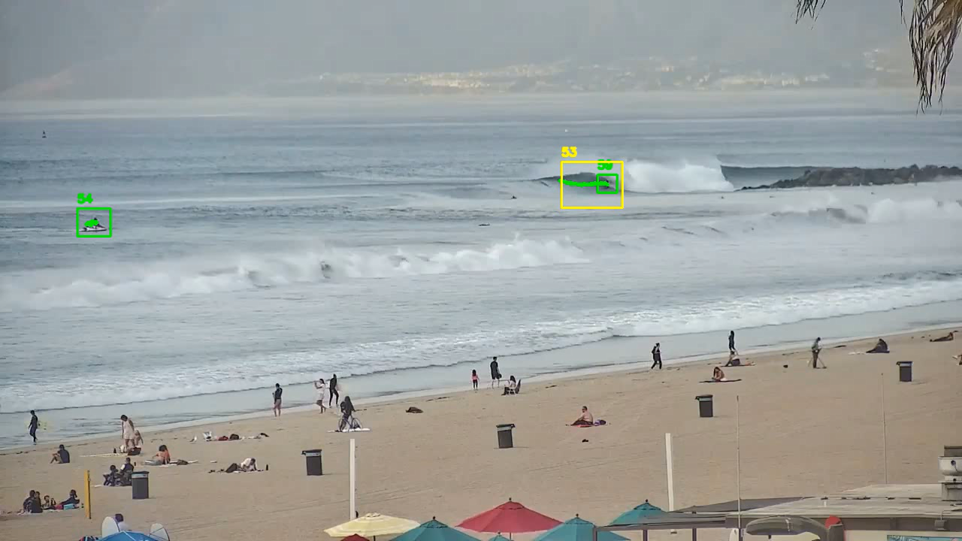
process
Challenges: Developing an accurate model to analyze sea conditions posed significant challenges, such as handling varying light conditions and camera angles in videos.
Research Approaches: The project used machine learning techniques, specifically the YOLO architecture, to address these challenges. Annotated datasets are critical for training the model.
5

Slide 6
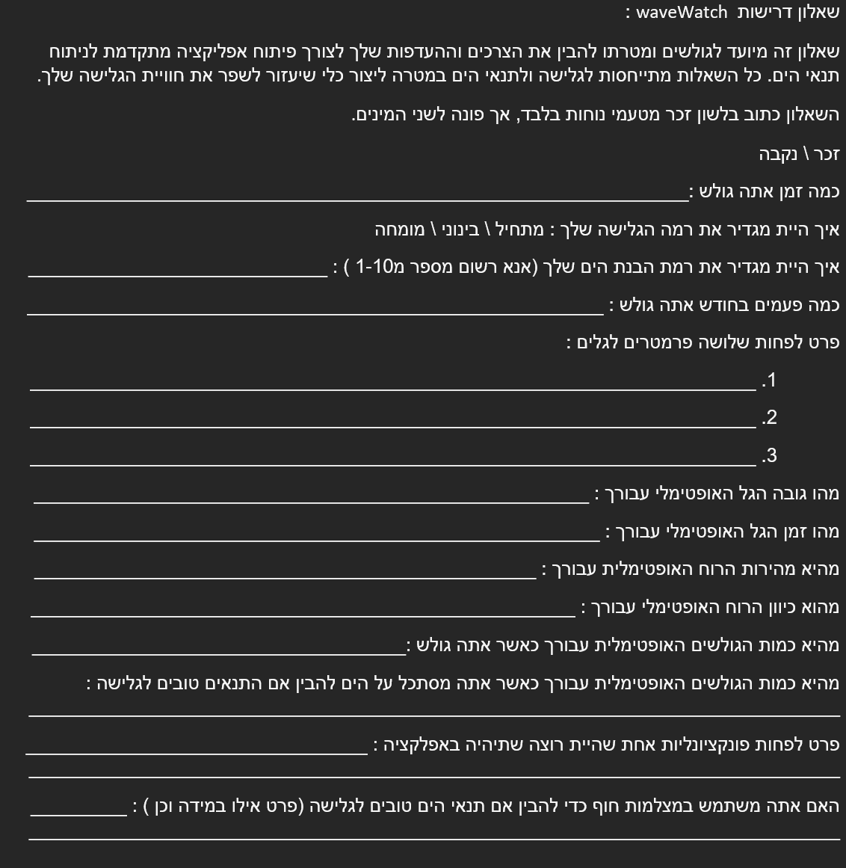
Research
Studied academic papers on beach monitoring and wave analysis to understand the background.
Conducted a questionnaire with local surfing groups to gather feedback on desired app features and analysis parameters.
Used community insights to guide app functionality and parameter selection.
6

Slide 7
Data Gathering and Annotation
Development starts with data collection from beaches, capturing various conditions (wave and weather conditions).
Annotate videos by labelling key objects like waves and surfers.
These annotations are crucial for building a strong dataset to train the YOLO model.
The accuracy of the annotations will directly impact the model's performance.
7

Slide 8
Model Training
Train the YOLO model using annotated data to detect and track the selected parameters.
Chose YOLO for its ability to provide real-time detection with high accuracy.
Fine-tune the model to handle the unique challenges of beach environments.
8

Slide 9
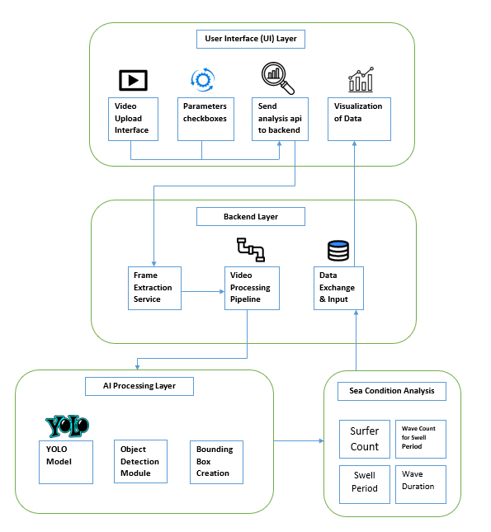
product
User uploads video and selects analysis parameters in the UI.
Backend extracts frames and processes video data.
YOLO model detects surfers and waves, creating bounding boxes.
Sea conditions like surfer count and wave duration are analyzed and visualized.
9

Slide 10
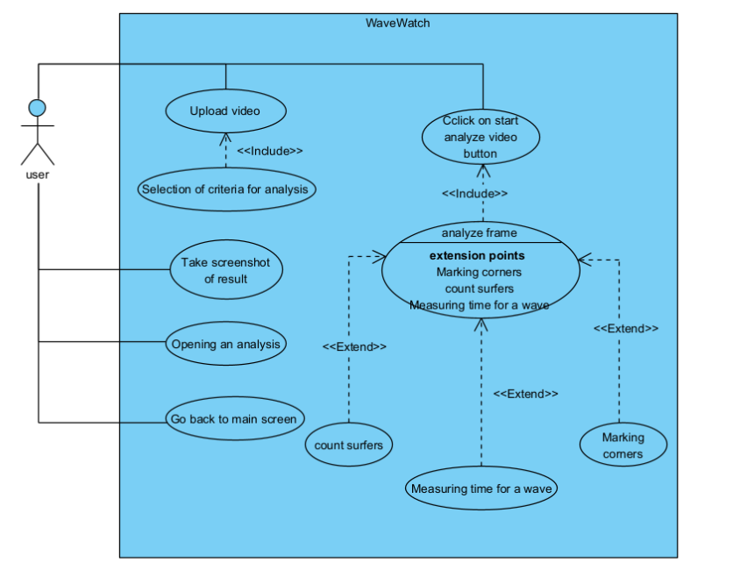
product
Upload video: The user uploads a video for analysis.
Select criteria for analysis: The user picks parameters for the video analysis.
Start analysis: The user clicks a button to begin analysing the video, which includes extensions like counting surfers, marking corners, and measuring wave time.
View results: The user can take a screenshot of the results, open a previous analysis, or return to the main screen.
10

Slide 11
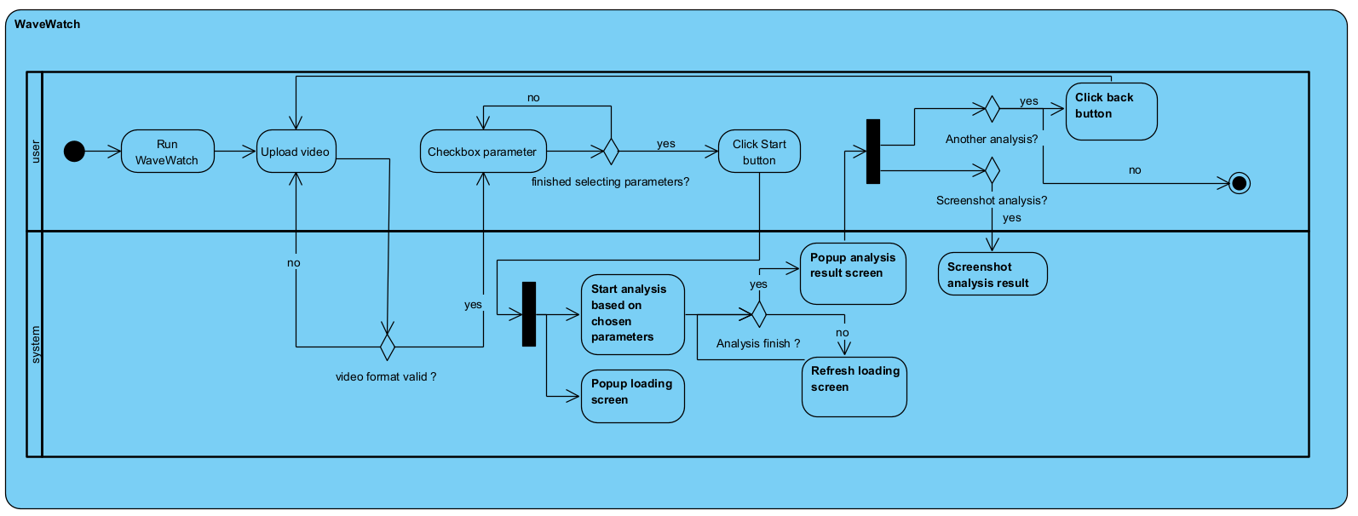
product
11

Slide 12
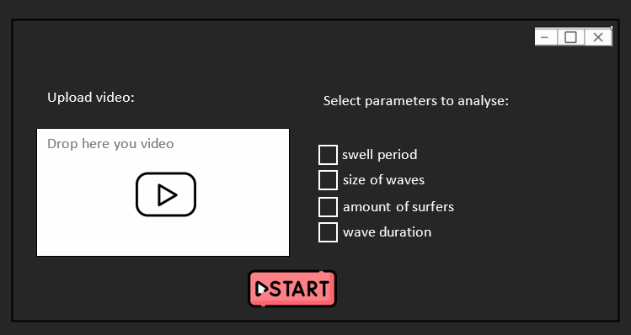
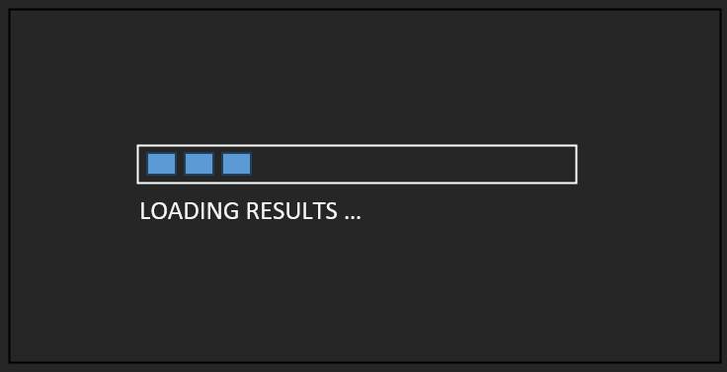
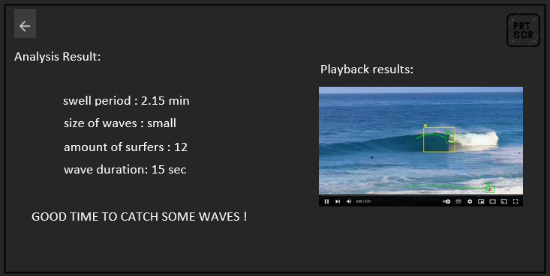
prototype
The application features a three-screen workflow: the first allows users to upload videos and select parameters for analysis, the second displays a progress indicator while processing, and the third presents the annotated results and metrics, with options to save or return to the dashboard.
12

Slide 13
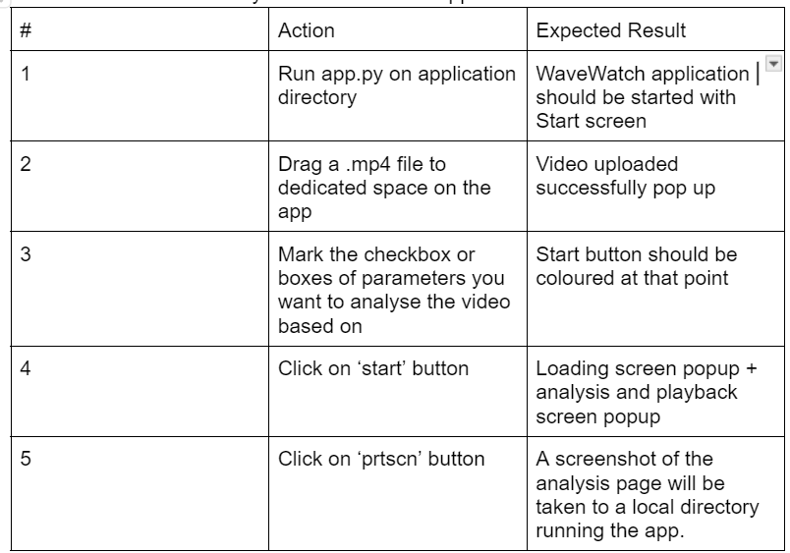
Testing plan
Functional Testing: Verify key features using manual testing and automated scripts.
13

Slide 14
Expected Achievements
AI-Driven Analysis: Delivers fast, accurate wave and sea condition insights.
User-Friendly Interface: Simplifies complex evaluations for all skill levels.
Versatile Applications: Optimizes surf sessions, ensures safety, and enhances all type of beach goers.
14

Slide 15
Conclusions
Currently, there are applications for forecasting sea conditions, but there are no tools for in-depth sea condition analysis. Our tool will be introducing a completely new aspect, making it easier for the surfing community. It will enhance the experience by providing a more enjoyable, safe, and enriching interaction with the sea.
15

Slide 16

Thank you for listening.
Q&A ☺
16

