Slide 1
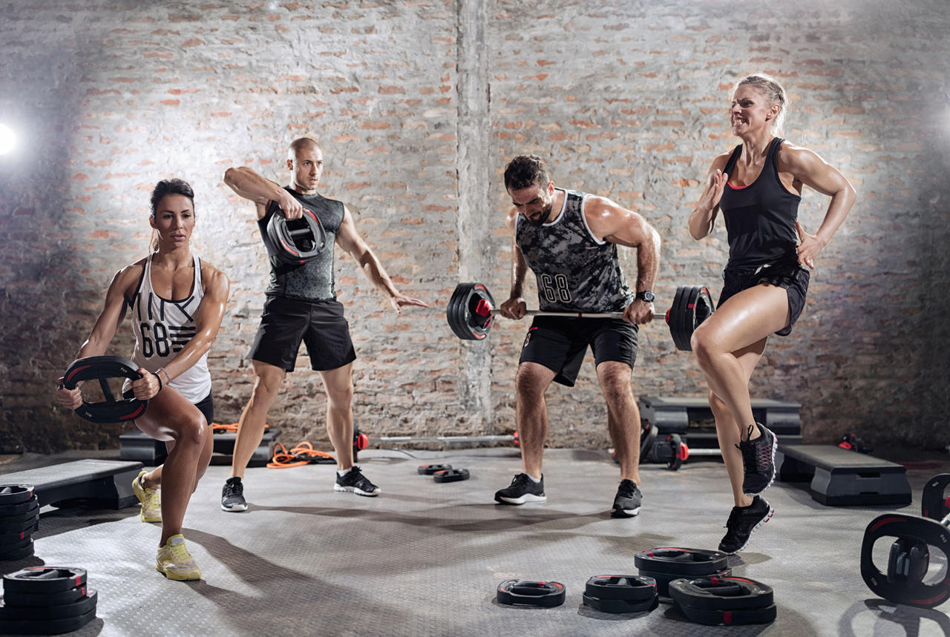
HIIT
HIIT

Slide 2
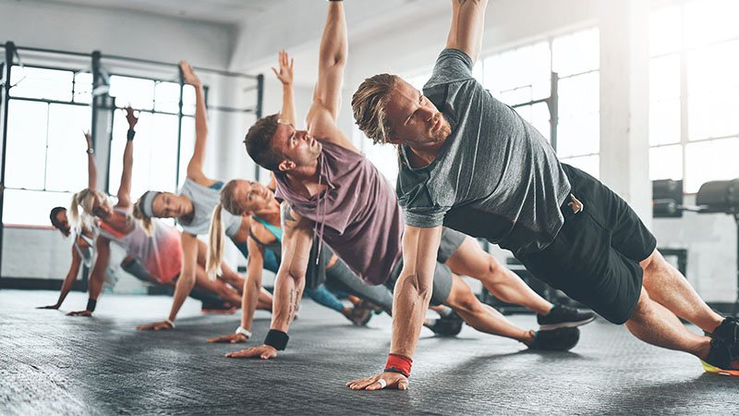
CORE
CORE

Slide 3
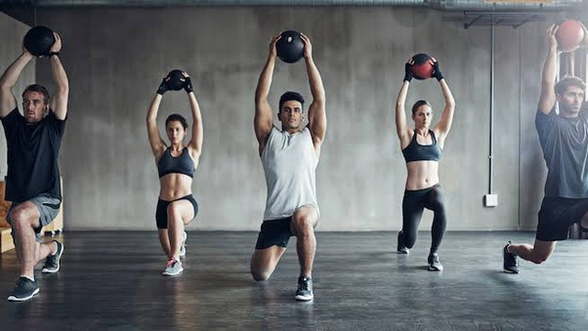
FUNCTIONAL
FUNCTIONAL

Slide 4
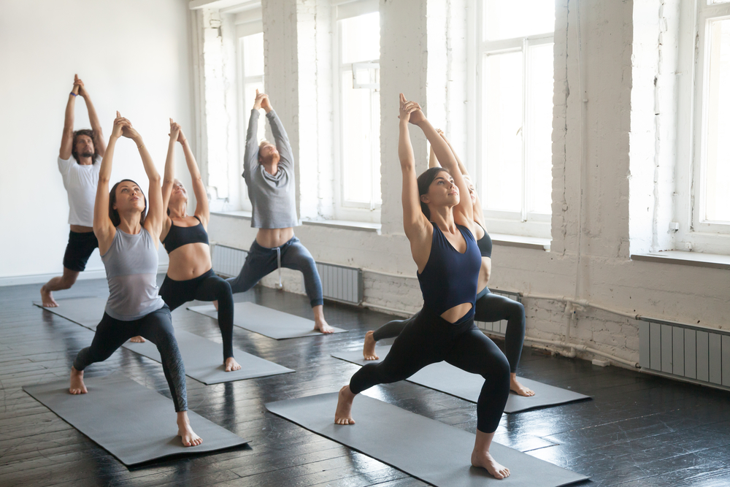
YOGA
YOGA

Slide 5
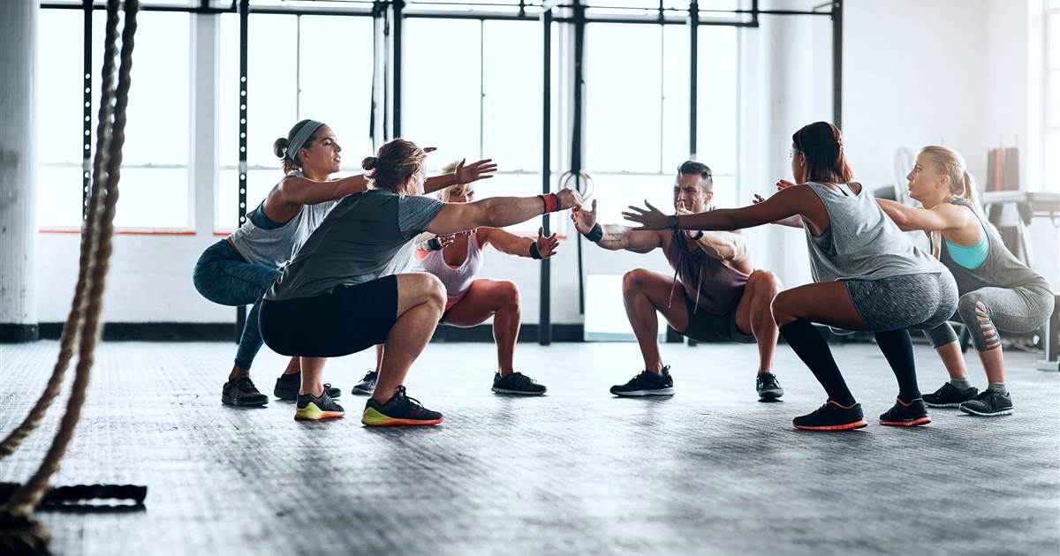
LOW IMPACT
LOW IMPACT

