Slide 1
Project 1

Slide 2
Source Data
Problem Statement
Given data blob, create simplified model that can be used to predict the prices of homes
Highlight most influential paramaters
Solution
Apply visualization techniques and utilize stat and scikit packages in python to build model

Slide 3
Data types
id - unique identified for a house
dateDate - house was sold
pricePrice - is prediction target
bedroomsNumber - of Bedrooms/House
bathroomsNumber - of bathrooms/bedrooms
sqft_livingsquare - footage of the home
sqft_lotsquare - footage of the lot
floorsTotal - floors (levels) in house
waterfront - House which has a view to a waterfront
view - Has been viewed
condition - How good the condition is ( Overall )
grade - overall grade given to the housing unit, based on King County grading system
sqft_above - square footage of house apart from basement
sqft_basement - square footage of the basement
yr_built - Built Year
yr_renovated - Year when house was renovated
zipcode - zip
lat - Latitude coordinate
long - Longitude coordinate
sqft_living15 - The square footage of interior housing living space for the nearest 15 neighbors
sqft_lot15 - The square footage of the land lots of the nearest 15 neighbors

Slide 4
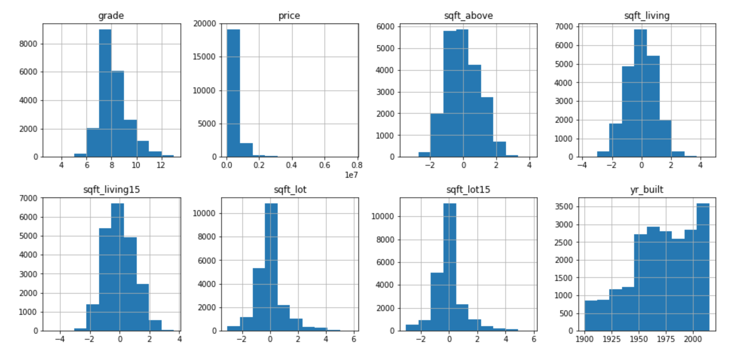
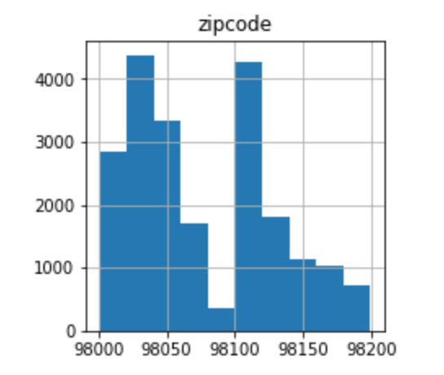
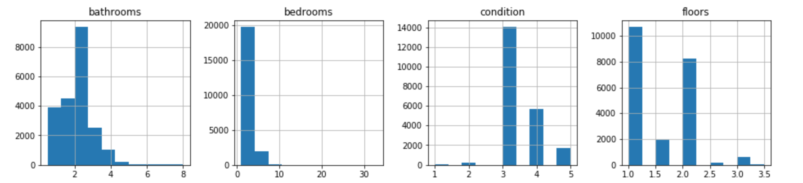
Data representation
Needed to visually investigate distribution of raw data

Slide 5
Most Influential Datapoints
bedroomsNumber - of Bedrooms/House
bathroomsNumber - of bathrooms/bedrooms
sqft_livingsquare- footage of the home
floorsTotal - floors (levels) in house
Condition - How good the condition is ( Overall )
Grade - overall grade given to the housing unit, based on King County grading system
yr_built - Built Year
sqft_living15 - The square footage of interior housing living space for the nearest 15 neighbors
Prediction Equation:
Price = -2.8e04bN + 1.06e05btN + 5.37e04sqftliv -2.53e03sqftlot +2.56e03flrs + 2.00e04cond + 1.67e05grd – 4.51e03yr_b + 3.7e04sqft_liv15
Explanation and Recommendations:

Slide 6
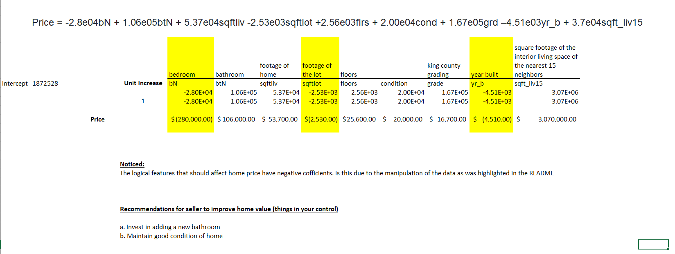
Explanations of features

Slide 7
END
Comments

