Slide 1
Project 2

Slide 2
Problem Statement
Given sqlite database file, provide recommendations to executives on the following points:
Do discounts affect product sales
Up to what level do discounts have a significant impact on sales
Provide other business insights
Solution
Utilize SQL skills to fetch data
Utillize t-tests to evaluate p values on hypothesis

Slide 3
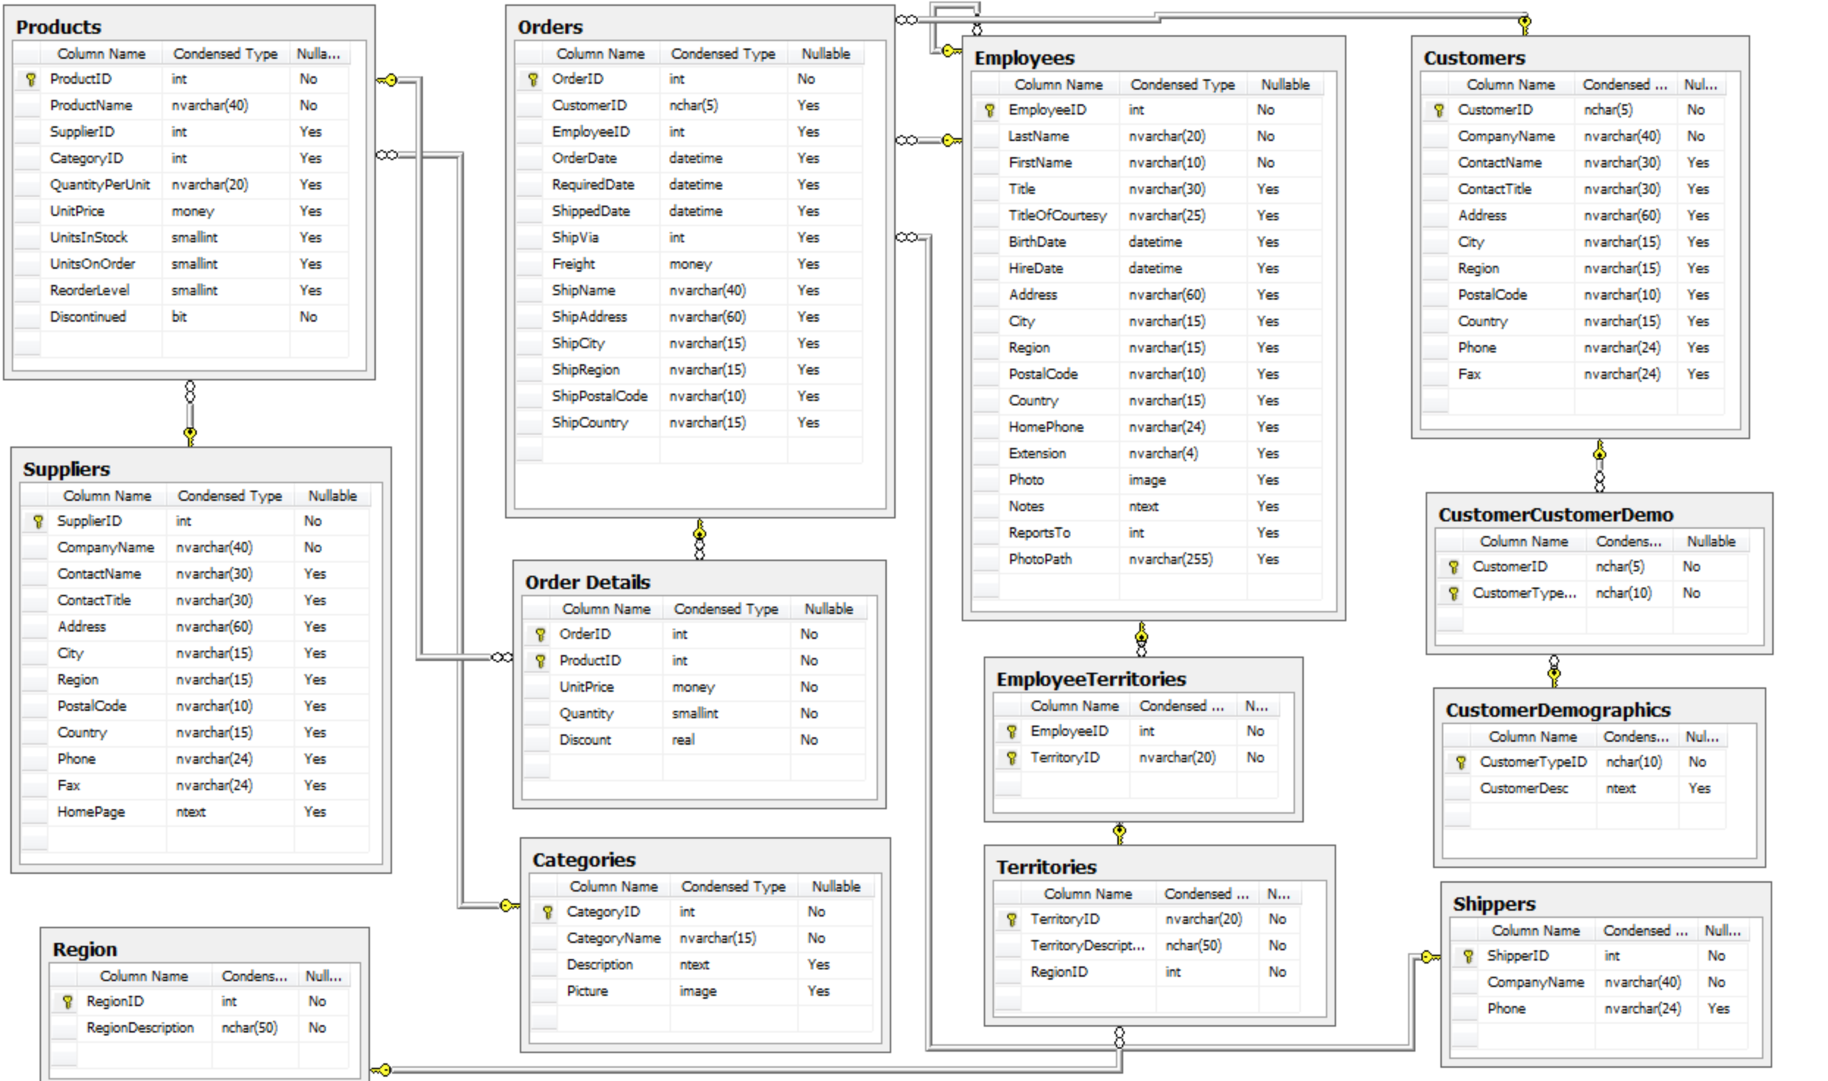
Database structure
Note: The database structure that was provided had typos in its name. This would have affected the performance of the code if I didn’t find an online SQL data viewer here
https://inloop.github.io/sqlite-viewer/

Slide 4
Data evaluation
I evaluated the quantity of products sold when there was a discount and when there was no discount.
My statistical tests revealed that
Discounts do affect product sales.
Applying more discounts on top of existing discounts is not a smart business decision as it has no significant impact on sales
It also revealed that the sales are significantly affected when a 5% discount is offered compared to a 10% discount
25% off discounts are the maximum limit that discounts should be offered up to.

Slide 5
Other business recommendations
#1. Apply more discounts to boost sales selectively
#2. Stock the same amount of products in both Western and Eastern Regions
#3. Employee sales seem to be the same across the board. Implement training for all employees
#4. Profits can be improved by giving more shipments orders to Express shipping

