Slide 1
Project 3

Slide 2
Problem Statement
Select a dataset of your choosing and create a classification model.
Start by identifying a problem you can solve with classification, and then identify a dataset.
Provide other business insights
Solution
Utilize airbnb data for bookings in Austin Texas
Perform classification task to identify features that can be used to predict customer review scores

Slide 3
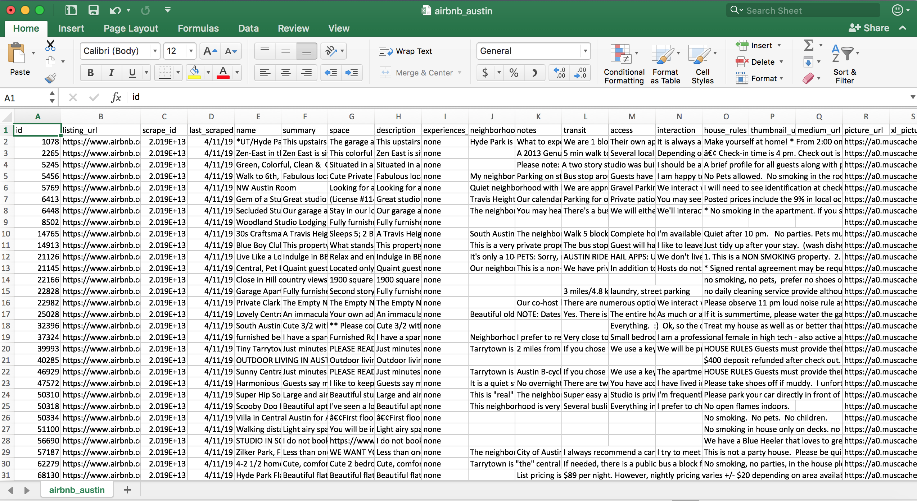
Database structure
Note: 50 MB csv data. Over 15K rows
Source: http://insideairbnb.com

Slide 4
Database structure – Relevant columns
host_id', - The ID of the host in the database
'host_url', - The url of the hosts profile in the database
'host_name', - The textual name of the host in the database
'host_since', - The date since the host has been a member of airbnb
'host_location', - The positional location of the host
'host_about', - A brief description of the host
'host_response_time', - The time it takes the host to respond to queries and questions
'host_response_rate', - The number of responses the host delivers in a day
'host_acceptance_rate', - The ratio of booking requests to acceptance for the host
'host_is_superhost', - The status of the host
'host_thumbnail_url', - A mini url for the host that they can send or embed in other webpages
'host_picture_url', - The location of the host pictures in the database
'host_neighbourhood', - The neighborhood rating of the host
'host_listings_count', - The number of active listings a host has
'host_total_listings_count', The total number of listings a host has
'host_verifications', The number of ways a host has verified themselves
'host_has_profile_pic’ – Identifier for if a host has a profile pic
'host_identity_verified', – Identifier for if a host has been verified by airbnb
'review_scores_rating', – The previous score ratings of the host
'review_scores_accuracy', – The accuracy of the reviews score
'review_scores_cleanliness', – Host score for rental cleanliness
'review_scores_checkin', - Host score for ease of checking in
'review_scores_communication', – Host score for proper and correct comminication
'review_scores_location', – Host score for rental location
'review_scores_value', - Final score for overall experience
'reviews_per_month'– Number of reviews a host gets per month

Slide 5
Data evaluation
I evaluated the data to extract the main features that could be used for my classification task.
My statistical tests revealed that
Price of rental was the most important feature that affected customers.
Cleaning fee was also very important to the customers
There seemed to be some bias to previous ratings when a customer was scoring.
Booking response time didn’t seem to affect post service scoring.

Slide 6
Business recommendations for Airbnb
#1. Recommend to property owners to aggressively price rentals (Maybe provide automatic recommendations to them of the sweet spot)
#2. Recommend aggressive or dynamic cleaning prices (e.g number of days drive cleaning price or sweet spot recommendation)
#3. Recommend first time property owners to add perks to boost initial rating score

