Slide 1
Project 4

Slide 2
Problem Structure
Select a problem
Predict stock market movement based on news headlines
Sourcing an appropriate dataset
The data set to be used was from Kaggle
https://www.kaggle.com/aaron7sun/stocknews/downloads/stocknews.zip/1
Activity:
Build, train, tune, and evaluate a Deep Neural Network

Slide 3
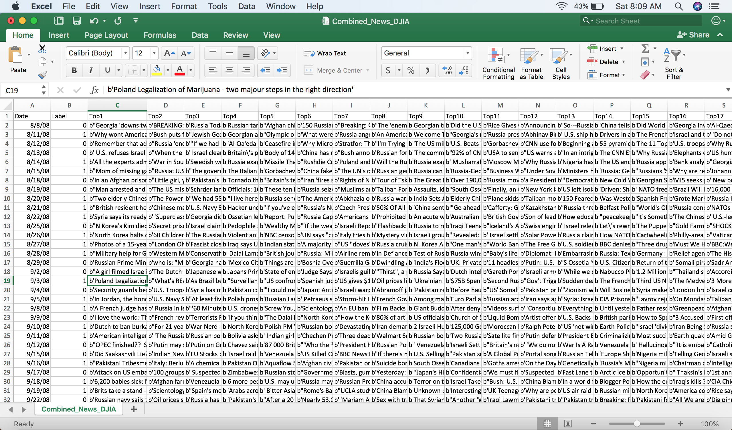
Database structure
Note: 5 MB csv data. Over 2K rows
Columns with news, Label : stock up (1) or stock down (0)

Slide 4
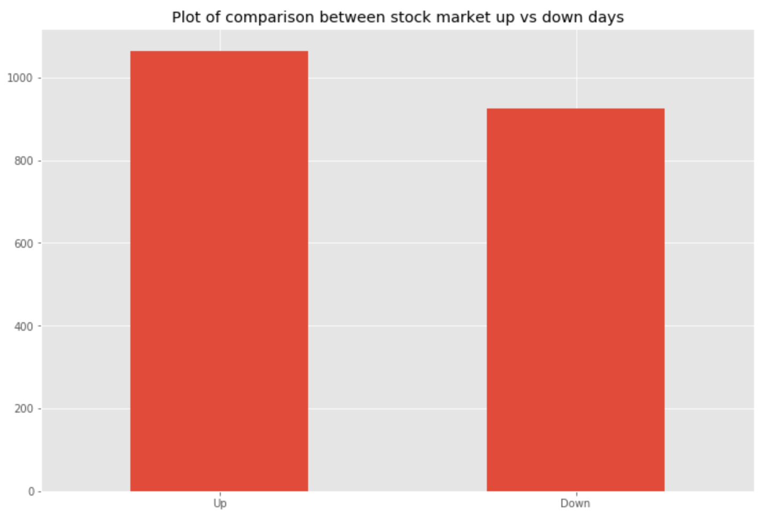
Data Visualization

Slide 5
Evaluation Process
The process was as follows:
I started by verifying that my data was structured properly and cleaned
I split the data into test and train sets based on the data range
I vectorized the text using TFID so my text was converted from human readable to machine readable.
I then built and ran 5 models and chose the best from the 5

Slide 6
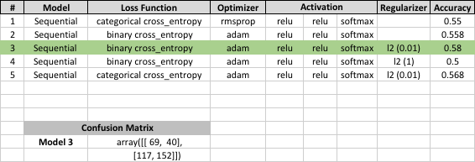
Model results

Slide 7
Interpretation
All models seemed to have the same predictive capabilities. No sizable difference
Model seems to be mimicking a “coin flip” effect
Difficult to predict stock market moves based on news headlines

