Slide 1
Project 5 Final Project for DataScience Certification

Slide 2
Problem Structure
Select a problem
Create an application that is able to fetch the top 200 tweets from CNN, BBC, BLOOMBERG, FOX and CNBC
Run a sentiment analysis on those tweets and recommend the most positive sentiment news tweets to a user upon request
Sourcing an appropriate dataset
The data set to be used was live tweets from the twitter handles of the news organizations above.
Activity:
Fetch data from twitter into note book, process data, analyze sentiment, build recommendation outline

Slide 3
Process
Determine news outlets
Create twitter access credentials and store them
Write script to fetch and analyze latest 200 tweets
Build an interactive interface to allow user to input news outlet and sentiment preference

Slide 4
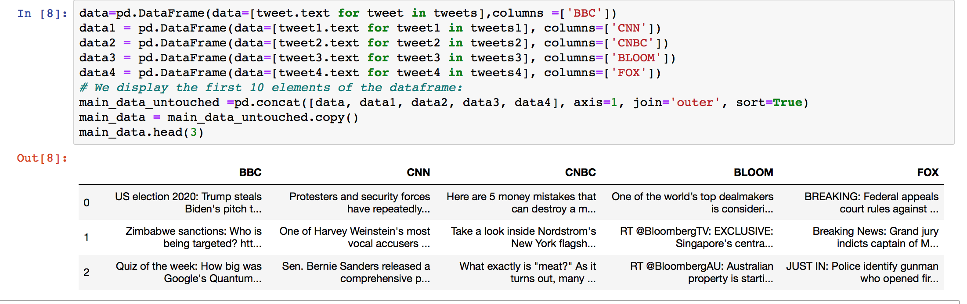
Database structure
Note: Showing only the top 3 tweets

Slide 5
Sentiment Evaluation
Sentiment on tweets is analyzed using Textblob.sentiment functionality
The sentiment analysis returns values between -1 and 1
Pick tweets from each news outlet with the maximum positive value

Slide 6
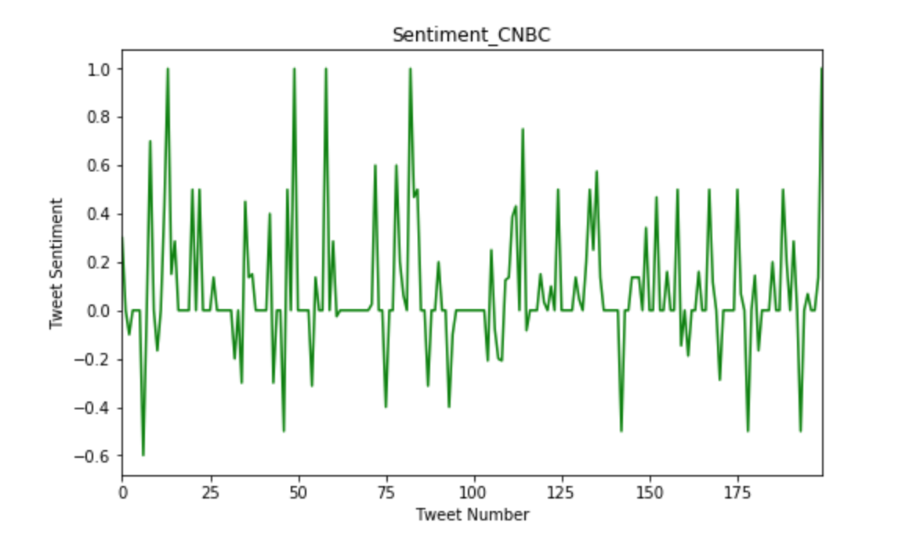
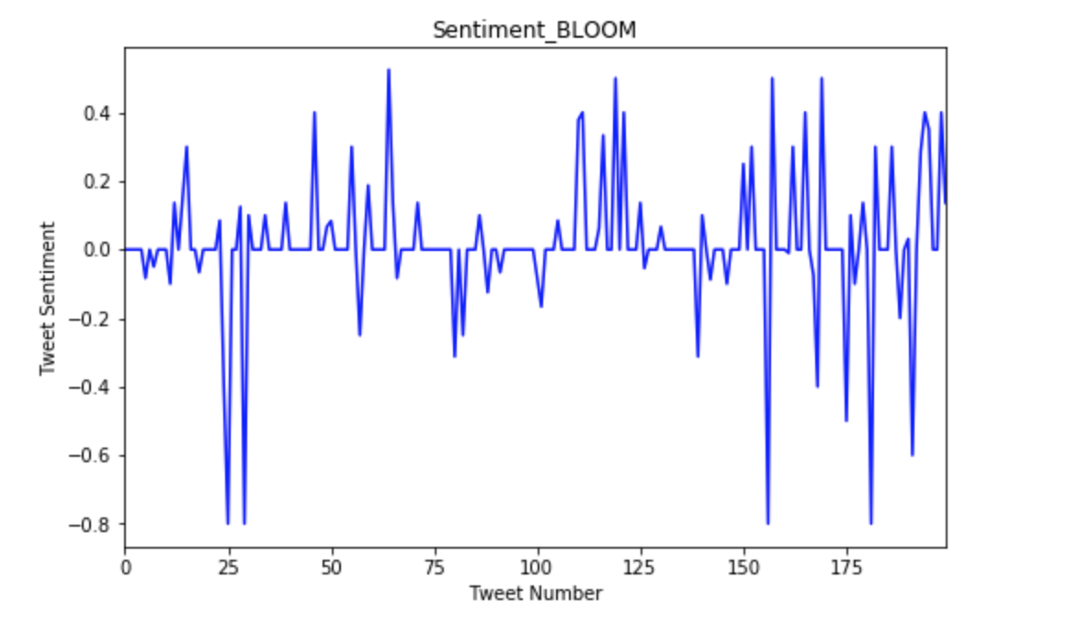
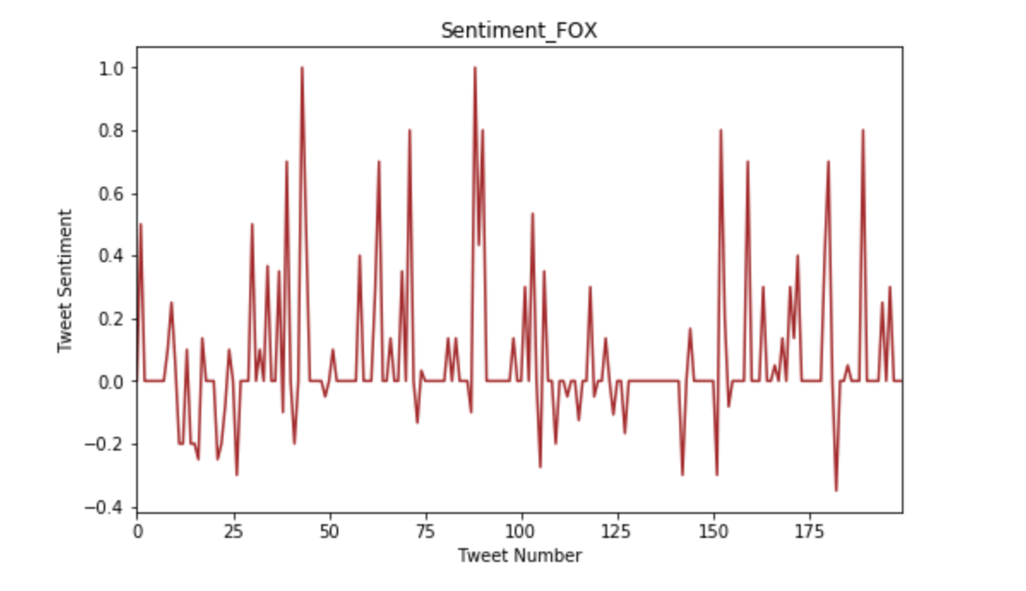
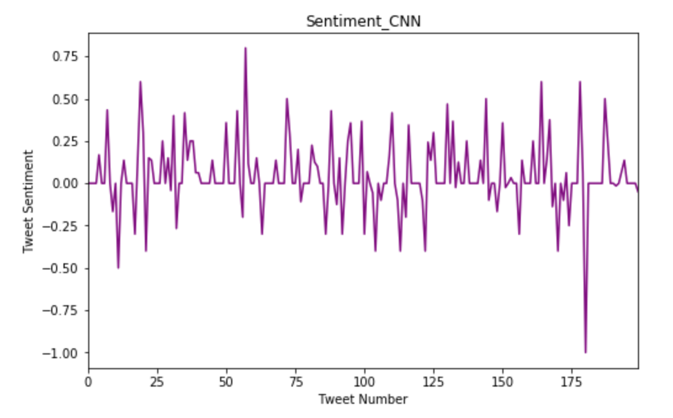
Visualization

Slide 7
Jarvis
Jarvis is a simplified interactive interface that asks the users:
Which news outlet they want their news from
If they want the most positive news or if they are indifferent.
Then it fetched the news tweets.

Slide 8
Summary
Script created to link to Twitter and fetch tweets
Sentiment analysis performed to analyze input tweets
Simplified User interface AI created to interact with users

