Slide 1
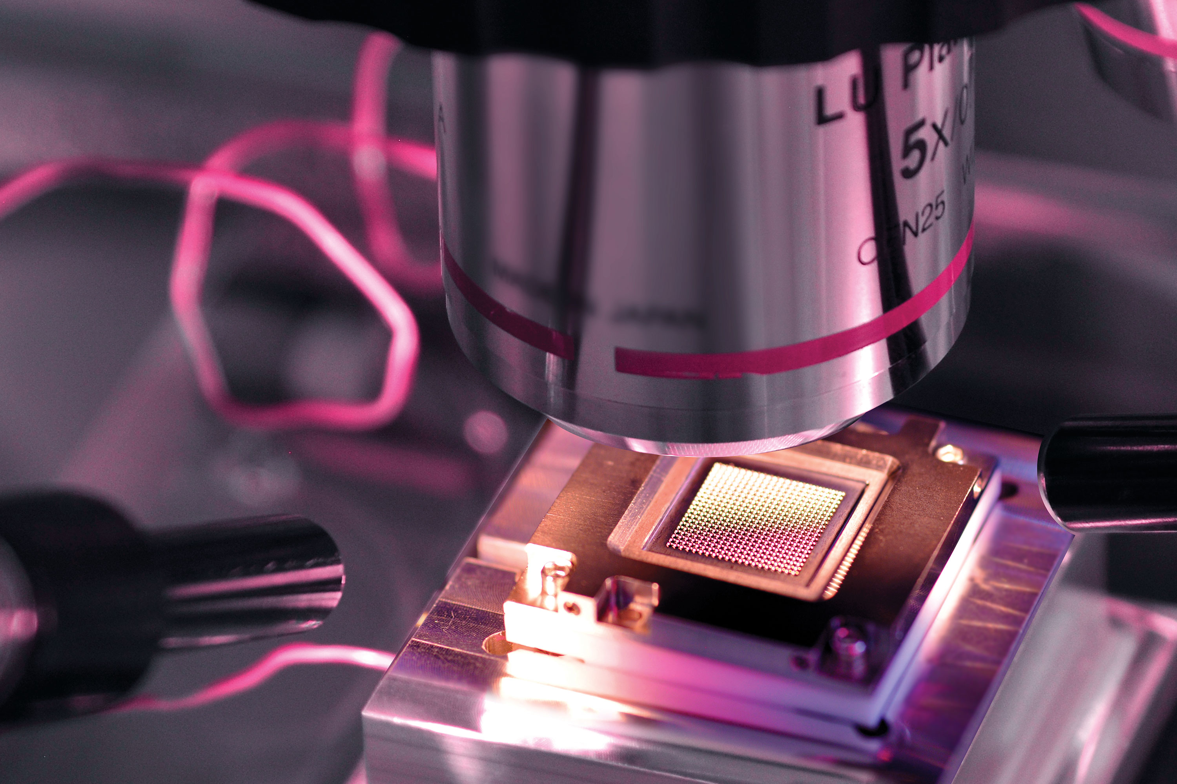
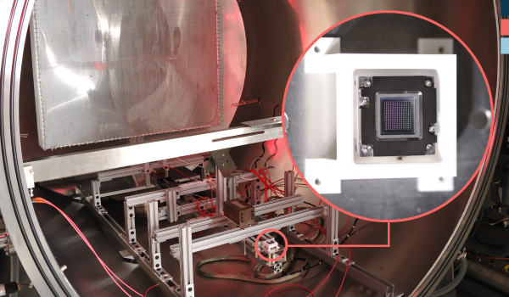
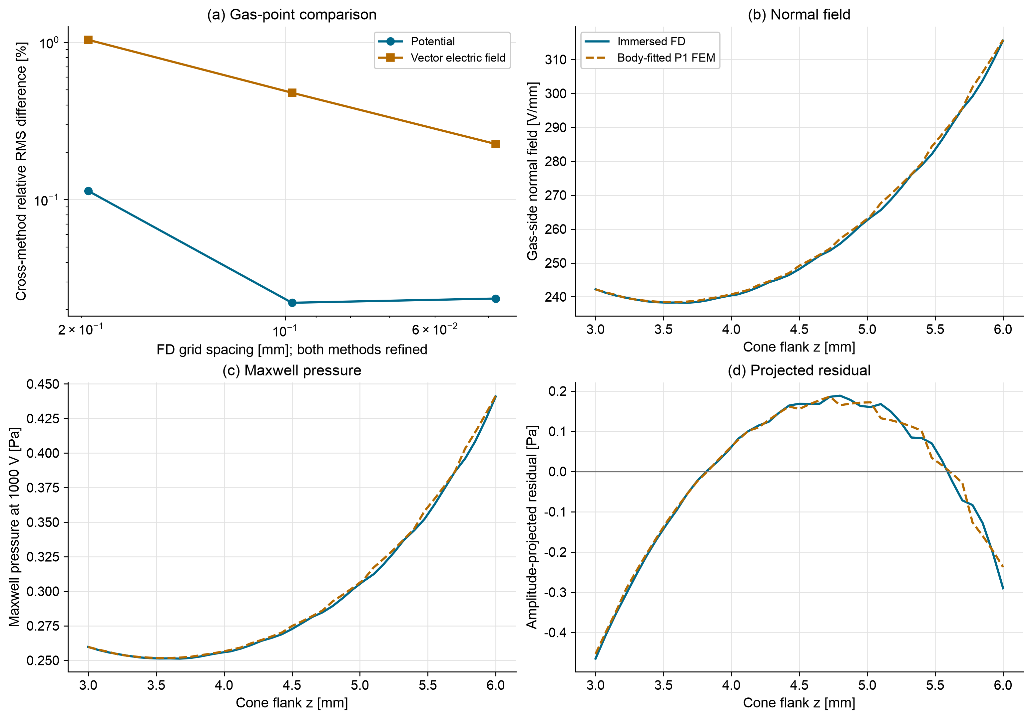
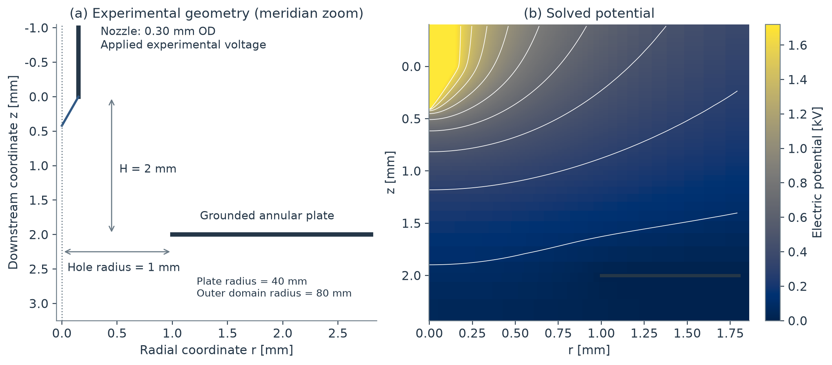
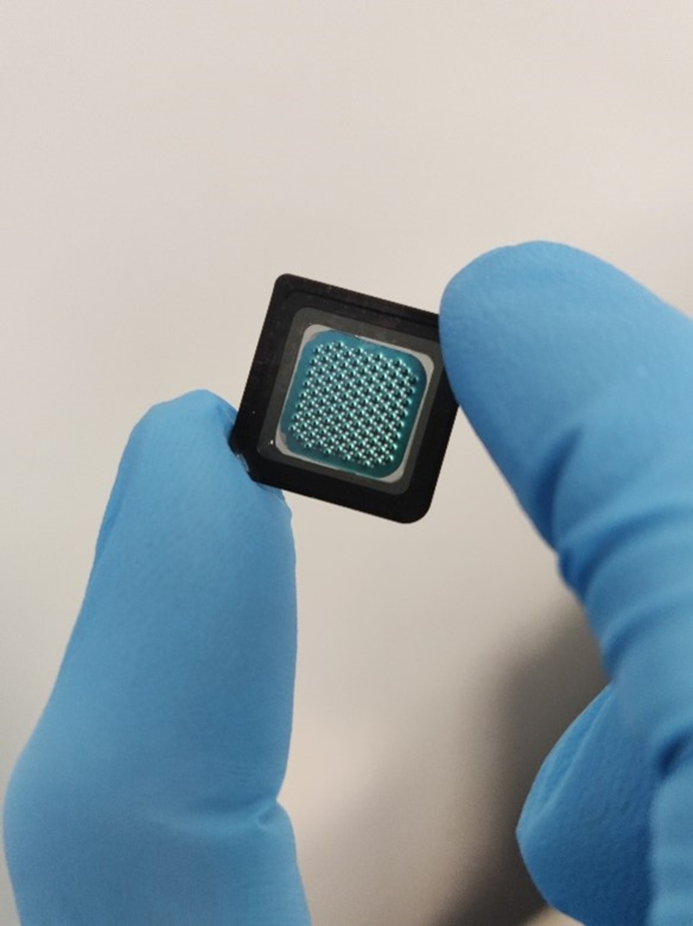
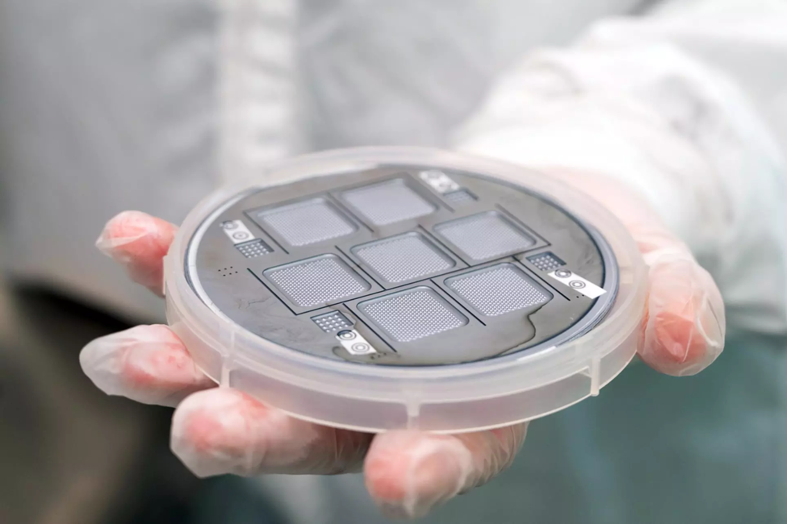
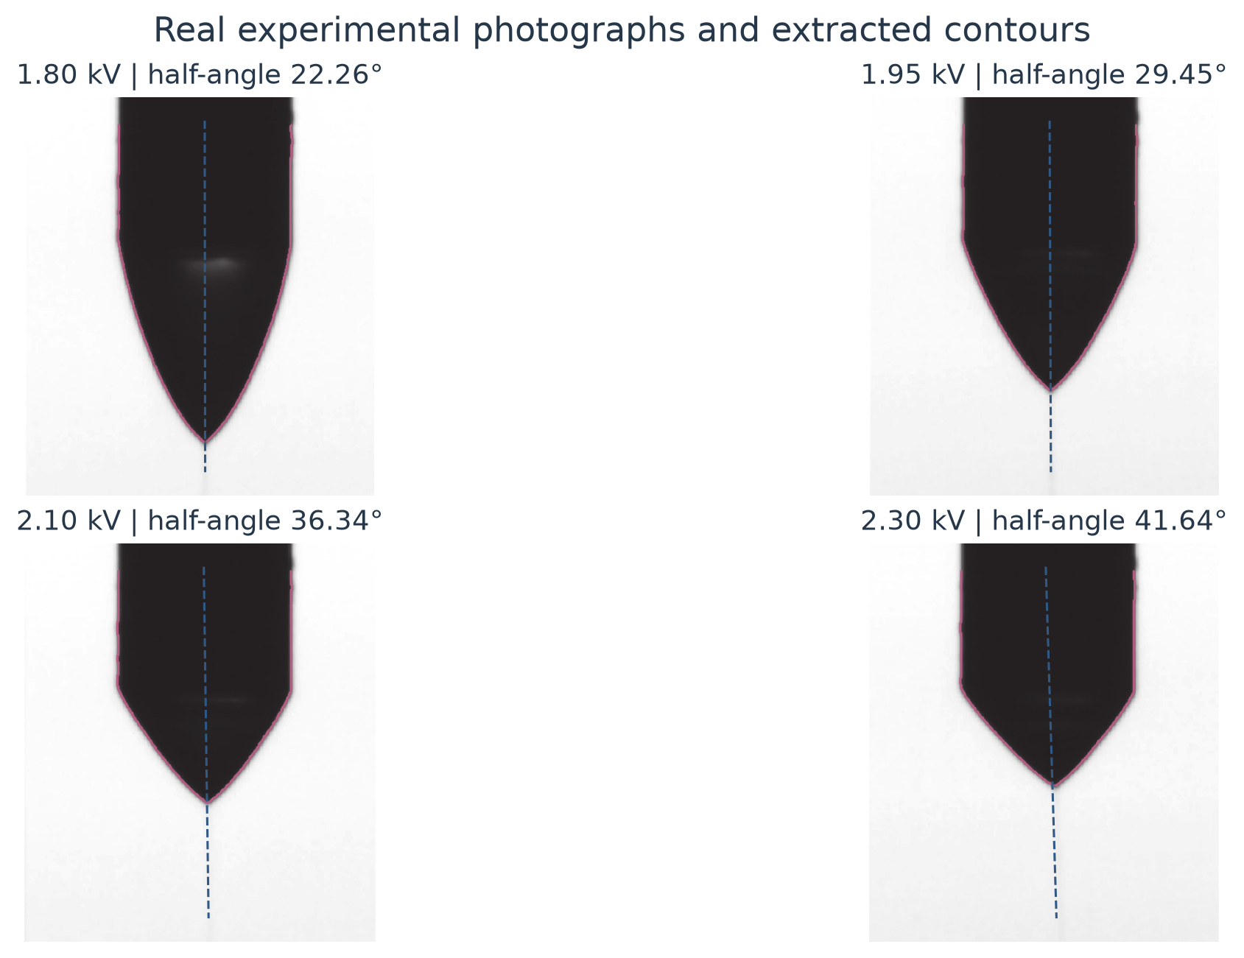
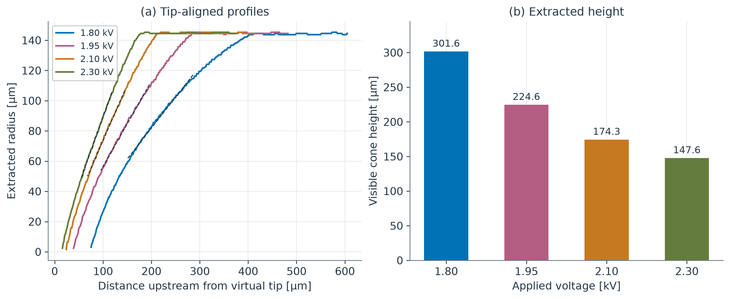
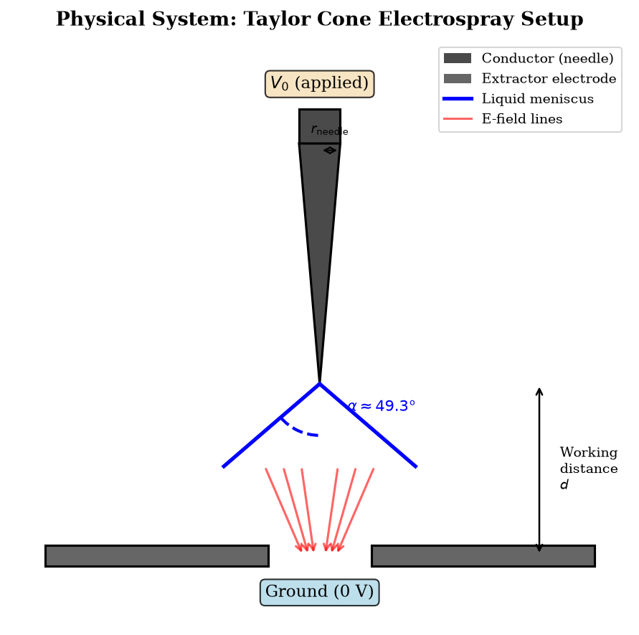
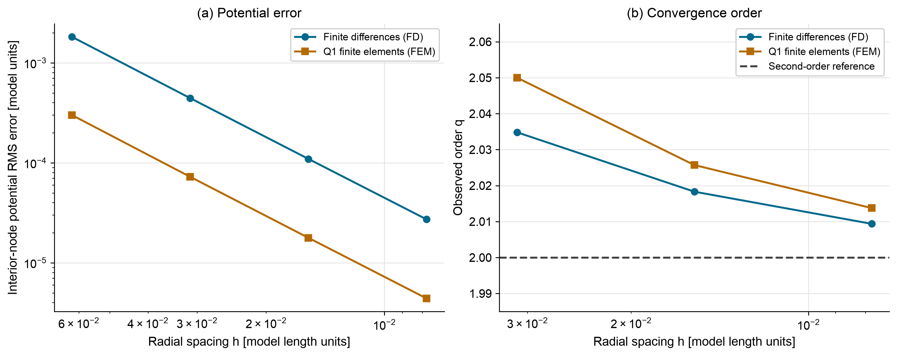
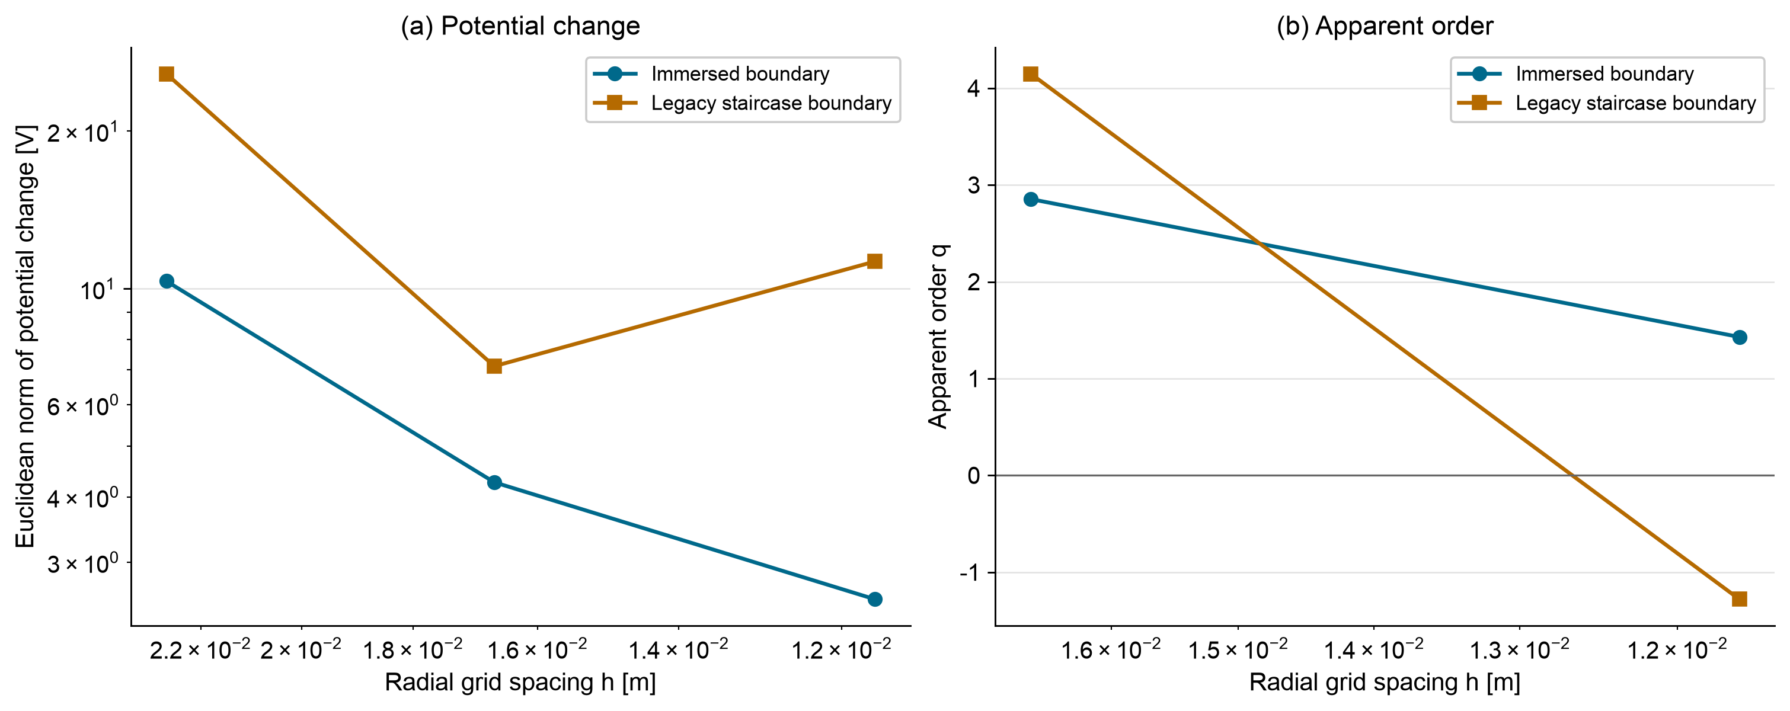
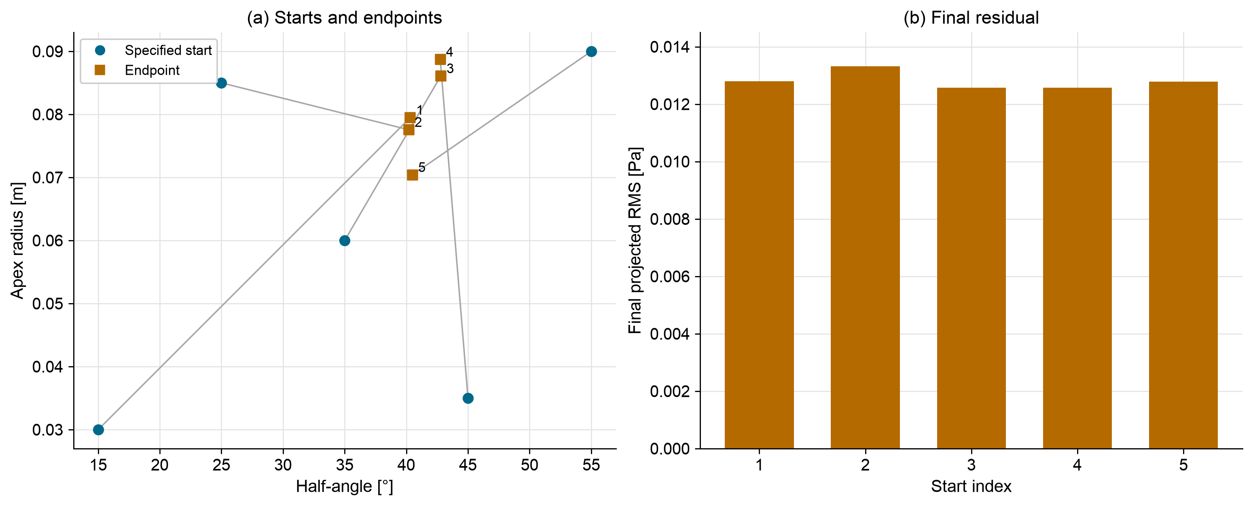
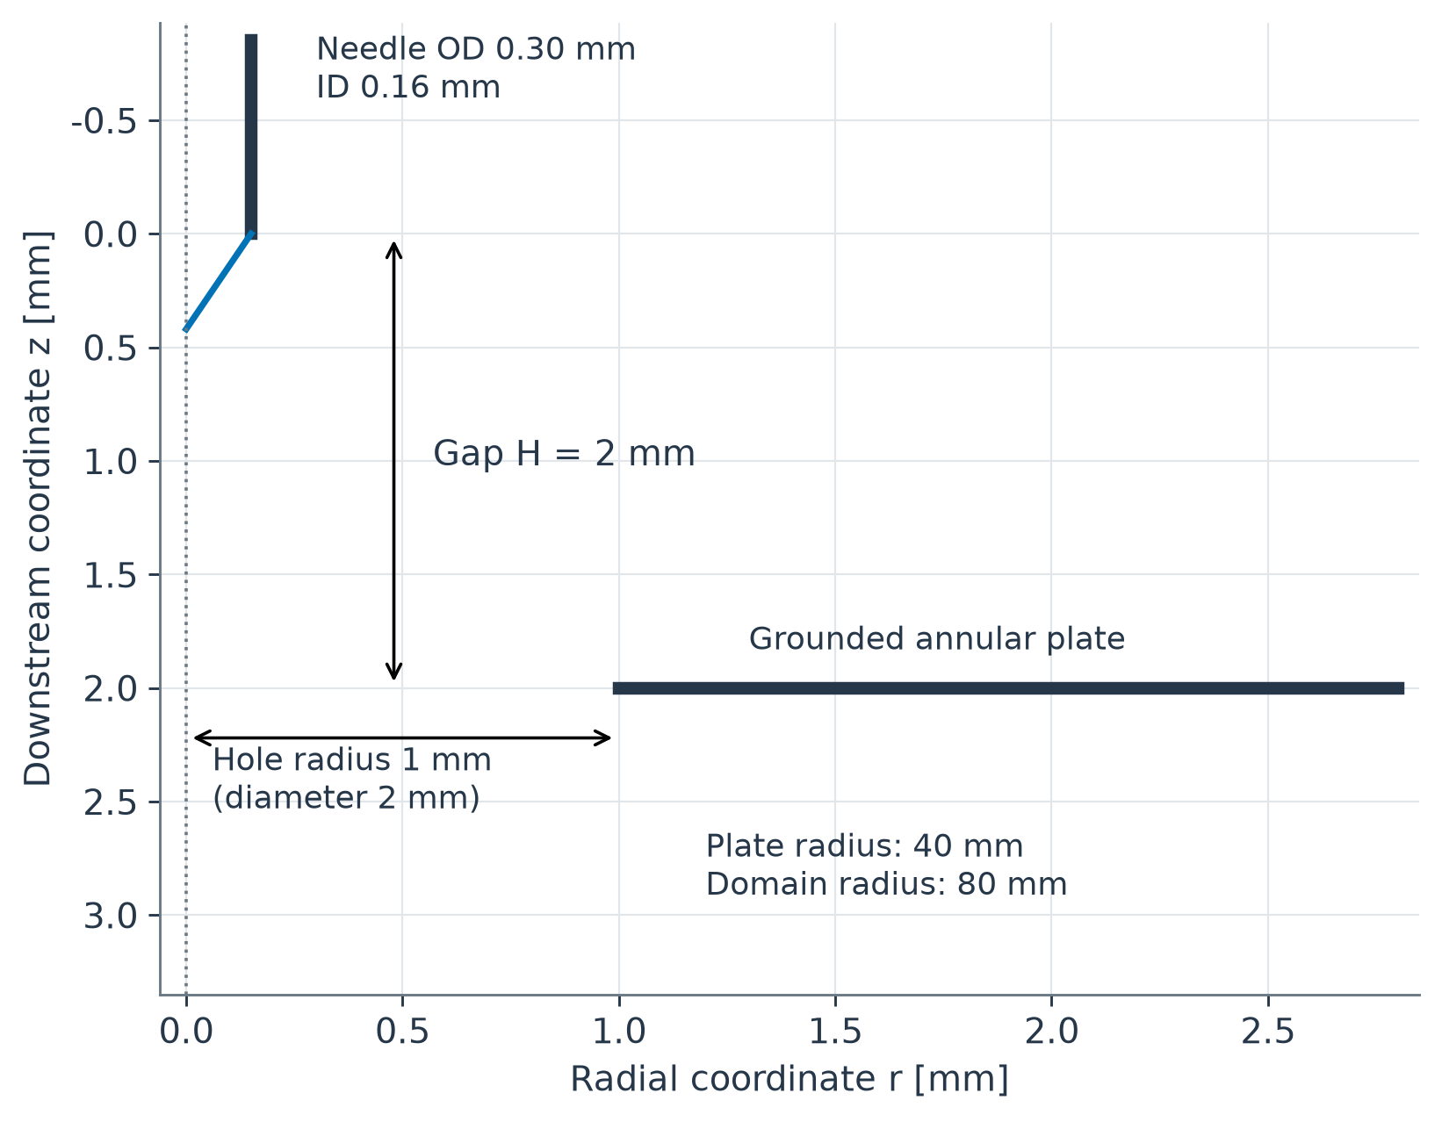
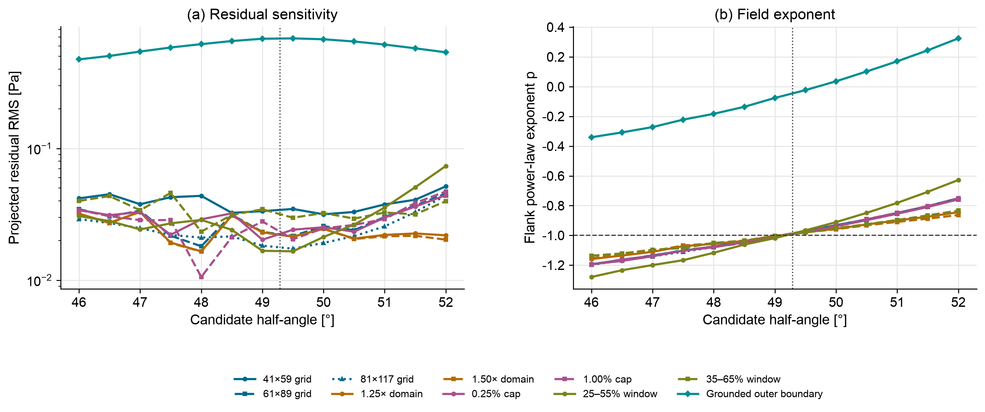
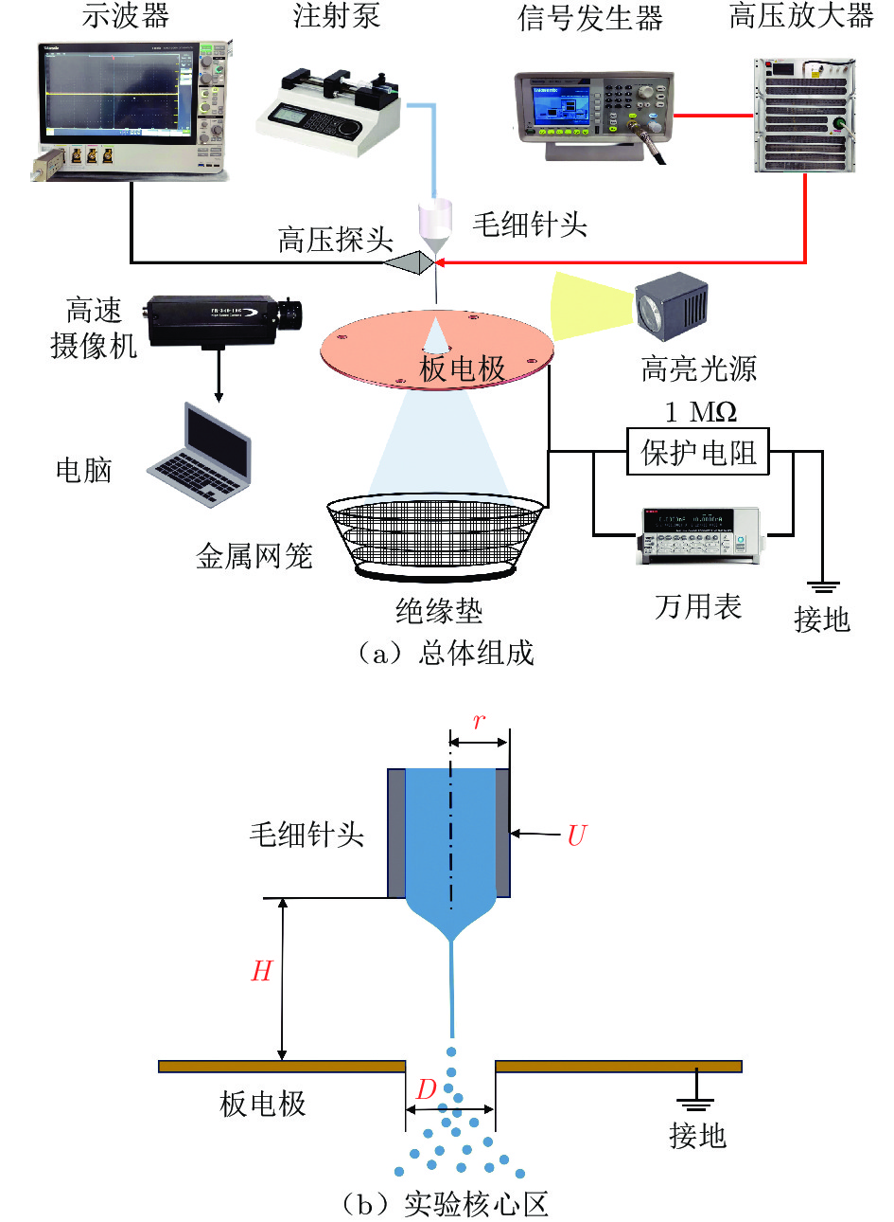
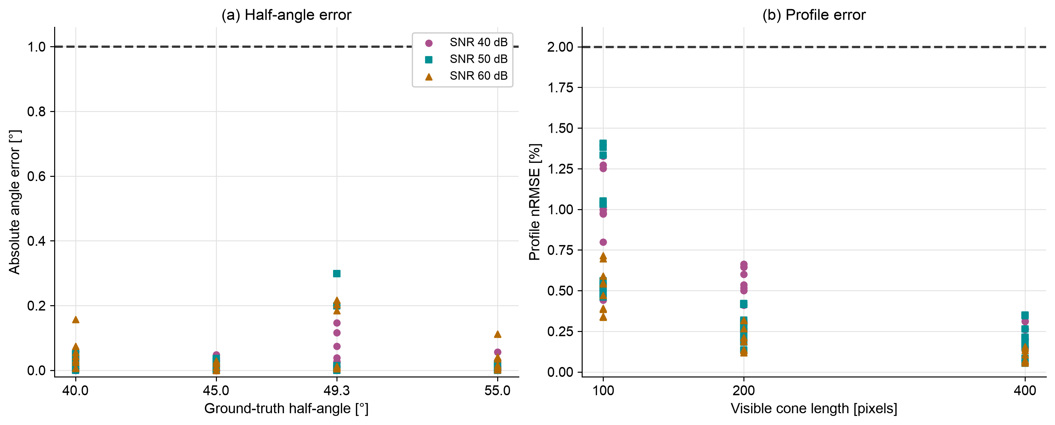
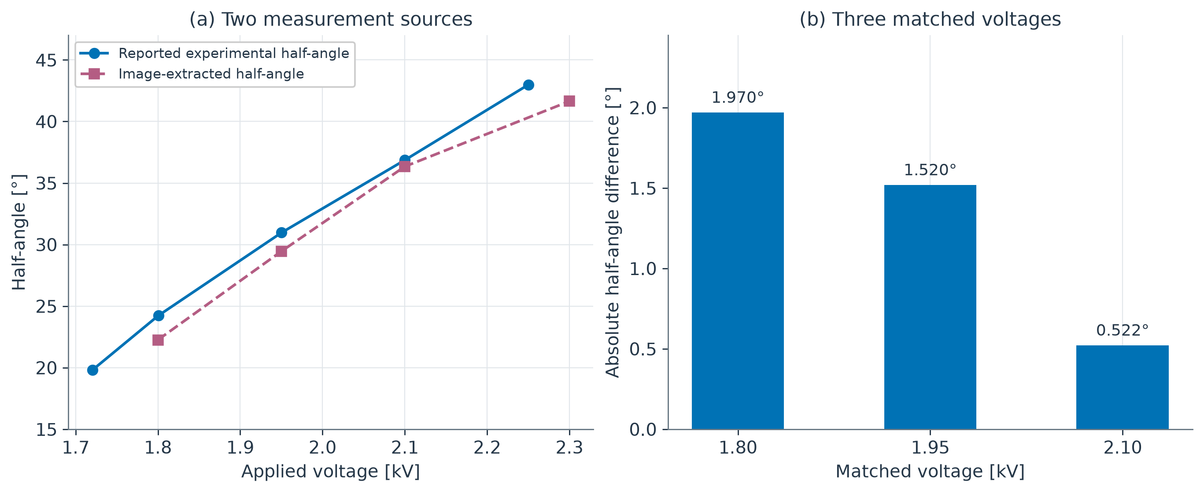
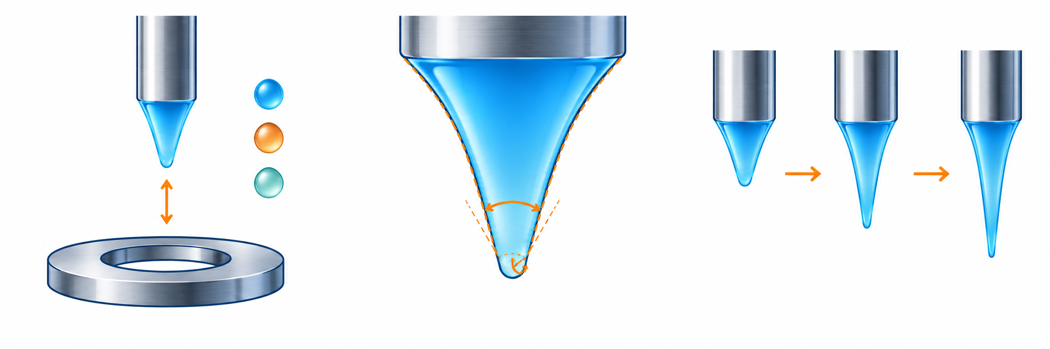
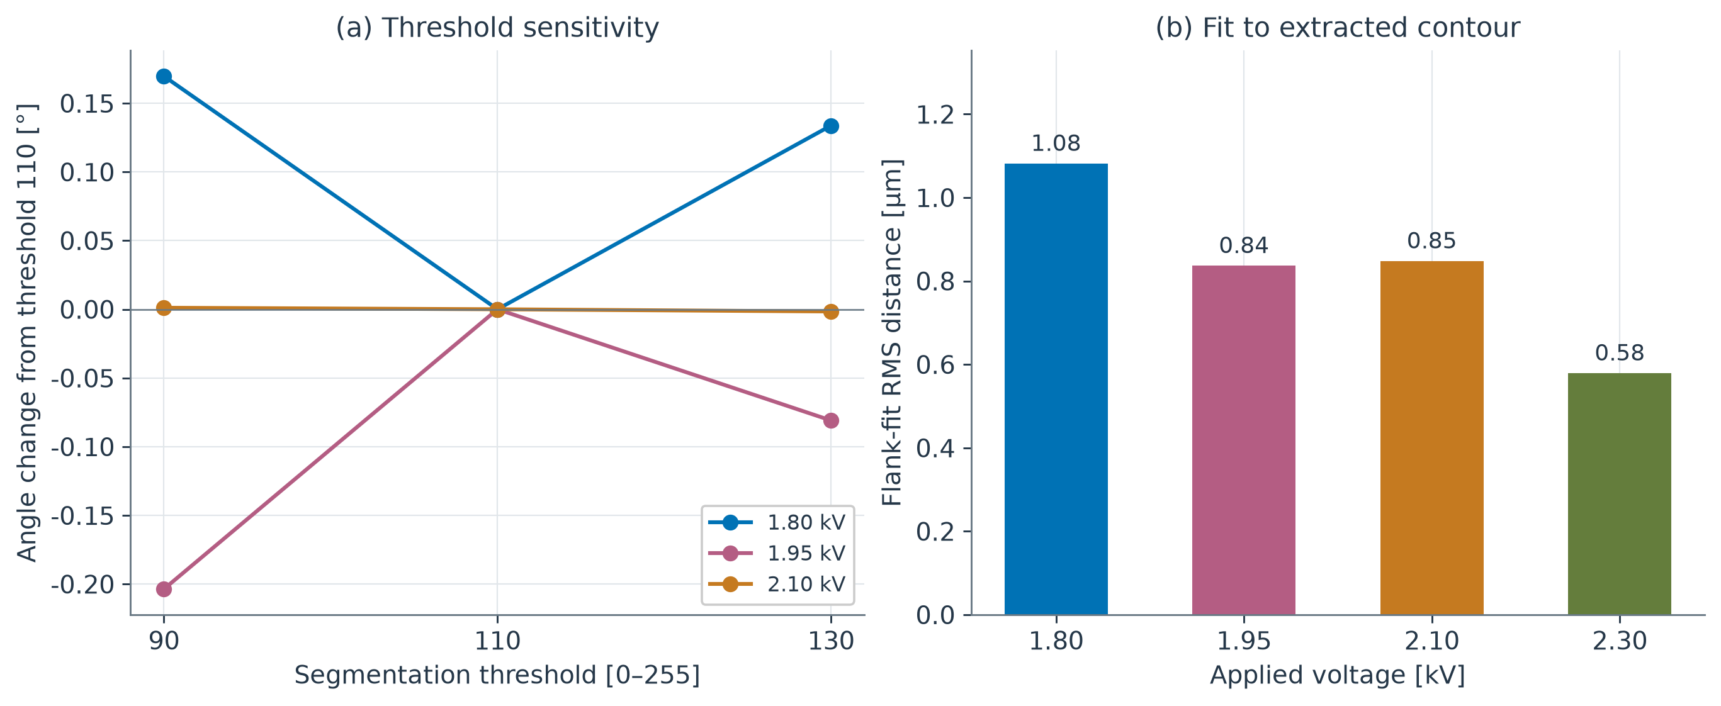
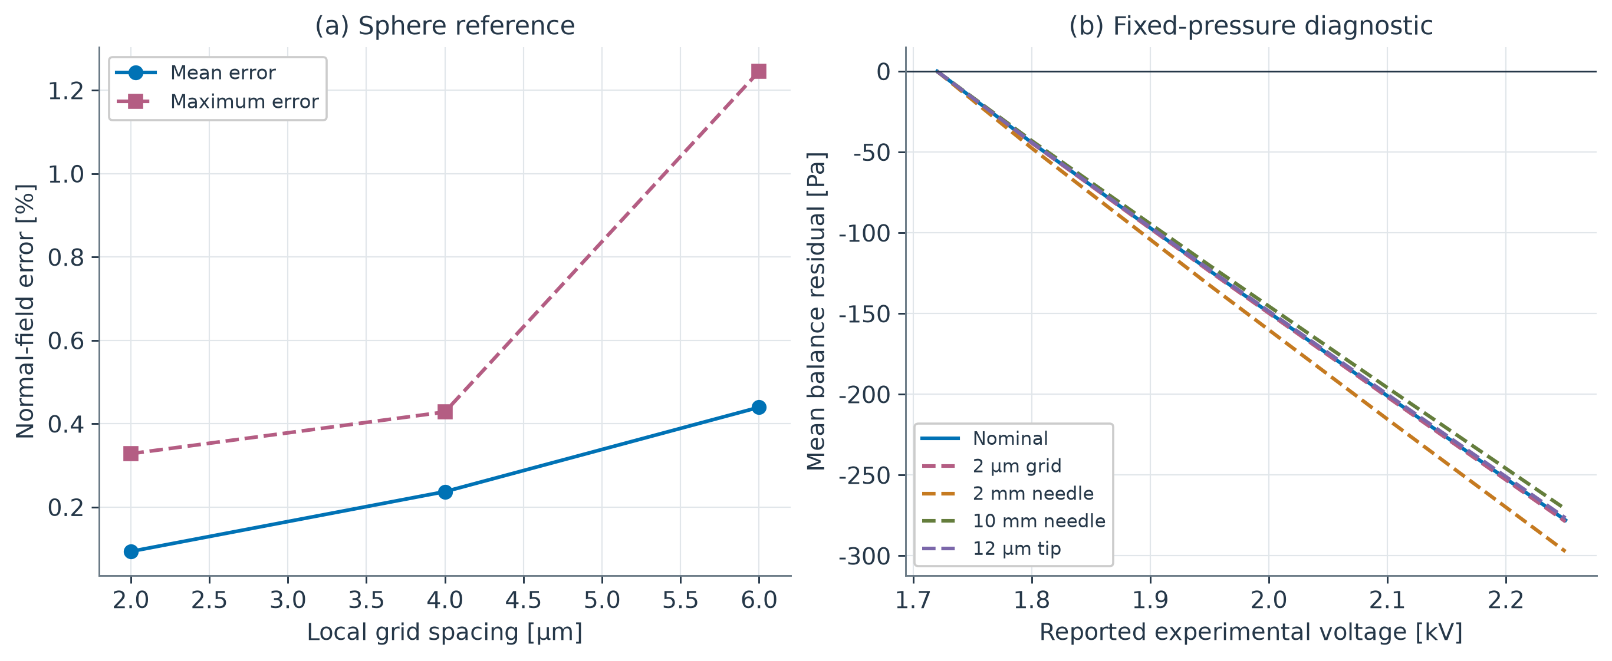
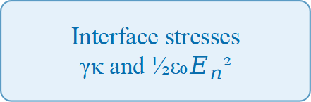
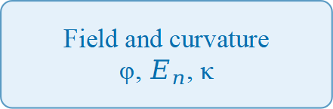
INTRODUCTION
Taylor-Cone Analysis
FIELD AND STRESS
1. Electrospray applications
Numerical Verification and Experimental Image Analysis
FD–FEM metric | Difference / %
Potential RMS | 0.024
Vector field RMS | 0.226
Normal field RMS | 0.381
Maxwell pressure RMS | 0.817
Projected residual RMS | 2.518
Projected voltage | 1.071
Electric stress. An applied voltage stretches the liquid surface while surface tension resists deformation.
Application. Cone geometry controls the local field in miniature electrospray emitters.
Ethan Yang · Elliot Dong · Curtis Lau
Emitter alignment
Independent Schools Foundation Academy
METHOD AND WORKFLOW
2. Research question
NUMERICAL ANALYSIS
Vacuum testing
Field accuracy： How accurately does a lightweight solver recover the electric field and interface stress?
Shape measurement： Can image-derived angles support a quantitative experimental comparison?
Geometry and inputs
Angle, tip radius, voltage
Field and curvature
φ, $E_{n}$, κ
Interface stresses
γκ and ½ε₀$E_{n}$²
Balance residual
R = pγ − pE − Δp
EXPERIMENTAL IMAGES
Microfabricated emitter
Published photographs
Ethanol cone-jet case
Scale and axis
Scale bar, registration
Profile and half-angle
Contour and flank fit
Angle comparison
Three matched voltages
Fig. 12. Maxwell pressure and projected stress comparison.
3. Our approach
Computed potential, 1.72 kV
Matched conditions. Both methods share geometry, voltage, material constants and sampling locations.
Stress agreement. Electric pressure follows ½εEn². The finest-grid Maxwell-pressure RMS difference is 0.817%.
Numerical verification. Compare finite differences with FEM and analytical references.
Experimental images. Extract four ethanol cone profiles and compare angles at three matched voltages.
Numerical checks. Analytical references and independent FEM test the field solver.
Experimental comparison. Pair extracted and reported angles. Use reported geometry for a separate stress-balance diagnosis.
IMAGE MEASUREMENT
Emitter arrays
EXPERIMENTAL IMAGES
Scale and axis. Read the 300 µm scale bar and register the needle centreline.
Boundary and fit. Extract both sides, select the flank window and fit the half-angle.
Profile alignment. Use the fitted flank intersection as the virtual tip.
PHYSICAL MODEL
1.80 kV
1.95 kV
2.10 kV
2.30 kV
The axisymmetric model links candidate cone geometry to electric potential, normal field, curvature and stress balance.
Governing equations
∇²φ = −ρ/ε
E = −∇φ
p_{E} = ½ εE_{n}²
p_{γ} = γκ
R = p_{γ} − p_{E} − Δp
Δp = ⟨p_{γ} − p_{E}⟩
α = 22.26° h = 301.6 µm
α = 29.45° h = 224.6 µm
α = 36.34° h = 174.3 µm
α = 41.64° h = 147.6 µm
Fig. 13. Tip-aligned profiles and extracted cone heights.
Fig. 3. Ethanol photographs. Pink: extracted boundary. Blue: registered axis. Labels give image-extracted half-angle α and visible height h.
Shape change. Cone height decreases as the extracted half-angle increases across the four photographs.
Sensitivity. Threshold changes give at most a 0.204° angle range at the three matched voltages.
Metric. Synthetic profile nRMSE divides radial RMS error by the reference cone length.
Voltage trend: From 1.80 to 2.30 kV, the extracted half-angle increases from 22.26° to 41.64° while visible cone height decreases from 301.6 to 147.6 µm.
Consistent measurement: A common scale conversion and axis registration make the four profiles quantitatively comparable.
Ideal Taylor reference: 49.29°
RESULTS
Fig. 1. Conceptual cone and electrode geometry.
PARAMETER STUDY
Geometry. Half-angle and rounded tip radius define a candidate interface. Electrical boundaries determine the surrounding field.
Field recovery. Sparse finite differences solve potential and reconstruct the gas-side normal field.
Stress balance. Curvature gives γκ. A pressure offset Δp completes the normal-stress balance.
1. Grid convergence
2. Curved boundary
Fig. 14. Five optimization starts and final residuals.
EXPERIMENT SETUP
Fig. 4. Potential error and convergence order.
Fig. 5. Potential changes between successive grids.
Result. Five starts reach 40.199°–42.791° with similar final residuals.
Interpretation. Different angle–radius pairs remain admissible. Additional profile measurements could constrain this ambiguity.
Dataset. Ethanol photographs and reported angle–voltage measurements.
Apparatus. Needle OD / ID: 0.30 / 0.16 mm. Gap: 2 mm. Plate-hole diameter: 2 mm.
Conditions. Flow rate 0.10 µL/s, temperature 25°C and surface tension 0.022 N/m.
Purpose. Check the regular Poisson solver against a known exact potential.
Result. FD orders are 2.035, 2.018 and 2.009. Independent Q1 FEM also approaches second order.
Meaning. Refinement reduces the error of the regular numerical component.
Purpose. Compare successive grids at the same 56 gas-side sampling points.
Result. Immersed-boundary potential changes decrease with refinement. Staircase changes vary more strongly.
Meaning. Boundary representation affects the stability of the refinement trend.
CONCLUSION
3. FD–FEM agreement
4. Angle sensitivity
Fig. 2. Model geometry (above) and experimental equipment from Yang et al.
Fig. 15. Finest-grid FD–FEM relative RMS differences (%).
Fig. 6. Potential differences and normal electric field.
Fig. 7. Residual landscape and field exponent.
Numerical accuracy. Near-second-order Poisson convergence and independent FEM agreement for potential, field and stress.
Measurement. All 108 synthetic cases pass; experimental half-angles differ by 1.337° on average at three matched voltages.
Physical diagnosis. Fixed-pressure residuals persist at higher voltages across the tested numerical settings.
Parameter insight. Similar residuals allow different angle–radius pairs, motivating additional geometric observations.
Pump
Camera
HV amplifier
Purpose. Cross-check two independent solvers on the same fixed rounded cone.
Result. Finest RMS differences are 0.024% in potential and 0.226% in the vector field.
Meaning. Agreement extends from gas-point potential to the interface normal field.
Purpose. Vary grid, domain, tip rounding, fitting window and outer boundary.
Result. Residual minima shift. With Taylor far-field data, exponent crossings lie at 49.067°–49.176°.
Meaning. The exponent diagnostic is more stable than the residual-minimizing angle in these tests.
Experimental inputs
A reproducible workflow connects verified field calculations, cone measurements and quantitative experimental-image comparisons.
Quantity | Value
Photo voltages | 1.80, 1.95, 2.10, 2.30 kV
Image scale bar | 300 µm
Photo / report pairs | 1.80, 1.95, 2.10 kV
5. Synthetic measurement
6. Experimental angles
FUTURE WORK
DATA PAIRING
Voltage (kV) | Image angle (°) | Reported angle (°)
1.72 | — | 19.80
1.80 | 22.26 | 24.23
1.95 | 29.45 | 30.97
2.10 | 36.34 | 36.86
2.25 | — | 42.99
2.30 | 41.64 | —
Fig. 8. Half-angle and profile errors in 108 images.
Fig. 9. Image-extracted and reported half-angles.
More conditions
Joint identification
Time evolution
Purpose. Test known cone silhouettes with varied length, rotation and blur/noise.
Result. All 108 cases meet the 1° angle and 2% profile limits. Maxima are 0.299° and 1.406%.
Meaning. The registered image pipeline recovers the prescribed geometry across the tested cases.
Purpose. Pair photographs with reported markers at 1.80, 1.95 and 2.10 kV.
Result. Mean absolute angle difference is 1.337° and the maximum is 1.970°.
Meaning. The two measurement sources show a consistent increase of half-angle with voltage.
Fig. 16. Proposed extensions (schematic).
More conditions. Extend comparisons to more voltages, electrode gaps and liquids.
Joint identification. Combine half-angle and full-profile information to constrain geometry.
Time evolution. Track interface motion in image sequences.
Shaded rows form the three matched pairs. Voltages rounded to 0.01 kV.
7. Extraction sensitivity
8. Field and balance checks
REFERENCES
REPRODUCIBILITY
[1] Taylor, G. I. Disintegration of water drops in an electric field. Proceedings of the Royal Society of London A, 280(1382), 383–397 (1964).
[2] Fernández de la Mora, J., & Loscertales, I. G. The current emitted by highly conducting Taylor cones. Journal of Fluid Mechanics, 260, 155–184 (1994).
[3] Zhang, Z. A flexible new technique for camera calibration. IEEE Transactions on Pattern Analysis and Machine Intelligence, 22(11), 1330–1334 (2000).
[4] Yang, P., Peng, Y., Yi, H., & Wu, J. Experimental study on ethanol electrostatic spray mode and Taylor cone-jet characteristics. Journal of Experiments in Fluid Mechanics, 39(3), 54–62 (2025). DOI: 10.11729/syltlx20220040.
[5] Fernández de la Mora, J. The fluid dynamics of Taylor cones. Annual Review of Fluid Mechanics, 39, 217–243 (2007).
[6] Melcher, J. R., & Taylor, G. I. Electrohydrodynamics: A review of the role of interfacial shear stresses. Annual Review of Fluid Mechanics, 1, 111–146 (1969).
[7] Saville, D. A. Electrohydrodynamics: The Taylor–Melcher leaky dielectric model. Annual Review of Fluid Mechanics, 29, 27–64 (1997).
[8] Gañán-Calvo, A. M. Cone-jet analytical extension of Taylor’s electrostatic solution and the asymptotic universal scaling laws in electrospraying. Physical Review Letters, 79(2), 217–220 (1997).
[9] Hartman, R. P. A., Brunner, D. J., Camelot, D. M. A., Marijnissen, J. C. M., & Scarlett, B. Electrohydrodynamic atomization in the cone–jet mode: Physical modeling of the liquid cone and jet. Journal of Aerosol Science, 30(7), 823–849 (1999).
[10] Cloupeau, M., & Prunet-Foch, B. Electrostatic spraying of liquids in cone-jet mode. Journal of Electrostatics, 22(2), 135–159 (1989).
112 software tests pass
Independent code. FD and FEM assemble separate operators under shared geometry and boundary conditions.
Traceable results. CSV / JSON files retain inputs, profiles, angles, residuals and errors for every condition.
Saved protocols. Mesh levels, fitting windows, thresholds and random seeds accompany the scripts.
Repeated image checks. A second 108-case noise seed also meets the angle and profile criteria.
Fig. 10. Threshold sensitivity and flank-fit residuals.
Fig. 11. Sphere reference and fixed-pressure diagnosis.
Purpose. Repeat extraction with intensity thresholds 90, 110 and 130.
Result. The largest angle range at matched voltages is 0.204°. Flank-fit RMS quantifies contour straightness.
Meaning. The angle trend persists across the tested segmentation thresholds.
Purpose. Check the field against a sphere solution, then vary numerical settings.
Result. Field error falls with refinement. Pressure fixed at 1.72 kV leaves systematic residuals at higher voltages.
Meaning. The constant-pressure mismatch persists across the tested grids and geometries.
Notes:
Sources and metric definitions for the academic poster.
Computational figures: 论文修改对照与图件交付/figures/en and figures/zh. Corresponding numerical data: 论文修改对照与图件交付/data/.
Public experimental case: Yang Pengfei, Peng Yuxing, Yi Hongliang and Wu Jian (2025), Journal of Experiments in Fluid Mechanics 39(3):54–62, DOI 10.11729/syltlx20220040.
Publisher PDF: https://pubs-data.cstam.org.cn/lxqkw-data/syltlx/2025/3/PDF/2022-040a.pdf
The four photos are at 1.80, 1.95, 2.10 and 2.30 kV. Published angle markers include five voltages ending at 2.2503 kV. Measurement MAE uses the three matching voltages 1.80, 1.95 and 2.10 kV.
Image measurement MAE 1.337459301 deg, max 1.970428562 deg. This crosscheck uses published markers from the same study rather than repeated measurement of the identical frame.
Synthetic measurement figures use the original 108 analytic image cases, max half-angle error 0.298517 deg, max profile nRMSE 1.405869%. Software regression test count is distinct from experiment count.
Application photographs: NASA/JPL-Caltech, https://microdevices.jpl.nasa.gov/capabilities/advanced-microfabrication-technologies/electrospray-propulsion/; © ESA, https://www.esa.int/ESA_Multimedia/Images/2023/03/Microfabricated_electrospray_emitter_and_fluidic_barrier.
ESA image credit and Standard Licence are retained. Publisher experimental images are attributed for research review. No additional image reuse license is asserted.
Additional application image: IENAI Space, ESA Pinhole propulsion for satellites, https://www.esa.int/ESA_Multimedia/Images/2023/12/Pinhole_propulsion_for_satellites . Image copyright IENAI Space. Educational research poster.
Hardware crops reproduce portions of Yang et al. Figure 1. They illustrate the published apparatus, and are not photos of newly conducted project experiments.
Poster experimental figures: revision_2026-10-09/scripts/render_experiment_figures.py. Inputs are the retained CSV measurements, contour samples and field libraries. Figure-data checksums accompany the rendered figures.
The image/report angle comparison uses three voltage-matched points from Yang et al. Figures 5 and 6. The mean absolute difference is 1.337459301 degrees. Missing photo/marker pairs are blank in the data-pairing table.
Numerical residual: R = gamma*kappa - epsilon*En^2/2 - Delta p, with the spatially constant offset removed by the surface mean. The separate fixed-pressure diagnostic fixes the offset at the first reported voltage and evaluates the other reported geometries.
Threshold sensitivity reuses the 90, 110 and 130 segmentation thresholds. The maximum half-angle range across the three matched voltages is 0.203613622 degrees. Flank-fit RMS measures distance to the fitted line on the same extracted contour.
Application photographs illustrate electrospray propulsion. Experimental apparatus photographs reproduce Yang et al. Figure 1. Figure 1 of this poster is a conceptual schematic. Figure 2 is a model geometry drawing with a separate equipment montage.
Figure 15 source: retained fixed-cone FD–FEM benchmark, finest level. Relative RMS differences: potential 0.024%, vector electric field 0.226%, Maxwell pressure 0.817%. Figure 16 is a generated conceptual illustration of proposed future work, not an experimental photograph.

