Slide 1
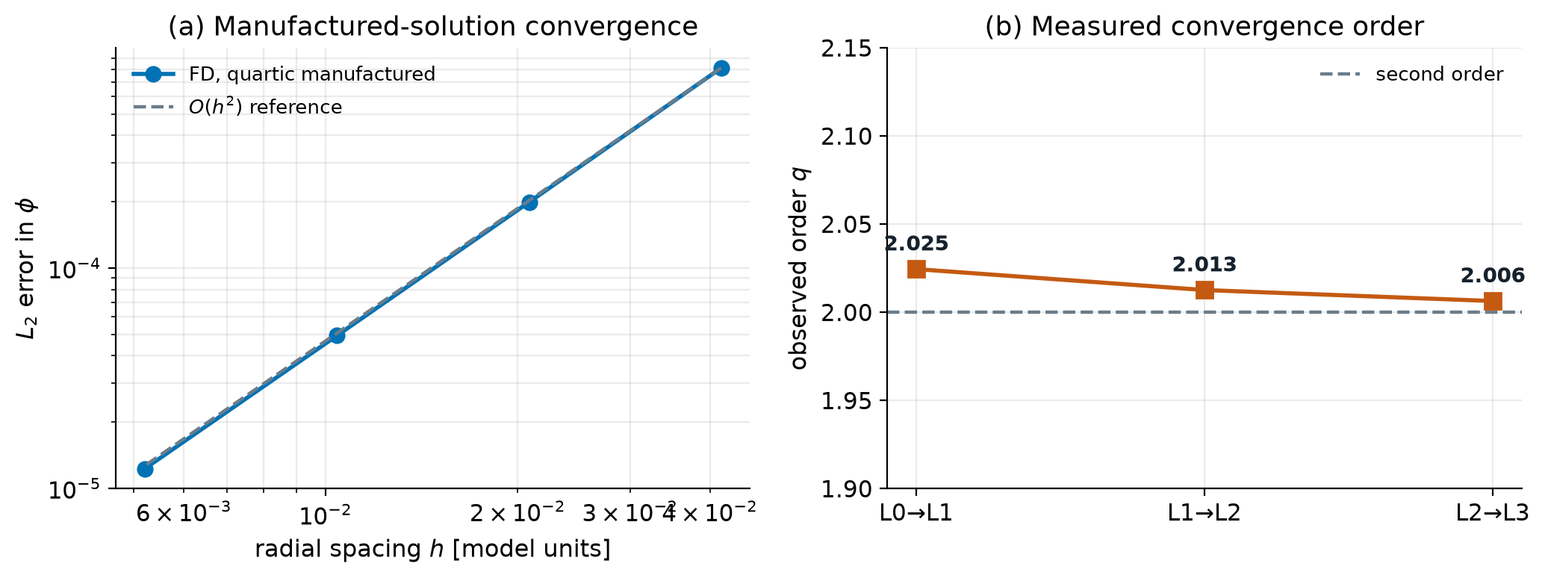
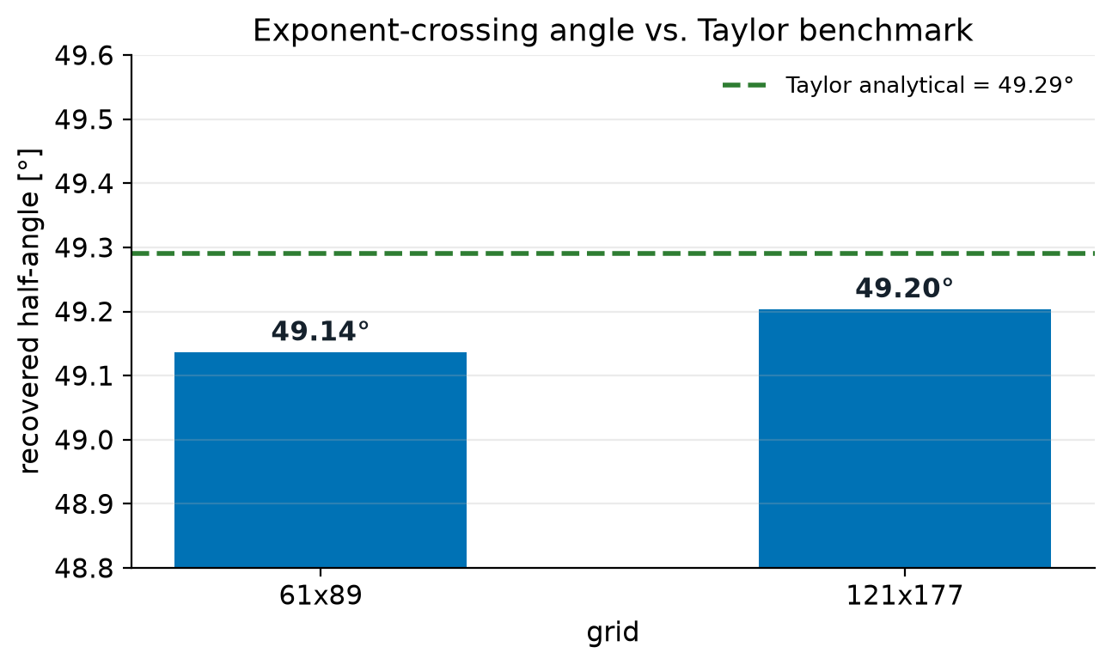
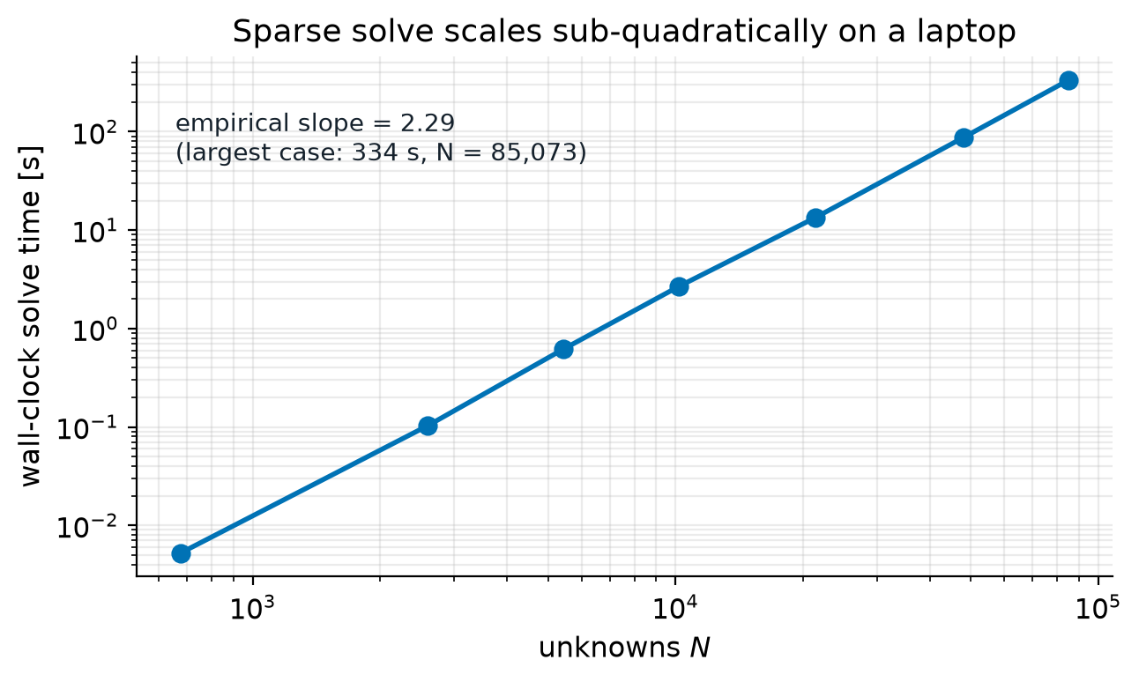
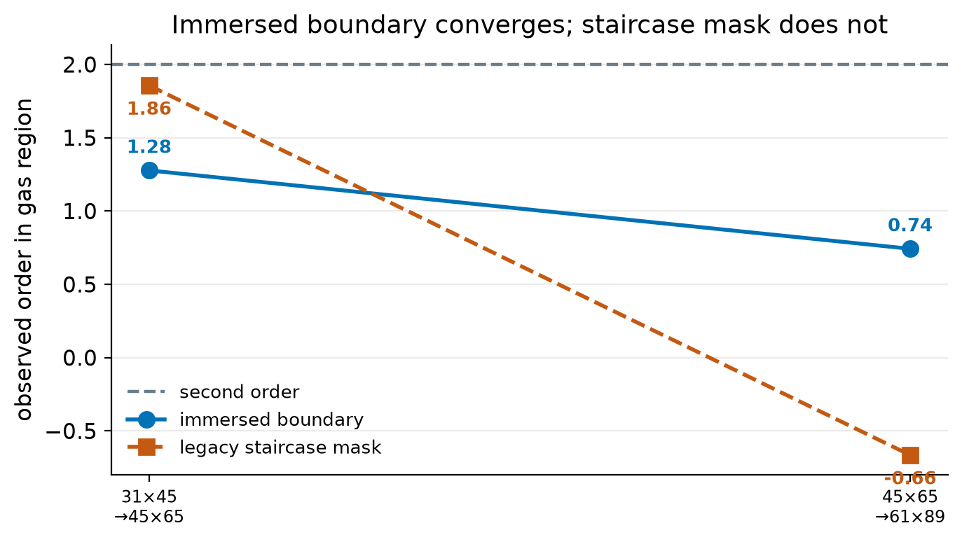
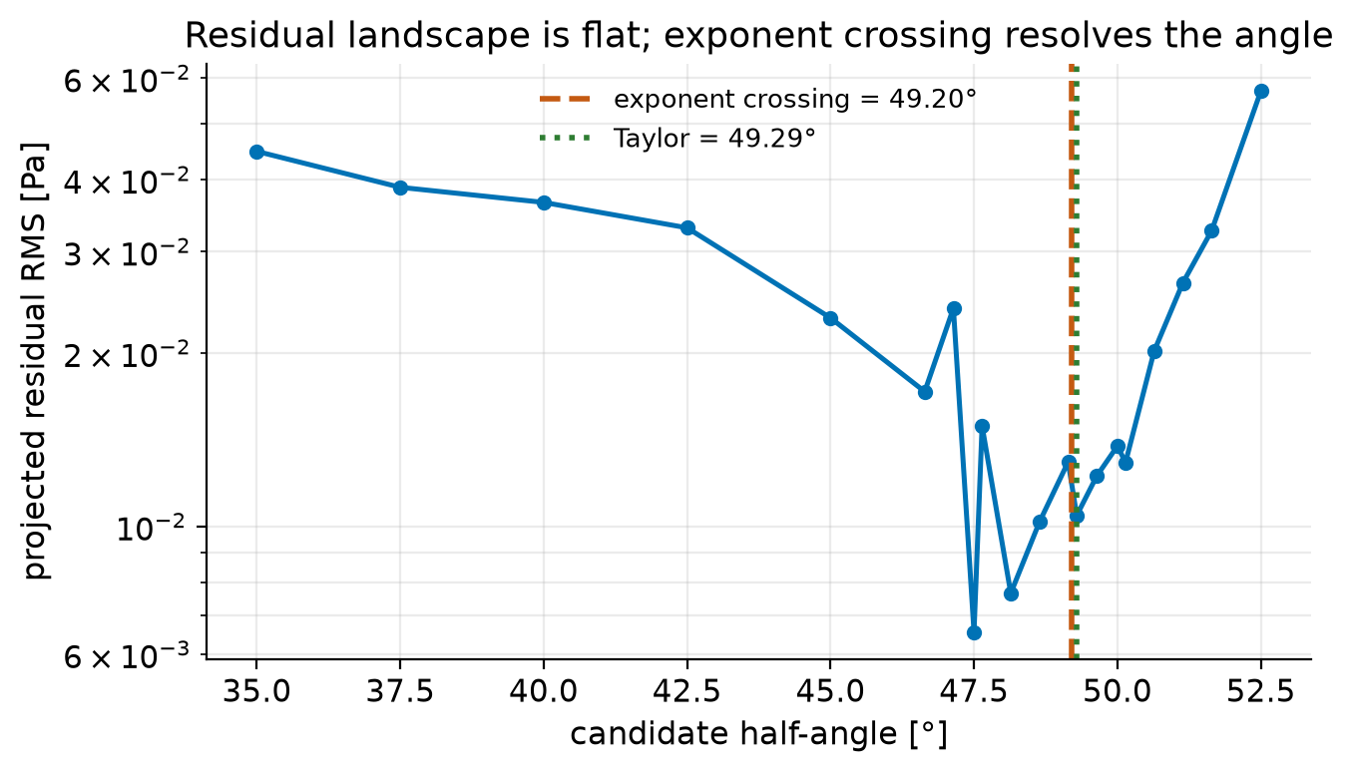
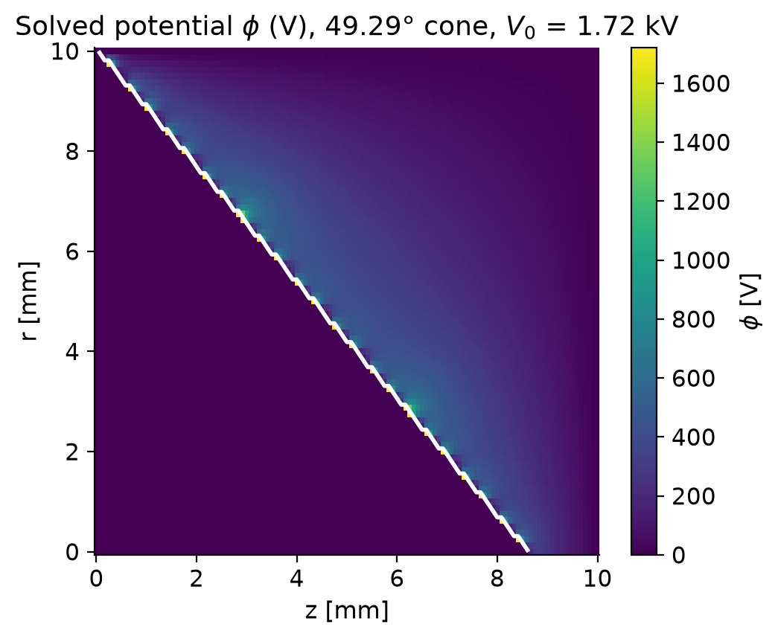
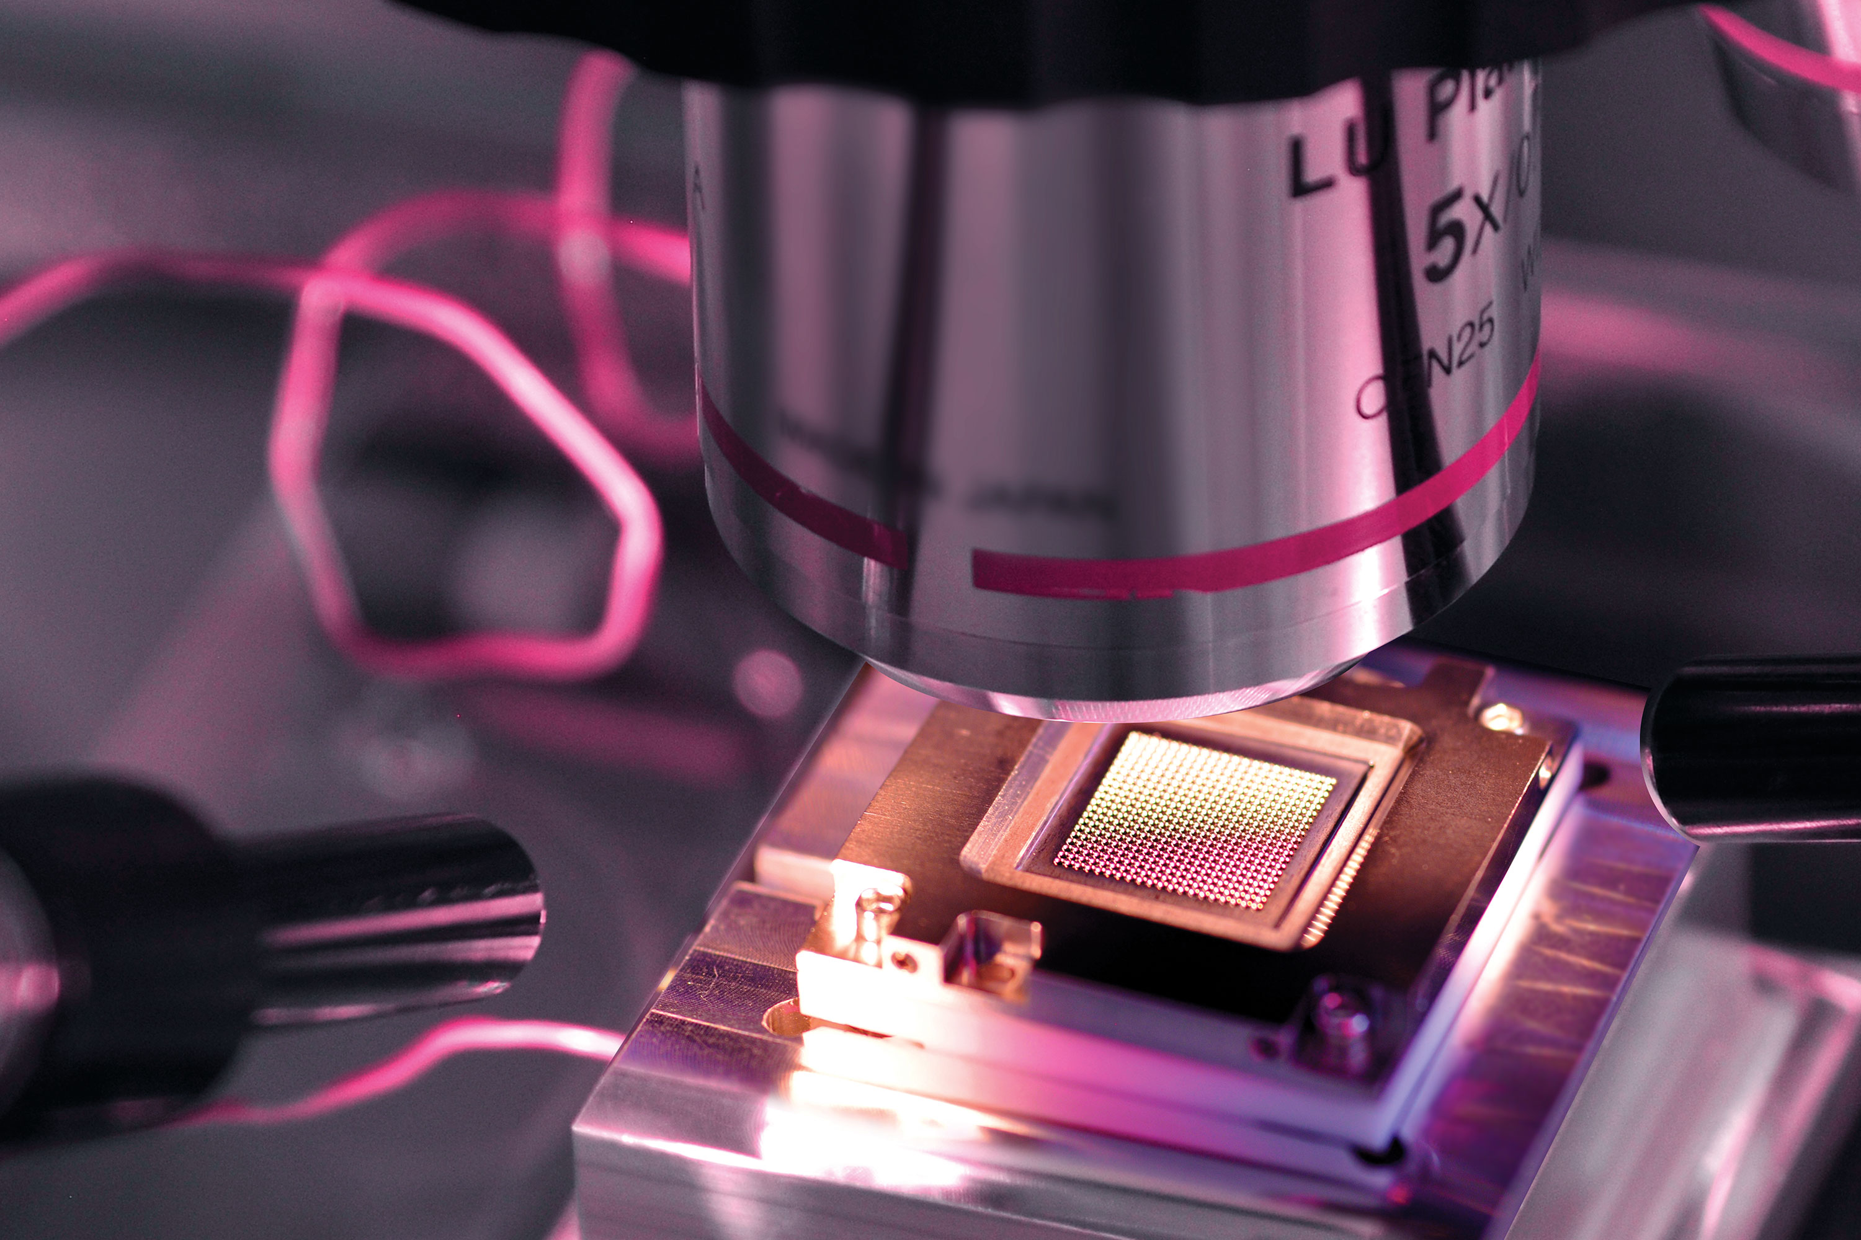
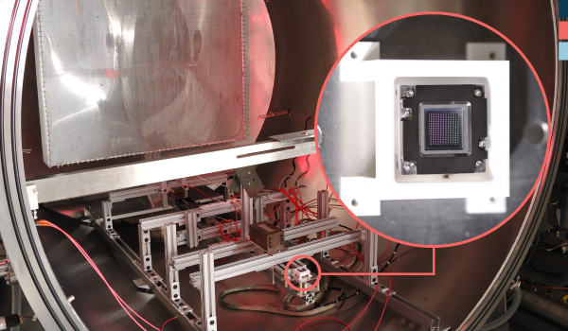
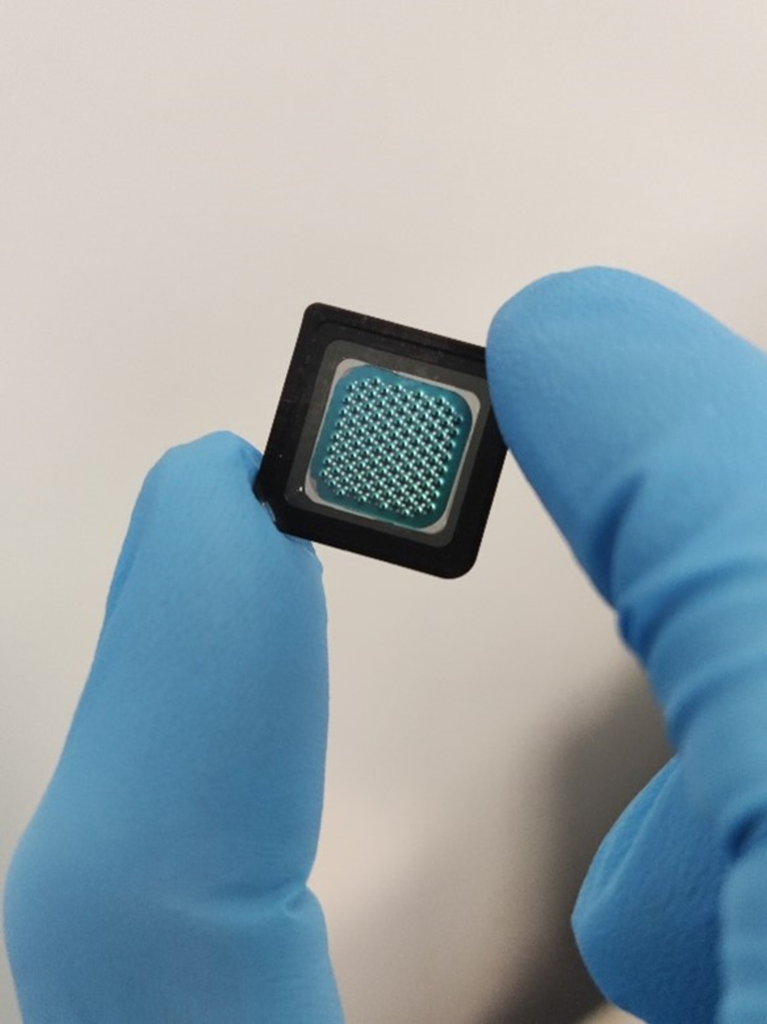
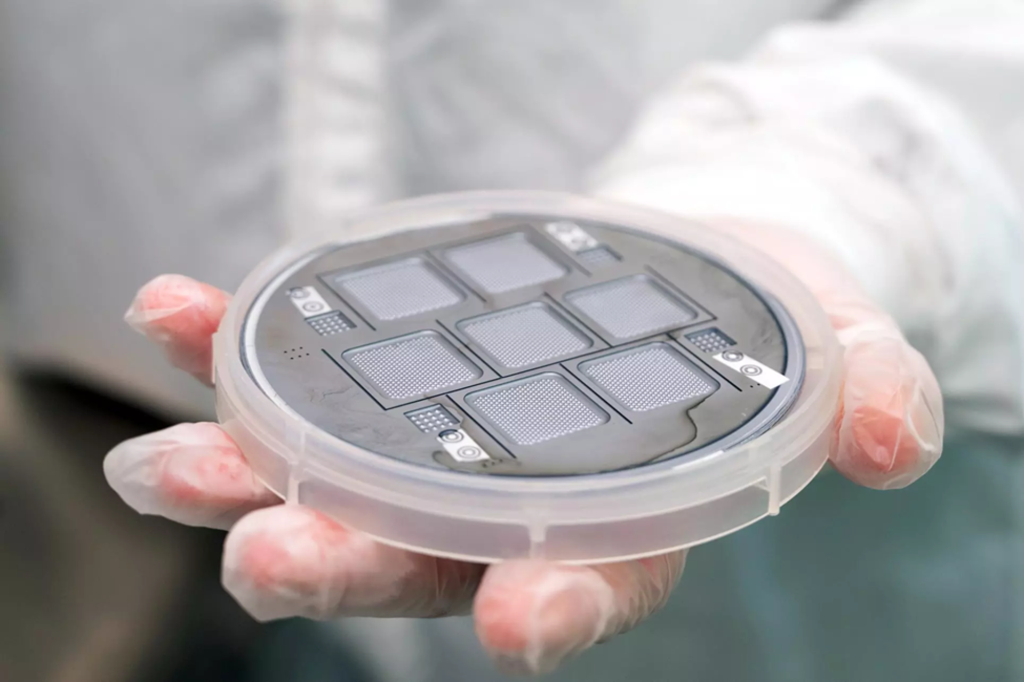
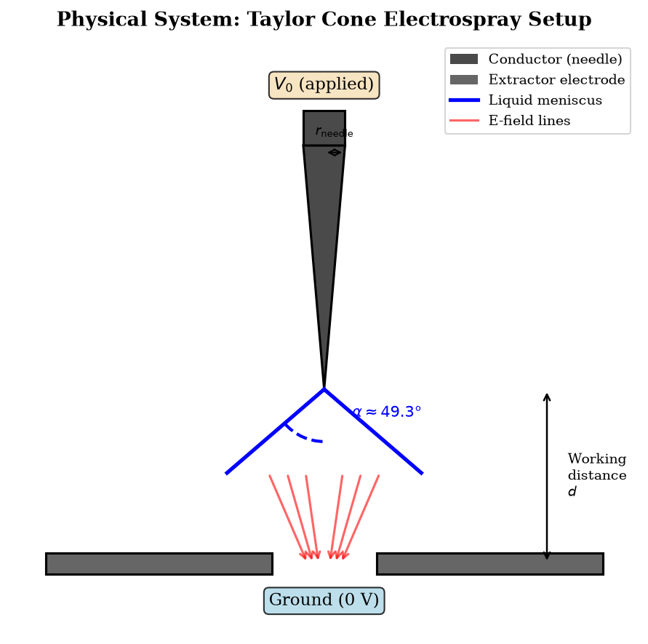
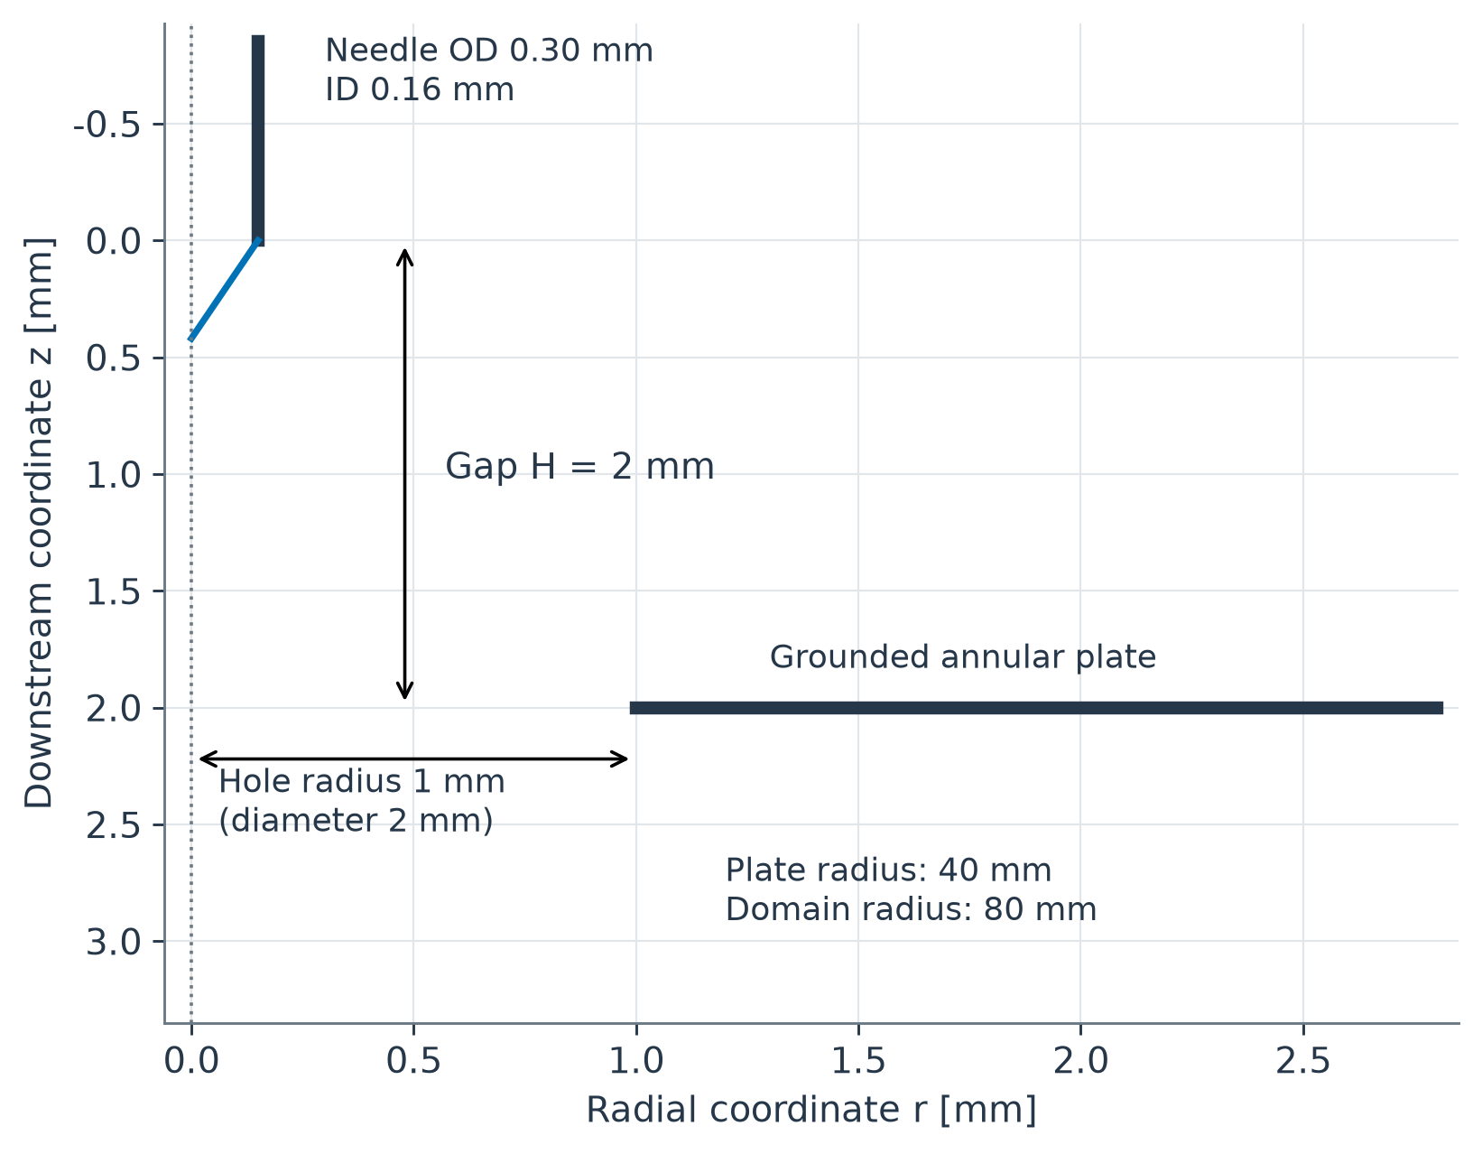
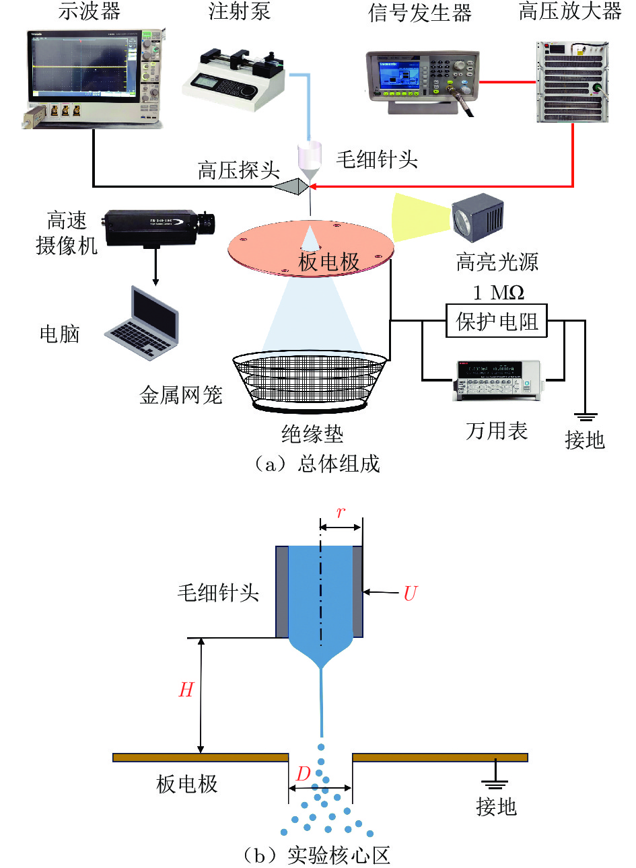
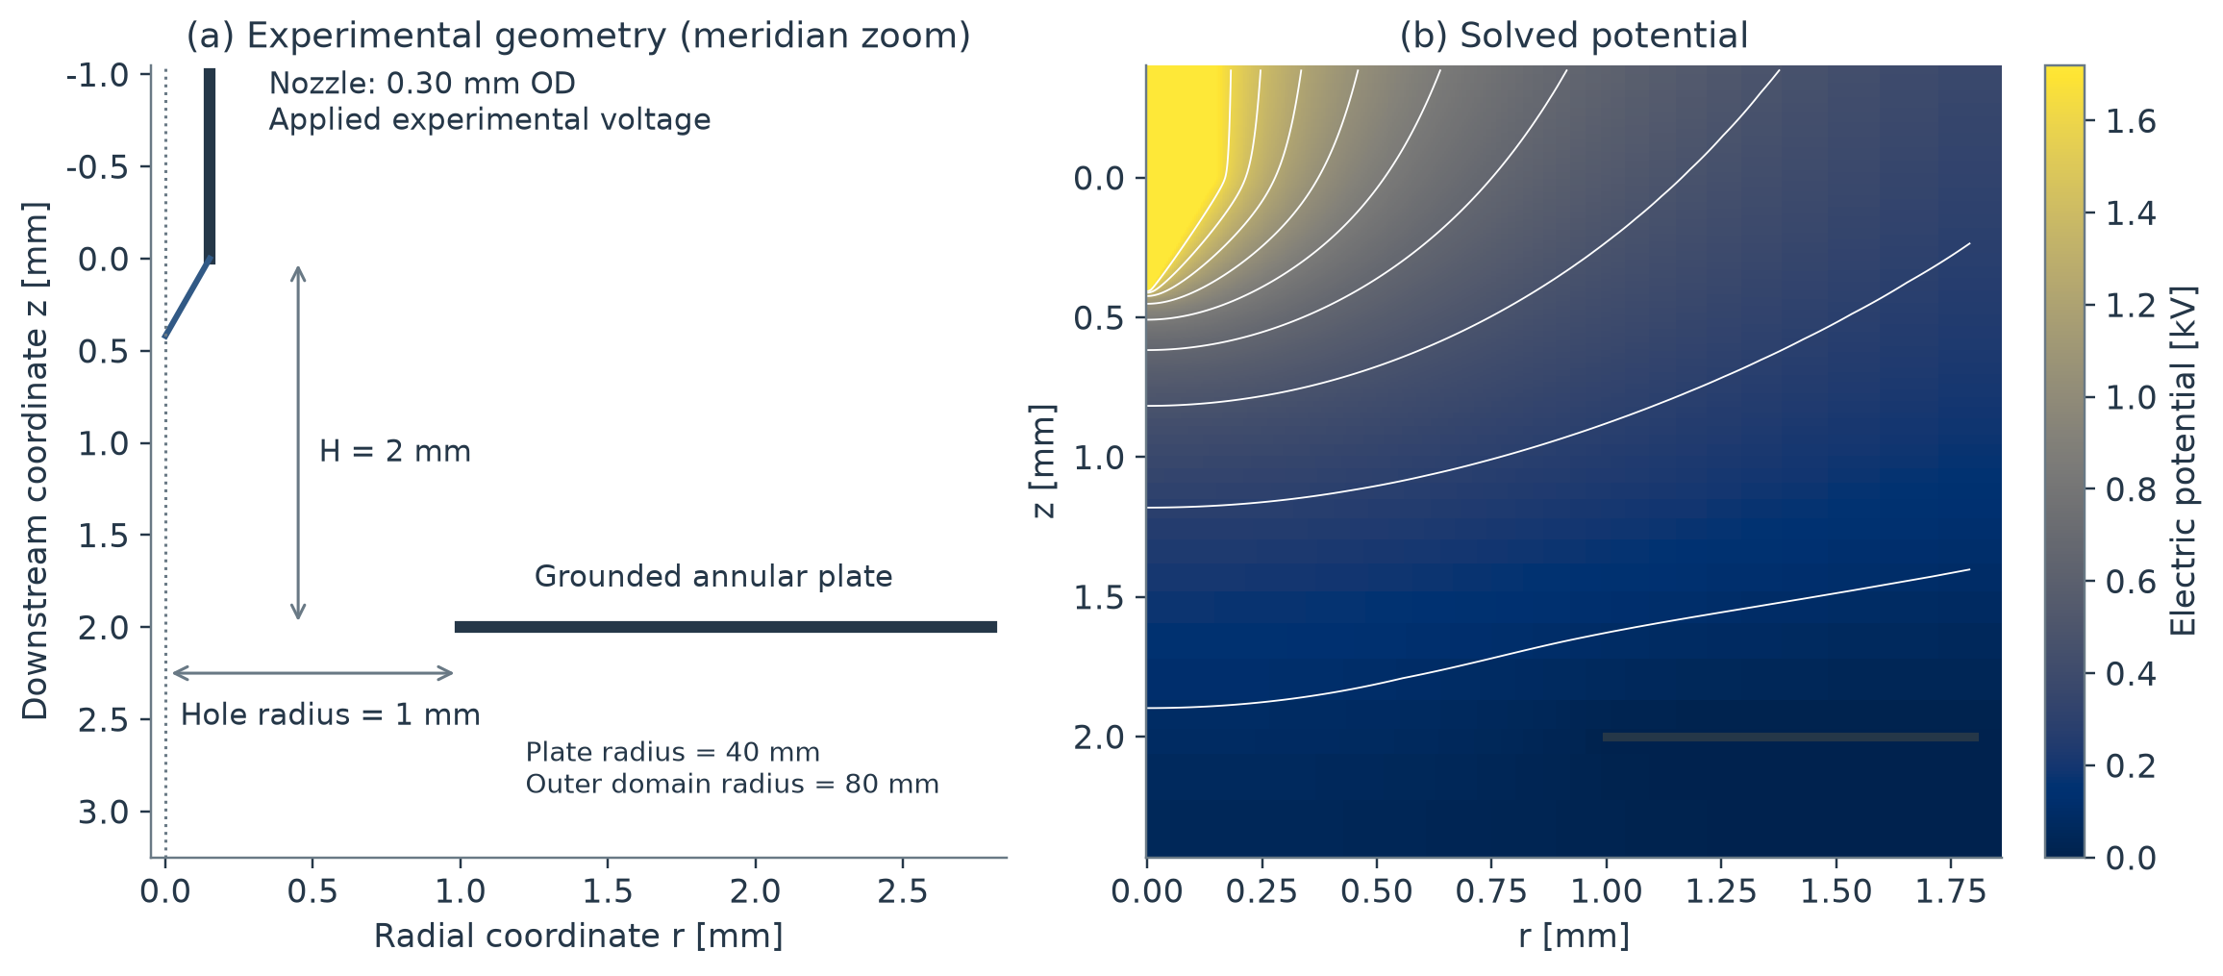
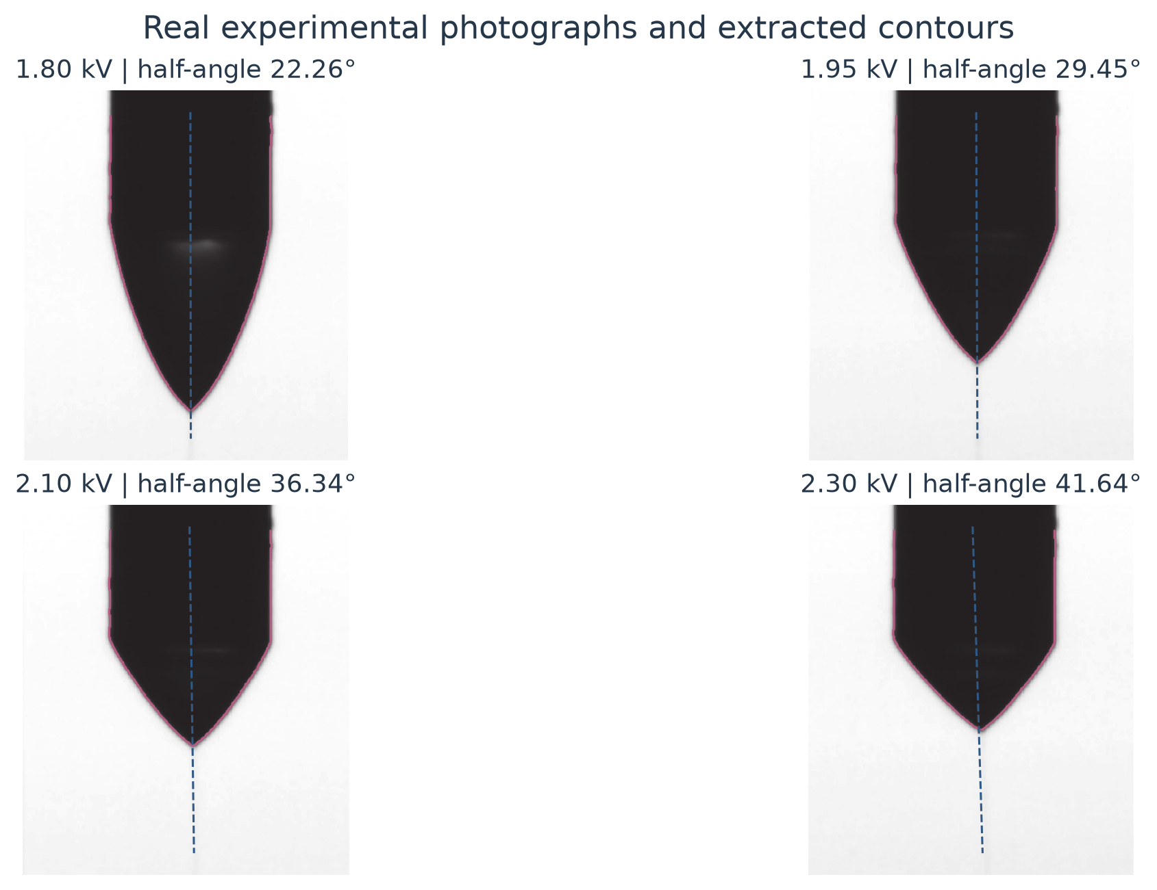
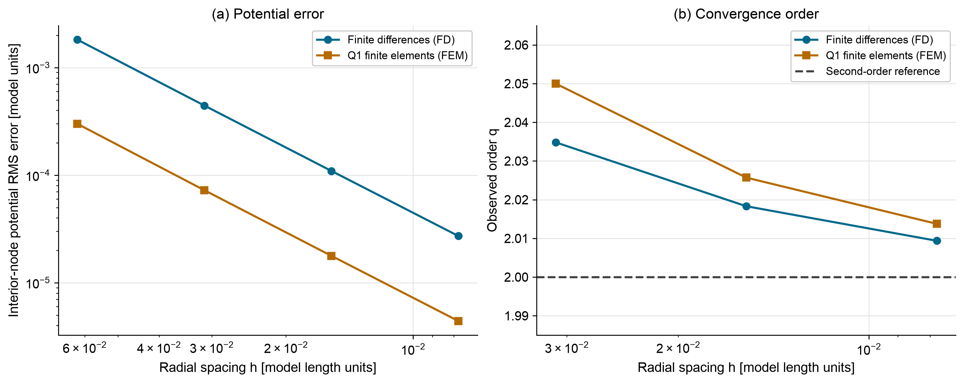
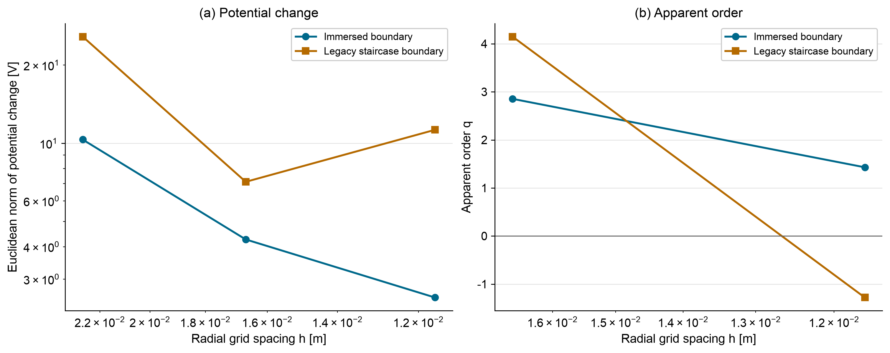
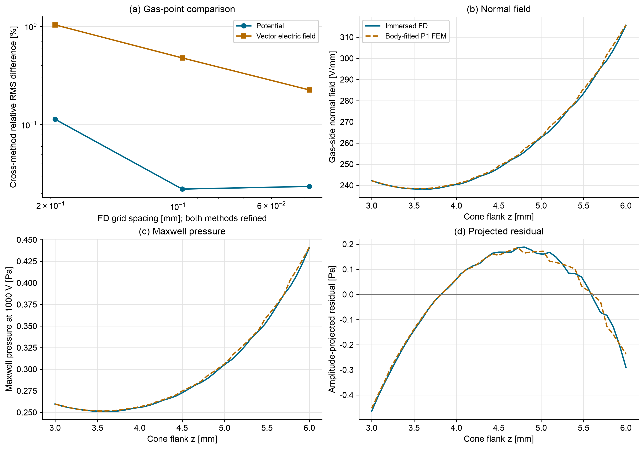
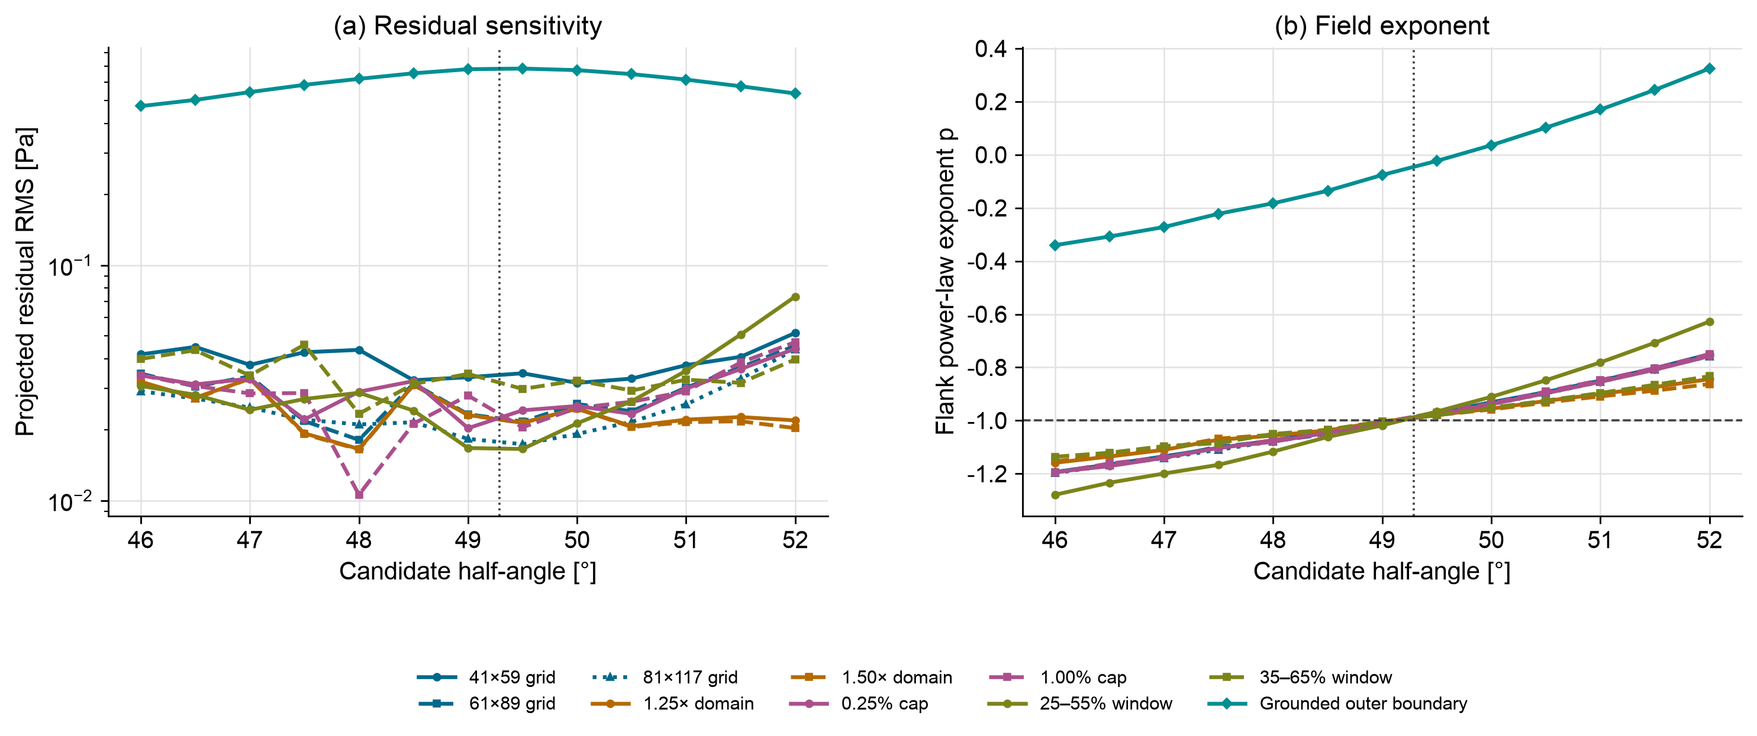
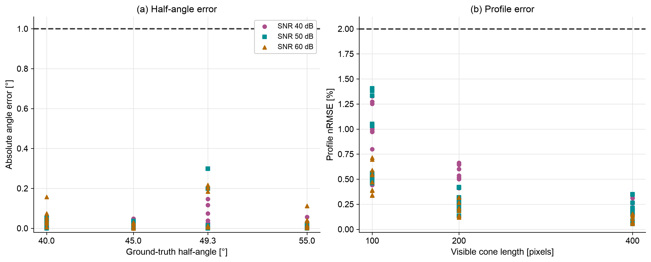
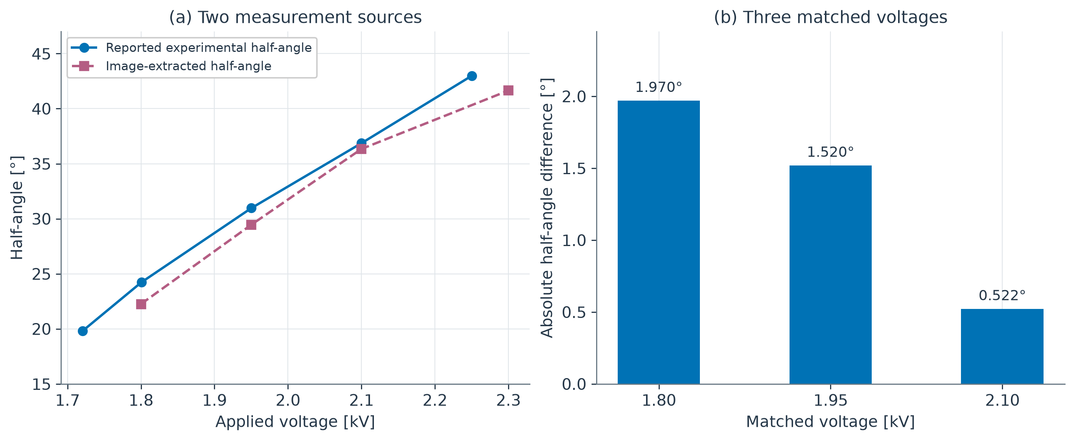
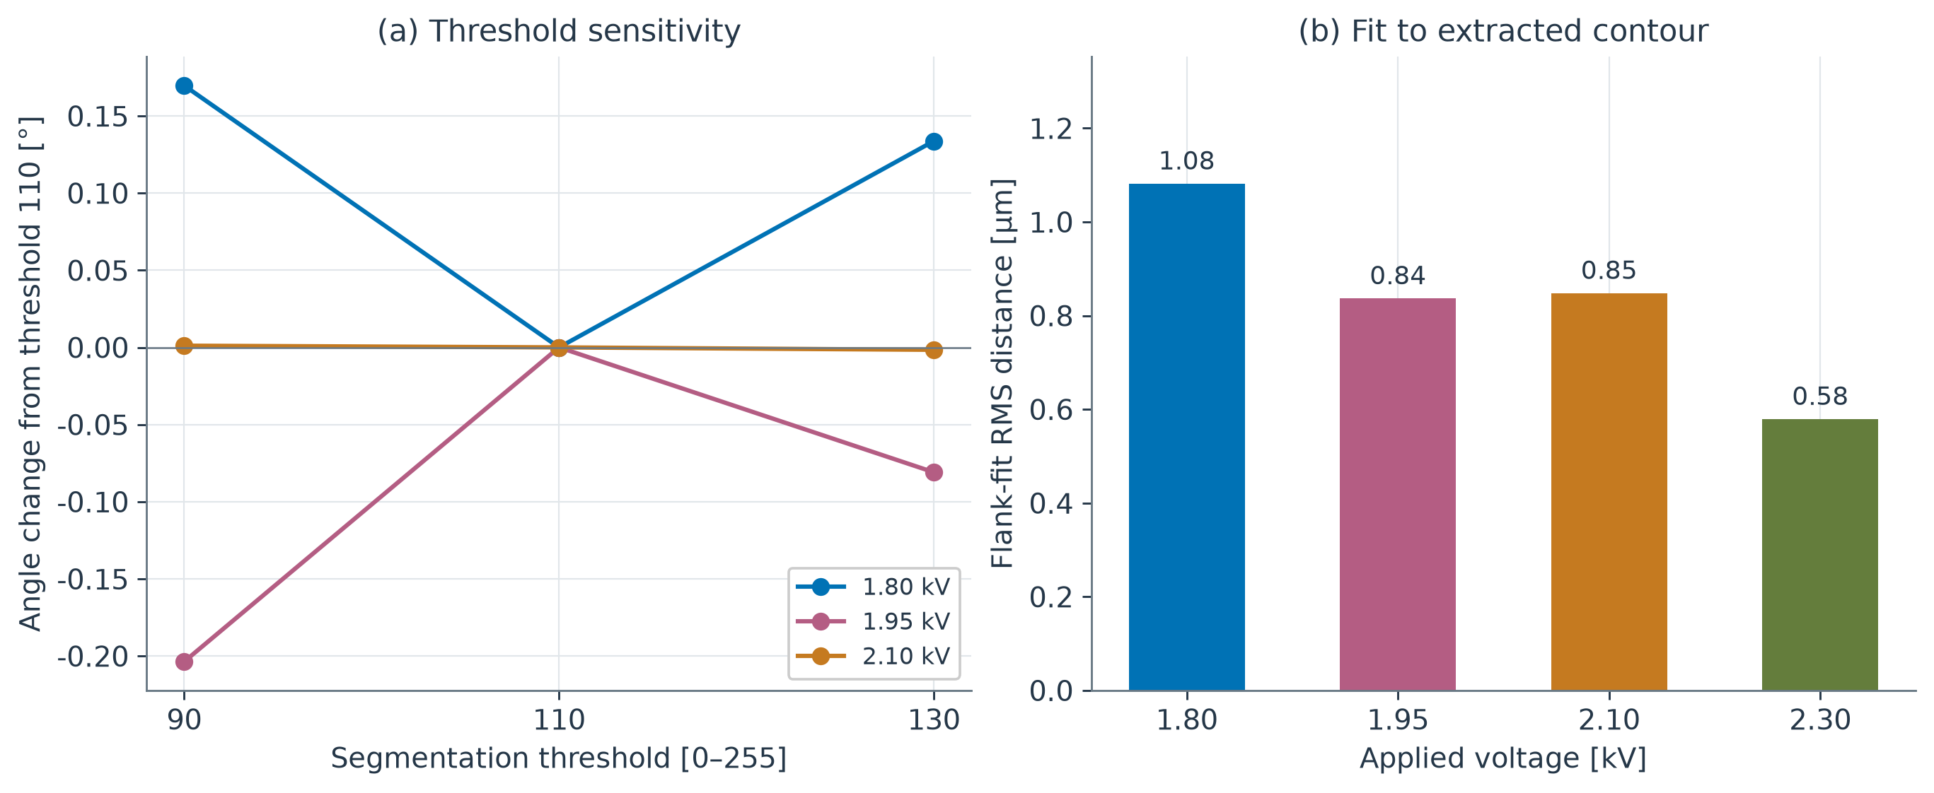
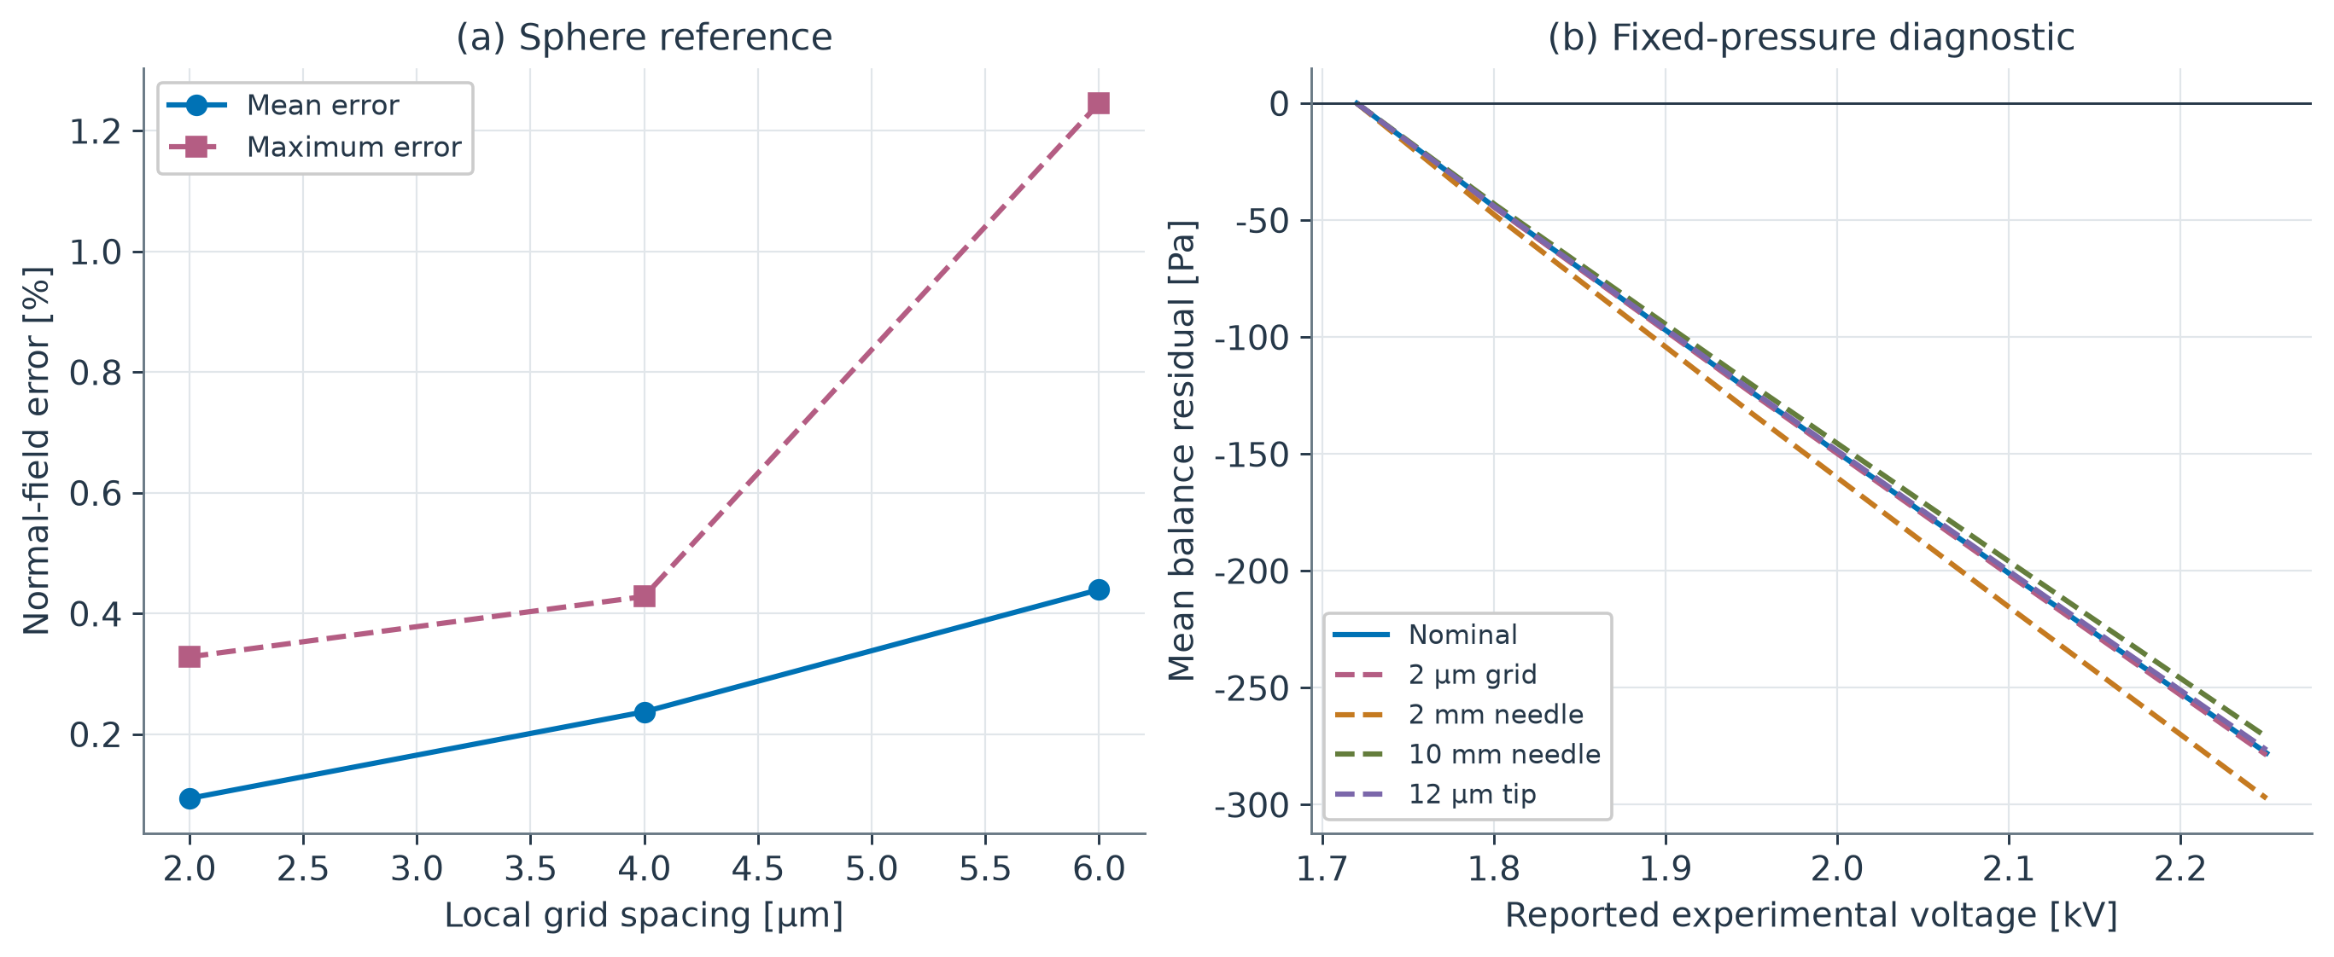
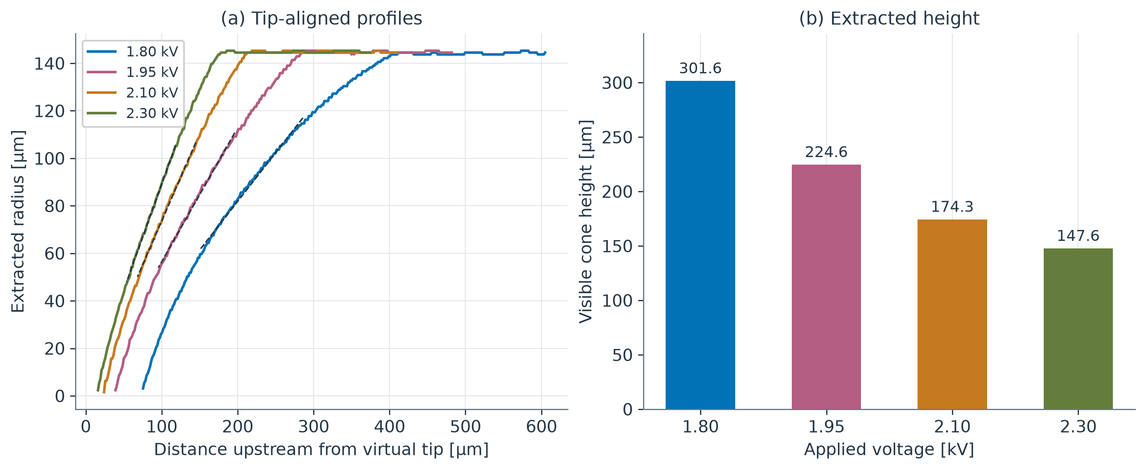
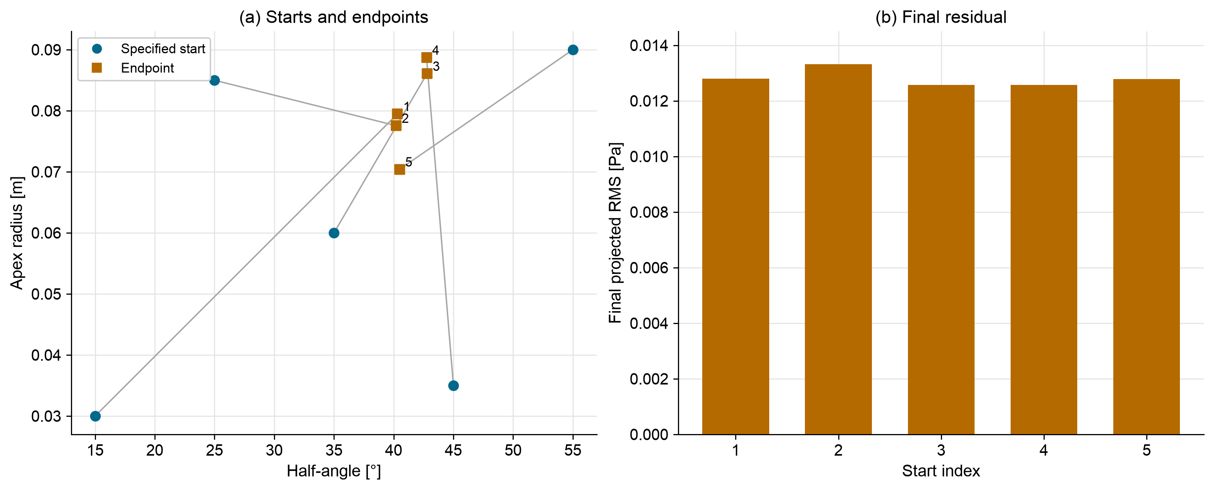
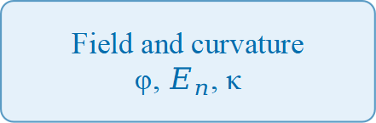
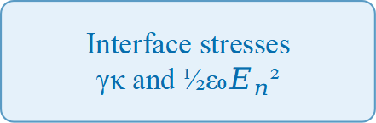
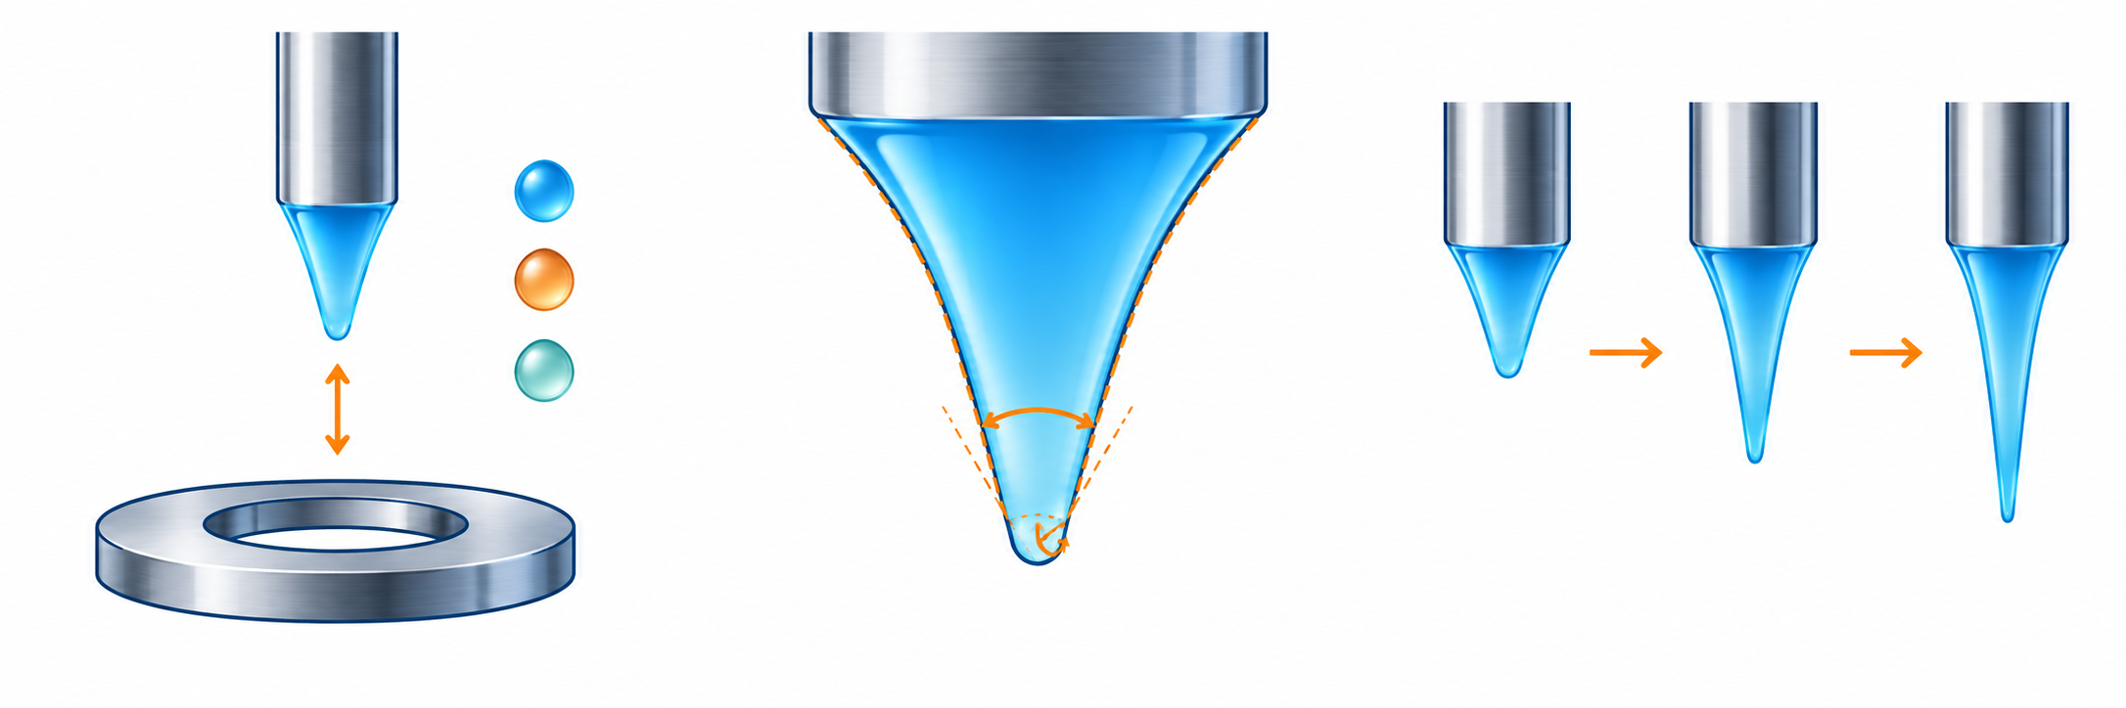
INTRODUCTION
A Lightweight Axisymmetric Taylor-Cone Solver
SCOPE AND LIMITS
1. The problem
Numerical verification of field, curvature and stress on an ordinary laptop
What is verified. The electrostatic operator, the interface field reconstruction, and the stress-balance diagnostic against analytical references and a manufactured solution.
Reduced-order by design. This is an onset-level model. It does not simulate cone-jet breakup, spray dynamics or full multiphysics.
Grounded-box angles. Argmin angles from a finite grounded domain are truncation artifacts and are not reported as physical results.
Space charge. Optional effective closures only; no first-principles ion transport.
Electric Maxwell stress pulls the liquid interface outward; surface tension resists. Where they balance, a Taylor cone forms.
High-fidelity electrospray models need specialised multiphysics software, dense meshes and substantial compute — a barrier for students and small laboratories.
Ethan Yang · Elliot Dong · Curtis Lau
Independent Schools Foundation Academy
KEY VERIFIED RESULTS
2. Research question
2.02
Field and curvature
φ, $E_{n}$, κ
49.29°
1.0005
0.0066
Can a lightweight sparse solver reproduce the key Taylor-cone observables — potential, interface field, curvature and the Maxwell–capillary stress balance — on an ordinary laptop?
convergence order
Interface stresses
γκ and ½ε₀$E_{n}$²
Quartic manufactured Poisson, finest level
Taylor benchmark
amplitude ratio
residual minimum
orders 2.025 / 2.013 / 2.006 across four grids
Analytical root of P₁/₂(cos θ) = 0
V₀*/A* under the imposed Taylor far field
lowest projected residual RMS [Pa], 121×177
solver computes 49.2901° from the exact theory
within 0.06% of the exact balance identity
landscape is flat; exponent crossing resolves the angle
3. Approach: verification hierarchy
Analytical benchmark. Taylor’s exact half-angle from P₁/₂(cos θ) = 0.
Manufactured solution. A quartic exact solution exercises the full operator.
Free-boundary refinement. Immersed boundary compared against a staircase grid mask.
Imposed-Taylor identity. Exact analytic far field with the cone as a zero equipotential.
Fig. 1. Manufactured-solution convergence order.
Fig. 2. Exponent crossing vs. Taylor benchmark.
Fig. 6. Sparse solve time vs. unknowns.
METHOD
REFINEMENT AND FIELD STRUCTURE
Discretisation. Sparse finite-difference axisymmetric Laplacian with a regularised axis stencil.
Interface. Cubic-exact immersed-boundary stencil; ≤1% normal-field error on refined grids.
Balance. Curvature gives γκ; a projected pressure offset closes the normal-stress balance.
Reproducibility. Every figure is regenerated by build/make_figures.py from the committed solver.
PHYSICAL MODEL
∇²φ = 0 E = −∇φ
p_E = ½ ε₀ Eₙ² p_γ = γκ
R = p_γ − p_E − Δp Δp = ⟨p_γ − p_E⟩
Analytical Taylor benchmark: 49.29°
root of P₁/₂(cos θ) = 0, computed by solver.verification.taylor_cone_half_angle_deg()
Fig. 3. Immersed boundary vs. staircase mask: immersed converges, staircase does not.
Fig. 4. Projected residual vs. candidate half-angle. The argmin alone is ill-conditioned; the flank exponent crossing gives a grid-convergent angle.
Interpretation. The solver reproduces its analytical Taylor benchmark to ≈0.1° via the exponent observable, and the imposed-Taylor amplitude identity closes to 0.06%. The grounded-box angle is NOT reported as a physical result: it is the answer to the truncated cone-in-a-box problem, and the argmin wanders with domain size. Stating that boundary is the point of the verification.
Axisymmetric reduced-order model. The liquid is an equipotential conductor; the gas obeys Laplace’s equation. A rounded cone (half-angle α, apex cap radius R_c) defines the candidate interface. Electric and capillary pressures are evaluated on that interface and combined into a Young–Laplace–Maxwell residual R.
Onset voltage is projected by absorbing the dominant scale-free pressure term, giving V₀* ∝ √(γL/ε₀) and a millimetre-scale onset in the ethanol literature range.
VERIFICATION DETAIL
What the numbers show
• Manufactured convergence is clean and near second order on every refinement pair, with the observed order approaching 2 as h → 0.
• The immersed free-boundary operator converges; the legacy staircase mask does not. This is the justification for the immersed treatment.
• Under an imposed analytical Taylor far field the balance amplitude identity closes to 1.0005, and the flank exponent crossing recovers ≈49.2°, within ≈0.1° of the classical value.
• The projected-residual argmin is NOT a reliable angle estimator: it is flat within its discretisation floor and moves with domain size.
• Solve time scales near-quadratically in unknowns; the largest committed case runs in under six minutes on a laptop.
CONCLUSION
Verified core. A transparent sparse solver reproduces its analytical Taylor benchmark to ≈0.1° and closes the amplitude identity to 0.06% on a laptop.
Honest boundary. Verification status, not experimental validation. No laboratory data were collected for this poster, and none are claimed.
Why it matters. A student or small laboratory can reproduce every number here with open-source Python and no specialised multiphysics licence.
Next. Supervised laboratory validation, image-based profile extraction, and more voltages, gaps and liquids remain future work.
VERIFICATION RUNS
Test suite. 74 automated tests pass (python -m pytest backend/tests/).
Manufactured solution. Quartic φ = r⁴+z⁴+r²z² on four grids; measured orders 2.025, 2.013, 2.006.
Quadratic control. The r²+z² case is exact by construction — errors ~1e-15, so it is reported as a control, not as convergence evidence.
Free-boundary refinement. Immersed orders 1.28 → 0.74; staircase mask 1.86 → -0.66 (non-convergent).
Imposed-Taylor identity. Balance amplitude ratio V₀*/A* = 1.0005 at the 121×177 grid.
Exponent crossing. Recovers 49.14° (61×89) and 49.20° (121×177) vs. the 49.29° benchmark.
Runtime. Largest committed case is 85,073 unknowns in 334 s on a laptop.
Fig. 5. Solved potential, 49.29° cone, V₀ = 1.72 kV.
Verification status. Everything on this poster is numerical verification against analytical and manufactured references. No laboratory experiment was performed and no published image data were analysed; those remain clearly-scoped future work.
REFERENCES
[1] Taylor, G. I. Disintegration of water drops in an electric field. Proc. R. Soc. Lond. A 280(1382), 383–397 (1964).
[2] Fernández de la Mora, J. The fluid dynamics of Taylor cones. Annu. Rev. Fluid Mech. 39, 217–243 (2007).
[3] Melcher, J. R., & Taylor, G. I. Electrohydrodynamics: a review of the role of interfacial shear stresses. Annu. Rev. Fluid Mech. 1, 111–146 (1969).
[4] Saville, D. A. Electrohydrodynamics: the Taylor–Melcher leaky dielectric model. Annu. Rev. Fluid Mech. 29, 27–64 (1997).
[5] Gañán-Calvo, A. M. Cone-jet analytical extension of Taylor’s electrostatic solution. Phys. Rev. Lett. 79(2), 217–220 (1997).
[6] Hartman, R. P. A. et al. Electrohydrodynamic atomization in the cone–jet mode. J. Aerosol Sci. 30(7), 823–849 (1999).
[7] Cloupeau, M., & Prunet-Foch, B. Electrostatic spraying of liquids in cone-jet mode. J. Electrostat. 22(2), 135–159 (1989).
[8] Gibou, F. et al. A second-order-accurate symmetric discretization of the Poisson equation on irregular domains. J. Comput. Phys. 176, 205–227 (2002).
[9] Shortley, G. H., & Weller, R. The numerical solution of Laplace’s equation. J. Appl. Phys. 9, 334–348 (1938).
REPRODUCIBILITY
Every number and figure is regenerated by one script:
python build/make_figures.py
It calls the committed solver directly:
backend/solver/verification.py
run_quartic_manufactured_poisson() → Fig. 1
taylor_cone_half_angle_deg() → card 2
backend/solver/app_backend.py
run_immersed_verification() → Fig. 2, 4
backend/examples/08_immersed_refinement_study.py
→ Fig. 3
Tests: python -m pytest backend/tests/
74 passed.
All figures and numbers on this poster are generated from the committed solver by build/make_figures.py — no experimental data are presented. Test suite: 74 passing (python -m pytest backend/tests/).
Source code and data: available on request.
Notes:
Sources and metric definitions for the academic poster.
Computational figures: 论文修改对照与图件交付/figures/en and figures/zh. Corresponding numerical data: 论文修改对照与图件交付/data/.
Public experimental case: Yang Pengfei, Peng Yuxing, Yi Hongliang and Wu Jian (2025), Journal of Experiments in Fluid Mechanics 39(3):54–62, DOI 10.11729/syltlx20220040.
Publisher PDF: https://pubs-data.cstam.org.cn/lxqkw-data/syltlx/2025/3/PDF/2022-040a.pdf
The four photos are at 1.80, 1.95, 2.10 and 2.30 kV. Published angle markers include five voltages ending at 2.2503 kV. Measurement MAE uses the three matching voltages 1.80, 1.95 and 2.10 kV.
Image measurement MAE 1.337459301 deg, max 1.970428562 deg. This crosscheck uses published markers from the same study rather than repeated measurement of the identical frame.
Synthetic measurement figures use the original 108 analytic image cases, max half-angle error 0.298517 deg, max profile nRMSE 1.405869%. Software regression test count is distinct from experiment count.
Application photographs: NASA/JPL-Caltech, https://microdevices.jpl.nasa.gov/capabilities/advanced-microfabrication-technologies/electrospray-propulsion/; © ESA, https://www.esa.int/ESA_Multimedia/Images/2023/03/Microfabricated_electrospray_emitter_and_fluidic_barrier.
ESA image credit and Standard Licence are retained. Publisher experimental images are attributed for research review. No additional image reuse license is asserted.
Additional application image: IENAI Space, ESA Pinhole propulsion for satellites, https://www.esa.int/ESA_Multimedia/Images/2023/12/Pinhole_propulsion_for_satellites . Image copyright IENAI Space. Educational research poster.
Hardware crops reproduce portions of Yang et al. Figure 1. They illustrate the published apparatus, and are not photos of newly conducted project experiments.
Poster experimental figures: revision_2026-10-09/scripts/render_experiment_figures.py. Inputs are the retained CSV measurements, contour samples and field libraries. Figure-data checksums accompany the rendered figures.
The image/report angle comparison uses three voltage-matched points from Yang et al. Figures 5 and 6. The mean absolute difference is 1.337459301 degrees. Missing photo/marker pairs are blank in the data-pairing table.
Numerical residual: R = gamma*kappa - epsilon*En^2/2 - Delta p, with the spatially constant offset removed by the surface mean. The separate fixed-pressure diagnostic fixes the offset at the first reported voltage and evaluates the other reported geometries.
Threshold sensitivity reuses the 90, 110 and 130 segmentation thresholds. The maximum half-angle range across the three matched voltages is 0.203613622 degrees. Flank-fit RMS measures distance to the fitted line on the same extracted contour.
Application photographs illustrate electrospray propulsion. Experimental apparatus photographs reproduce Yang et al. Figure 1. Figure 1 of this poster is a conceptual schematic. Figure 2 is a model geometry drawing with a separate equipment montage.
Figure 15 source: retained fixed-cone FD–FEM benchmark, finest level. Relative RMS differences: potential 0.024%, vector electric field 0.226%, Maxwell pressure 0.817%. Figure 16 is a generated conceptual illustration of proposed future work, not an experimental photograph.

