Slide 1
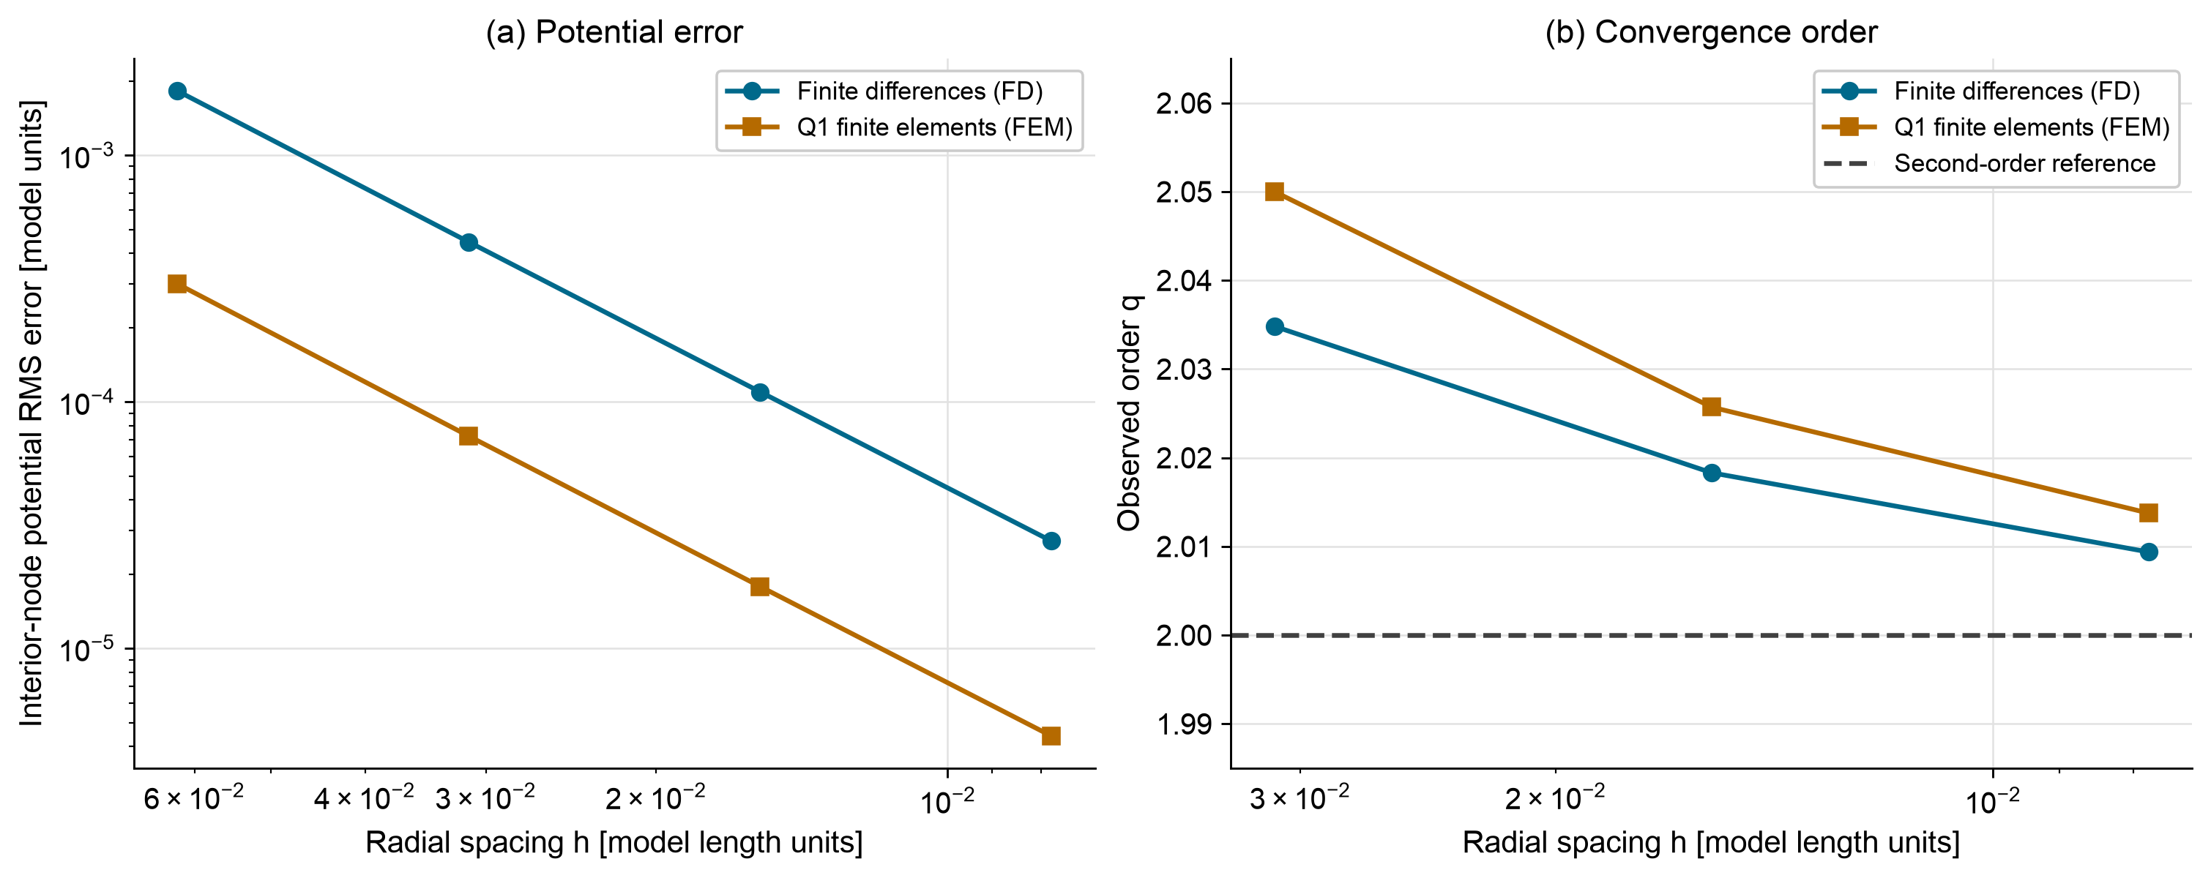
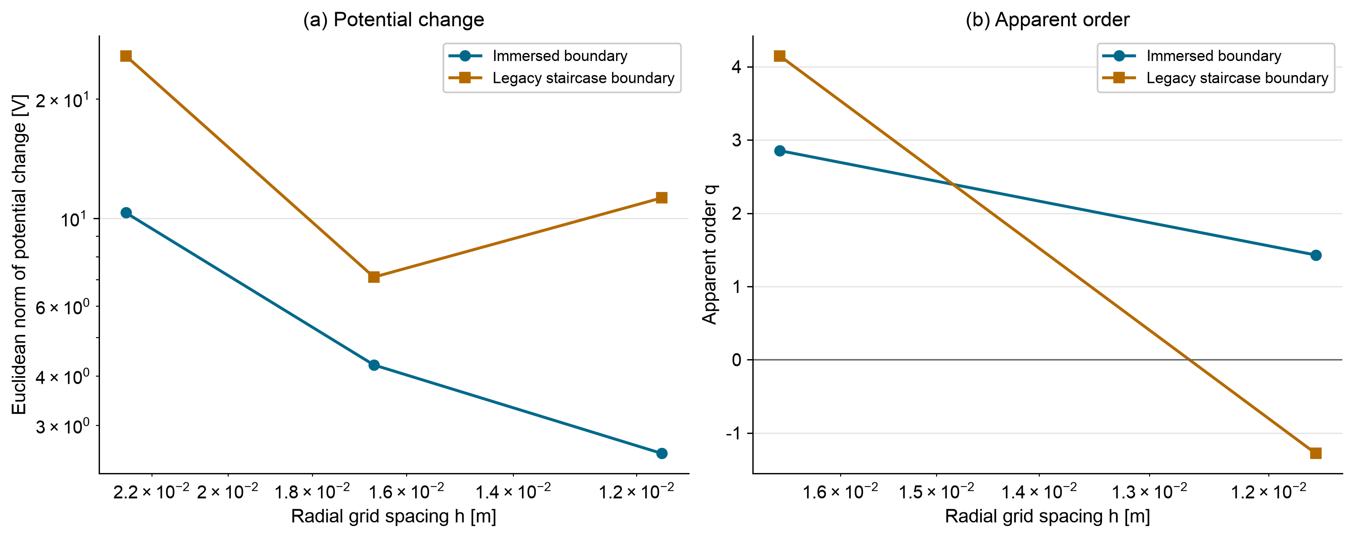
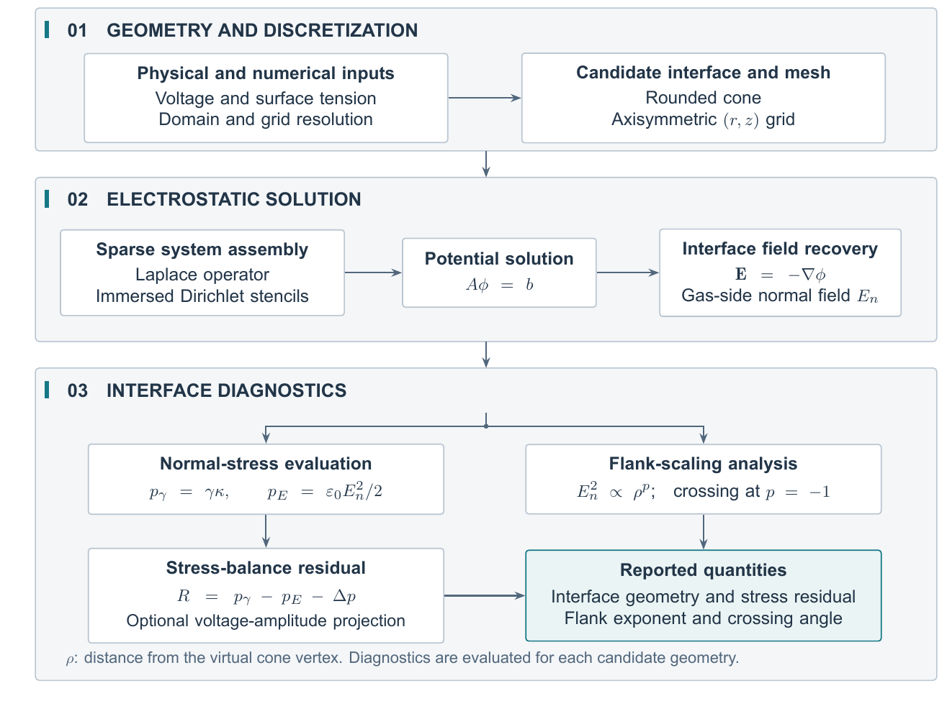
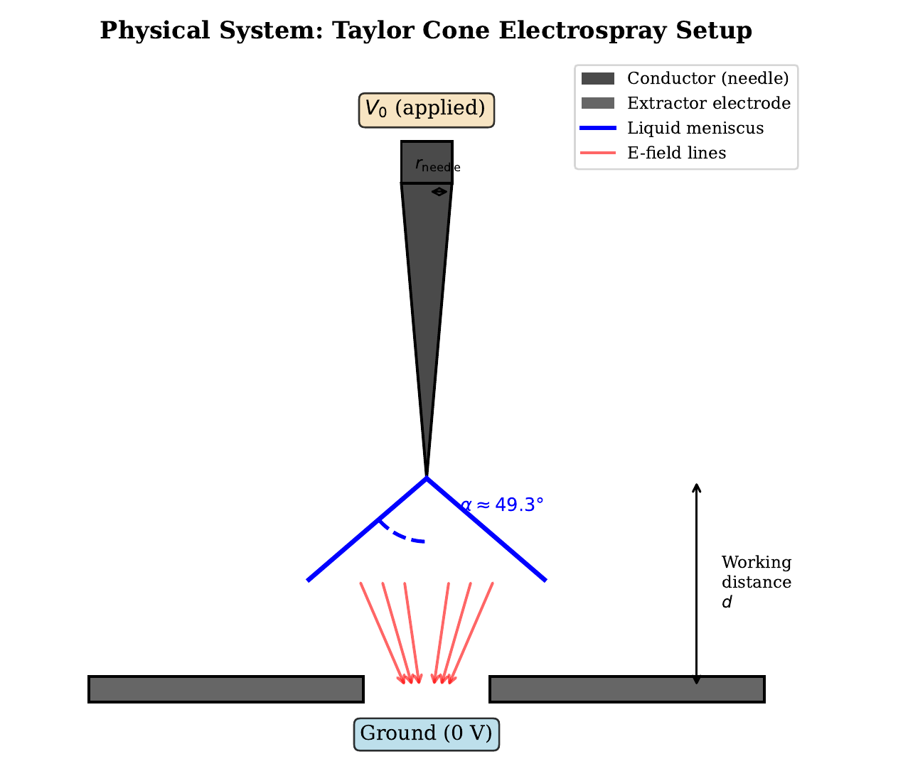
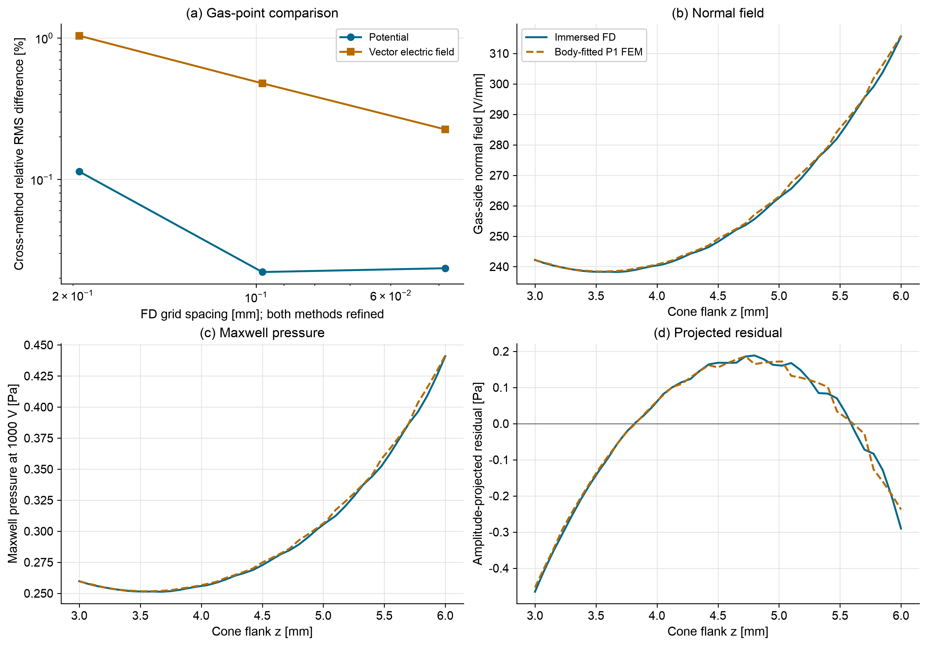
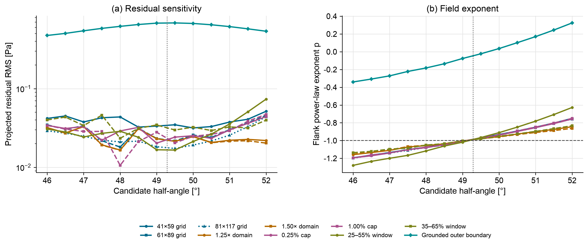
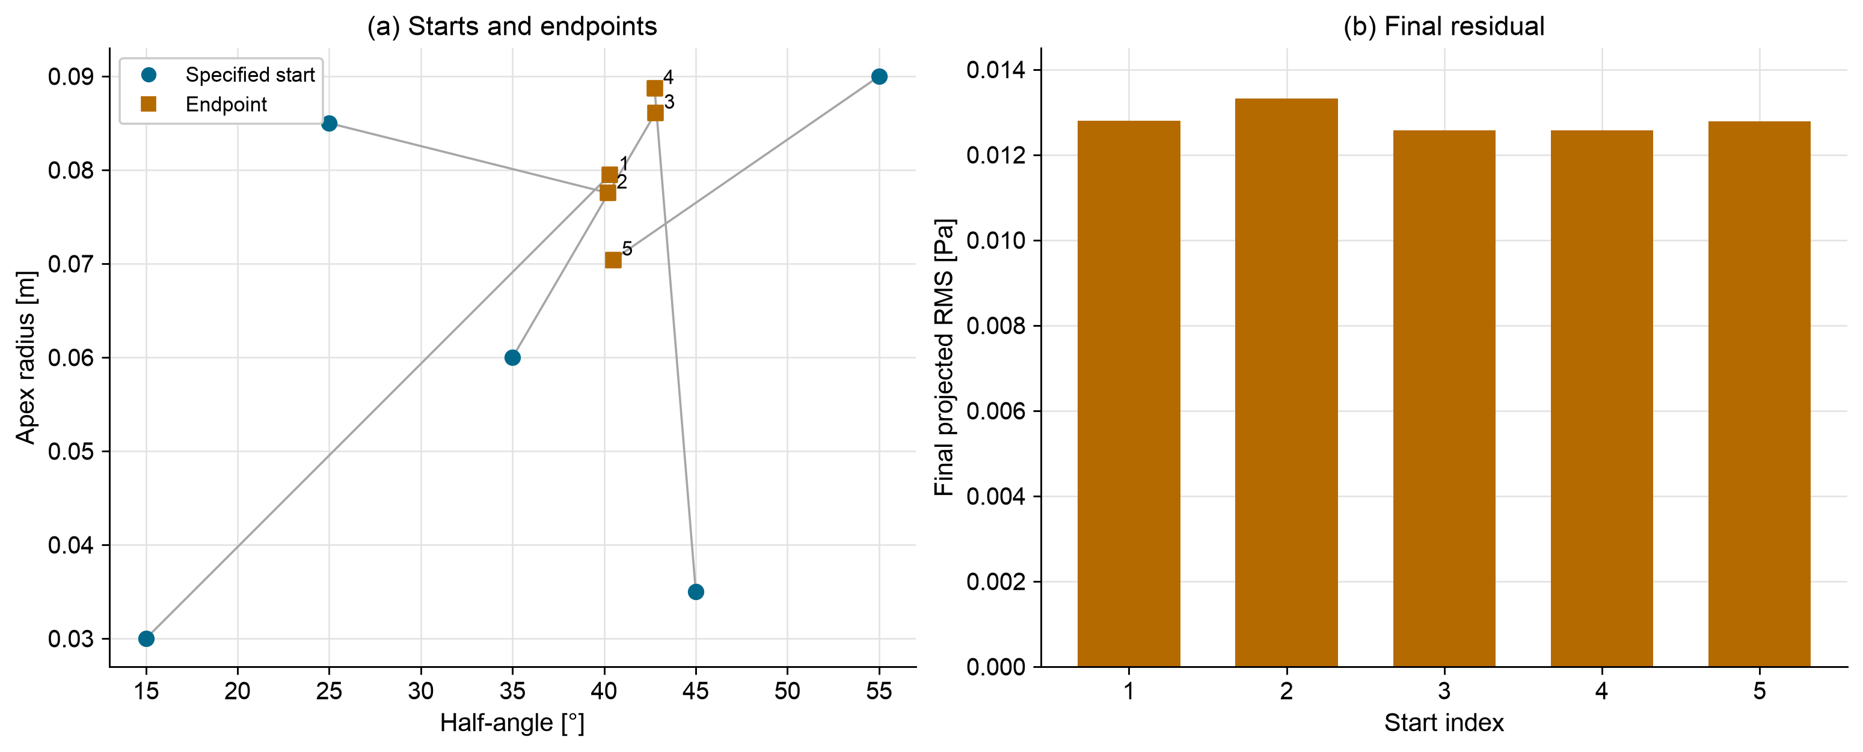
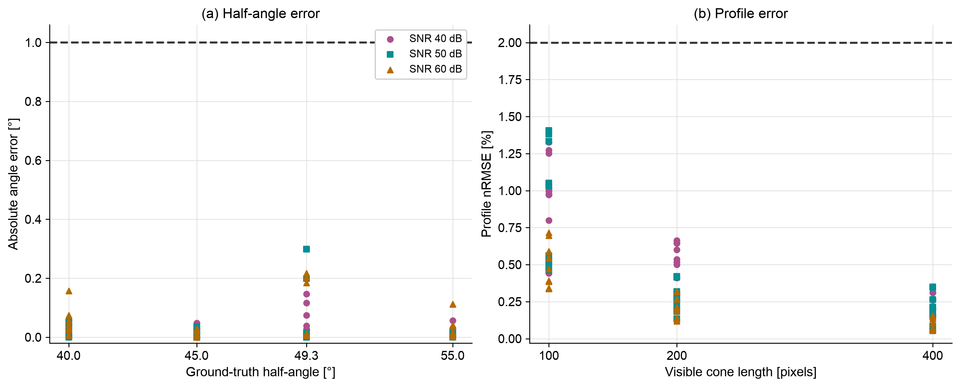
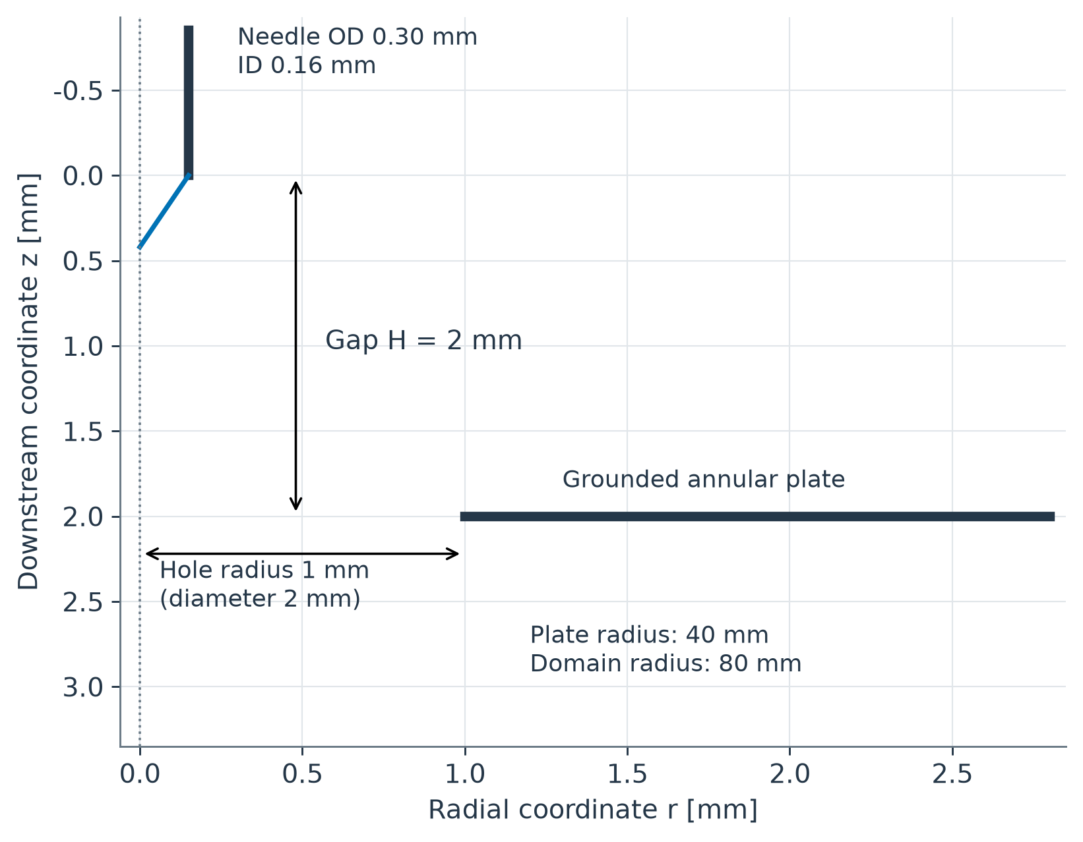
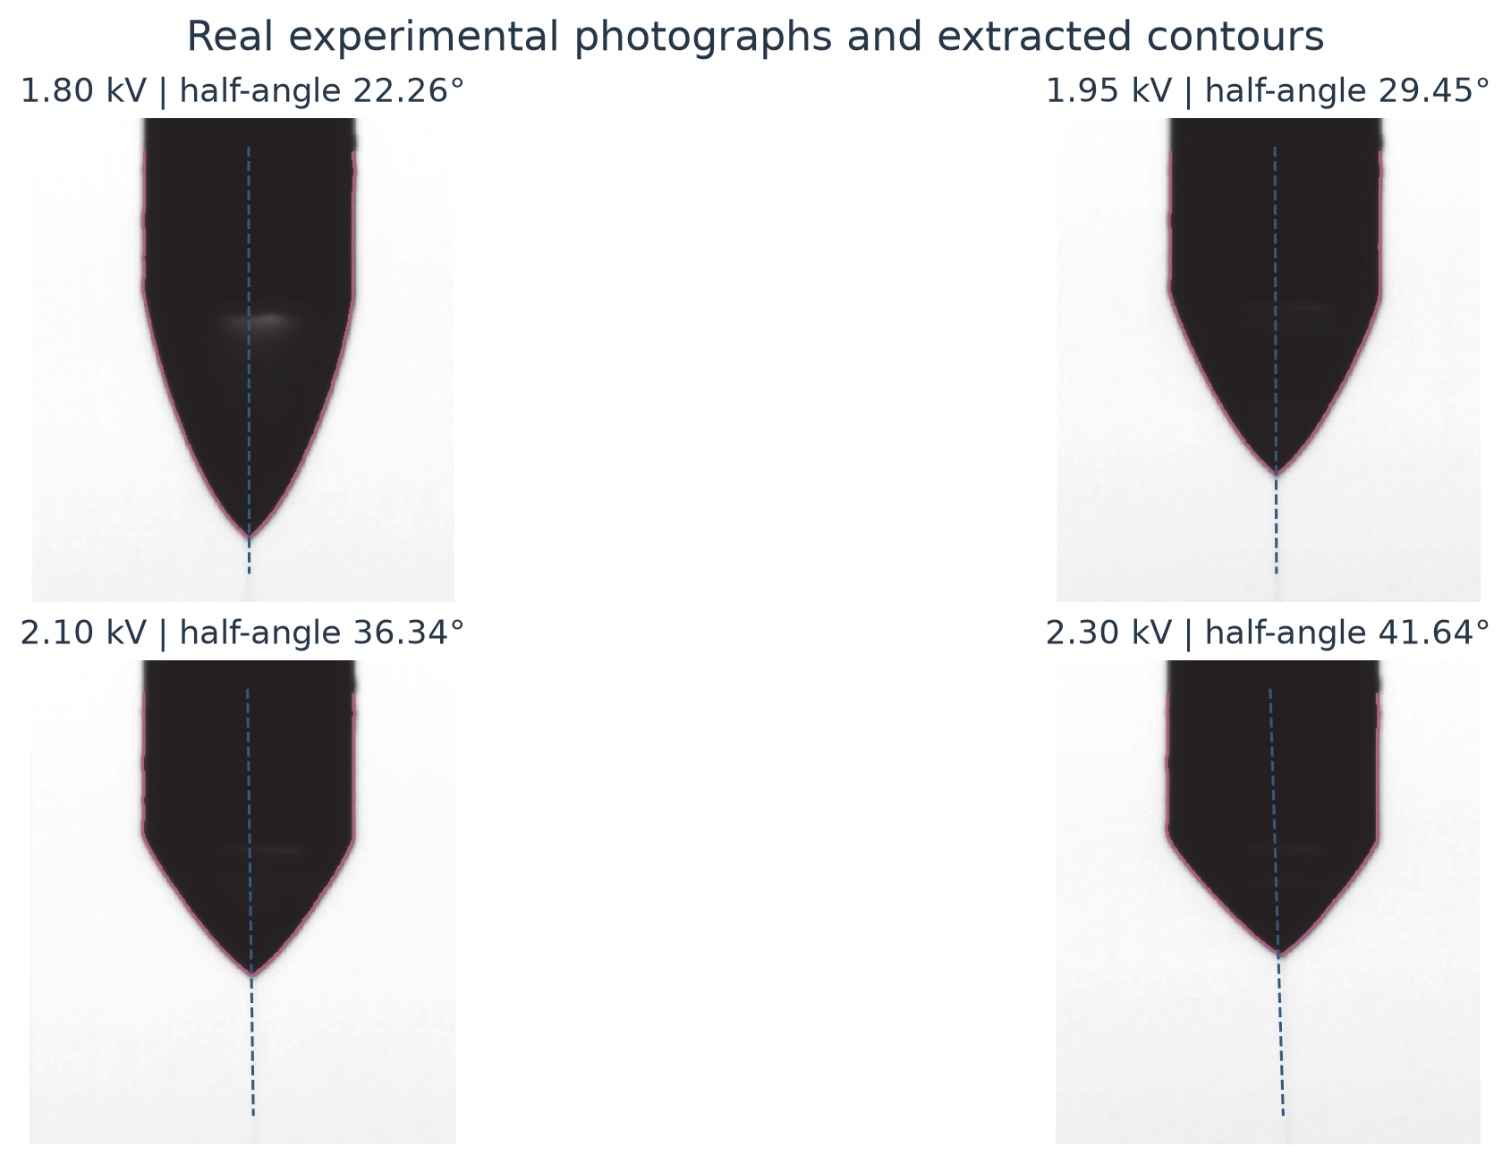
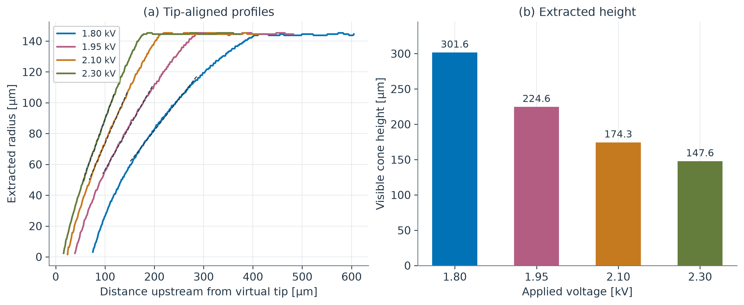
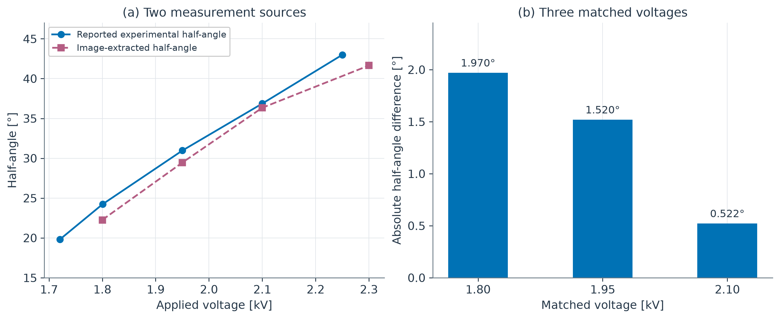
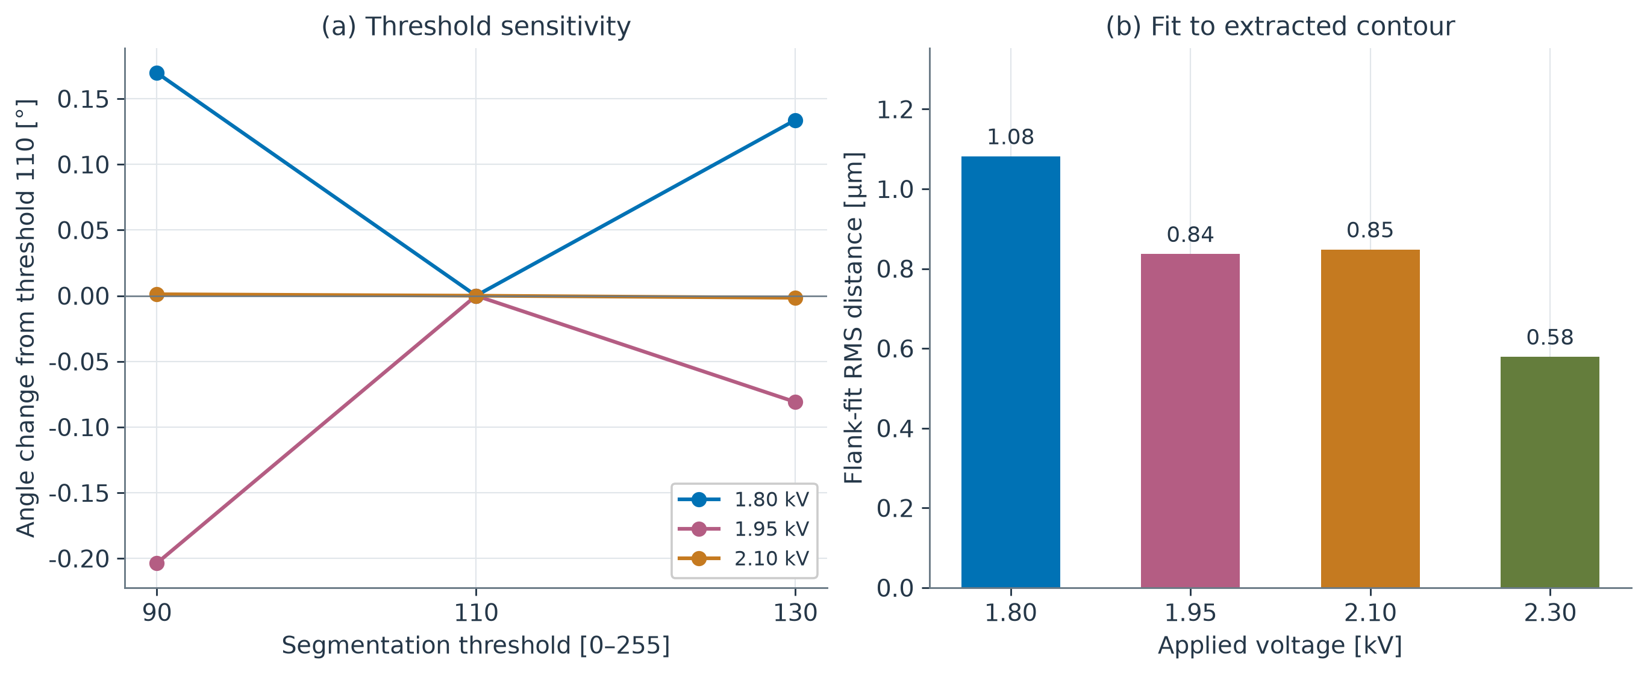
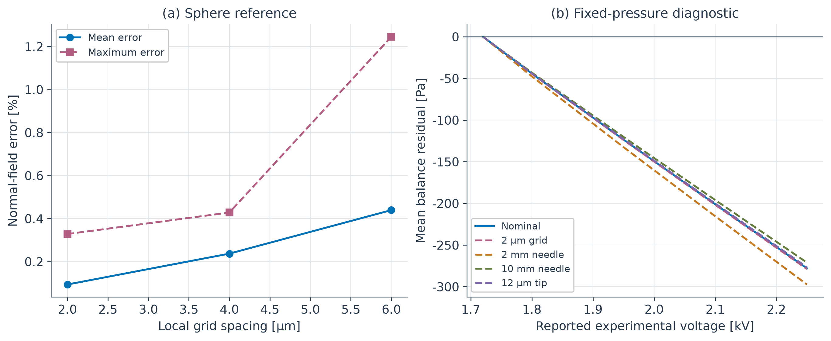
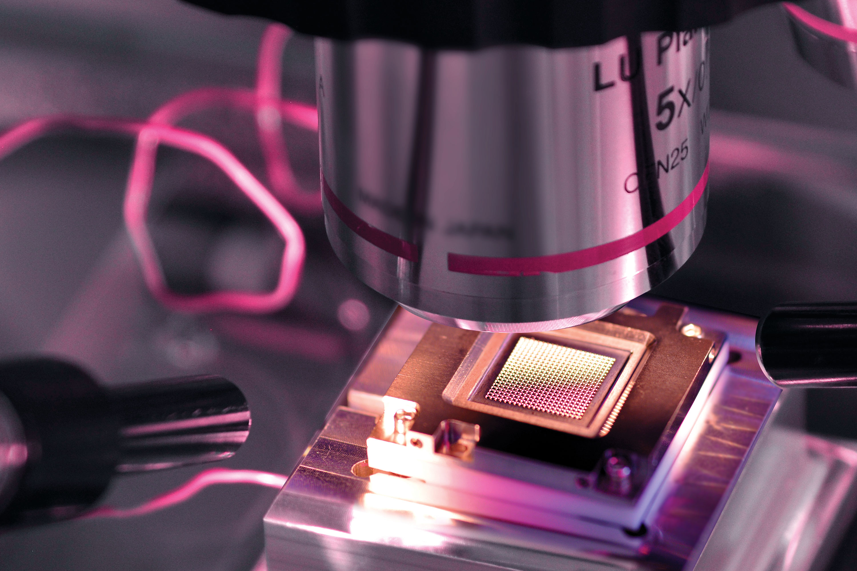
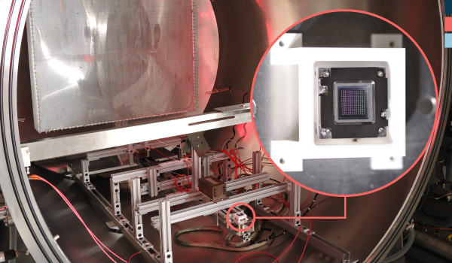
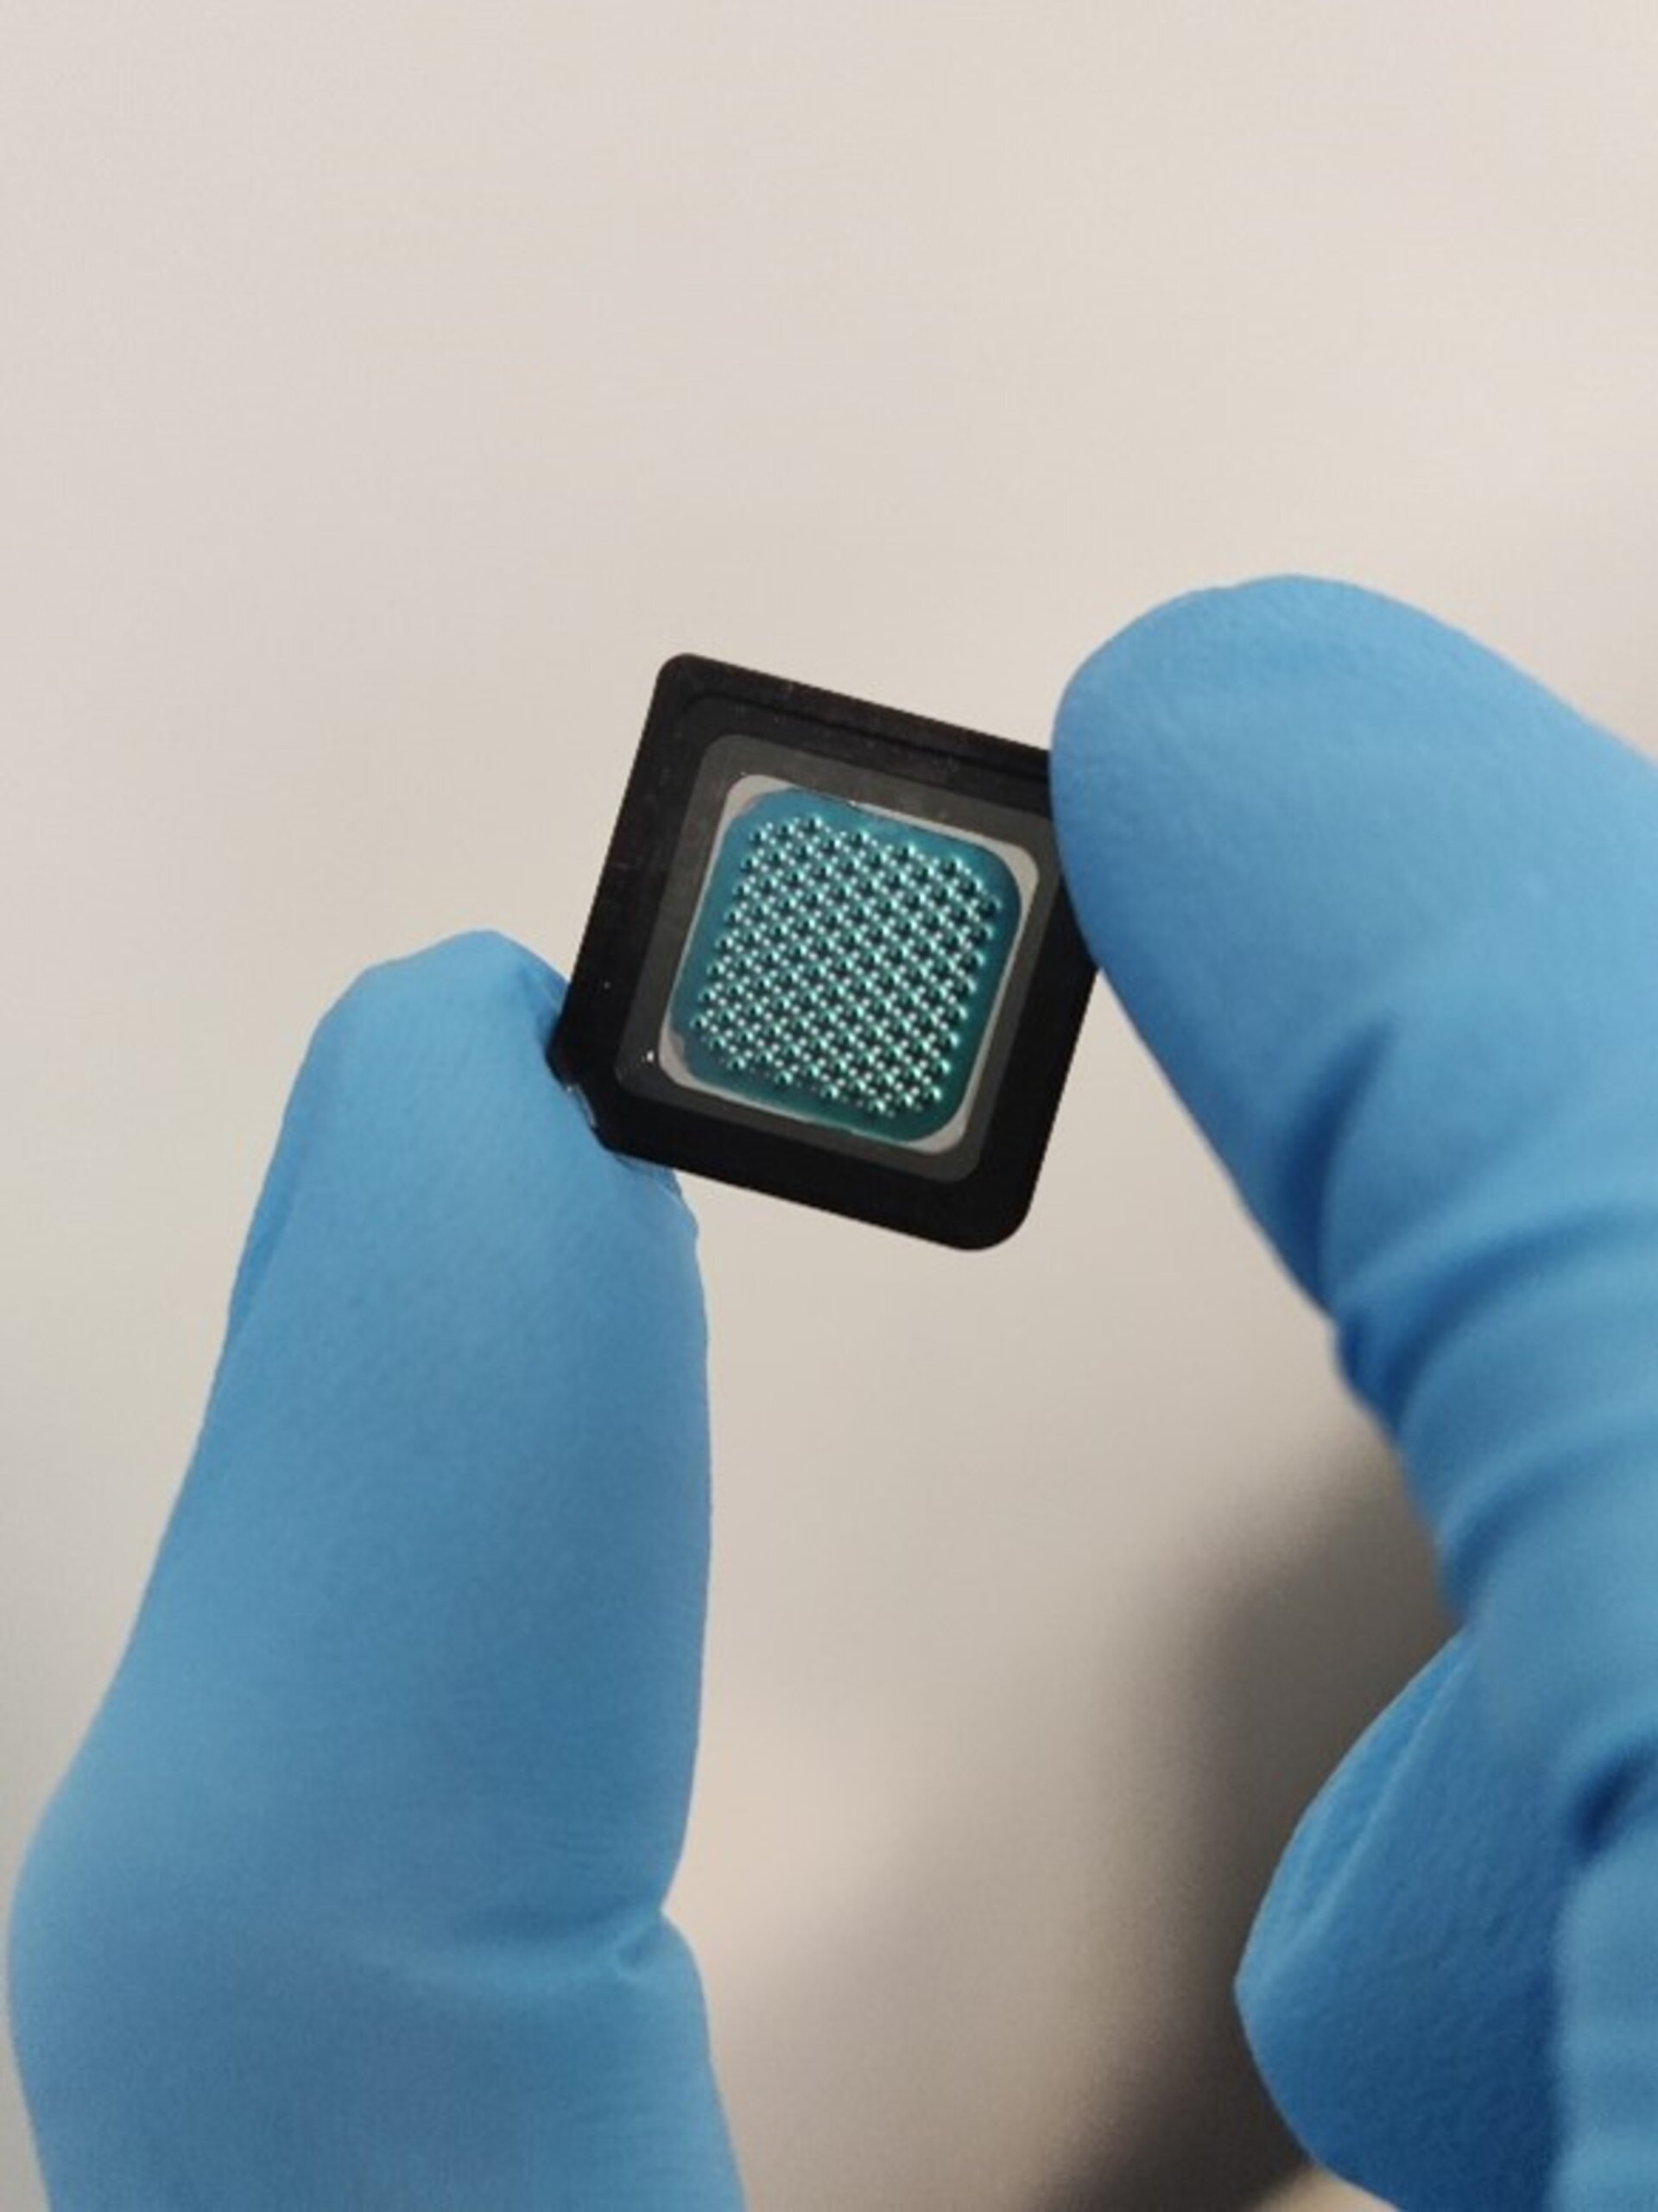
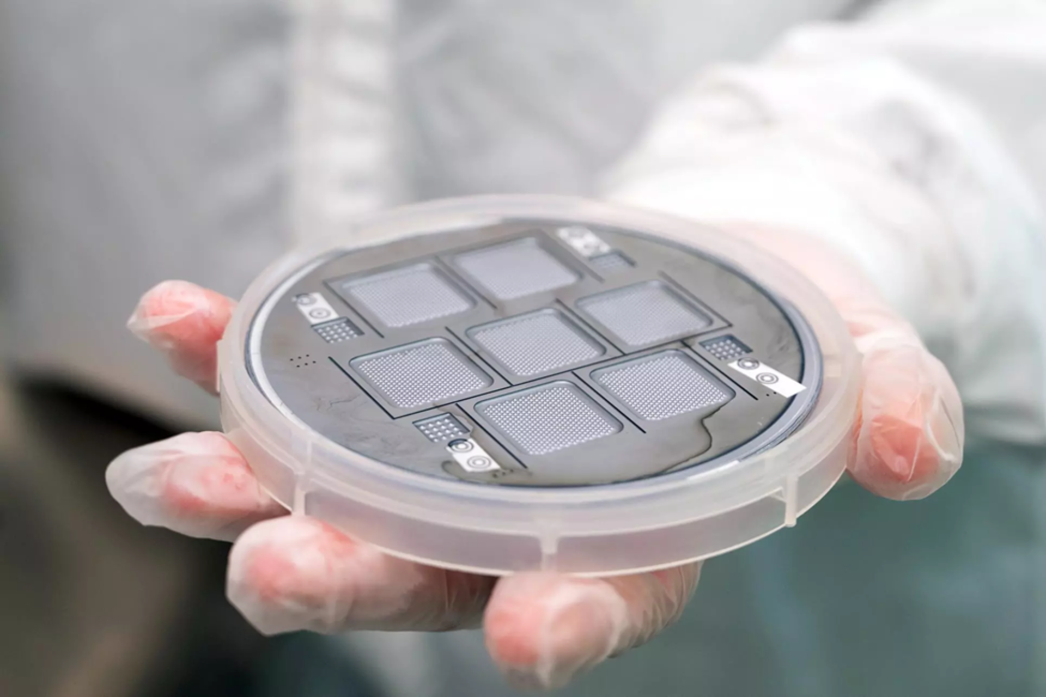
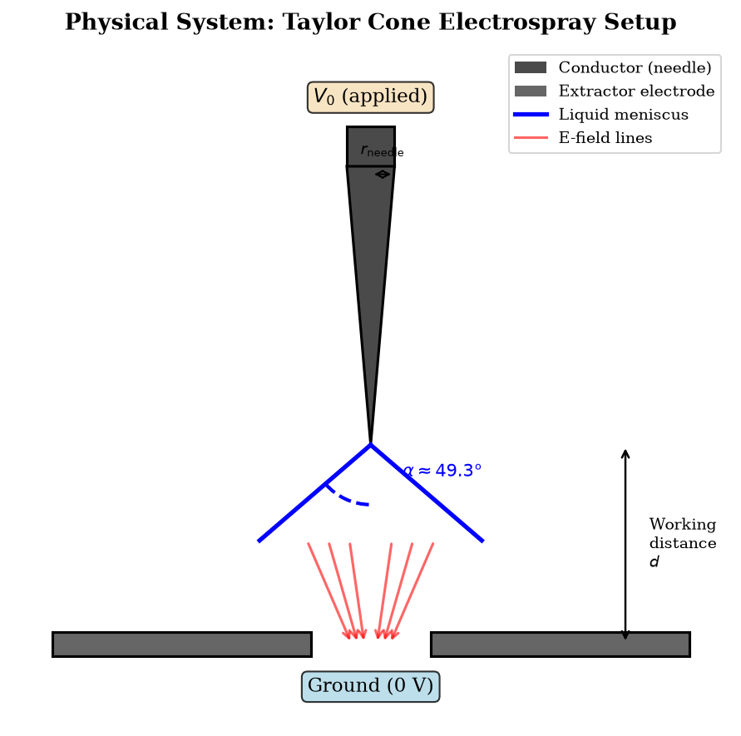

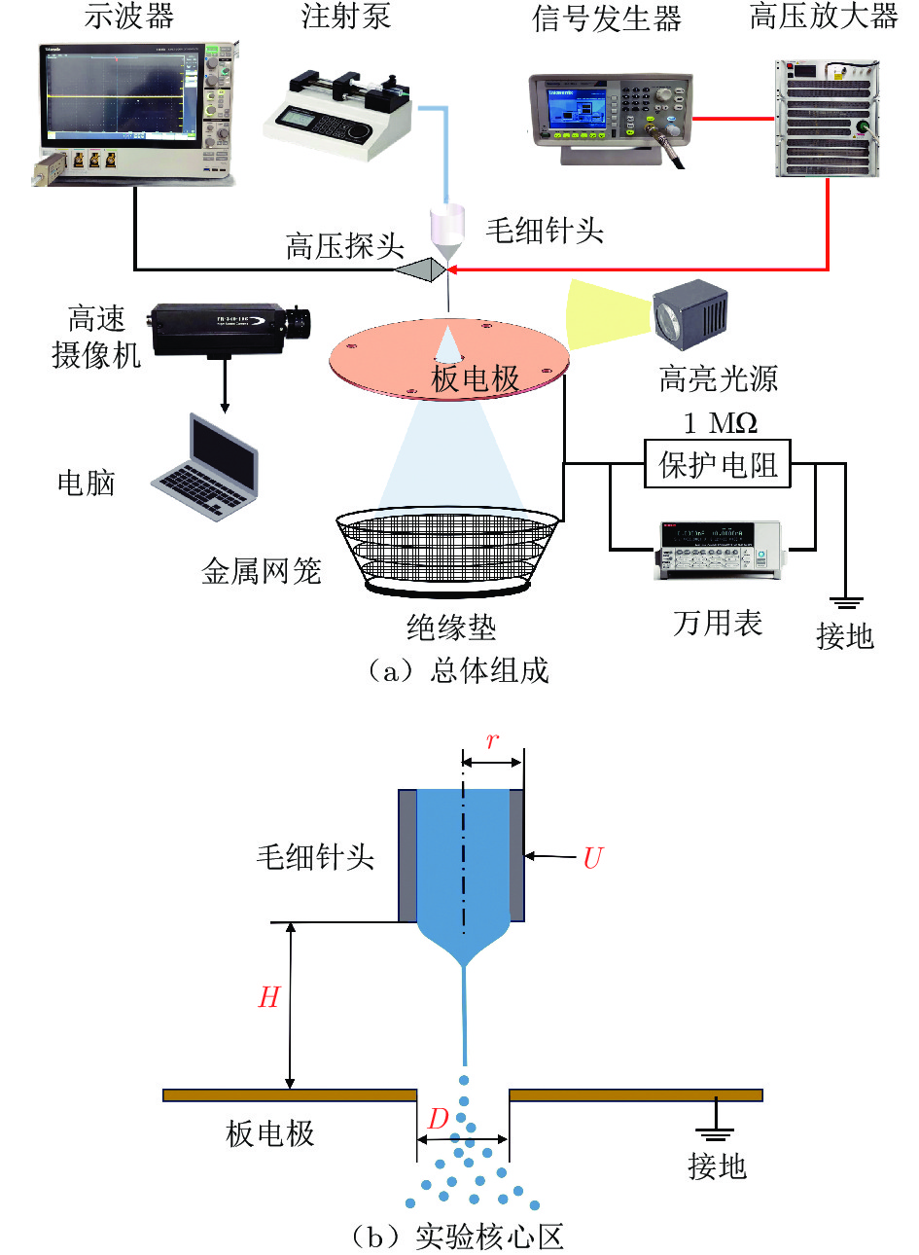
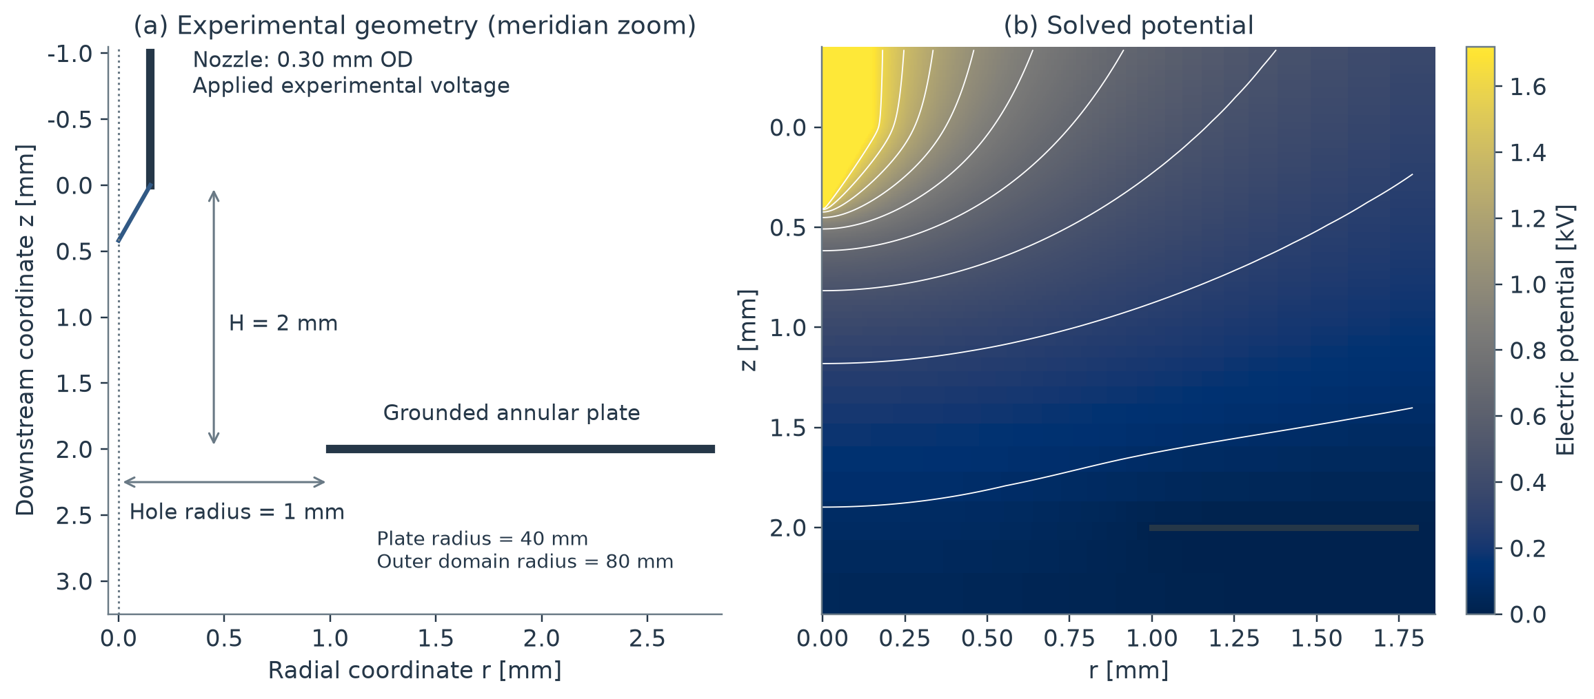











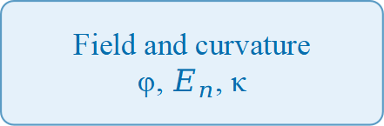
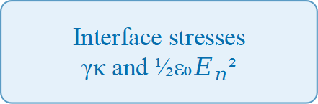
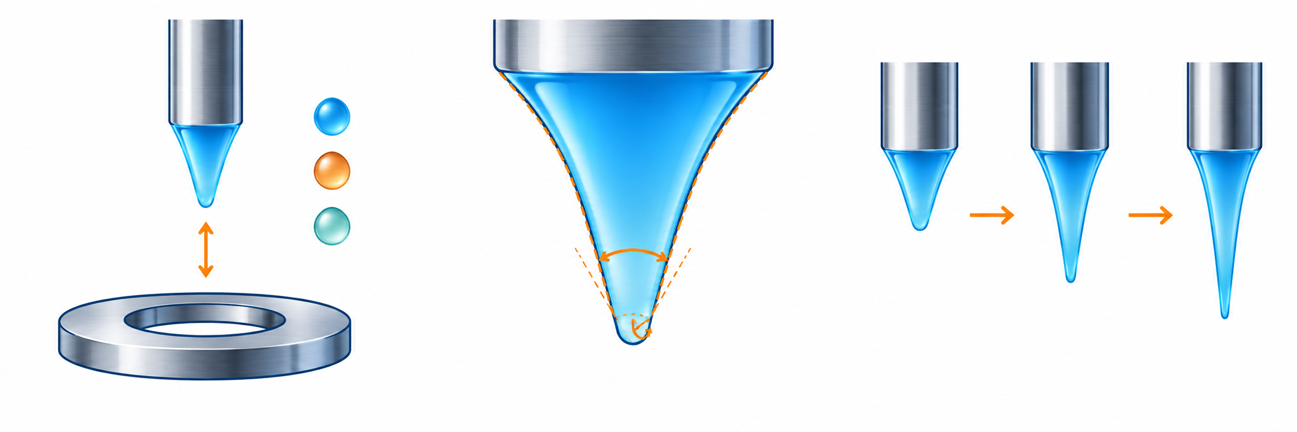
INTRODUCTION
A Lightweight Axisymmetric Taylor-Cone Solver
SCOPE AND LIMITS
1. The problem
Numerical verification of the field, curvature and stress balance on an ordinary laptop
What is verified. The axisymmetric electrostatic operator, the gas-side interface field reconstruction, and the stress-balance diagnostic — against an exact manufactured solution, an independent P1 finite-element solve and the classical Taylor benchmark.
Electric Maxwell stress pulls the liquid interface outward; surface tension resists. Where the two balance, a Taylor cone forms at the classical half-angle α ≈ 49.3°.
Ethan Yang · Elliot Dong · Curtis Lau
High-fidelity electrospray models need specialised multiphysics software, dense meshes and substantial compute — a practical barrier for students and small laboratories.
Independent Schools Foundation Academy, Hong Kong SAR — numerical results plus a published-data comparison
Reduced-order by design. This is an onset-level electrostatic model. It does not simulate cone-jet breakup, spray dynamics, droplet transport or full electrohydrodynamics.
2. Research question
KEY VERIFIED RESULTS
Can a lightweight sparse axisymmetric solver reproduce the key Taylor-cone observables — potential, interface normal field, curvature and the Maxwell–capillary stress balance — on an ordinary laptop?
2.02
49.2901°
1.00054
49.14°–49.20°
0.00655 Pa
Grounded-box angles. Argmin angles from a finite grounded domain are truncation artefacts: they move with domain size and are not reported as physical results.
Which observable actually pins down the half-angle: the projected-residual minimum, or the flank field-exponent crossing?
convergence order
Taylor benchmark
amplitude identity
exponent crossing
residual minimum
Space charge. Only effective algebraic closures are implemented. There is no first-principles ion transport.
Quartic manufactured Poisson
Root of P₁/₂(cos θ) = 0
V₀*/A* under the imposed Taylor far field
Flank Eₙ² ∝ ρ⁻¹ crossing angle
Lowest projected residual RMS, 121×177
3. Approach: a verification hierarchy
L² orders 2.025 / 2.013 / 2.006 across four grids
computed by the solver, not quoted
closes to 0.05% of the exact balance identity
within 0.09°–0.15° of the ideal 49.2901°
flat landscape — the argmin is not the angle estimator
Experimental scope. The photographs analysed here are published data from Yang et al. (2025), processed by our pipeline. No laboratory work was performed for this poster, and no photograph is presented as our own experiment.
Analytical benchmark. Taylor's exact half-angle from P₁/₂(cos θ) = 0, recomputed by the solver rather than quoted.
Five headline numbers. The exponent crossing is grid-convergent and lands within 0.09°–0.15° of the Taylor ideal, so it is the angle estimator we trust. The projected-residual landscape is flat to within its discretisation floor, so its argmin is reported only as a diagnostic, never as a physical angle. The amplitude identity closes under the imposed analytical far field, and every one of these values regenerates from the committed solver in a single command.
Manufactured solution. The exact quartic φ = r⁴ + z⁴ + r²z² exercises the full axisymmetric operator.
What we do not claim. The solver does not replace multiphysics software, does not predict a true onset voltage, and does not prove the physical cone shape.
Independent comparison. Immersed finite differences against a body-fitted P1 finite-element solve of the same problem.
Free-boundary refinement. The immersed interface against a legacy staircase grid mask on four successive grids.
NUMERICAL VERIFICATION (PAPER §6)
METHOD AND PIPELINE
Sensitivity and synthetic tests. Grid, domain, cap size, sampling window and outer boundary over α = 46°–52°, plus 108 analytic cone silhouettes for the imaging pipeline.
PHYSICAL MODEL
Fig. 3. Regular-grid convergence. Errors are measured against the exact manufactured potential; h is the radial spacing. The finite-difference stencil and an independently assembled bilinear Q1 finite element fall on the same asymptotic slope, consistent with second-order accuracy.
Fig. 4. Curved-boundary refinement. Potential changes are compared at the same 56 gas-side points on 31×45 → 87×129. The immersed representation decays monotonically with refinement; the legacy staircase mask reverses, which is the justification for the immersed treatment.
Fig. 5. Independent fixed-cone FD–FEM comparison. (a) Gas-point potential differences. (b) Interface-normal field. (c) Maxwell pressure p_E = ε₀Eₙ²/2 at 1000 V. (d) Amplitude-projected residual. Finest-level relative RMS differences: 0.024% potential, 0.226% vector field, 0.381% interface-normal field, 0.817% Maxwell pressure. The FEM solution was produced outside this repository.
Fig. 2. Computational workflow for the charge-free immersed formulation. Geometry and discretisation feed the electrostatic solution and two interface diagnostics; voltage-amplitude projection is optional.
Discretisation. Sparse finite-difference axisymmetric Laplacian with a regularised axis stencil; the operator has a handful of non-zeros per row.
Fig. 6. Angle sensitivity. Candidate half-angles 46°–52° with mesh, domain size, cap size, flank window and outer boundary varied. Residual minima move from 48.0° to 50.0°, while the p = −1 exponent crossing stays within 49.067°–49.176°. The two diagnostics resolve different things: the crossing measures consistency with the imposed Taylor scaling, the minimum reflects the finite-domain stress balance.
Interface. Cubic-exact immersed-boundary stencil on the gas side; ≤1% normal-field error on refined grids, against 0.440% → 0.094% for the sphere reference.
Balance. Curvature supplies γκ; the Maxwell pressure ½ε₀Eₙ² and a projected pressure offset Δp close the normal-stress balance into R.
Diagnostics. Two complementary observables: the projected stress residual and the flank exponent p from Eₙ² ∝ ρᵖ, whose p = −1 crossing is the grid-convergent angle estimate.
Fig. 1. Physical system. A conducting liquid meniscus at the needle tip deforms under the applied voltage V₀. Maxwell stress balances capillary stress at the classical half-angle α ≈ 49.3°.
Reproducibility. Every number and figure on this poster regenerates from the committed solver in one command; 74 automated tests pass.
Reduced-order model. The liquid is an equipotential conductor and the gas obeys Laplace's equation. A rounded cone — half-angle α, apex cap radius R_c — defines the candidate interface; electric and capillary pressures on that interface combine into a Young–Laplace–Maxwell residual R.
CONCLUSION
∇²φ = 0 E = −∇φ
p_E = ½ ε₀ Eₙ² p_γ = γκ R = p_γ − p_E − Δp
Verified core. A transparent sparse solver reproduces its analytical Taylor benchmark to ≈0.1° through the flank-exponent observable, and closes the imposed-Taylor amplitude identity to 0.05%, on a laptop.
VERIFICATION RUNS
Fig. 7. Multistart optimisation. Five angle–apex-radius starts on the 31×45 grid. Final half-angles span 40.199°–42.791° and apex radii 0.0704–0.0887 m, yet projected RMS residuals stay within 0.01257–0.01333 Pa. The flat objective reveals an angle–radius ambiguity in the fitted parameterisation.
Fig. 8. Synthetic-image accuracy. 108 analytic cone silhouettes: four half-angles (40°, 45°, 49.29°, 55°), three visible lengths (100/200/400 px), three registered rotations (−5°/0°/+5°) and three paired noise–blur settings. Maximum absolute angle error 0.299° and profile nRMSE 1.406% — all 108 cases inside the preset 1° and 2% criteria.
Independent agreement. Against a body-fitted P1 finite-element solve the finest grid agrees to 0.024% in potential, 0.226% in the vector field and 0.381% in the interface-normal field.
Nine committed runs, each with its own reference. Manufactured convergence is the primary evidence for the electrostatic operator; the immersed/staircase pair justifies the interface treatment; the identity and crossing runs test the balance diagnostics.
PUBLIC-DATA ANALYSIS (PAPER §7)
Measurement. The 108-case synthetic test bounds angle error at 0.299° and profile nRMSE at 1.406%. Applied to published ethanol photographs, the extracted half-angles differ from the separately reported series by 1.337° mean absolute at three matched voltages.
Run | Grid(s) | Observable | Value
Analytical Taylor benchmark | P₁/₂(cos θ) = 0 | half-angle | 49.2901°
Quartic manufactured Poisson | 25×27 → 193×209 | L² order | 2.025 / 2.013 / 2.006
Quadratic manufactured control | 193×209 | L² error | ≈1e-14 (exact by construction)
Immersed-boundary refinement | 31×45 → 87×129 | inter-level order | 1.28 → 0.74
Legacy staircase mask | 31×45 → 87×129 | inter-level order | 1.86 → −0.66 (non-convergent)
Imposed-Taylor identity | 121×177 | amplitude ratio | 1.00054
Flank exponent crossing | 61×89 ; 121×177 | recovered angle | 49.136° ; 49.203°
Projected-residual landscape | 121×177 | minimum RMS | 0.00655 Pa
Sparse solve scaling | 675 → 85,073 unknowns | time exponent | 2.29 (334 s at largest)
Fig. 9. Axisymmetric representation of the published case. Geometry of the Yang et al. (2025) ethanol experiment: flow rate Q = 0.10 µL/s, nozzle-to-plate spacing H = 2 mm, aperture diameter D = 2 mm, nozzle outer/inner diameter 0.30/0.16 mm. Plate and aperture dimensions are reported inputs; the 80 mm outer-domain radius and the 5 mm exposed needle length are numerical settings.
Fig. 10. Published ethanol photographs with extracted contours. Source: Yang et al. (2025), Figure 5 — this is their experiment, not ours; the contour and axis overlays are our analysis. Acquired at 1.80, 1.95, 2.10 and 2.30 kV with a common calibration of 300/191 = 1.57068 µm/pixel and a grayscale threshold of 110. The extracted half-angle rises from 22.26° to 41.64° as voltage increases.
Balance diagnosis. With a fixed pressure calibrated at 1.7203 kV, mean residuals grow negative with voltage (−44 to −278 Pa) across five numerical settings — a systematic departure from a constant-pressure static balance.
Why it matters. A student or small laboratory can reproduce every number here with open-source Python and no specialised multiphysics licence.
Next. Supervised laboratory validation, sharper interface representation, space charge inside the optimisation loop, and more voltages, gaps and liquids.
Quadratic control. The φ = r² + z² case is exact by construction, so its ~1e-14 error is reported as a control and not as convergence evidence. Test suite. 74 automated tests pass under python -m pytest backend/tests/.
REFERENCES
[1] Taylor, G. I. Disintegration of water drops in an electric field. Proc. R. Soc. Lond. A 280(1382), 383–397 (1964).
[2] Fernández de la Mora, J. The fluid dynamics of Taylor cones. Annu. Rev. Fluid Mech. 39, 217–243 (2007).
REPRODUCIBILITY
[3] Melcher, J. R., & Taylor, G. I. Electrohydrodynamics: a review of the role of interfacial shear stresses. Annu. Rev. Fluid Mech. 1, 111–146 (1969).
One script regenerates every numerical number and figure on this poster, calling the committed solver directly.
[4] Saville, D. A. Electrohydrodynamics: the Taylor–Melcher leaky dielectric model. Annu. Rev. Fluid Mech. 29, 27–64 (1997).
$ python build/make_figures.py
solver figures + headline cards -> Figs 3-8
$ python -m pytest backend/tests/
74 passed
backend/solver/verification.py
run_quartic_manufactured_poisson() -> Fig. 3
taylor_cone_half_angle_deg() -> card 2
backend/solver/app_backend.py
run_immersed_verification() -> Figs 4, 6
backend/examples/08_immersed_refinement_study.py
immersed vs. staircase inter-level orders
backend/experimental/image_processing.py
contour + registered axis extraction -> Fig. 10
backend/experimental/profile_extraction.py
flank fit, half-angle, visible height -> Figs 11-13
backend/experimental/synthetic_validation.py
108 analytic cone silhouettes -> Fig. 8
Fig. 11. Registered profiles and visible heights. Dashed flank fits summarise the extracted contours. Presenting the profiles on a common physical scale shows the cone widening and shortening: visible height falls from 301.6 µm at 1.80 kV to 224.6, 174.3 and 147.6 µm.
Fig. 12. Photo-derived vs. reported half-angles. Comparison is restricted to the three voltage pairs whose mismatch is below 0.005 kV. Absolute differences are 1.970°, 1.520° and 0.522°, giving a mean absolute difference of 1.337° and an RMS difference of 1.468°. Both series rise with voltage; the largest matched discrepancy is at 1.80 kV.
[5] Gañán-Calvo, A. M. Cone-jet analytical extension of Taylor's electrostatic solution. Phys. Rev. Lett. 79(2), 217–220 (1997).
[6] Fernández de la Mora, J., & Loscertales, I. G. The current emitted by highly conducting Taylor cones. J. Fluid Mech. 260, 155–184 (1994).
[7] Hartman, R. P. A. et al. Electrohydrodynamic atomization in the cone–jet mode. J. Aerosol Sci. 30(7), 823–849 (1999).
[8] Cloupeau, M., & Prunet-Foch, B. Electrostatic spraying of liquids in cone-jet mode. J. Electrostat. 22(2), 135–159 (1989).
[9] Cloupeau, M., & Prunet-Foch, B. Electrohydrodynamic spraying functioning modes: a critical review. J. Aerosol Sci. 25(6), 1021–1036 (1994).
[10] Karimi, M. et al. Onset voltage and stability island of electrospray in the cone-jet mode using a curved counter electrode. J. Electrostat. 98, 1–10 (2019).
Fig. 13. Extraction sensitivity. Repeating the segmentation at grayscale thresholds 90/110/130 shifts the three voltage-matched half-angles by at most 0.204° and the unpaired 2.30 kV case by 0.322°. At the nominal threshold the straight-flank fit RMS is 1.082, 0.837, 0.848 and 0.579 µm in ascending voltage order — so threshold sensitivity is smaller than the inter-source discrepancy.
Fig. 14. Field and balance checks. (a) Sphere-reference normal-field error falls from 0.440% mean / 1.245% max to 0.094% mean / 0.328% max when the local spacing is refined from 6 to 2 µm. (b) With pressure calibrated at 1.7203 kV (Δp ≈ 6.458 Pa) and held fixed, mean residuals at the reported angles are ≈ 0, −44, −123, −201 and −278 Pa. The negative high-voltage trend persists across five numerical settings, indicating a systematic departure from the constant-pressure static balance.
[11] Zhang, Z. A flexible new technique for camera calibration. IEEE Trans. Pattern Anal. Mach. Intell. 22(11), 1330–1334 (2000).
The Streamlit app exposes the same parameters (voltage, surface tension, electrode spacing, domain radius, grid resolution, space-charge model) with classic and immersed boundary tabs.
[12] Yang, P., Peng, Y., Yi, H., & Wu, J. Experimental study on ethanol electrostatic spray mode and Taylor cone-jet characteristics. J. Exp. Fluid Mech. 39(3), 54–62 (2025).
Numerical results and Figs 3–8 regenerate from the committed solver by build/make_figures.py; the test suite passes 74 checks. Figs 10–14 analyse photographs published by Yang et al. (2025) and are not our own experiments.
Source code and data: available on request.
Notes:
Sources and metric definitions for the academic poster.
Computational figures: 论文修改对照与图件交付/figures/en and figures/zh. Corresponding numerical data: 论文修改对照与图件交付/data/.
Public experimental case: Yang Pengfei, Peng Yuxing, Yi Hongliang and Wu Jian (2025), Journal of Experiments in Fluid Mechanics 39(3):54–62, DOI 10.11729/syltlx20220040.
Publisher PDF: https://pubs-data.cstam.org.cn/lxqkw-data/syltlx/2025/3/PDF/2022-040a.pdf
The four photos are at 1.80, 1.95, 2.10 and 2.30 kV. Published angle markers include five voltages ending at 2.2503 kV. Measurement MAE uses the three matching voltages 1.80, 1.95 and 2.10 kV.
Image measurement MAE 1.337459301 deg, max 1.970428562 deg. This crosscheck uses published markers from the same study rather than repeated measurement of the identical frame.
Synthetic measurement figures use the original 108 analytic image cases, max half-angle error 0.298517 deg, max profile nRMSE 1.405869%. Software regression test count is distinct from experiment count.
Application photographs: NASA/JPL-Caltech, https://microdevices.jpl.nasa.gov/capabilities/advanced-microfabrication-technologies/electrospray-propulsion/; © ESA, https://www.esa.int/ESA_Multimedia/Images/2023/03/Microfabricated_electrospray_emitter_and_fluidic_barrier.
ESA image credit and Standard Licence are retained. Publisher experimental images are attributed for research review. No additional image reuse license is asserted.
Additional application image: IENAI Space, ESA Pinhole propulsion for satellites, https://www.esa.int/ESA_Multimedia/Images/2023/12/Pinhole_propulsion_for_satellites . Image copyright IENAI Space. Educational research poster.
Hardware crops reproduce portions of Yang et al. Figure 1. They illustrate the published apparatus, and are not photos of newly conducted project experiments.
Poster experimental figures: revision_2026-10-09/scripts/render_experiment_figures.py. Inputs are the retained CSV measurements, contour samples and field libraries. Figure-data checksums accompany the rendered figures.
The image/report angle comparison uses three voltage-matched points from Yang et al. Figures 5 and 6. The mean absolute difference is 1.337459301 degrees. Missing photo/marker pairs are blank in the data-pairing table.
Numerical residual: R = gamma*kappa - epsilon*En^2/2 - Delta p, with the spatially constant offset removed by the surface mean. The separate fixed-pressure diagnostic fixes the offset at the first reported voltage and evaluates the other reported geometries.
Threshold sensitivity reuses the 90, 110 and 130 segmentation thresholds. The maximum half-angle range across the three matched voltages is 0.203613622 degrees. Flank-fit RMS measures distance to the fitted line on the same extracted contour.
Application photographs illustrate electrospray propulsion. Experimental apparatus photographs reproduce Yang et al. Figure 1. Figure 1 of this poster is a conceptual schematic. Figure 2 is a model geometry drawing with a separate equipment montage.
Figure 15 source: retained fixed-cone FD–FEM benchmark, finest level. Relative RMS differences: potential 0.024%, vector electric field 0.226%, Maxwell pressure 0.817%. Figure 16 is a generated conceptual illustration of proposed future work, not an experimental photograph.

