Slide 1
CS308 Project Presentation I Autonomous Defensive Robot
Harshvardhan Mandad 08005022 (TL)
Vinay Surana 08005031
Vivek Surana 08005030
Akhil Tak 08005029
Group 12

Slide 2
Autonomous Defensive Robot(ADR)
ADR will detect enemies coming inside an Arena (for simplicity we assume enemy on ground i.e. 2D).
ADR will fire on enemies using laser gun.
ADR will take an image after each shooting and will confirm whether the shoot was successful or not and will take further decisions accordingly.

Slide 3
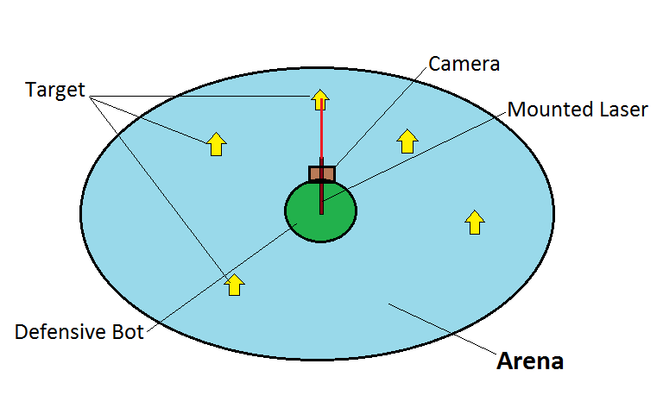
Top View Of Arena

Slide 4
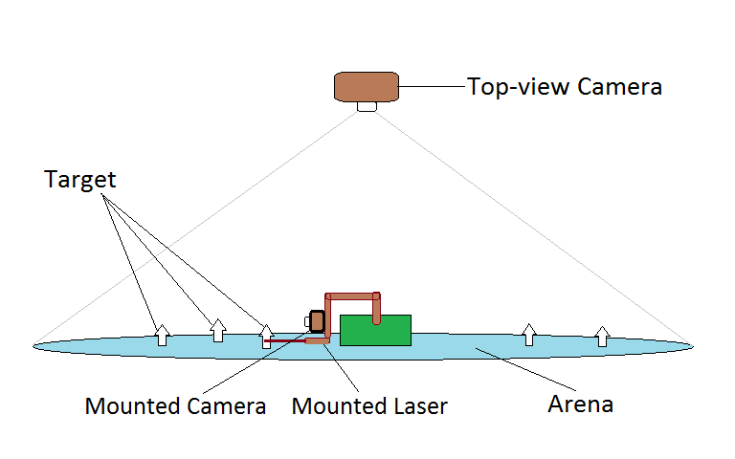
Side of the Arena

Slide 5
Members and Their Roles
Vinay Surana : Image Processing & Algorithms
Vivek Surana : Algorithms and calibration
Harshvardhan Mandad : Image Processing & Algorithms
Akhil Tak : Image Processing & Rotation and Mounting Mechanisms
*The above distribution is tentative.

Slide 6
Requirements (1/2)
Hardware :
FIREBIRD ROBOT
Two Cameras
One Laser Gun
Mechanism to mount gun
Servo Motor for rotation mechanism
Software :
MATLAB for image processing.
AVR Studio

Slide 7
Requirements(2/2)
Arena Specification
Red Rectangular arena with the robot at the center of Arena
Enemy Specification
Will be a green color tennis ball.
Detecting Enemies on Arena
Will use mounted camera on the top of Arena
After processing the image, the system will send the angle w.r.t. the zero of the servo motor.
Shooting a enemy
After receiving the angle, the robot will rotate the mounted laser gun towards the enemy and shoot it.
Gun can rotate 360 degree on the bot.
Verifying Successful Hit
Will verify by camera mounted on the robot along with the gun.
A dot of the laser on the enemy will imply successful hit.
On successful hit , beep sound will be produced.

Slide 8
Technical Challenges
Image Processing to detect targets and confirmation of successful hit.
Rotating the mounted gun accurately.
Real time delay of sending data from system like Laptops to the FireBird.
Detecting the bottleneck of the processing performed.

Slide 9
Testings
Enemy Detection
Enemies are green tennis balls on Red Arena.
Balls should move in a range 0-20cm per second.
Enemies(Balls) must be detected by top camera.
Angle must be displayed on LCD.
Enemy Hit
White spot by laser gun on enemy(green tennis ball).
White spot on the ball must be detected by front camera.
On successful hit beep sound must be produced.

Slide 10
Testing Strategy
Robot will be placed inside the arena and z ball will be thrown from outside.
If robot detects the target and successfully shoots the target, it will be indicated by a beep.
Balls will be of green color so we can detect a successful hit easily.
Multiple stationary balls will be detected and killed one by one.

Slide 11
Future Directions
ADR can be extended to work in 3-Dimensions.
ADR can be used as a basic robot for building Autonomous defensive Military bots to protect a certain area (e.g. a Military base).
ADR can also be used as a standalone Security Robot in Exhibitions and in other commercial establishments.

