Slide 1
Android BASED Remote Tennis Ball Collector
CS308: ERTS Lab Group 14
Team Members
Hasan Kumar Reddy A (09005065)
Bhanu Prakash V (09005050)
Vinod Reddy G (09005071)
Avinash Theetla (09005056)

Slide 2
Problem Statement
Aim : To control the Fire Bird V motion using an android mobile
Utility : Tennis ball collection
Modes : Autonomous mode and Manual Mode
Notes :
Image Processing using Open-CV on android mobile
Remote Live Video Transmission via Wi-Fi Camera
Mobile to Bot communication via Bluetooth

Slide 3
Description
Our Fire Bird V functions as a tennis ball collector. It sends the video stream of environment in front of it via an IP Camera fixed in front of it. Android mobile downloads the video from the IP Address of camera and processes it for the presence of tennis ball. Then it sends appropriate signal to the bot via Bluetooth communication module.
Motivation
Setting up a PC is a cumbersome task, especially in times of emergency. Hence we switched to android mobile for image processing and sending the signals.

Slide 4
Requirements Aimed
S.No. | Aim | Status
1. | Remote Video Transmission via Wi-Fi (Hardware) | completed
2 | Android Application (Software) | completed
3. | Image Processing on Android Mobile (Software) | completed
4. | Bluetooth signal Transmission (h/w + s/w) | completed
5. | Ball Picker (Arm) Construction | done
6. | Firebird application code | completed
7. | Completely wireless | done

Slide 5
Project Plan
S.No. | Milestone | Alloted to | Completed On
1. | Project Presentation | Vinod, Hasan | 7th March
2. | Identifying modules and allotment | All | 16th March
3. | Setting up the Wi-Fi Camera | Hasan | 29th March
4. | Received our order for Bluetooth module |  | 3rd April
5. | Android Application | Hasan | 7th April
6. | Image Processing Code | Vinod | 9th April
7. | Firebird Application Logic | Bhanu | 8th April
8. | Fixing Arm on Bot | Avinash | 9th April
9. | Bluetooth Transmission | Avinash, Hasan | 10th April
10. | Bluetooth Receiving | Bhanu, Vinod | 10th April
11. | Project Integration | All | 11th April
Weekly team-meet and work review - Not strictly followed.

Slide 6
Finite State Machine
Start
Auto
Manual
Rotate right
Move Backward
Found the
ball to right
Rotate left
Move forward
Rotate left
B
Found the
ball to leftt
L
F
Scan for ball
Take user input
Found the
ball in center
Move Forward
Not Found
R
P
Found the
ball in center
Rotate Right
Pick the ball
Pick the ball
M
m

Slide 7
Tasks, Challenges & Innovation
Video Transmission
Android doesn’t recognize the usual Ad-hoc network setup by PC
Tried
Rooting mobile, using various apps.
Setting up a WLAN network bridge in PC - Worked
Android Application
Loaded the video in a webview
Default view from IP Camera shows four streams
Ran Javascript on top of it to display just the video required.
Initially loaded a snapshot and regularly updated it at fixed intervals
Java timer made the app non-responsive sometimes

Slide 8
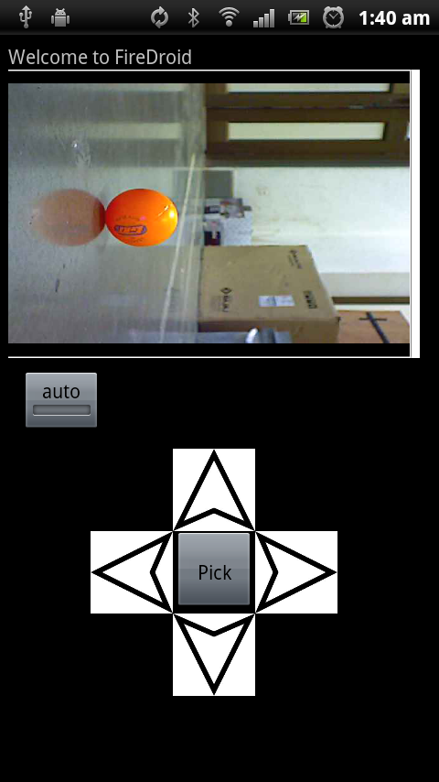
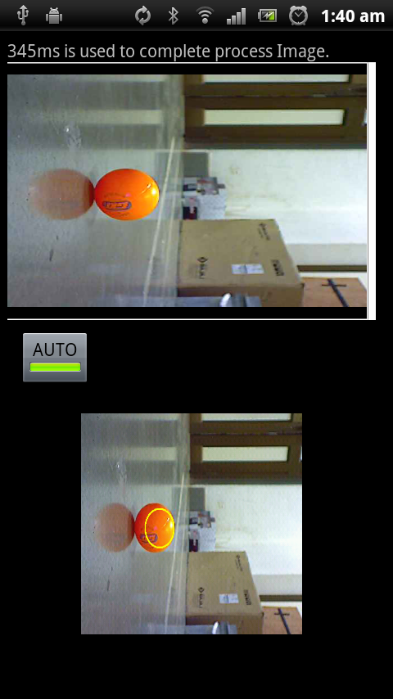
Tasks, Challenges & Innovation
Manual Mode
Auto mode

Slide 9
Tasks, Challenges & Innovation
Open CV
Installation on windows – a challenge by itself
Tried many work arounds, online tutorials
Finally could get it working – links in report
Linking the OpenCV C++ code with Android Java
Android jni – relatively simpler
Usual approach using cvHoughCircles – shape detection – slow
Devised a new approach
Pixel by pixel analysis

Slide 10
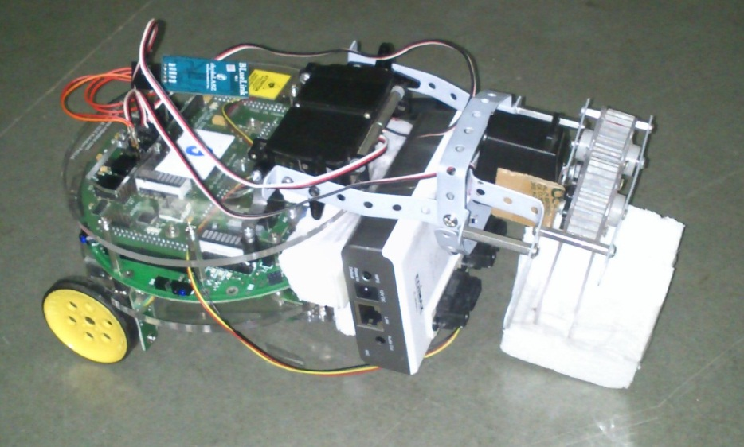
Tasks, Challenges & Innovation
Hardware
Camera mounting
Front
will block the sharp sensors
will block grippers movement
Top
Gripper arp in its path
Sensor
Single sensor – missed the ball many times
Solution
Increase the arm’s length
Place 2 sensors ON the Camera
Fix the Camera in front of bot

Slide 11
Tasks, Challenges & Innovation
Bluetooth Setup
Identification & Procurement
Help from Piyush, Lab Asst.
Programming
Firebird Logic Implementation
Identifying the correct sensor(s) reading under which the gripper arm should be signaled to pick the ball
Understanding ( and fixing the gripper arm ) the behaviour of gripper arm for various values servo motor

Slide 12
Assumptions & Limitations
Only orange colored objects in view are TT balls
Only one ball in the bots view
Though our openCV code can distinguish and identify one of the balls, bot might get confused in few cases
Sensor value might change with hardware
Hardware
Android :
armv7 processor is recommended, because of have a floating point preprocessor (Open CV).
Touch enabled – by design
Bluetooth and Wi-Fi capability – most smart phones have it
Basket not implemented
Build only for android v>=2.3
Bug in 2.2 regarding BitmapFactory

Slide 13
Test Criteria and Delays involved
Introduced a delay of 1s between any two consecutive communication.
Android (Sony MT11i) takes about 0.5 – 1s to download, process and transmit the signal
Much less resources when compared to PC
Share your PCs network with the WLAN setup,
Otherwise, the download seemed to be very slow (20 s), apparently no reason which we could find
Once the ball is picked in auto mode, cannot pick any more balls until reset.
By design
Drawbacks
Android application seemed to crash when many other applications are running simultaneously.
May be using more runtime memory
Close all other applications before you start the app

Slide 14
Re-usability
Have provided brief documentation and references to Open CV in android setup and usage
Could save a lot of effort
Also included the jni resources – cross compilation and linking
Modular nature
Image Downloading
Image Processing
Communication
Application
codes are all separated via different classes.
In code documentation standards
Followed the usual Java commenting style (eclipse friendly)

Slide 15
Future Enhancement
Replace the Bluetooth communication with Wi-Fi sheild
http://www.instructables.com/id/How-to-build-an-Arduino-WiFi-4x4-with-Android-Cont/
http://asynclabs.com/store?page=shop.product_details&product_id=26&vmcchk=1
Will make the whole application really remote
Use an existing or write an Open CV wrapper for android
http://code.google.com/p/javacv/
Improve the UI control – use joystick
Good project
http://www.instructables.com/id/JabberBot-The-Arduino-robot-with-an-ATMega-brain-/

