Slide 1

CS 308 Project
Rangoli Bot
(Extension to Mtech Project)
Rohith S - 09005052
Manohar T - 09005053
Anush V - 09005055 (TL)
Manoj Azad - 09005074

Slide 2
Problem Statement
Draw a given image of Rangoli on floor using coloured powder.
Previous project 'PROBLEMS ENCOUNTERED'
Tri Colour Rangoli
Vectorized rangoli drawing
Entirely negative feedback system
We thought to work on
Tri Colour Rangoli
Negative Feedback System

Slide 3
Initial Approach
Scilab program will take an input image and encodes in such a way that the transfer to the bot will be efficient.
The encoded bot will be sent to the bot using Zigbee.
Implement GPS like system for negative feedback.
ADDED Limitation
We added limit on the number of colours it can draw to 3 , cause more the number of colours supported more is the required hardware.

Slide 4
Implementation
Takes an image which has only red, green and blue colours.
Process the Image and encodes to send it to the bot most efficient way(i.e less amount of data)
This is sent to the bot using USB module.
The bot saves this data and used in accordance with the data sent by negative feedback system.
A camera hanging over the arena will provide the feedback to the robot to actuate its position in form of co-ordinated through USB module
The implemented negative feedback system gives respective signals for the bot movement.

Slide 5
Image Processing
Takes an image with only red , green and blue colours.
First it takes red pixel values for entire image and it replaces all the pixel values near to 255 with 1 and remaining with zeros.
It does the same to green and blue pixel values.
It does lengthwise encoding of the data and sends to the bot.
Lenghtwise Encoding
The data encoded will be of the form
Xaxaxaxa …... byayayayayaya....brbcb
X = 1(red) or 2(green) or 3(blue) or 4(nothing-zeroes)
Y corresponding count of x,i.e second y represents the count of second x in the sequence.
r – rows, c - columns

Slide 6
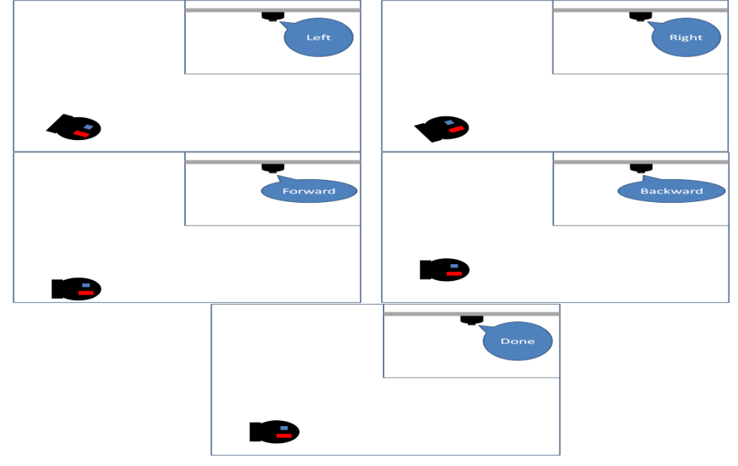
Negative Feedback System

Slide 7
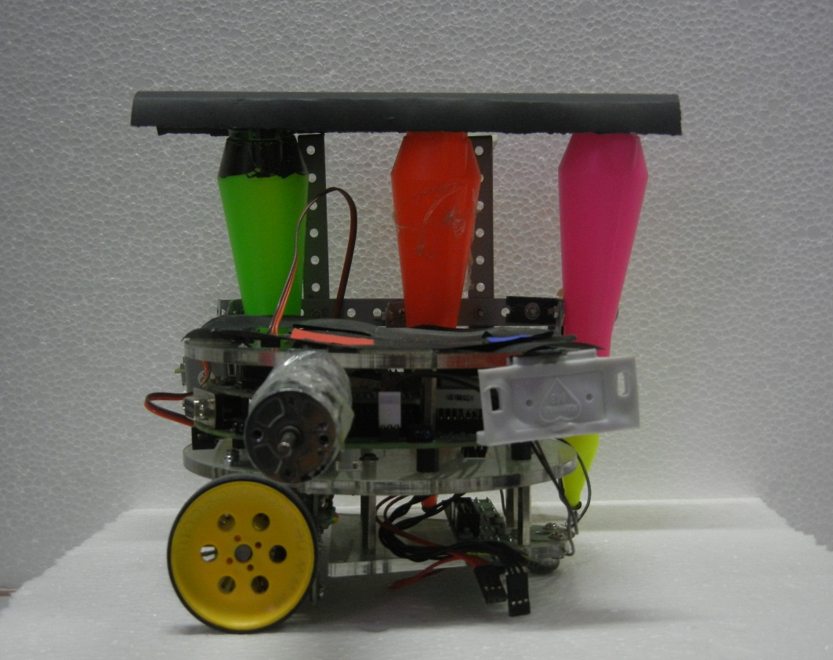
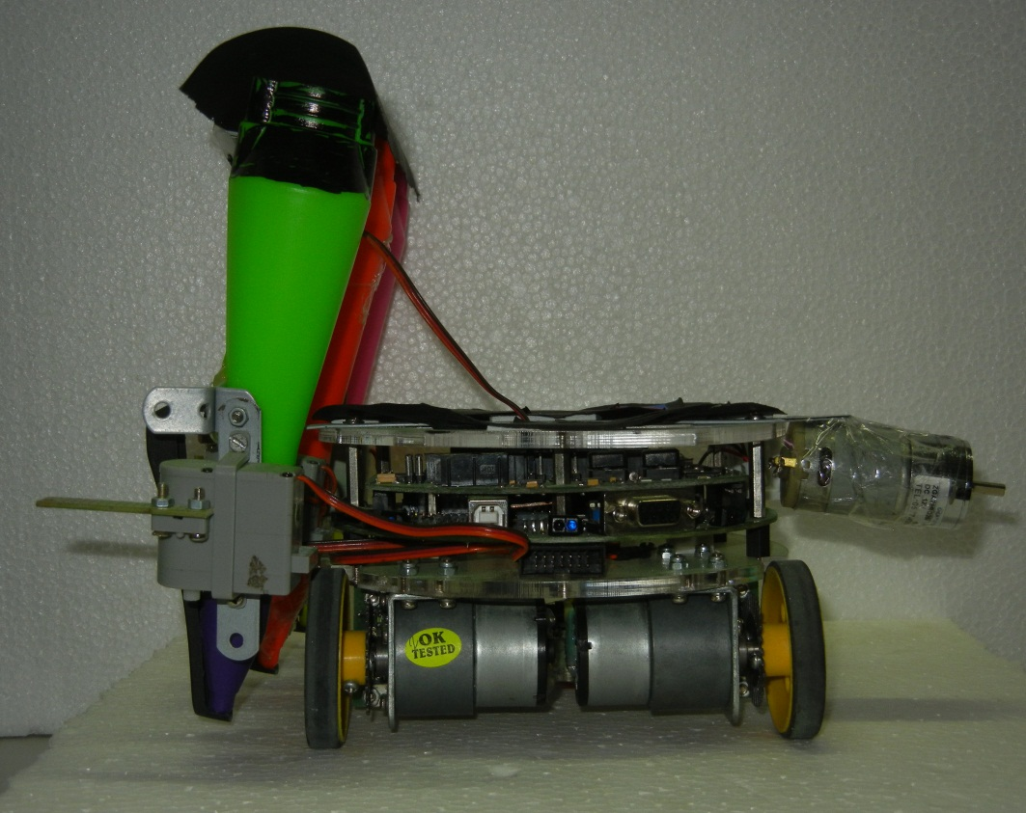
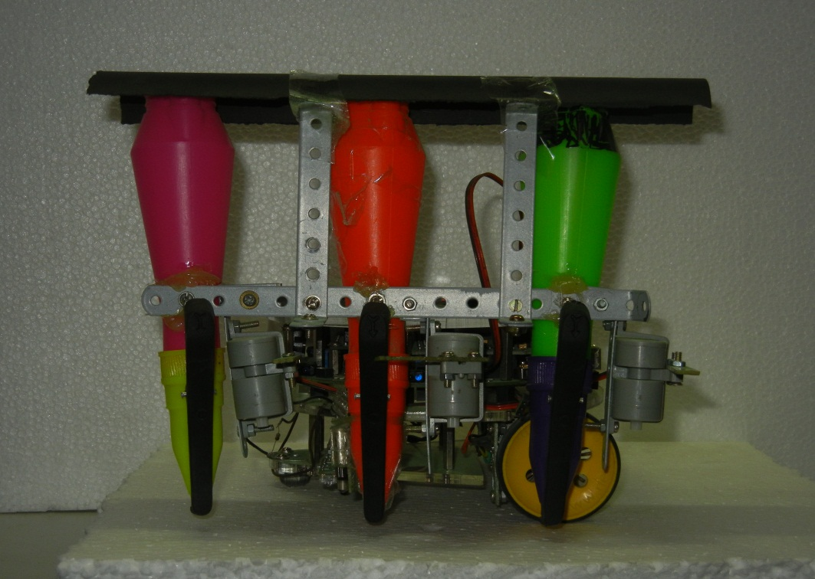
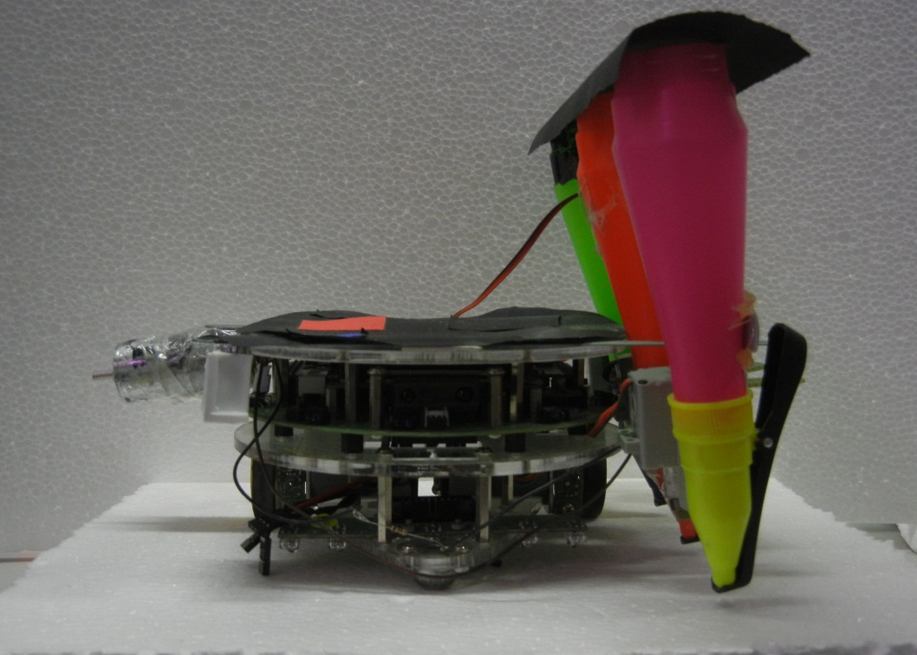
Final System

Slide 8
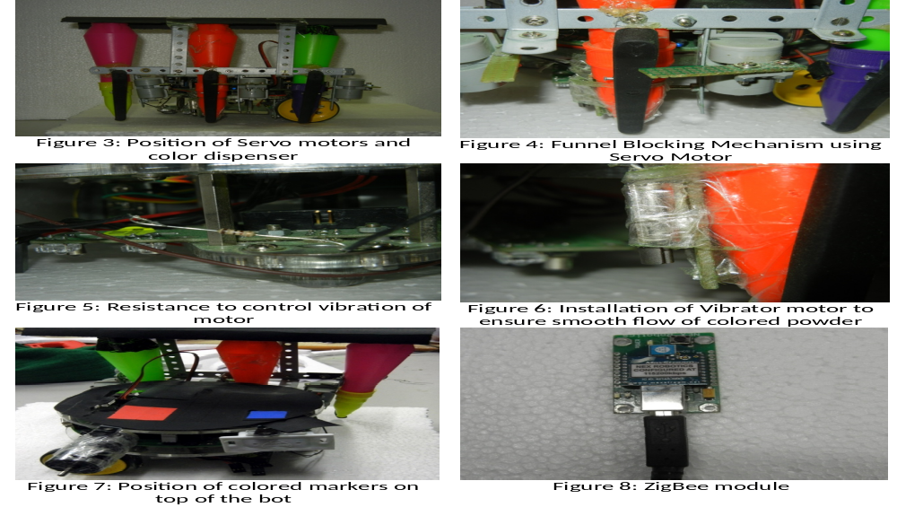
Components

Slide 9
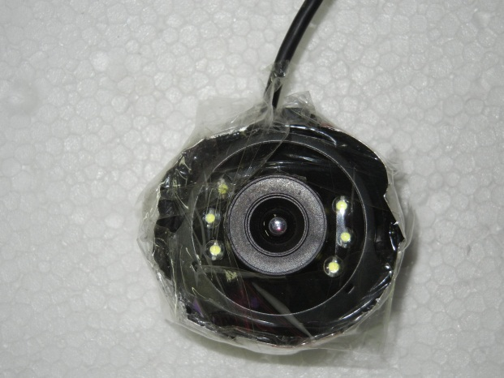
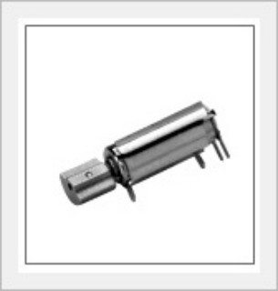
Components

Slide 10
Problems Encountered
Modifying colouring device
OpenCV
Comparison bug in Scilab
If else takes more time in Scilab
Previous project will work only for pure white and black image
Hardware for three colours
Large Image
imshow()
Negative feedback system

Slide 11
Future Scope
Vectorized Rangoli can be implemented
Negative Feedback System can be improvised
Usage of new versions of scilab and opencv and SIVP to make the process fast

Slide 12
Thank you

