Slide 1
2 Wheel
Self Balancing Bot
Group No 8
Nitish Jhawar 09005032
Vinayak Gagrani 09005035
Tarique Aziz 09005036
Vaibhav Krishan 09005042

Slide 2
Problem Statement
We intend to implement a two wheel self balancing bot.
The basic idea for a two-wheeled dynamically balancing robot is pretty simple :-
Drive the wheels in the direction that the upper part of the robot is falling.
If the wheels can be driven in such a way as to stay under the robot's center of gravity, the robot remains balanced.
If the center of gravity by construction can be brought below the shaft then the bot will always be balanced
This bot can be very small, robust to collisions and autonomus.

Slide 3
Task Specification
This requires two feedback sensors :-
A Tilt or Angle sensor to measure the tilt of the robot with respect to gravity, and
Wheel Encoders to measure the position of the base of the robot.
Four terms are sufficient to define the motion and position of this "inverted pendulum" and thereby balance the robot :-
  the tilt angle and
  its first derivative, the angle velocity, and
  the platform position and
  its first derivative, the platform velocity.
These four measurements are summed and fed back to the platform as a motor voltage, which is proportional to torque, to balance and drive the robot.

Slide 4
Project Plan
Balance the initial robot :- We implemented PID and Filters on the initial robot design of two wheel balancing bot :- till first demo
Redesign the robot :- We reconstructed the robot from scratch to improve the balance by raising the center of mass :- till 4th April
Tuning the new robot :- We then re-tuned the PID and Kalman filter for the new robot :- till final demo
Work Division :-
  Nitish Jhawar : construction of new robot, kalman filter implementation
  Vinayak Gagrani : construction of new robot, PID implementation
  Tarique Aziz : construction of new robot, tuning PID, testing and fault tolerance
  Vaibhav Krishan : construction of new robot, tuning PID, testing and fault tolerance

Slide 5
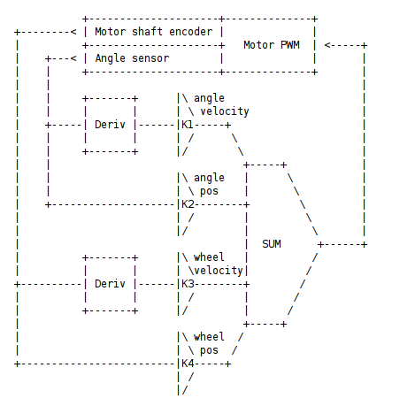
Workflow Block Diagram

Slide 6
Innovation & Challenges
1. The construction of the new bot design had to be very stable and sturdy (so, as to withstand collisions). The center of mass should be perfectly aligned with the center of the axis of rotation.
2. The tuning of the PID parameters would itself be a challenge. Sometimes due to low battery, the motors don't get the full voltage, leading to low speeds and hence low torque. So once correct parameters may seem wrong on low battery.

Slide 7
Task Completed
1. The initial bot design was very horizontal (not good for balancing).
Solution :- We looked up some balance bot designs online and constructed a new bot altogether. Making it vertical for better balance and added more weight on top to move Center of Mass away from the axis (more free fall time to balance).
2. The readings from the accelerometer were very noisy. The values varied from (-30 to +30) on slight motion, which led to great difficulty.
Solution :- Read about kalman filter(to filter out noise from readings), but that required a gyroscope as well. But on further search we found a one dimensional and only accelerometer version, that we then implemented. The parameters for kalman filter were found out by hit and trial, but finally the readings were noise free.

Slide 8
Task Completed
3. During construction of the new bot design, we found that there were no nuts/bolts of the size we were looking for. It took us hrs to find a single nut/bolt.
Solution :- There should be more classified collection of nuts/bolts in the ERTS Lab.
4. The task of accurately tuning the bot took a lot of time, and due to the long charging time of the battery, we were unable to compute all the three parameters. The existing battery took 45-60 minutes to charge and would run only for 15-20 minutes (equivalent to 5 test runs).
Solution :- Had there been more batteries, the tuning may have been completed before the final demo.

Slide 9
Review
Test Criteria :- Our test criteria was pretty simple. We would simply record the time the bot would balance without collision. The higher the time the better the tuning.
Performance :-
1. The initial bot on significant tuning managed to balance for 2-3 sec at times.
2. The intermediate bot was also no better, it also managed to balance 3-4 sec, that too with kalman filter.
3. Finally, the final bot showed some promise as it at times balanced for 6-7 seconds and we still have to tune the integral and differential parameters of PID.

Slide 10
Re-usability
The code for our project is quite simple and easy to understand. This means that it can easily be reused.
The PID implementation is very generic and can be used for other tasks like (whiteline following etc.).
The code for kalman filter can be used to clear any input data (from a single source) from noise by correctly setting its parameter.

Slide 11
Future Enhancements
There is lot of scope if the battery and hardware support from ERTS lab is enhanced. Lot of time was wasted which could have been used better.
You can include Gyroscope for second source of error and thus enhance the kalman filter implementation.
Bot design can be more robust in a way to allow for more time for feedback to tuning software.
Once the balanacing at static position is achieved then you can add the movement features to it.
Wifi and other addons are secondary once the bot is in movement conditions. It can be then easily used to replace even firebird.

