Slide 1

Presented by
GROUP 15
ARJIT TIWARI - 10305083
GOKUL RAMASWAMY - 10305023
VIJAYKUMAR AGNIHOTRI - 10305902

Slide 2
OVERVIEW
Problem Statement
Requirement/Task Specification
Project Plan
Flowchart
Challenges
Tasks Completed
Test Plan
Performance metrics
Reusability
Future Scope

Slide 3
Problem Statement
To compute the shortest path from a start node to a goal node for a class of graphs called multistage graphs using FireBird V Robot.

Slide 4
Requirement specification
Hardware requirement
  Firebird V robot
Software requirement
  AVR Studio 4

Slide 5
Task Specification
Core Algorithm Design – Graph Traversal
Edge Detection
Backtracking
Computing Optimal path

Slide 6
Project Plan
Task Schedule:
Task | Completion Date
Core Algorithm Design | 15 October
Build Whiteline Graph | 15 October
Outgoing Edge Detection | 25 October
Backtracking | 25 October
Computing Optimal path | 27 October

Slide 7
Task Distribution
Graph Traversing with possible accuracy :
Arjit Tiwari
Edge Detection and Calculation of the shortest path : Gokul Ramaswamy
Error handling for Robot motion and Documentation : Vijay Agnihotri
Note: All works are done in presence of all team member.*

Slide 8
Working
The robot traverses the entire graph and determines the distances between each nodes
Calculates the shortest path from the start node to the goal node.
The robot takes the shortest path from the start node to the goal node.

Slide 9
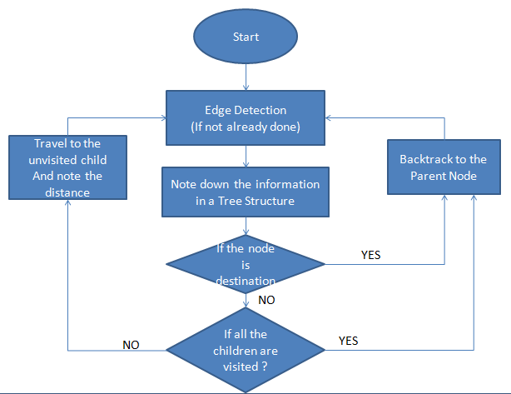
Flowchart

Slide 10
Challenges
Identifying all the outgoing edges from the current node.
Backtracking.
Identifying between nodes and intersecting edges.
Identifying whether a node is a goal node.

Slide 11
Tasks Completed
Graph Traversal using Whiteline sensors.
  Problems
    Sensors rarely gave 100% accurate reading.
  Solutions
    Values padded to work only for a given bot.
Maintaining stack to take of backtracking.
  Problems
    Stack becomes too huge.
  Solutions
    Maintain a finite tree.

Slide 12
Tasks Completed ..Contd
Edge Detection.
  Problems
    Inaccurate if edges packed closely.
  Solutions
    Graph redrawn with edges spaced out.
Computing Distances
  Problems
    Error due to edge detection incurred.
  Solutions
    Calculate distances while backtracking.

Slide 13
Test Plan
The following are the test cases that we have planned:
  To check whether an error in one stage is propagated to the next stage.
    Result: Error propagated and it effected the values in the immediate stage. Eg: If the bot turns more at a certain stage, the value for rotation at the next will in turn to give wrong data. To overcome this effect a variable named 'error' is padded.
  To check the effect of inaccuracies in distance calculation due to rotation in edge detection.
    Result: Effect canceled out as distances are calculated when bot followed white line.

Slide 14
Metrics
Project
  Total lines of code written: ~600 lines
  Time spent in man-hours: 80 man-hours
Working
  Little communication delay due to no involvement of other hardware/software.
  Computation delay is less as only few things such as angle to rotate etc. need to be calculated.
  Delay is introduced in some places to show the status in LCD screen

Slide 15
Reusability
Code is formatted and commented as per coding guidelines.
Modules such as edge-detection can be reused.
There is no dependencies on hardware other than basic FireBird 5

Slide 16
Future Scope
With proper modifications, the general range of graphs can be supported.
Edge detection can be performed using Image processing.
Other uninformed search techniques such as A* can be added
An arm can be attached to the bot which has whiteline sensors, so that only the arm can be moved instead of the entire bot motion.

Slide 17
THANK YOU

