Slide 1
CS-684 Project
“Pick n Place Robot”
Guided By:
Prof Kavi Arya
Bharat Jain
Dinesh Rajpoot

Slide 2
Problem Statement
Objective is to pick objects scattered on arena and place them to the base
For picking robot select the object of minimum distance.

Slide 3
Task Specification
Wireless Communication
Navigation
Picking
Placing

Slide 4
Project Plan
Plan
  Analysis
  Image processing
  Algorithm design
  Implementation
Work division
  Image processing : Dinesh
  Communication and servo mechanism : Bharat

Slide 5
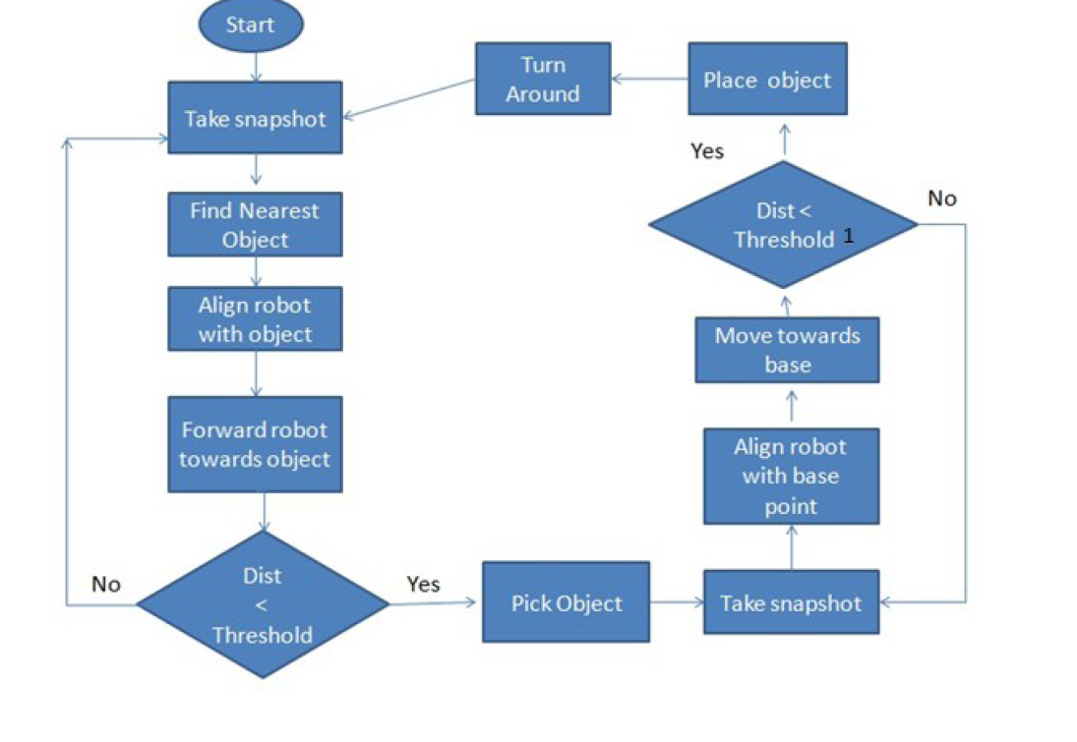
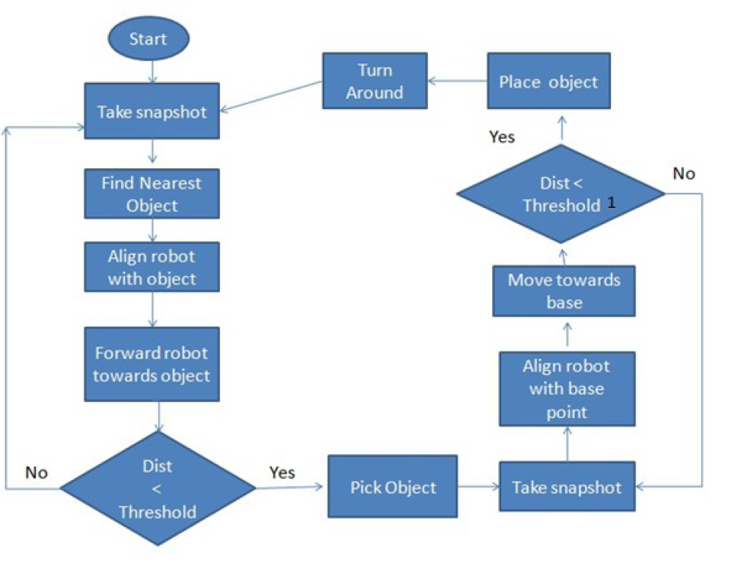

Slide 6
Threshold : Distance between Robot and objects on arena
Threshold1 : Distance between Robot and base
Information : angle of rotation, direction, commands (pick, place, forward, stop)
Information
MATLAB
fFirebird V
acknowledgement

Slide 7
Innovation
Identify objects precisely using overhead camera
Capable of handling unbalanced wheels motion
Capable of distinguishing between objects based on area
Challenges
Difficult to detect color accurately, due to reflection of light
Problem in distinguishing different colors due to low resolution camera

Slide 8
Task Completed
Wireless communication : Through zigbee
Navigation: Image processing (using Matlab)
Pick and Place : Through arm assembly

Slide 9
Problem Faced
Mainly in Image Processing
Unbalanced wheel motion
Solution :
  Use of primary colors
  Continuous tracking of robot position

Slide 10
Reusability and features
Code can be reusable in various applications based on same concept(like collaborative picking and placing)
Modular approach is used in which header file consists of all I/O related functions.
Image processing task is independent of H/W

Slide 11
Future work
Stacking/Arranging of objects
Collaborative pick and place

