Slide 1
Rangoli Bot
Team 1
Sarbartha Sengupta (10305903) [Team Leader]
Kaustav Das (10305024)
Kishaloy Halder (10305022)

Slide 2
Problem Statement
Draw a given image of Rangoli on floor using coloured powder.
Solution Approach:
Scilab program will take an input image and convert it into a binary image.
The binary image is encoded using run-length encoding.
The encoded data is sent to the bot using Zigbee.
Implement GPS like system for negative feedback using overhead camera.

Slide 3
Requirement specification
Convert image into Binary Image using Scilab.
Mono Colour Image: 0’s and 1’s for White and Black Pixels.
Tri Color Image: 3 values used for 3 color pixels
Draw one line at a time by dropping powder.
Draw consecutive same colored pixel in one straight trail.
Draw Image with small pixels.
The bot will start drawing when the entire image matrix is fed into the bot.
The bot will divide each row into line segments of different colors and draw those line segments.
The robot should not tread on the portion already drawn.
Bot will draw rows parallel to each other in a to and fro fashion.
A camera hanging over the arena has to provide feedback to the robot to actuate its position in form of co-ordinates through ZigBee module.

Slide 4
Final System

Slide 5
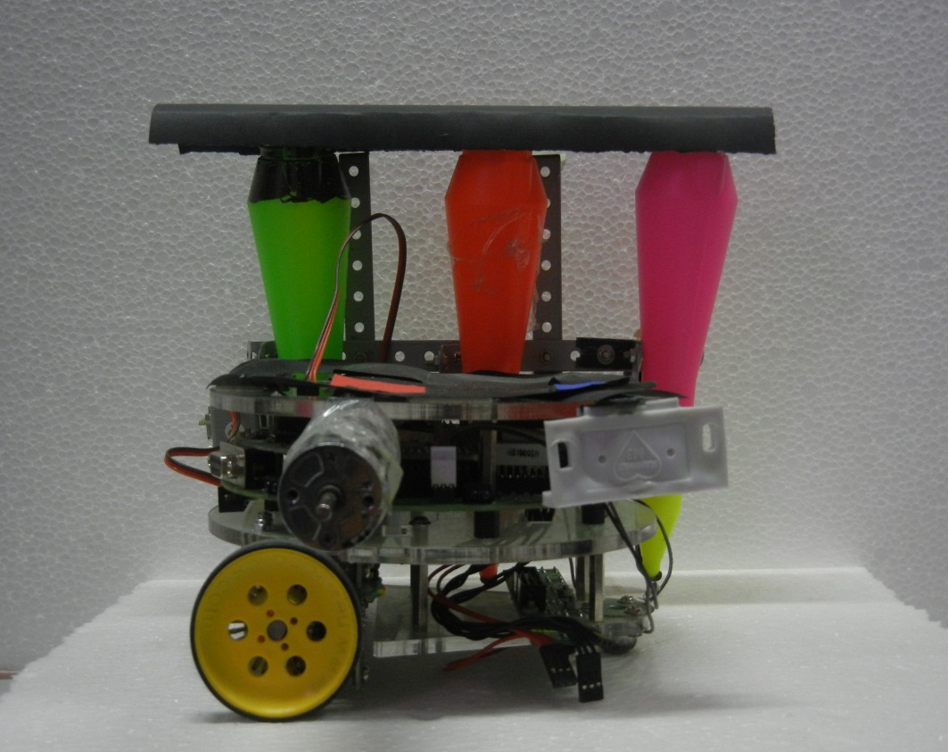
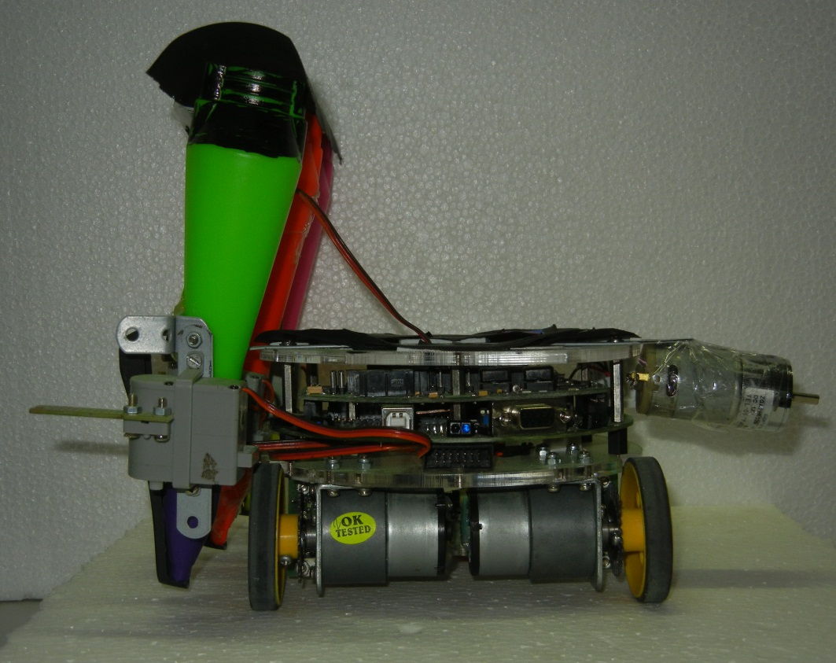
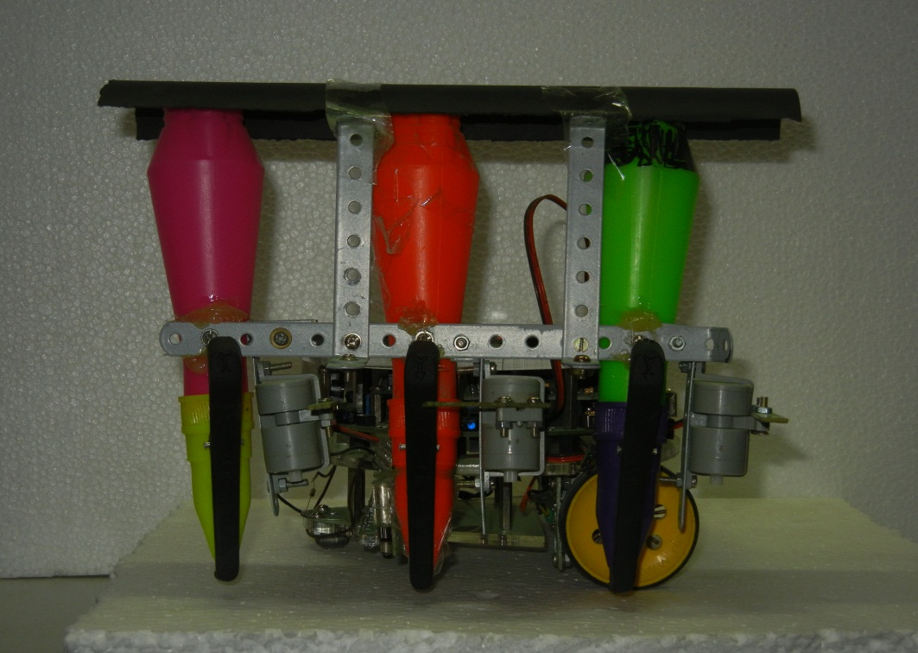
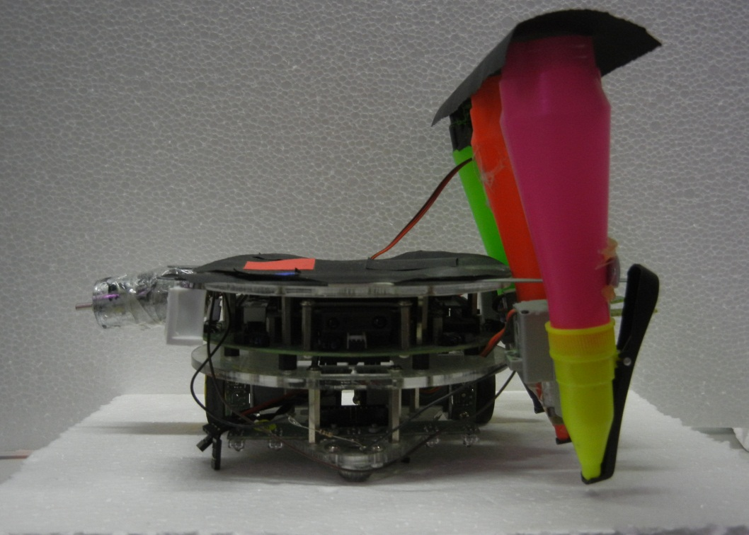

Slide 6
Components

Slide 7
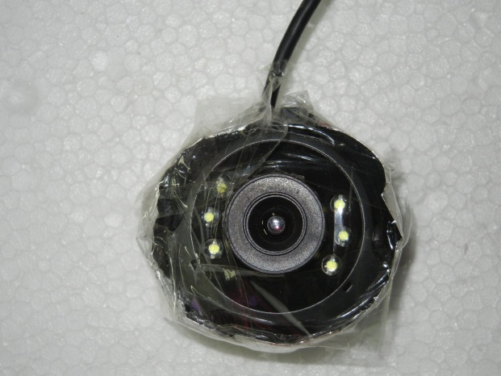
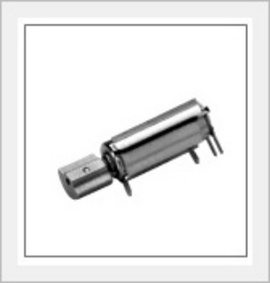
Components
Overhead Camera
Vibrator Motor

Slide 8
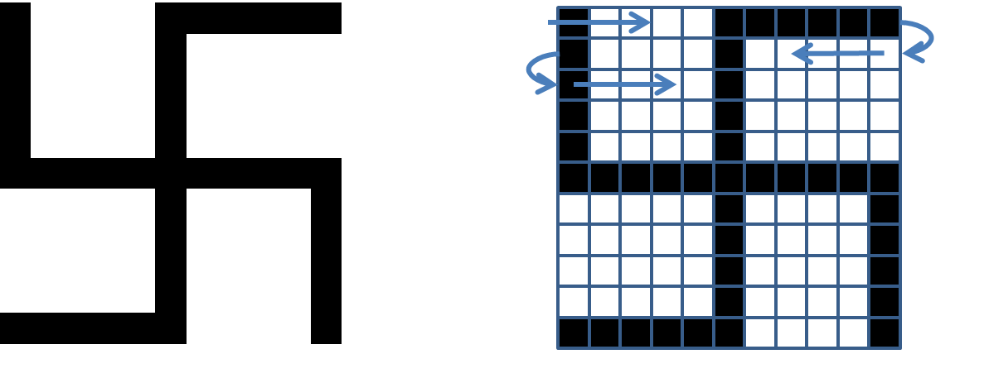

Working Principle

Slide 9
Negative Feedback

Slide 10
Problems encountered
Hardwae Chellanges
Hight of the Funnel.
Position of motor.
Use of color dispensors.
Implementation of locking system.
Use of vibrator.
Weight balancing.

Slide 11
Problems encountered
Implementation Chellanges
Adjusting height of the camera.
Determination of proper color values.
Choice of arena.
Determining movement threshold values.
Placing color marker on the bot.

Slide 12
Problems encountered
Coding chellanges
Scilab slow and unstable.
Bugs in esterel compiler.
Compensating inaccurate movement of bot.
Interfacing zigbee.

Slide 13
Problems encountered
Tri Color Rangoli.
Vectorized rangoli drawing.
Entirely negative feedback system.

Slide 14
References
www.telit.com/module/infopool/download.php?id=542
http://en.wikipedia.org/wiki/ZigBee
www.cse.iitb.ac.in/~cs684/esterel/Programming_Firebird_Esterel_manual.pdf
http://www.scilab.org/
http://sorceforge.net/projects/opencv/opencvlibrary
http://atoms.scilab.org/toolboxes/IPD/2.0

Slide 15
Thank You

