Slide 1
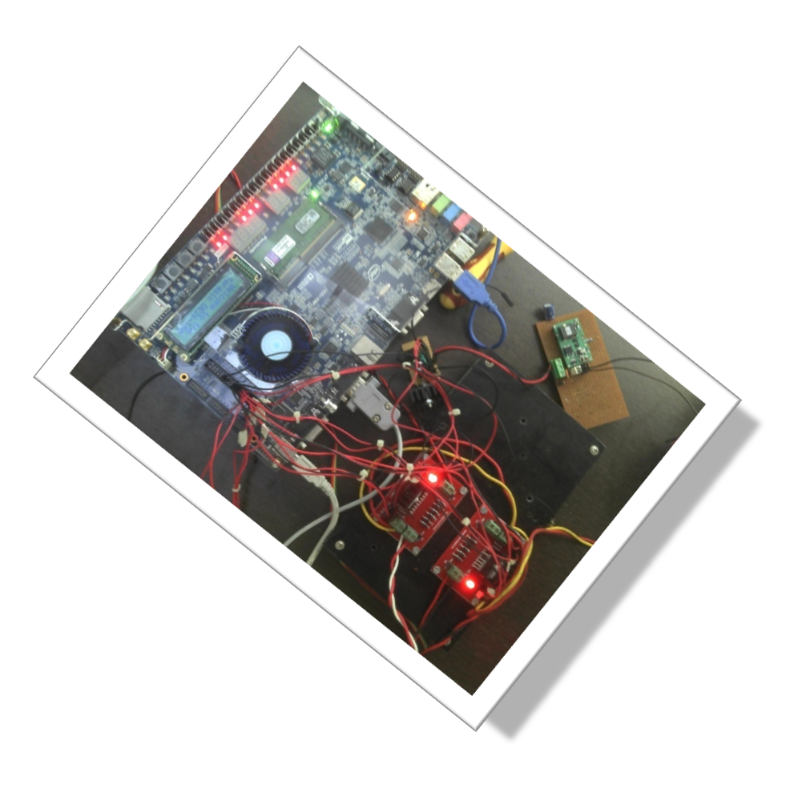
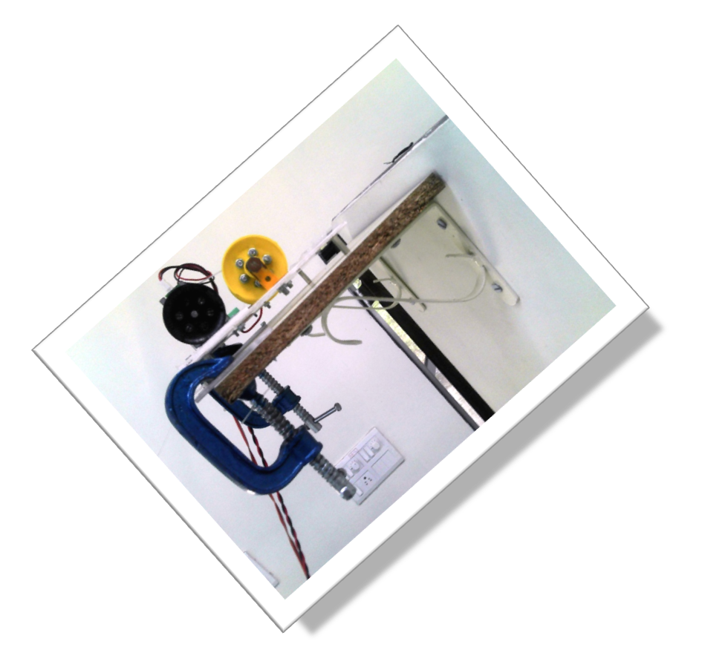
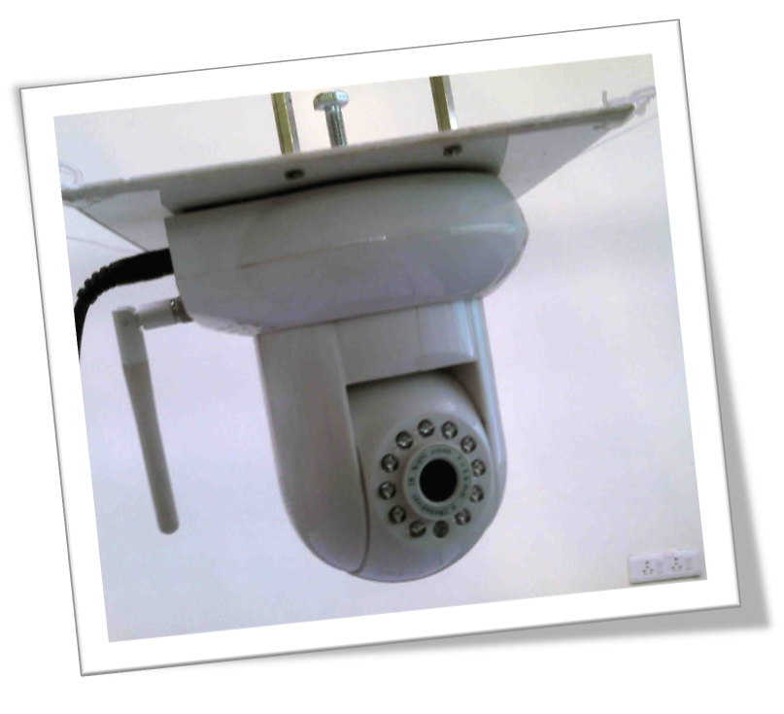
Spider bot motion control
Group 7
Sanam Shakya (EE MTech2) - Team Leader
Rahul Prajapat (EE DD IV Yr)
Sanchar Sharma (EE DD IV Yr)
Ritubala Kachhwahe (CSE MTech2)

Slide 2
Problem Statement
To remotely control the spider bot position using manual control and get the camera images from remote location.
Spider Bot waypoint navigation control by giving the simple X, Y and Z coordinates.
Get the sensor feedback(temperature) for those locations
Notes:
Our system consists of platform hanging through 4 cables which are controlled by 4 motors.
All these 4 motors are controlled by intel atom board.
We also have GUI for controlling the bot from remote location.

Slide 3
Specifications
Spider Cam
  It is a bot hanging by four cables of variable length. One end of each cable is ﬁxed to a motor on the periphery of the roof
  Lengths of the cables can be changed to enable controlled navigation of the bot.
  The bot has an IP camera.
Notes:
The data will be sent wirelessly (zigbee in case of sensors and WiFi in case of camera) to a central processor of Intel Atom.

Slide 4
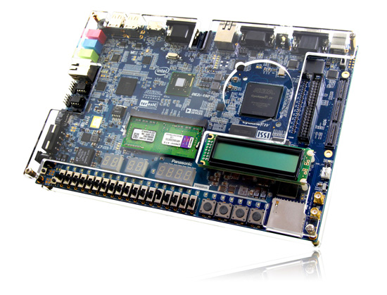
Development Platform
Terasic-DE2i-150 FPGA Development Kit
(Image –courtesy http://www.terasic.com.tw/cgi-bin/page/archive.pl?Language=English&CategoryNo=139&No=529&PartNo=1)

Slide 5
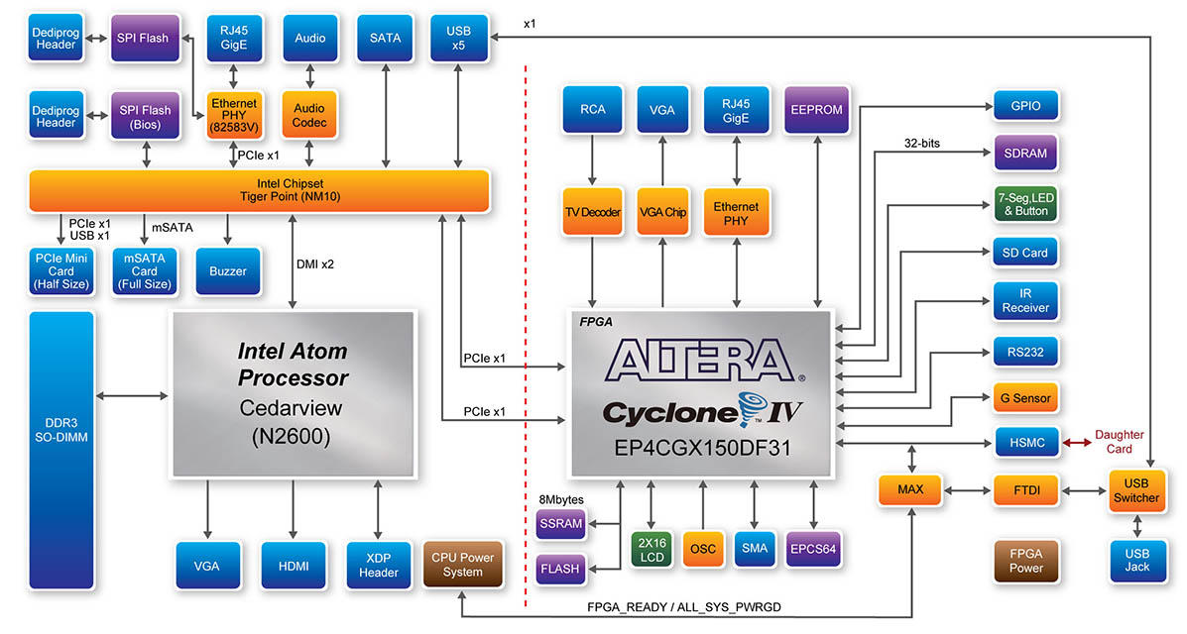
Terasic-DE2i-150 FPGA Development Kit
Image-courtesy http://www.terasic.com.tw/attachment/archive/529/image/image_9_thumb.jpg

Slide 6
Development Platform
This will act as the main server which will have an API to take in sensor data and video feed wirelessly. The API should read data from the wireless channels and store it in ﬁles
It will be responsible for navigation of bot as well by providing the necessary signals to the motors.
It will receive a feedback from the motors about the length of the cables calculated using encoders. The information about the lengths is enough to ﬁnd the location of the spider cam.
Notes:
This will act as the main server
It will be responsible for navigation of bot as well by providing the necessary signals to the motors.
It will receive a feedback from the motors about the length of the cables calculated using encoders. The information about the lengths is enough to ﬁnd the location of the spider cam.

Slide 7
Current System
Simple control of spider bot remotely from browser.
User can see the Camera feedback and control the bot through anywhere in IITB intranet

Slide 8
GUI
Consists of IP camera feedback
Consists of PAN and Tilt control for IP camera
Manual control of bot position

Slide 9
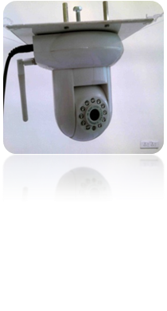


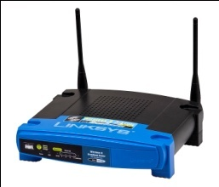

Current system
Intel Atom
Board
Running Ubuntu running
Apache Webserver
Altera Cyclone IV
FPGA
Serial comm
Ethernet
Power supply
L298 Motor Drivers
IP camera
IITB Intranet
Wifi Router
M0
M1
M2
M3
Remote PC
Remote Pc

Slide 10
Issues encountered
Development of the required hardware
  Four motor platforms located at four corners of room
  Put a pulley system to fix encoder
Learning the new development platform
  Communication between Intel atom part and FPGA part
  Developing the user interface to control the bot remotely
Controlling the precise location of the bot due to non uniform speed of motors

Slide 11
Issues encountered
Developing the control algorithm for the precise control for the length of the cables
  Independent control of ropes were note possible during motion always one of the rope become slack
Developing the power supply for the IP camera module
Because of dense wiring and big circuits in the electrical design, the debugging was challenging.
Initially, working with Yocto project to use peripherals (WiFi) was a little difficult.
Communication between FPGA and Atom was challenging.

Slide 12
Insights gained
Learnt a lot about our development board capability
Learnt to create the remote web server for control applications
Learnt to develop and use the Quartus feature for development and synthesis of FPGA hardware
  Intellectual Property blocks(IP blocks) or Mega-function blocks

Slide 13
Future Work
Develop the waypoint control for the bot
Solve the problem of communication between FPGA and Intel atom board
Develop the api for getting the sensor data

