Slide 1

Presented by
GROUP 17
RAJ DEEPAK P 10305081
VISHNU KANTH T 10305020
ANUP NAIK 10305915

Slide 2

Problem statement
Requirement specification
Preparation required
Support required from lab
Design steps
Project management
Risk management

Slide 3

Aim : To program the robot to collect tennis balls scattered over a field and place it at a specified location.

Slide 4

Hardware requirement
  Firebird with gripper attachment
  Camera for image processing
  Zig-bee module
Software requirement
  AVR Studio4
  Matlab for image processing

Slide 5

Working:
The robot at initial position rotates and takes snapshots and send it to computer for processing.
If in an image, the ball is detected(using colour), the robot detects it and calculates the distance of the ball using sharp sensor
The robot moves to the ball and grabs it using gripper and places it at the specified location.

Slide 6
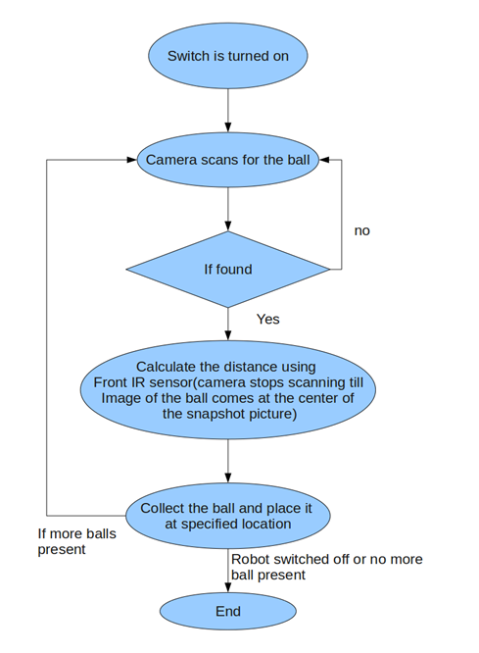



Slide 7

Identifying the ball using camera
Also distance from the current position to the ball needs to be calculated correctly.
Communication between the robot and computer needs to be fast.

Slide 8

Use efficient matlab code so that the robot and ball are correctly aligned (front side of robot and ball are in straight line )
Use wired communication if zig-bee communication is slow.

Slide 9

Provide us with equipment
Provide us with IDE for development
Doubt clearance and guidance

Slide 10

Task breakup
  Image processing
  Movement of the robot to correct location
  Collecting ball , zig-bee communication
Schedule for completion of task
Task | Expected Date of completion
Detecting the ball | 15 Oct
Collecting the ball at the specified location | 20 Oct
Communication | 23 Oct
Testing and debugging | 25 Oct

Slide 11

Delay in image processing will align the robot in wrong direction and hence the robot cannot pick up the ball.
Solution: If zig-bee communication is the cause ,will replace it with a serial communicator.
Portability to the new platform should be taken care of.
Proper documentation will be done so that any error can correctly be traced.

Slide 12

A basket attachment on the top of the robot will do the job effectively(the gripper should pick the ball and keep it in the basket, but this requires a special gripper).
Detecting multiple coloured balls.

Slide 13


