Slide 1
Making a Robot Traverse Along an Arbitrary Curved Path
Team 21
Rakesh Dhanireddy – 10305069
Revya Naik - 09305078

Slide 2
Project Problem Statement
The aim of the project is to make the Firebird V robot traverse along arbitrarily shaped curved paths
The degree of accuracy in tracing the path can be verified by attaching a Marker to the Robot so that it draws the curve as it traces the path
The image may contain multiple instances of curves, in which case the Robot is supposed to draw all the curves by lifting the Marker up and down at appropriate points

Slide 3
Task Specification
Tasks:
1. Given a binary image representing an arbitrary 2 dimensional curve, we should extract the appropriate data from the image and make the robot should faithfully trace the curve by means of a marker attached to it.
2. If the image consists of multiple instances of curves, the robot should trace all the curves by moving the marker up and down whenever necessary.

Slide 4
Project Plan
We divided our work into four parts :
Image processing to extract the list of co-ordinates of segments
Generating useful data - lengths of segments, angle between segments, directions of turn at the end of each segment – from the list of co-ordinates
Implement the code in C to test the accuracy of data, test the path traced by the robot
Extend the project to include cases of multiple curves in the image.

Slide 5
Work Division
Image processing, generation of useful data from the list of co-ordinates – Rakesh
Implementation of the C code to test the generated data – Revya Naik
Critical Tasks – Generation of accurate angles, directions of turn proved to be critical
Dates of completion :
23rd Oct – Image processing, Data generation complete
27th Oct - C code to test the bot with the generated data
7th Nov – Extension of the project to include multiple curves

Slide 6
Flow chart
Start
Process the input image to extract connected components.
Generate sequences of consecutive points from the connected components.
Extract displacements, directions of the turns, magnitude of the angle by which the robot turns
Yes
No
Is the robot on a curve ?
Marker up
Marker down

Slide 7
Innovation and Challenges
The Robot is capable of handling arbitrarily complex curve instead of straight line images.
Thus the Project can be used to enable the robot maneuver around arbitrarily shaped obstacles by drawing the trajectory it follows.
Challenges – The main challenge was to extract the precise angles, displacements required for each segment of the path from the image

Slide 8
Tasks completed
We successfully completed the task 1 – moving the robot along curved path. The marker attached to the robot reproduces the curve in the image fairly accurately.
In task 2 – extending the project to draw multiple curves, we succeeded partially. The Robot draws multiple curves faithfully, but the relative positioning between curves isn’t quite accurate.
The problem can only be solved if the angle by which robot turns can be more accurately controlled (to the level of (1/2) degree

Slide 9
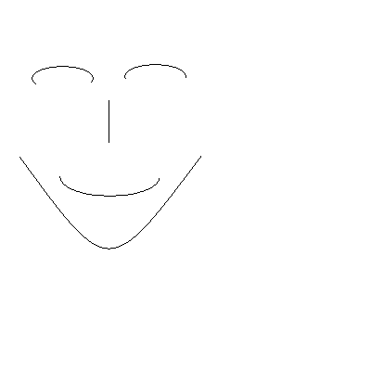

Test Cases, Performance
We tested the final version of the project with images containing multiple arbitrary curves such as the following images:

Slide 10
Performance
The Robot successfully reproduced the first image on the ground as shown in the video.
In the second case the Robot was accurately tracing all the curves, but the relative positioning between the curves was in error. The error is getting significantly magnified because of the scaling used to draw a large size picture
The register which holds angles, distances is only 8 bit wide and hence the angle has to be rounded to nearest 8-bit integer.
This caused problems as a change in 0.5 degrees will also affect the accuracy of relative positioning of curves, as the distances between curves are large.

Slide 11
Reusability features
The code is broadly divided into two parts – Matlab where image processing, data extraction are done, C part where the actual implementation of the tasks is done with the help of generated data
The Matlab Code is designed into 8 functions with well defined interfaces, each one implementing a specific well defined subtask
All the functions in Matlab, C have been fully documented explaining the working of the code

Slide 12
Future Enhancements
The project as of now doesn’t handle curves which cross themselves like the alphabet A B etc. The project can be extended to handle such curves
The accuracy of the relative positioning of the curves can be improved by helping the robot realize its current position by providing the error feedback.
The input given to the project can be online i.e the robot traverses the curves as one draws the curves on an input device such as touch pad or touch screen etc.

Slide 13
Thank You

