Slide 1
Controlling FB5 using Android Phone over Bluetooth
Group No. 7
Jatin Kanzaria
Rohan Shah
Jagbandhu
K.L.Srinivas

Slide 2
Problem statement:
Controlling FB5 using mobile via Bluetooth
User Interface developed on Android Platform
FB5 to sense user gestures (tilting of phone in different directions)
Two major components of project :
1. Developing user interface.
2. Building Bluetooth module on FB5.

Slide 3
Requirements/Task specifications:
Interface accelerometer on Android phone
Built in commands in API for accelerometer can provide acceleration values, used for decoding tilt values.
Interface Bluetooth module on Android phone.
Raw data transfer mechanism using RFCOMM is implemented
Interface Bluetooth module on FB5.
3V supply from 5V supply with minimal power wastage using LM317.
Logic conversion from 5V to 3V using potential divider.

Slide 4
Project plan:
Task | Person | Expected Deadline | Completion Date
Reading accelerometer values | Srinivas | 5/10/10 | 4/10/10
Communication using Bluetooth(in mobile) | Jatin | 15/10/10 | 15/10/10
Integration of accelerometer and bluetooth modules(in mobile) | Srinivas and Jatin | 20/10/10 | 18/10/10
Bluetooth-Serial module testing & setup | Jagbandhu | 27/10/10 | 27/10/10
Integrating bluetooth module onto FB5 | Rohan and Jagbandhu | 01/11/10 | 02/11/10
Integrating mobile app with FB5 | Jatin and Rohan | 04/11/10 | 04/11/10

Slide 5
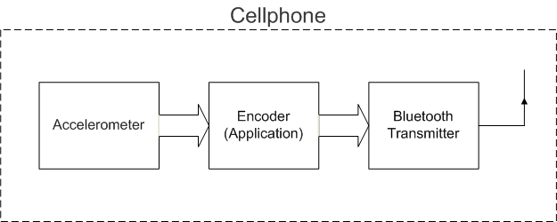
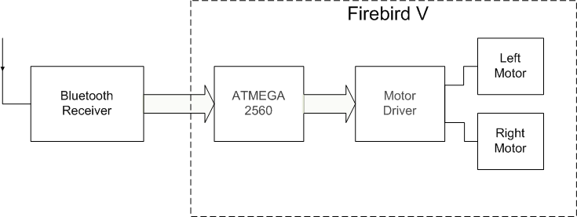
Block Diagram

Slide 6
Project flowchart:

Slide 7
Project flowchart (cont.):

Slide 8
Innovation and Challenges:
Innovations:
Bluetooth connectivity on FB5
Challenges:
Developing mobile application on Android platform
Interfacing Bluetooth module with FB5

Slide 9
Task completed:
Reading accelerometer values
Communication using Bluetooth in mobile
Initial testing using SDP
Implementing RFCOMM communication
Integration of accelerometer and Bluetooth modules in mobile
Bluetooth-Serial module testing and setup
3V power supply
5V to 3V logic conversion
Integration Bluetooth module onto FB5
Configuration settings
Integration mobile application with FB5

Slide 10
Test plan:
Test criteria and description:
Movement of FB5 in desired direction with speed confirming to extent of tilt.
Tilting in simultaneously two directions should give preference to rotation (right or left).
Results:
Speed variation from 10% to100% in 8 steps was achieved.

Slide 11
Reusability:
Accelerometer reading code is modular and can be reused by any other application by suitably initializing and calling it.
Similarly, for Bluetooth after initialization, a send command with “byte array” as argument, transmits the array over Bluetooth.
Application layer of FB5 and Bluetooth layer works independently.

Slide 12
Future Enhancements:
Wireless surveillance camera can be mounted onto FB5 which will stream back the video captured through WIFI to Android based phone.
On the mobile platform, instead of just tilt, other gestures such as touch can be sensed to determine the direction and speed for motor control.
Developing an application on mobile which senses the actual acceleration of mobile in 2 dimension and convert it to full path which FB5 has to move.

Slide 13
Thank you

