Slide 1
Exploring the Correlation Between Environmental & Demographic Indicators across the US
By Emily Yarvis

Slide 2

Roadmap
01
Introduction:
Environmental Justice? Whats that?
02
Discovery:
Initial findings and Data
03
Exploration
Who is truly most effected and why?
04
Conclusion:
Why do we care?

Slide 3

Introduction
Explaining Environmental Justice

Slide 4

Climate Change
In 2019 60 million individuals died due to particulate matter
in the air around the world
70%
30%

Slide 5
Environmental Discrimination
In 2019 60 million individuals died due to particulate matter
in the air around the world
≠
70%
30%

Slide 6
Research Question:
What is the correlation between environmental and demographic indicators across the US?

Slide 7
What is EJ Screen
EJ Screen is a web tool created by the Environmental Protection Agency (EPA)
to give users access to environmental and demographic information
for locations across the United States.
70%
30%

Slide 8
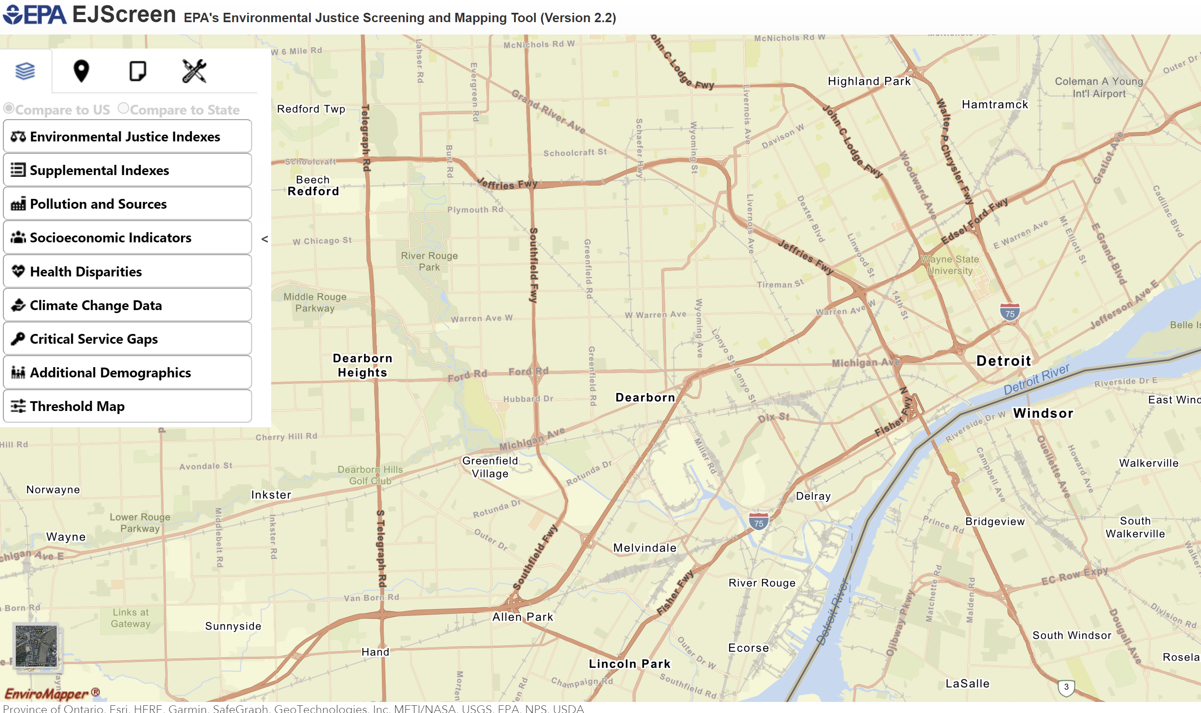

Slide 9
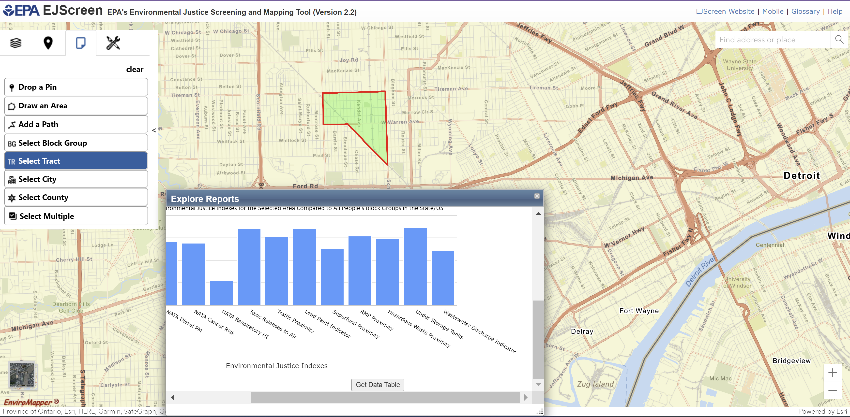

Slide 11
Environmental Indicators
Factor # | Factor
1 | Particulate Matter
2 | Ozone
3 | Diesel
4 | Air Toxics Cancer Risk
5 | Air Toxics Respiratory Hazard Index
Factor # | Factor
6 | Toxic Releases to Air
7 | Traffic Proximity and Volume
8 | Lead paint indicator
9 | Superfund proximity
10 | RMP Proximity
Factor # | Factor
11 | Hazardous Waste Proximity
12 | Underground Storage Tank Indicator
13 | Wastewater Discharge Indicator

Slide 12
Demographic Indicators
Factor # | Factor
1 | Demographic Index
2 | Supplemental Demographic Index
3 | People of Color Pop.
4 | Low Income Pop.
5 | Unemployed Pop.
6 | Limited English Speaking Households Pop.
7 | Less Then High School Education Pop.

Slide 13

Demographic Index: Factor 13

Slide 14
Environmental Indicators:
01
Particulate Matter (pm 2.5)
Annual average PM2.5 levels in air
02
Ozone
Annual Average of the top ten daily ozone concentrations in air (Measured in a span of 8 hours)
03
Diesel
Diesel particulate matter level in air
04
Air Toxics Cancer Risk
Lifetime cancer risk from inhalation of air toxics
05
Air Toxics Resp. Hazard Index
Ratio of exposure concentration to health-based reference concentration

Slide 15
Discovery
Initial Research and Findings

Slide 16
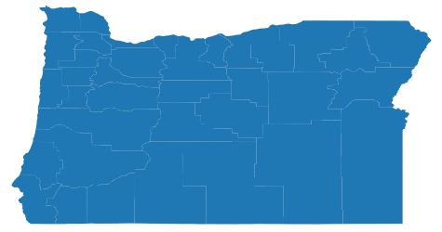
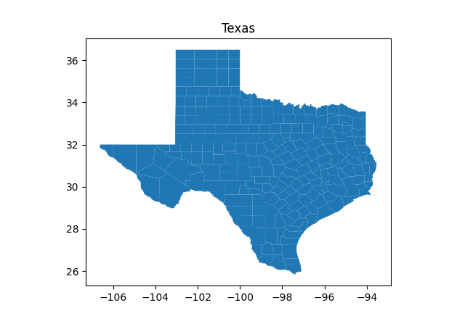
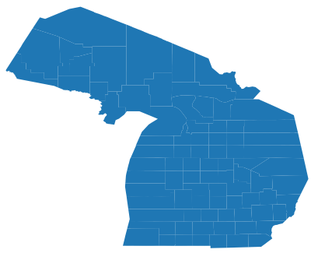
Initial Chosen Cities
Portland, Oregon
Houston, Texas
Detroit, Michigan

Slide 17
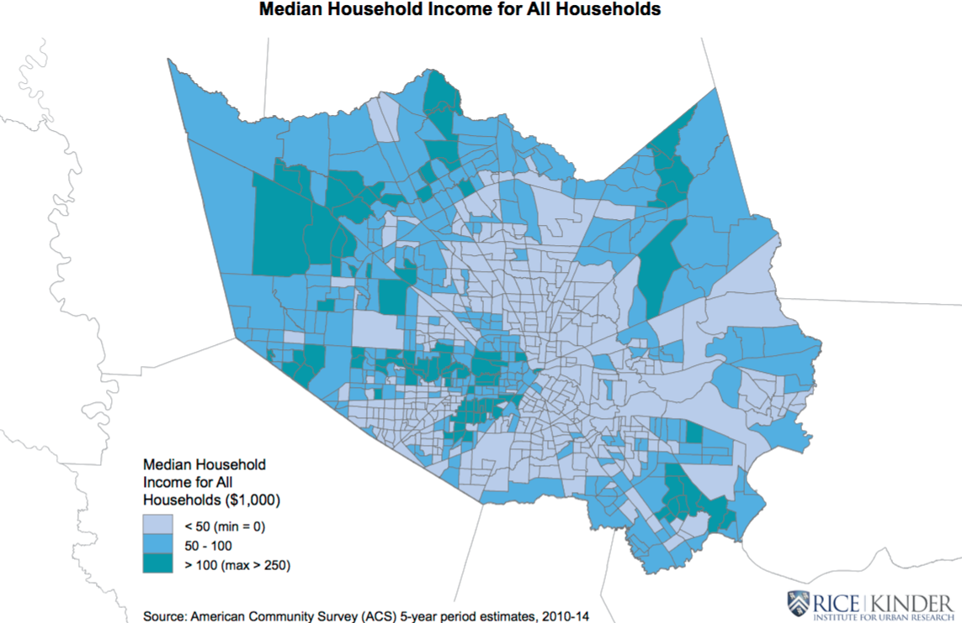
The Arrow

Slide 18
The Arrow

Slide 19
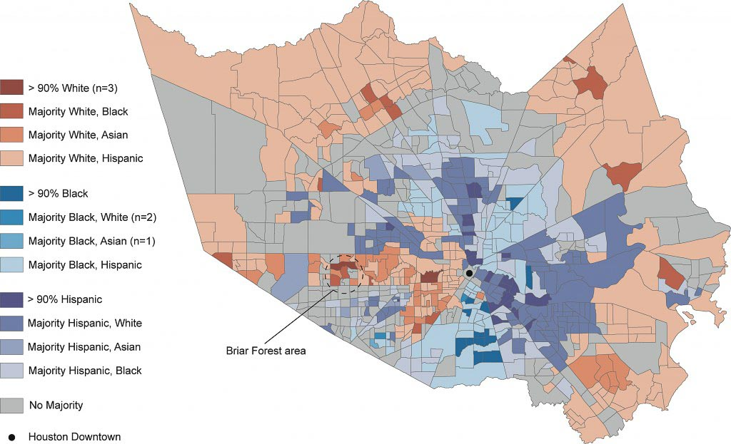
The Arrow

Slide 20
The Arrow

Slide 21
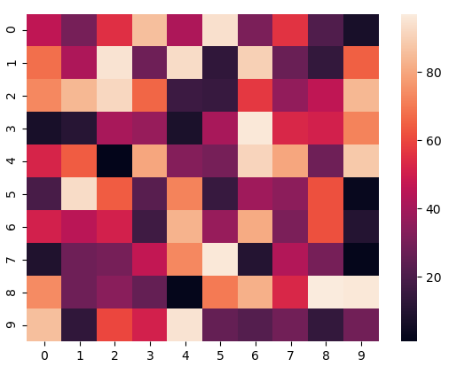
Method:
Pearson Correlation Coefficient

Slide 22
Method:
Pearson Correlation Coefficient
Color Bar/Legend
% based

Slide 23
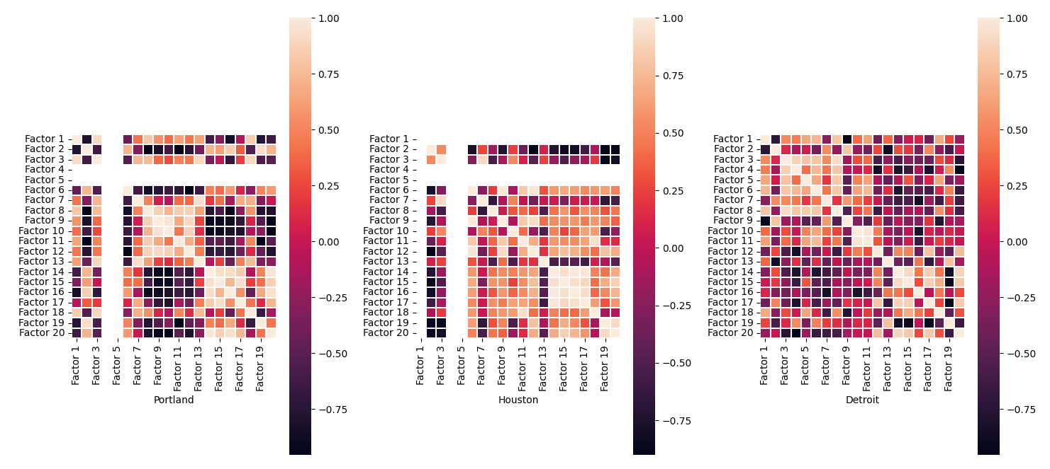

Slide 25
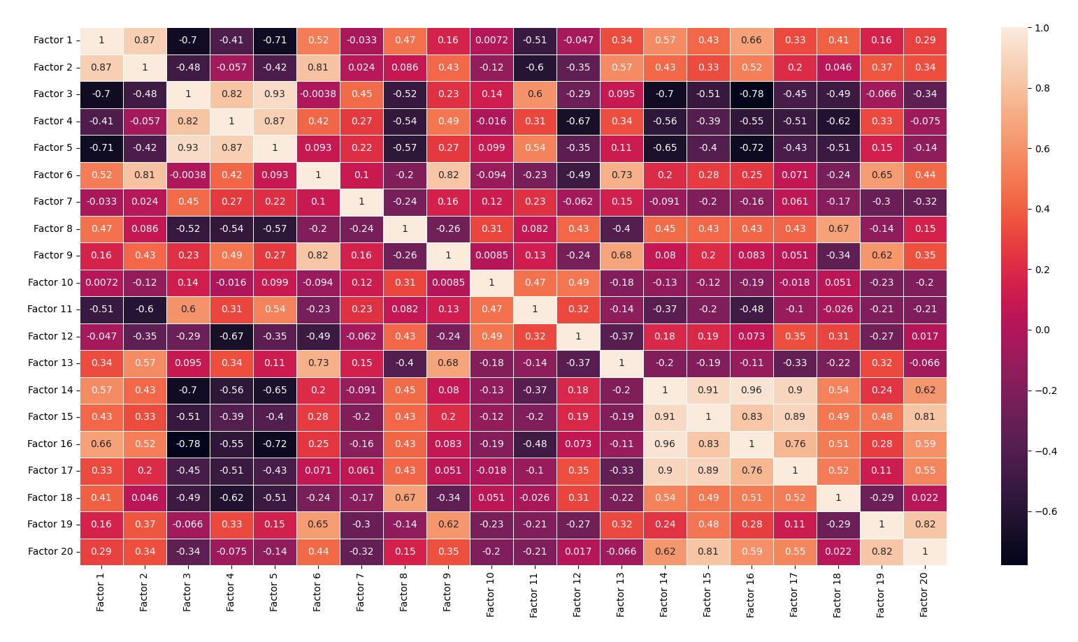

Slide 26
Environmental Indicators
vs
Environmental Indicators
Demographic Indicators
vs
Demographic Indicators

Slide 27
Environmental Indicators
vs
Environmental Indicators
Demographic Indicators
vs
Demographic Indicators

Slide 28
Exploration
Further Findings

Slide 29
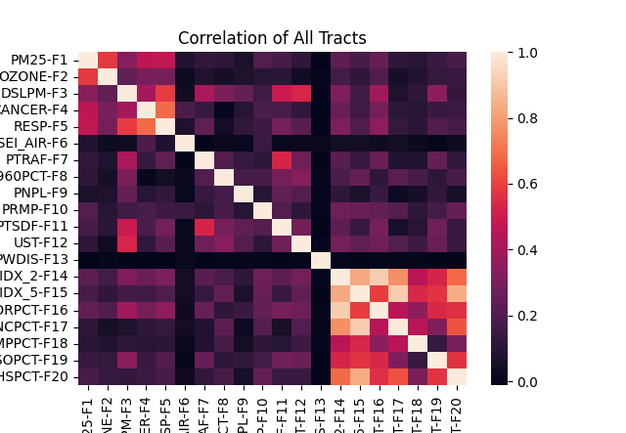
Total Tracts

Slide 30
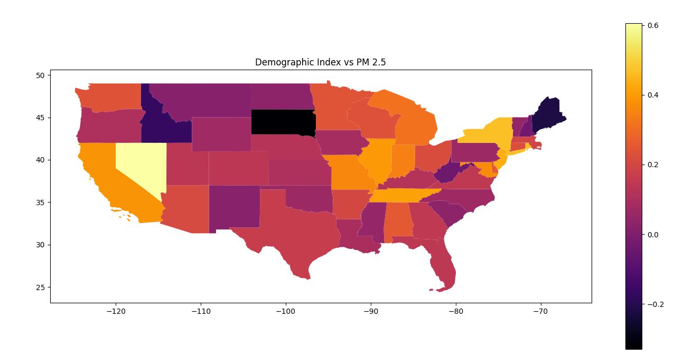

Slide 32
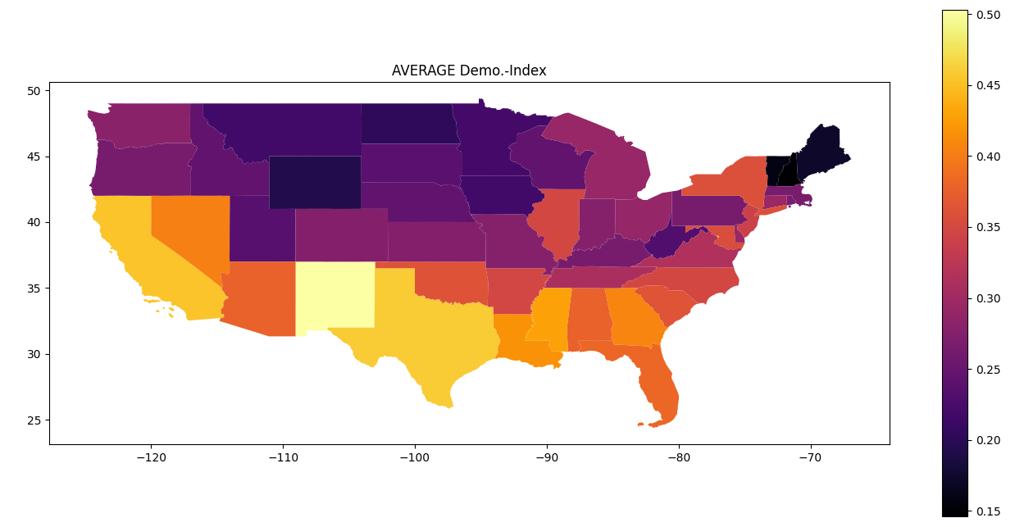

Slide 34
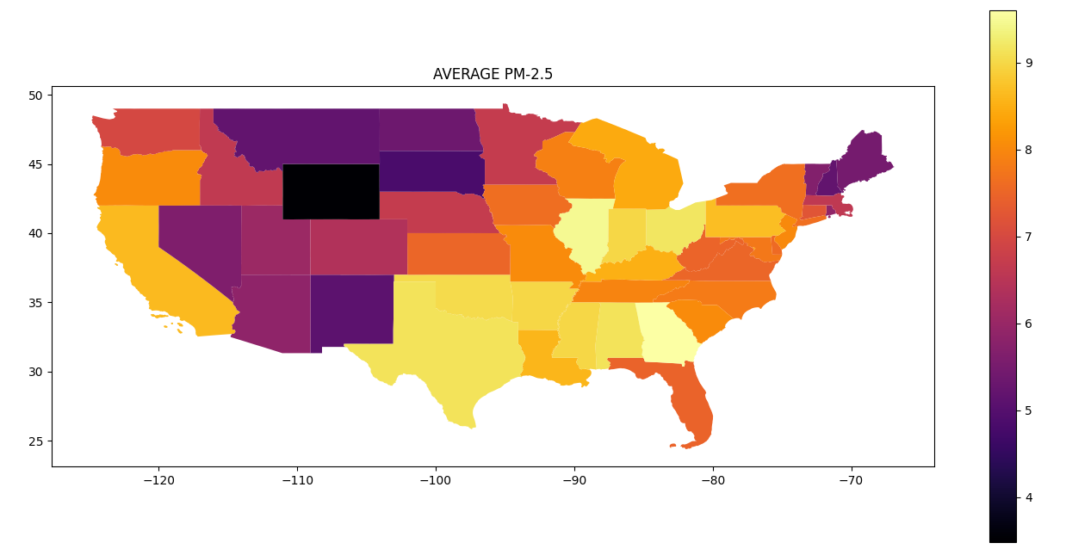

Slide 37
Conclusion
Next steps and why we should care

Slide 38
Next Steps:
Examining Counties
Within States

Slide 39
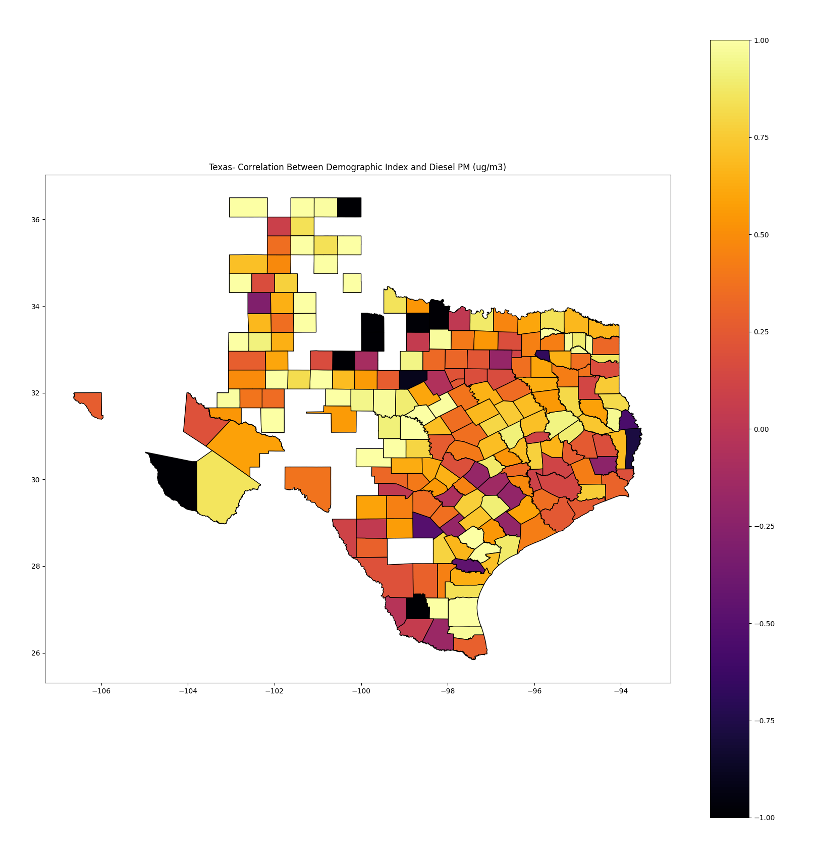
Next Steps:
Examining Counties
Within States

Slide 40
Next Steps:
Examining Counties
Within States

Slide 41
Takeaways:
01
Environmental Discrimination is real
02
Must be more conscious about our actions
03
Changing our mindset

Slide 42
Thank You For Listening
Questions?

