Slide 1
3.2.Common Emitter (CE) Configuration

Slide 2


3.2.Common Emitter Configuration

Slide 3
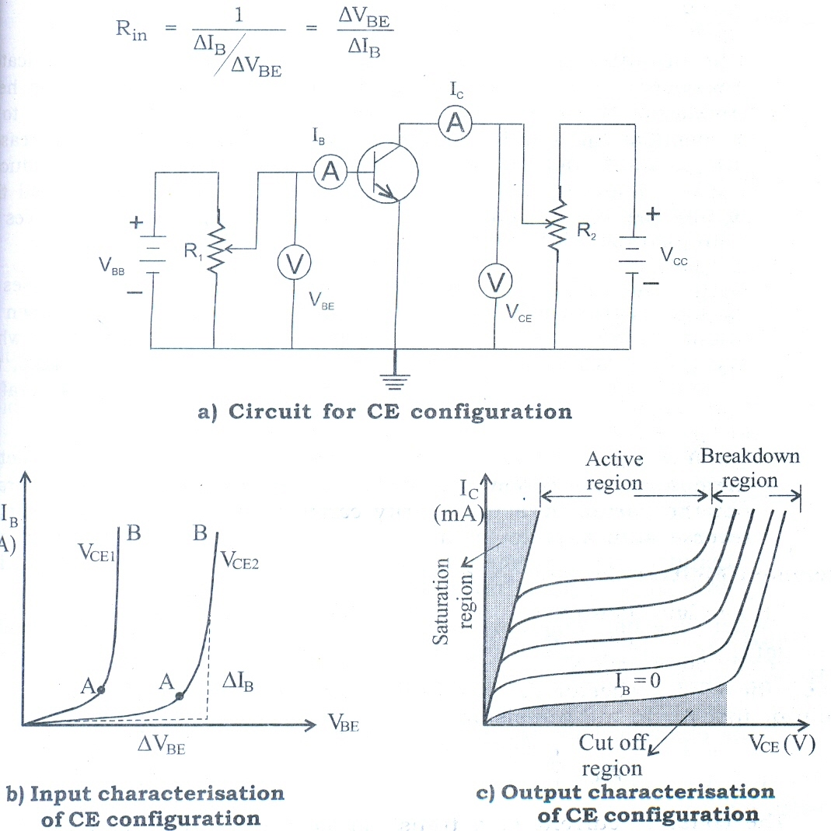





Characteristics of CE configuration

Slide 4
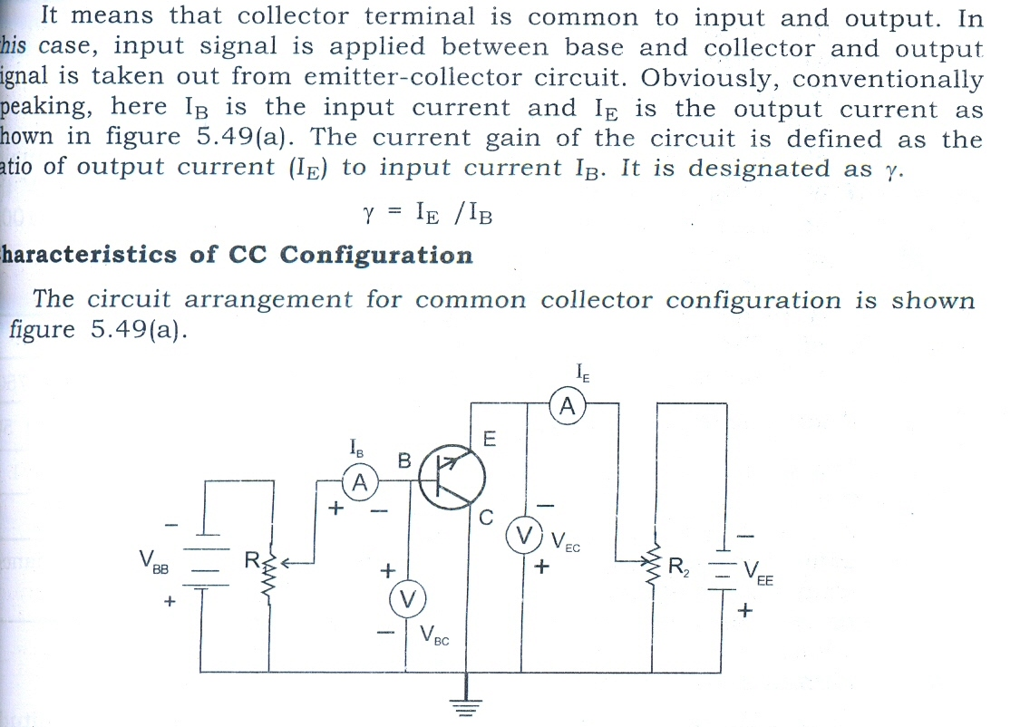





3.3 Common Collector Configuration

Slide 5
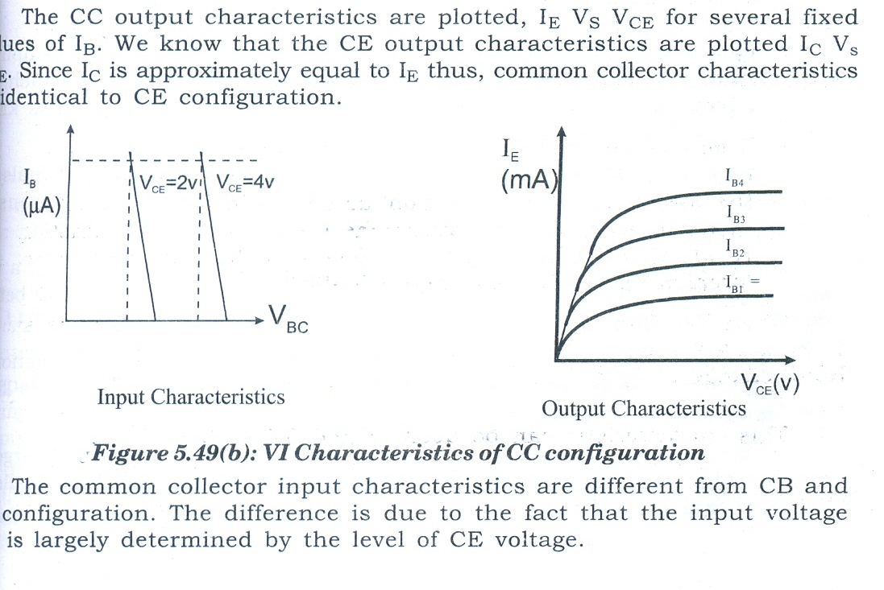


Slide 6
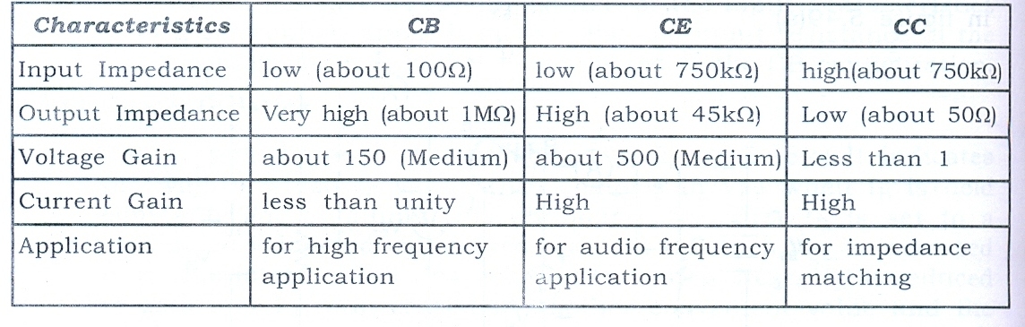













Comparison of three configurations

