Slide 1
Transistor Bias Circuits

Slide 2
Objectives
Discuss the concept of dc biasing of a transistor for linear operation
Analyze voltage-divider bias, base bias, and collector-feedback bias circuits.
Basic troubleshooting for transistor bias circuits

Slide 3
Introduction
For the transistor to properly operate it must be biased.
There are several methods to establish the DC operating point.
We will discuss some of the methods used for biasing transistors.

Slide 4
Biasing
Biasing: The DC voltages applied to a transistor in order to turn it on so that it can amplify the AC signal.
The term biasing is an all-inclusive term for the application of dc voltages to establish a fixed level of current and voltage.
For transistor amplifiers the resulting dc current and voltage establish an operating point, Since the operating point is a fixed point on the characteristics, it is also called the quiescent point (abbreviated Q-point).
DC Biasing – used to set the initial values of I_{B}, I_{C}, and V_{CE} for ac operation of the transistor

Slide 5
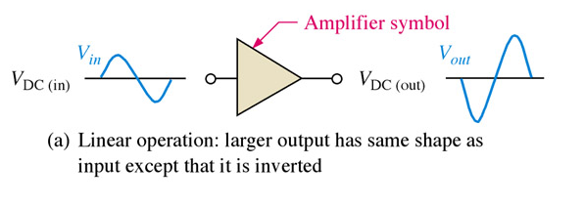
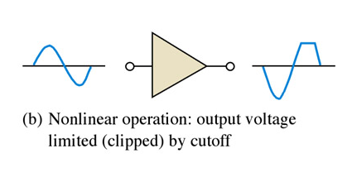
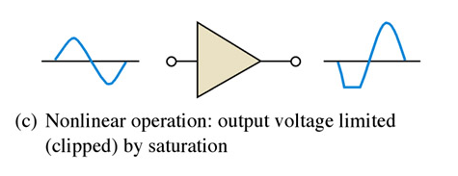
The DC Operating Point
The goal of amplification in most cases is to increase the amplitude of an ac signal without altering it.
Notes:
Fig 5-1a, b, & c

Slide 6
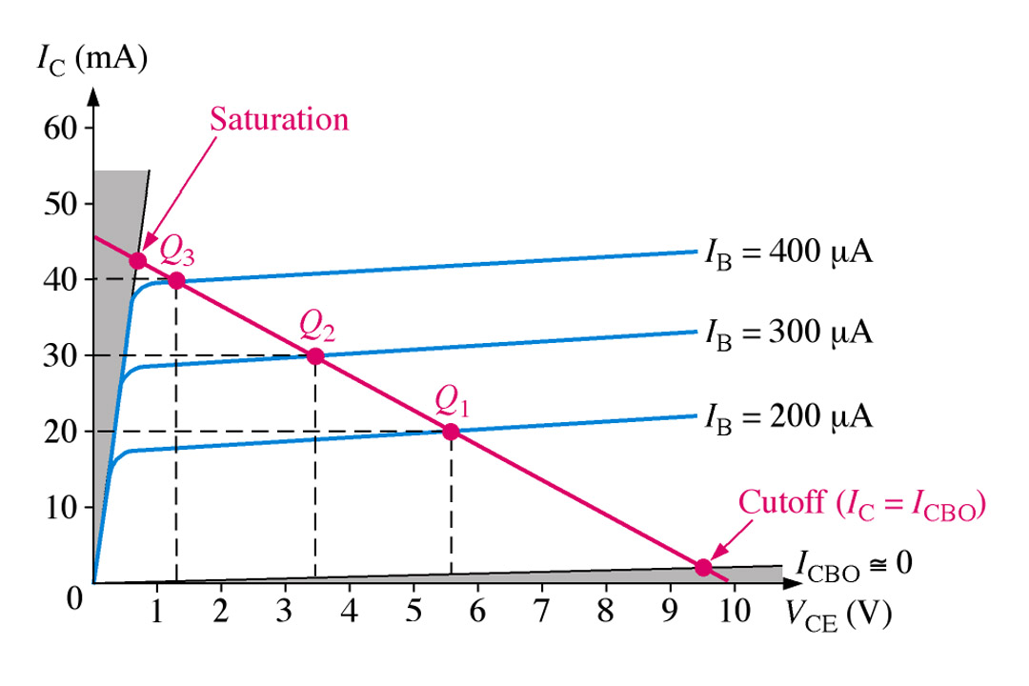
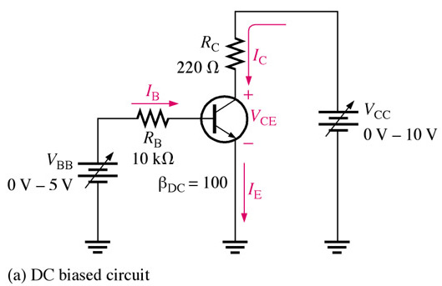
The DC Operating Point
For a transistor circuit to amplify it must be properly biased with dc voltages. The dc operating point between saturation and cutoff is called the Q-point. The goal is to set the Q-point such that that it does not go into saturation or cutoff when an a ac signal is applied.
Notes:
Fig 5-2a & Fig 5-4

Slide 7
The DC Operating Point
With the dc load line superimposed across the collector curves for this particular transistor we see that 30 mA of collector current is best for maximum amplification, giving equal amount above and below the Q-point. Note that this is three different scenarios of collector current being viewed simultaneously.
Notes:
Fig 5-2a & Fig 5-4

Slide 8
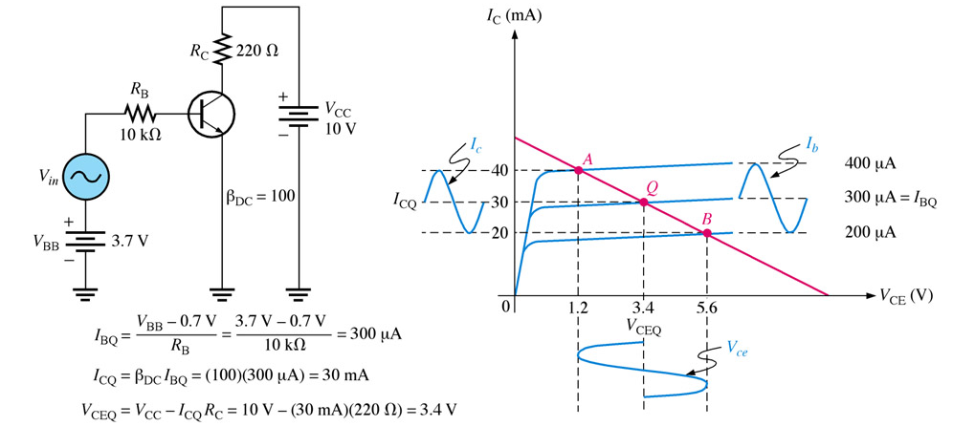
The DC Operating Point
Amplification process:
Notes:
Fig 5-5 circuit and load line w/signals

Slide 9
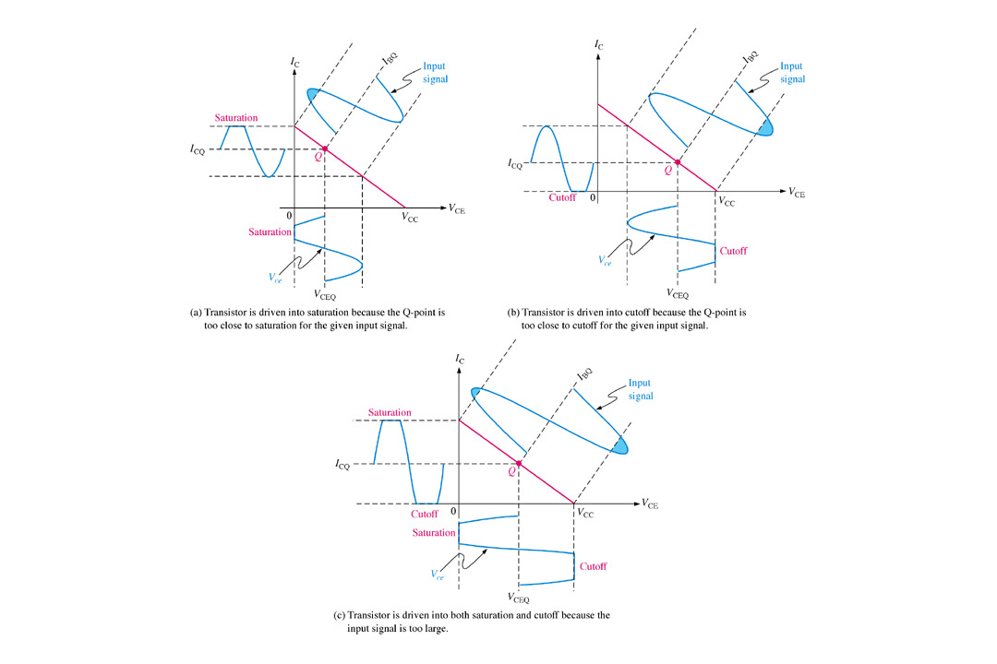

Slide 10
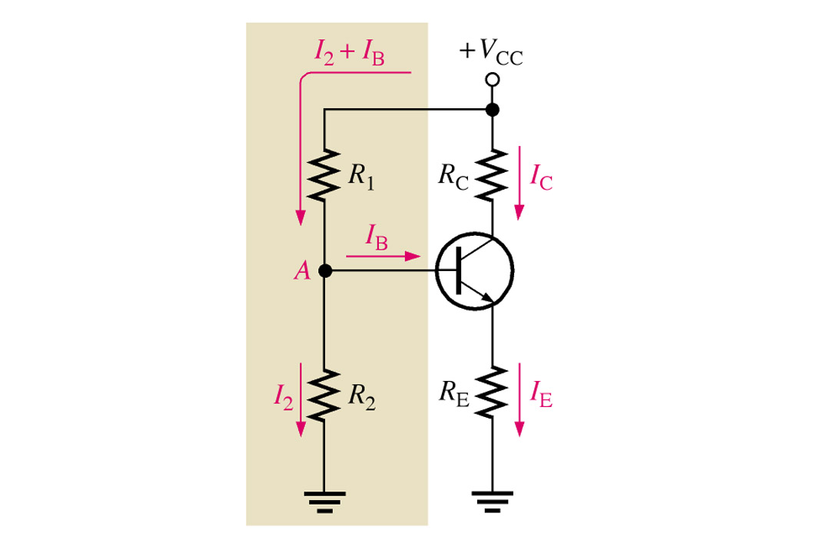
Voltage-Divider Bias
Voltage-divider bias is the most widely used type of bias circuit. Only one power supply is needed and voltage-divider bias is more stable(independent) than other bias types. For this reason it will be the primary focus for study.
Notes:
Fig 5-9 Voltage-Div. Bias

Slide 11
Voltage-Divider Bias
Apply your knowledge of voltage-dividers to understand how R₁ and R₂ are used to provide the needed voltage to point A(base). The resistance to ground from the base is not significant enough to consider in most cases. Remember, the basic operation of the transistor has not changed.
Notes:
Fig 5-9 Voltage-Div. Bias

Slide 12
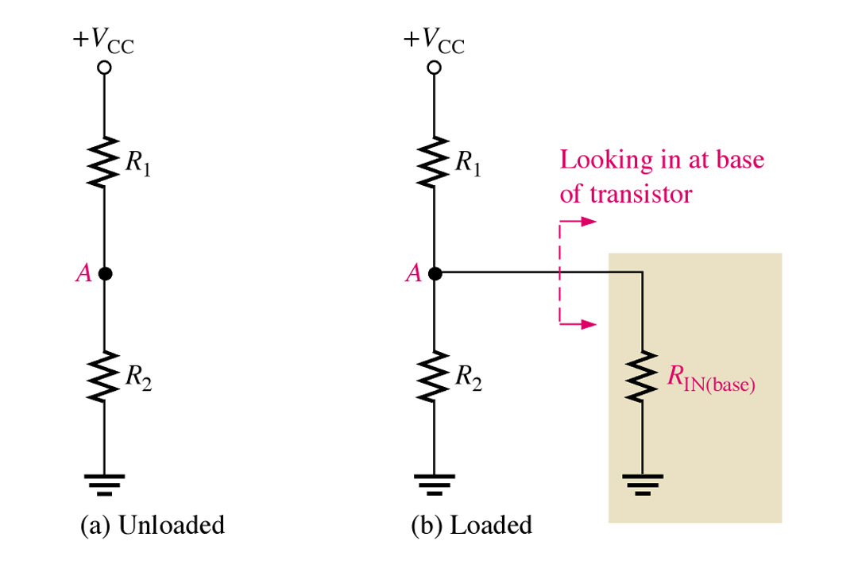
Voltage-Divider Bias
In the case where base to ground resistance(input resistance) is low enough to consider, we can determine it by the simplified equation R_{IN(base)} = β_{DC}R_{E}
We can view the voltage at point A of the circuit in two ways, with or without the input resistance(point A to ground) considered.
Notes:
Fig 5-10a & b

Slide 13
Voltage-Divider Bias
For this circuit we will not take the input resistance into consideration. Essentially we are determining the voltage across R2(V_{B}) by the proportional method.
V_{B} = (R₂/(R₁ + R₂))V_{CC}
Notes:
Fig 5-9 Voltage-Div. Bias

Slide 14
Voltage-Divider Bias
We now take the known base voltage and subtract V_{BE} to find out what is dropped across R_{E}. Knowing the voltage across R_{E} we can apply Ohm’s law to determine the current in the collector-emitter side of the circuit. Remember the current in the base-emitter circuit is much smaller, so much in fact we can for all practical purposes we say that I_{E} approximately equals I_{C}.
I_{E} ≌ I_{C}
Notes:
Fig 5-9 Voltage-Div. Bias

Slide 15
Voltage-Divider Bias
Although we have used npn transistors for most of this discussion. There is basically no difference in it’s operation with exception to biasing polarities. Analysis for each part of the circuit is no different than npn transistors.
Notes:
Fig 2-16

Slide 16
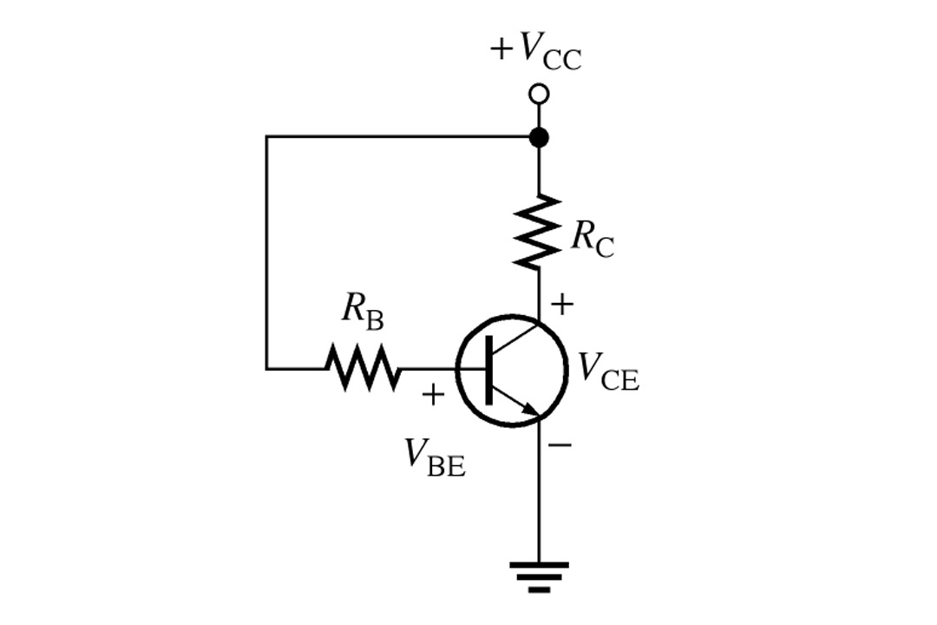
Base Bias
We used base bias type circuit for the purpose of simplicity for the initial discussion of transistor circuits. This type of circuit is very unstable since it’s β changes with temperature and collector current. Try Exercise 5.6
Notes:
Fig 5-19 Base bias circuit

Slide 17
Example
Assume that RB=240kohm, RC==2.2kohm, Vcc=12
IBQ=(Vcc-VBE)/RB = 47.08microA
ICQ=ß IBQ = 2.35mA
VCEQ=Vcc-ICQRC=6.83V
VB=VBE=0.7V
VC? What is Ic(sat)?
Notes:
Fig 5-19 Base bias circuit

Slide 18
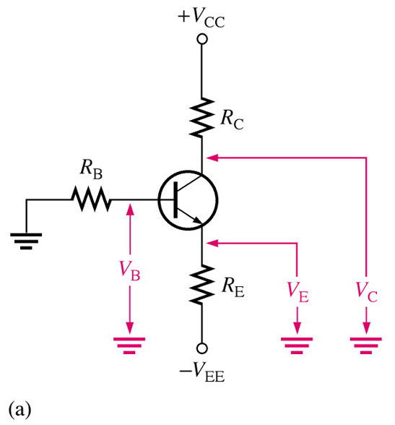
Emitter Bias
This type of circuit is independent of β making it as stable as the voltage-divider type. The drawback is that it requires two power supplies.
Two key equations for analysis of this type of bias circuit are shown below. With these two currents known we can apply Ohm’s law and Kirchoff’s law to solve for the voltages. Try Exercise 5.7
I_{C} ≌ I_{E} and I_{C}= I_{B}* β
I_{B} ≌ I_{E}/β
≌(-V_{EE}-V_{BE})/(R_{E} + R_{B}/β_{DC})‏
Notes:
Fig 5-21a npn emitter bias

Slide 19
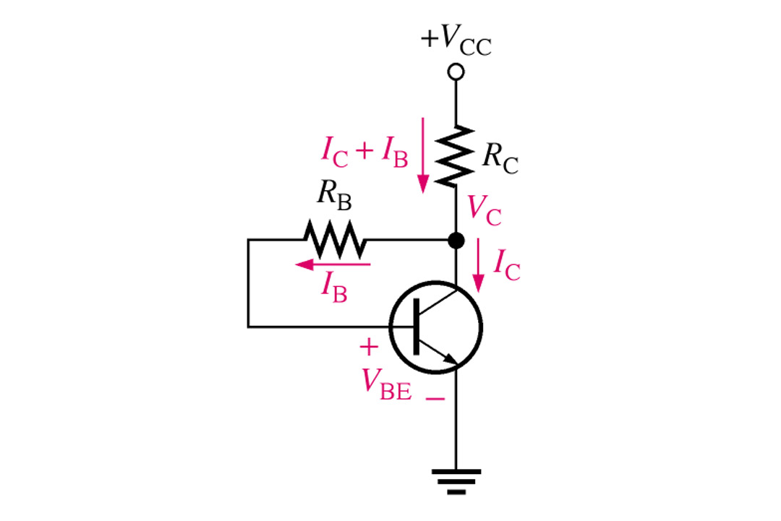
Collector-Feedback Bias
Collector-feedback bias is kept stable with negative feedback, although it is not as stable as voltage-divider or emitter. With increases of I_{C,} less voltage is applied to the base. With less I_{B ,}I_{C} comes down as well. The two key formulas are shown below. Try Exercise 5.8
I_{B} = (V_{C} – V_{BE})/R_{B}
I_{C} = (V_{CC} - V_{BE} )/ (R_{C} + R_{B}/β_{DC} ) assuming I_{C} is much bigger than I_{B}
Notes:
Fig 5-23 collector feedback

Slide 20
Summary
The purpose of biasing is to establish a stable operating point (Q-point).
The Q-point is the best point for operation of a transistor for a given collector current.
The dc load line helps to establish the Q-point for a given collector current.
The linear region of a transistor is the region of operation within saturation and cutoff.

Slide 21
Summary
Voltage-divider bias is most widely used because it is stable and uses only one voltage supply
Base bias is very unstable because it is β dependant.
Emitter bias is stable but require two voltage supplies.
Collector-back is relatively stable when compared to base bias, but not as stable as voltage-divider bias.

Slide 22
4. BJT AS AN AMPLIFIER

Slide 23
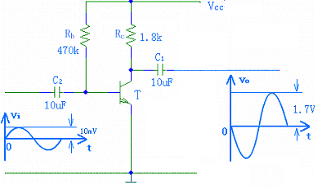
Basic BJT Amplifiers Circuits
Single-Stage BJT Amplifiers
C-E Amplifiers
To operate as an amplifier, the BJT must be biased to operate in active mode and then superimpose a small voltage signal v_{be} to the base.
DC + small signal
coupling capacitor
(only passes ac signals)

Slide 24
Basic BJT Amplifiers Circuits
Single-Stage C-E BJT Amplifiers

Slide 25
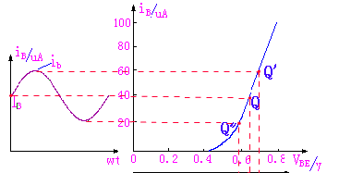
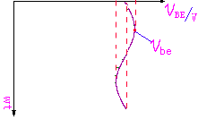
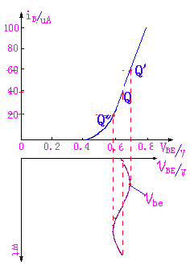
Basic BJT Amplifiers Circuits
Single-Stage C-E BJT Amplifiers
Apply a small signal input voltage and see i_{b}
v_{BE}=v_{i}+V_{BE}

Slide 26
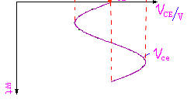
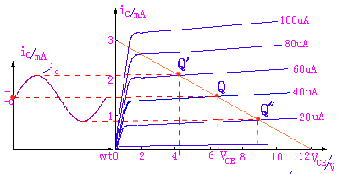
Basic BJT Amplifiers Circuits
Single-Stage C-E BJT Amplifiers
See how i_{b} translates into v_{ce.}
v_{i} = 0 → I_{B}、I_{C}、V_{CE}
i_{C}=i_{c}+I_{C}
v_{o} out of phase with v_{i}
v_{CE}=v_{ce}+V_{CE}

Slide 27
5. BJT AS A SWITCH

Slide 28
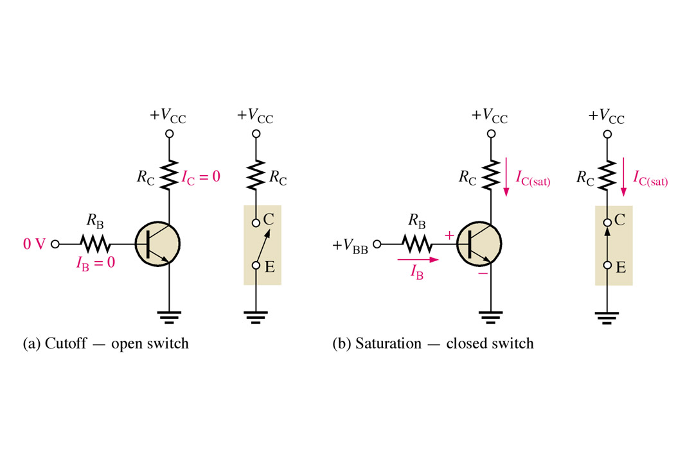
5. BJT AS A SWITCH
A transistor when used as a switch is simply being biased so that it is in:
cutoff (switched off)
saturation (switched on)
Notes:
Fig 4-22

Slide 29
Conditions in Cutoff
5. BJT AS A SWITCH
Neglect leakage current and all currents
are zero. BE junction is reverse biased.
Conditions in Saturation
Since V_{CE(sat)} is very small compared to
V_{CC}, it can be neglected.

Slide 30
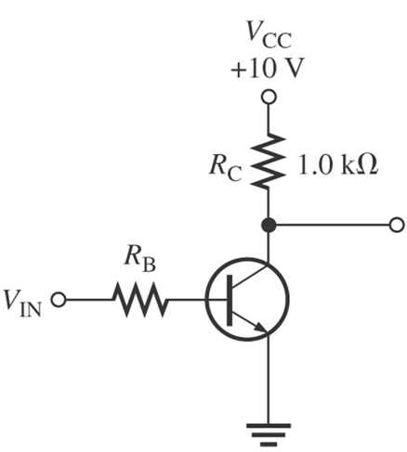
Example 3
For the transistor circuit in below figure, what is V_{CE} when V_{IN}=0v?
What minimum value of I_{B} is required to saturate this transistor if β_{DC} is 200?
Calculate the maximum value of R_{B} when V_{IN}=5V.

Slide 31
Solution Example 3
When V_{IN}=0V, the transistor is in cutoff (act as open switch), so V_{CE(cutoff)}=V_{CC} = 10V.
Since V_{CE(sat)} is neglected (assumed 0V),
This is the value of I_{B} necessary to drive transistor to point of saturation.
c) When transistor is ON, V_{BE}=0.7V. The voltage across R_{B} is
V_{RB}=V_{IN} – V_{BE} = 5 – 0.7 = 4.3V
By Ohm’s Law, the maximum value of R_{B} is:

