Slide 1
Single Stage BJT Amplifier

Slide 2
AMPLIFIER GAIN
Amplifier
Ratio of output signal to input signal
Ratio < 1: attenuator
Ratio = 1: buffer
Ratio > 1: amplifier
3 types of gains associated with an amplifier
Voltage gain
Current gain
Power gain

Slide 3
VOLTAGE GAIN
Defined as the ratio of ac output voltage to ac input voltage
Or, the mathematical expression:

Slide 4
CURRENT GAIN
Defined as the ratio of ac output current to ac input current
Mathematically, expressed as:

Slide 5
AMPLIFIER IMPEDANCE
When a signal (current or voltage) is fed into the input, a portion of it will not get through the amplifier. This is due to external resistance effects.
2 types of impedances associated with an amplifier:
Input impedance
Output impedance

Slide 6
BJT Transistor Modeling
A model is an equivalent circuit that represents the AC characteristics of the transistor.
A model uses circuit elements that approximate the behavior of the transistor.
There are two models commonly used in small signal AC analysis of a transistor:
r_{e} model
Hybrid equivalent model

Slide 7
The r_{e} Transistor Model
BJTs are basically current-controlled devices; therefore the r_{e} model uses a diode and a current source to duplicate the behavior of the transistor.
One disadvantage to this model is its sensitivity to the DC level. This model is designed for specific circuit conditions.

Slide 8
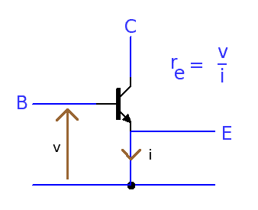

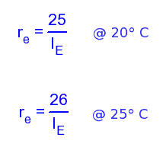
The r_{e} Model
Small r_{e} is the resistance looking into the emitter terminal of a transistor. As there is a voltage on the base of a transistor and a current flowing in the emitter, then from ohm's law
r_{e} = v/i
= v_{BE} /I_{E}
K is Boltzman's constant 1.38 x 10-23 joule/K

