Slide 1
Optical Diodes
There are two popular types of optoelectronic devices:
light-emitting diode (LED) and photodiode.
The Light-Emitting Diode (LED)
LED is diode that emits light when biased in the forward direction of p-n junction.
Anode
Cathode
The schematic symbol and construction features.

Slide 2
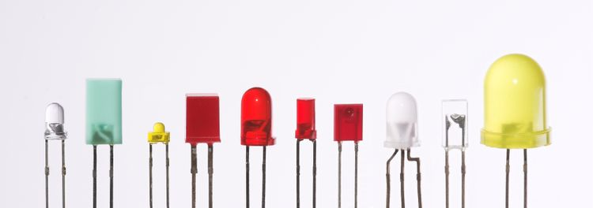
The Light-Emitting Diode (LED)
LED that are produced in an array of shapes and sizes.
LED characteristics:
characteristic curves are very similar to those for p-n junction diodes
higher forward voltage (V_{F})
lower reverse breakdown voltage (V_{BR}).

Slide 3
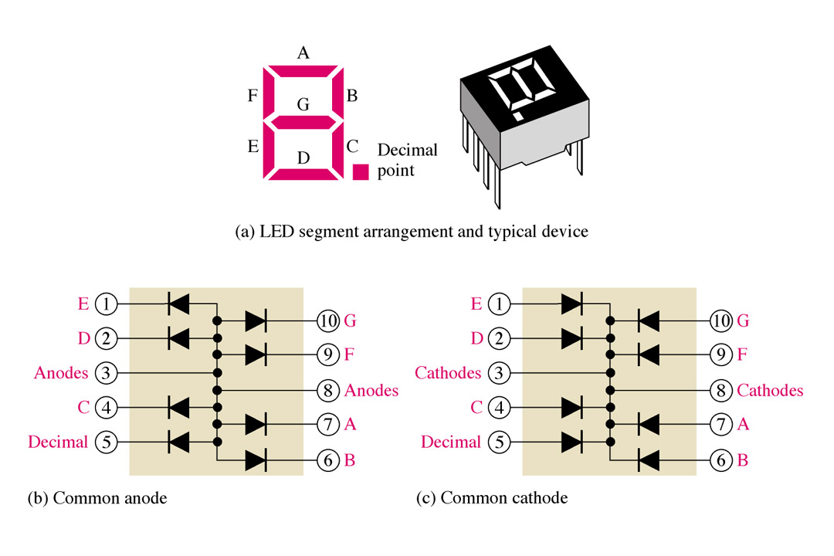
The Light-Emitting Diode (LED)
Application
The seven segment display is an example of LEDs use for display of decimal digits.
The 7-segment LED display.

Slide 4
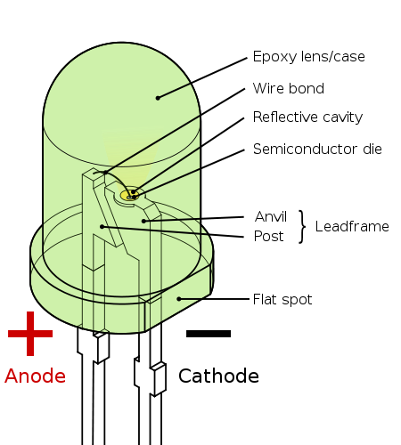
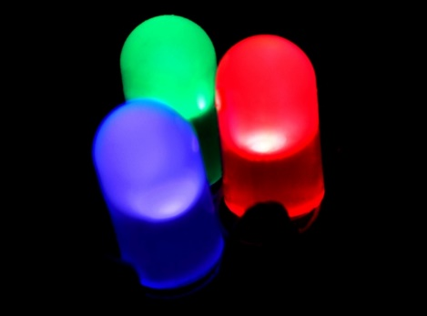
The Light-Emitting Diode (LED)
When a light-emitting diode is forward biased, electrons are able to recombine with holes within the device, releasing energy in the form of photons.
This effect is called electroluminescence and the color of the light (corresponding to the energy of the photon) is determined by the energy gap of the semiconductor.
Fabricating the pn junction using a semiconductor of the type known as direct-bandgap materials.

Slide 5
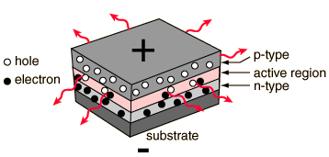
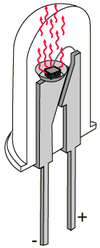
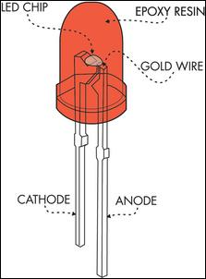
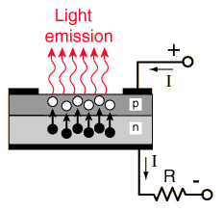
LED - Light Emitting Diodes
UV – AlGaN
Blue – GaN, InGaN
Red, green – GaP
Red, yellow – GaAsP
IR- GaAs

