Slide 1
Diode Applications
Half-wave & Full-wave Rectifiers

Slide 2
Why we go for Rectifiers?
All electronic circuits need smooth DC power supply in order to function correctly. All the power supply contains rectifiers
The DC power supplied either from battery or power pack units
The battery power supply may not be economical
Some other circuits, those using digital ICs, also need their power supply to be regulated.

Slide 3
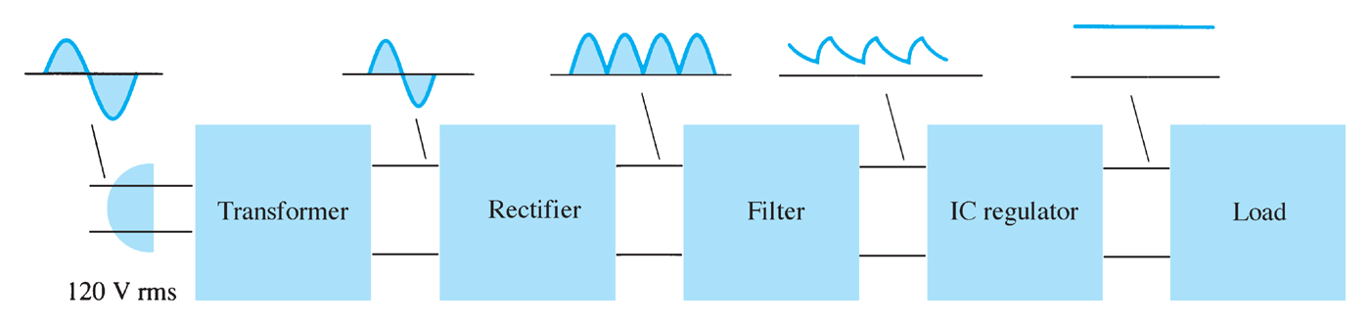
Power Supply Block Diagram

Slide 4
Rectifiers
Rectifier is a device which convert AC voltage in to pulsating DC
A rectifier utilizes unidirectional conducting device Ex : P-N junction diodes

Slide 5
Important points to be studied while analyzing the various rectifiers
Rectifier efficiency
Peak value of the current
Peak value of the voltage
Ripple factor

Slide 6
Rectifier Types
Depending up on the period of conduction
Half wave rectifier
Full wave rectifier
Depending up on the connection procedure
Bridge rectifier

Slide 7
Half wave rectifier
The ripple factor is quite high(1.21)
Rectifier efficiency is very low(40%)
Transformer Utilization Factor (TUF) is low (0.21)
The half wave rectifier circuit is normally not used as a power rectifier circuit
Transformer Utilization Factor (TUF) is defined as the ratio of DC power output of a rectifier to the effective Transformer VA rating used in the same rectifier

Slide 8
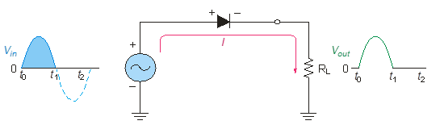
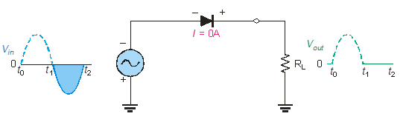
Half wave Rectifiers
As diodes conduct current in one direction and block in other.
When connected with ac voltage, diode only allows half cycle passing through it and hence convert ac into dc.
As the half of the wave get rectified, the process called half wave rectification.
Notes:
Random topics just for revising some concepts.

Slide 9
A diode is connected to an ac source and a load resistor forming a half wave rectifier.
Positive half cycle causes current through diode, that causes voltage drop across resistor.

Slide 10
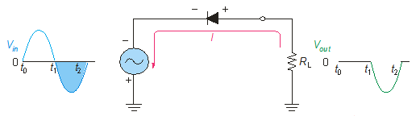
Diode as Rectifiers
Reversing diode.
Average value of Half wave output voltage:
V_{AVG} = V_{P} / pi
V_{AVG} is approx 31.8% of V_{p}
PIV: Peak Inverse Voltage = V_{p}

Slide 11
Full wave rectifier
Ripple factor is (0.48)
Rectifier efficiency is high(81.2%)
TUF is high(0.693)

Slide 12
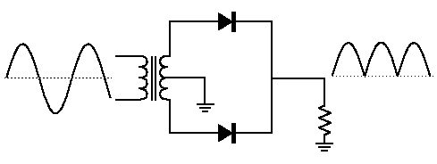
Full wave rectifiers
A full wave rectifier allows unidirectional current through the load during the entire 360 degree of input cycle.
The output voltage have twice the input frequency.
VAVG is 63.7% of Vp
Full Wave Rectifier
V_{AVG} = 2V_{P} / pi
Notes:
Random topics just for revising some concepts.

Slide 13
The Center-Tapped Full wave rectifiers
A center-tapped transformer is used with two diodes that conduct on alternating half-cycles.
During the positive half-cycle, the upper diode is forward-biased and the lower diode is reverse-biased.
During the negative half-cycle, the lower diode is forward-biased and the upper diode is reverse-biased.
Notes:
Random topics just for revising some concepts.

