Slide 1
Diode Clamper

Slide 2
Clampers (Electronic Circuits)
Also called DC Restorers.
It clamps (or holds, or ties) either the positive or the negative peak of a signal to a definite level.
The circuit has a capacitor, a diode, and a resistor.
In addition, it may have a dc supply to introduce additional shift.
Time constant τ = RC is made much larger than T (time period) of the signal.
The capacitor does not discharge when diode is not conducting.

Slide 3
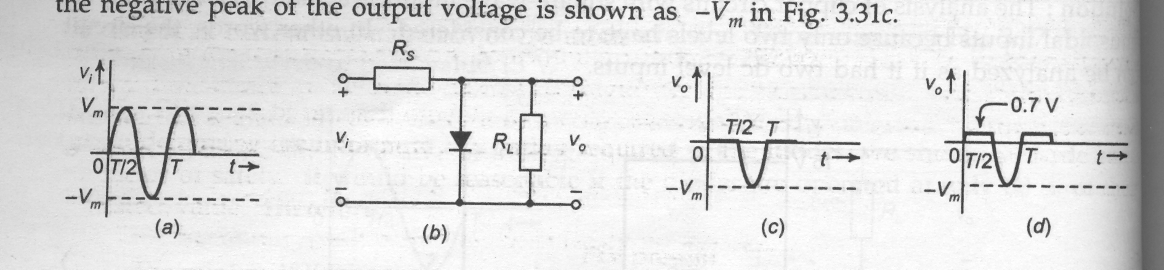
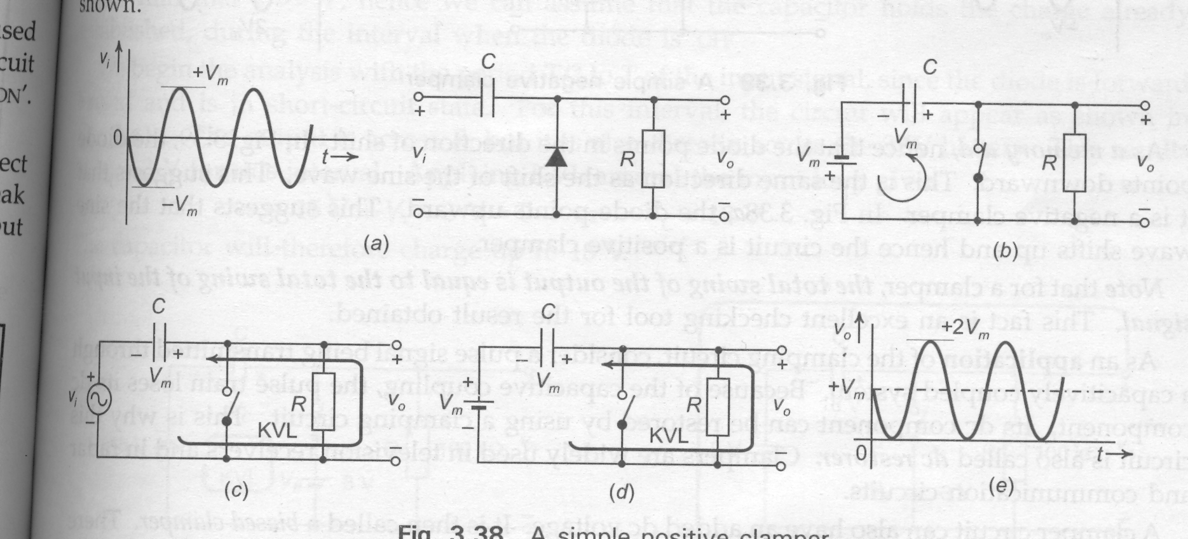
Positive Clamper
(a) The input.
(b) The circuit.
On first negative cycle, the diode turns ON. The capacitor starts charging. At negative peak, the circuit is as shown in (c). The capacitor charges to V_{m}.

Slide 4
(c)
(d)
Slightly beyond negative peak, the diode turns OFF. Capacitor does not discharge much because of high RC. At positive peak, the circuit is as shown in (d). The net output is shown in (e).

Slide 5
(e) The output.
The charged capacitor acts like a battery of V_{m}. This is the dc voltage that is added to the signal, as seen in (e). The output sits on 0 V level. The output is shifted in positive direction.

Slide 6
Diode Clamper circuit Continued…
Positive diode clamper circuit inserts a positive DC level in the output waveform.
When negative half cycle of input AC signal is provided to positive diode clamper circuit, diode is forward biased and capacitor will be charged up to voltage level (Vin-0.7), because diode has to drop 0.7volts.
During when positive half cycle of input AC signal is provided to positive diode clamper circuit, diode is reverse biased and as capacitor is already charged up to voltage level (Vin-0.7)volts, now this capacitor will work as a battery of (Vin-0.7)volts, that’s why capacitor voltage is added with positive half cycle of AC input signal, furthermore this capacitor voltage will also be added with next negative half cycle of input AC signal. In result input AC signal is shifted upward by the magnitude of (Vin-0.7)volts.

Slide 7
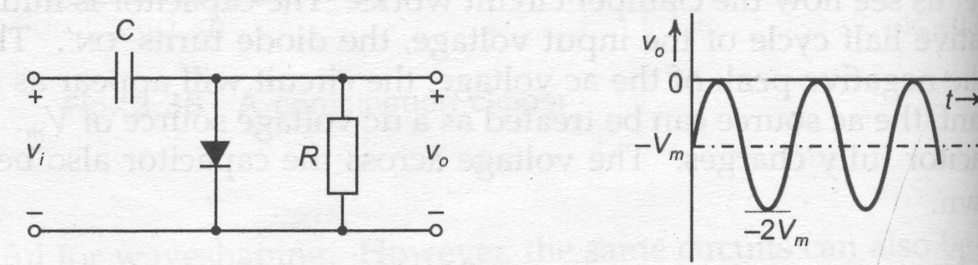
Negative Clamper
(a) The circuit.
(b) The output.
The diode is turned around. The capacitor voltage reverses, and the circuit becomes negative clamper. It is clamped to zero-volt level, but always remaining below 0 V.
Memory Aid : The diode points in the direction of shift.

Slide 8
Diode Clamper circuit Continued…
Negative diode clamper circuit inserts a negative DC level in the output waveform.
When positive half cycle of input AC signal is provided to negative diode clamper circuit, diode is forward biased and capacitor will be charged up to voltage level (Vin-0.7), because diode has to drop 0.7volts.
During when negative half cycle of input AC signal is provided to negative diode clamper circuit, diode is reverse biased and as capacitor is already charged up to voltage level (Vin-0.7)volts, now this capacitor will work as a battery of (-Vin+0.7)volts, that’s why capacitor voltage is added with negative half cycle of AC input signal, furthermore this capacitor voltage will also be added with next positive half cycle of input AC signal. In result input AC signal is shifted downward by the magnitude of (Vin-0.7)volts.

Slide 9
Note :
The total swing of the output is the same as that of the input.
A clamper can also have an added dc voltage. It is then called biased clamper.
Start the analysis of the circuit for that part of input, for which diode is ON.
Assume that the capacitor charges to voltage level decided by the circuit.
Assume that when diode is OFF, the capacitor does not discharge.

Slide 10
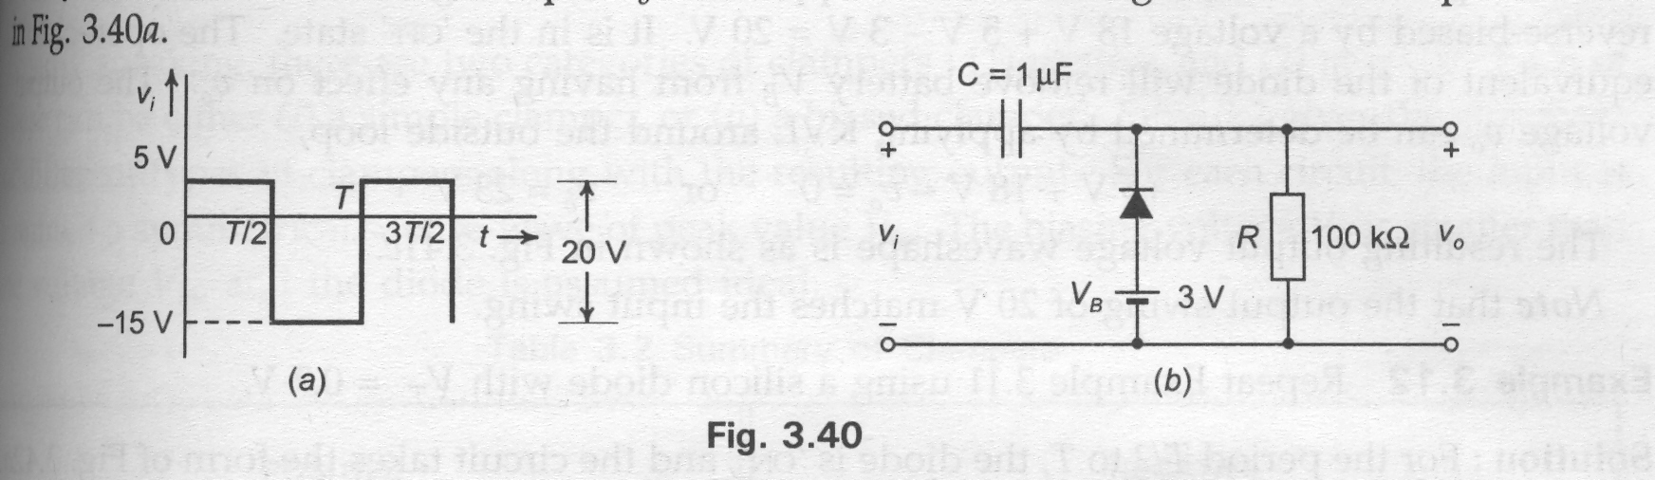
Example 1
Determine the output for the input of 1 kHz shown.
(a) The input.
(b) The circuit.
Is it a positive or negative clamper ?
Ans. : Biased positive clamper.

Slide 11
Description Continued..
A clamp circuit adds the positive or negative dc component to the input signal so as to push it either on the positive side, as illustrated in figure (a) or on the negative side, as illustrated in figure (b).
The circuit will be called a positive clamper , when the signal is pushed upward by the circuit. When the signal moves upward, as shown in figure (a), the negative peak of the signal coincides with the zero level.
The circuit will be called a negative clamper, when the signal is pushed downward by the circuit. When the signal is pushed on the negative side, as shown in figure (b), the positive peak of the input signal coincides with the zero level.

Slide 12
Continued…
For a clamping circuit at least three components — a diode, a capacitor and a resistor are required. Sometimes an independent dc supply is also required to cause an additional shift. The important points regarding clamping circuits are:
(i) The shape of the waveform will be the same, but its level is shifted either upward or downward,
(ii) There will be no change in the peak-to-peak or rms value of the wave­form due to the clamping circuit. Thus, the input waveform and output waveform will have the same peak-to-peak value that is, 2V_{max}. This is shown in the figure above. It must also be noted that same readings will be obtained in the ac voltmeter for the input voltage and the clamped output voltage.

Slide 13
Continued…
(iii) There will be a change in the peak and average values of the waveform. In the figure shown above, the input waveform has a peak value of V_{max} and average value over a complete cycle is zero. The clamped output varies from 2 V_{max} and 0 (or 0 and -2V_{max}). Thus ths peak value of the clamped output is 2V_{max} and average value is V_{max.}
(iv) The values of the resistor R and capacitor C affect the waveform.
(v) The values for the resistor R and capacitor C should be determined from the time constant equation of the circuit, t = RC. The values must be large enough to make sure that the voltage across the capacitor C does not change significantly during the time interval the diode is non-conducting. In a good clamper circuit, the circuit time constant t = RC should be at least ten times the time period of the input signal voltage.

Slide 14
Where It is used?
Clamping circuits are often used in television receivers as dc restorers. The signal that is sent to the TV receiver may lose the dc components after being passed through capacitively coupled amplifiers.
Thus the signal loses its black and white reference levels and the blanking level. Before passing these signals to the picture tube, these reference levels have to be restored. This is done by using clamper circuits. They also find applications in storage counters, analog frequency meter, capacitance meter, divider and stair-case waveform generator.

Slide 15
Difference Between Clipper and Clamper Circuit
A Clipper clips or removes a portion of the AC waveform while the clamper shifts the DC level.
A clipper requires a diode and resistor while a clamper requires a diode, resistor & capacitor.
A clipper is used for limiting the voltage of the AC signal while the Clamper is used for multiplying the voltage of an AC signal.
A clipper changes the shape of the signal while the clamper does not affect the shape of the waveform.
A clipper cannot change the DC level of the signal while the Clamper’s main purpose is to change the DC level.
A clipper does not require an energy-storing component while a clamper requires a capacitor for voltage amplification.

