Slide 1
Computer Architecture and Organization Introduction
Abdullah Al Shiam Lecturer, Dept. of CSE, Sheikh Hasina University, Netrokona email: shiam.cse@shu.edu.bd

Slide 2
Introduction
Consider three terms – Computer organization, computer architecture and computer design
Computer Organization refers to the level of abstraction between digital logic level and OS.
The major components are functional units or subsystems that correspond to specific pieces of hardware built from the lower level building blocks.

Slide 3
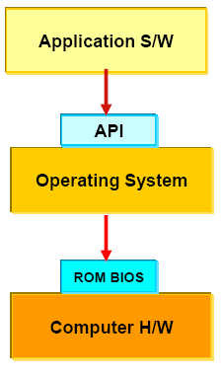
Introduction

Slide 4
Introduction
Computer organization is concerned with the way the hardware components
Operation and connection together to form the computer system.
It encompasses all physical aspects of computer systems e.g. circuit design, control signals, memory types.
The various components are assumed to be placed for proper functioning
Computer organization will answer you how does a computer work.

Slide 5
Introduction
Computer design is concerned with the hardware design of the computer.
Once the computer specifications are formulated, designer develops the hardware.
Determine what hardware should be used and how the parts should be connected.
Sometimes referred to as computer implementation.

Slide 6
Introduction
Computer architecture is concerned with the structure and behavior of the computer as seen by the users.
It includes the information formats, the instruction set, and techniques for addressing memory.
It deals with all logical aspects e.g. instruction sets, instruction formats, data types, addressing modes.
It concerns with the specification of processors and memories, and structuring them to gather into a computer system.
Computer architecture will answer you how do I design a computer.

Slide 7
Introduction
Why study computer architecture?
Design better programs, including system software such as compilers, operating systems, and device drivers.
Optimize program behavior.
Evaluate (benchmark) computer system performance.
Understand time, space, and price tradeoffs.

Slide 8
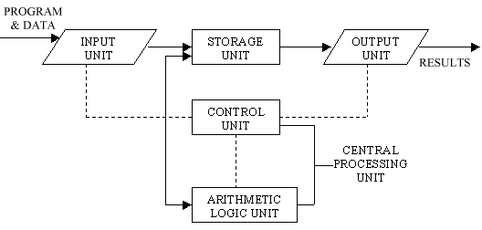
Introduction
Basic computer operation

Slide 9
Introduction
A computer performs basically five major operations or functions irrespective of their size and make. These are:
1) it accepts data or instructions by way of input,
2) it stores data,
3) it can process data as required by the user,
4) it gives results in the form of output, and
5) it controls all operations inside a computer.

Slide 10
Introduction
Basic Operational Concepts of a Computer
Most computer operations are executed in the ALU (arithmetic and logic unit) of a processor.
Example: to add two numbers that are both located in memory.
Each number is brought into the processor, and the addition is carried out by the ALU.
The sum then may be stored in memory or retained in the processor for immediate use.

Slide 11
Introduction
Registers
When operands are brought into the processor, they are stored in high-speed storage elements (registers).
A register can store one piece of data (8-bit registers, 16-bit registers, 32-bit registers, 64-bit registers, etc…)
Access times to registers are faster than access times to the fastest cache unit in the memory hierarchy.

Slide 12
what do u mean by 64 bit processor
A 64-bit processor is a microprocessor with a word size of 64 bits, a requirement for memory and data intensive applications such as computer-aided design (CAD) applications, database management systems, technical and scientific applications, and high-performance servers. 64-bit computer architecture provides higher performance than 32-bit architecture by handling twice as many bits of information in the same clock cycle.

Slide 13
Introduction
Instructions
Instructions for a processor are defined in the ISA (Instruction Set Architecture)
Typical instructions include:
– Mov BX, LocA
Fetch the instruction
Fetch the contents of memory location LocA
Store the contents in general purpose register BX

Slide 14
Introduction
BUS STRUCTURES:
A bus is basically a subsystem which transfers data between the components of computer.
It connects peripheral devices at the same time.
In computer architecture, a bus is a communication system that transfers data between components inside a computer, or between computers.
Some properties:
In single bus structure all units are connected in the same bus than connecting different buses as multiple bus structure.
A multiple Bus Structure has multiple inter connected service integration buses and for each bus the other buses are its foreign buses.
Multiple bus structure's performance is better than single bus structure.
Single bus structure's cost is cheap than multiple bus structure.

Slide 15
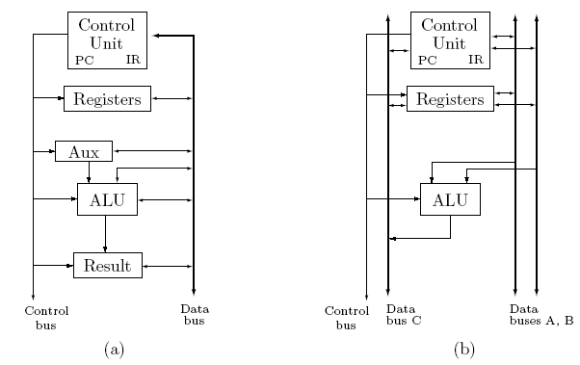
Introduction
Single (a) and multiple (b) bus structures

Slide 16
Introduction
Performance
Computer performance is characterized by the amount of useful work accomplished by a computer system compared to the time and resources used.
Computer performance is often described in terms of clock speed (usually in MHz or GHz).
This refers to the cycles per second of the main clock of the CPU.
It is somewhat misleading, as a machine with a higher clock rate may not necessarily have higher performance.
The manufacturers have moved away from clock speed as a measure of performance.

Slide 17
Introduction
Modern CPUs can execute multiple instructions per clock cycle to speed up. Other factors influence speed:
The mix of functional units, bus speeds,
Available main and cache memory
The type and order of instructions in the programs being run
Performance is affected by a very wide range of design choices — for example, pipelining, parallel processing

Slide 18
Introduction
There are two main types of speed, latency and throughput.
Latency is the time between the start of a process and its completion
Throughput is the amount of work done per unit time.
Interrupt latency is the guaranteed maximum response time of the system to an electronic event

Slide 19
Introduction
Why study performance?
Make intelligent design choices
See through the marketing publicity
Key to understanding underlying computer organization
Why is some hardware faster than others for different programs?
What factors of system performance are hardware related? (e.g., Do we need a new machine, or a new operating system?)
How does a machine’s instruction set affect its performance?

Slide 20
Introduction
Design Tradeoff
Maximum performance: measured by the numbers of instructions executed per sec
Minimum cost: measured by the size of the circuit.
Best performance/price: measured by the ratio of MIPS to size. In power sensitive applications MIPS/Watt is important too.

Slide 21
Introduction
Execution time
Elapsed Time/Wall Clock Time: counts everything (disk and memory accesses, I/O, etc.) a useful number, but often not good for comparison purposes
CPU time: Doesn’t include I/O or time spent running other programs can be broken up into system time, and user time
Our focus on CPU time: Time spent executing actual instructions of “our” program

Slide 22
Introduction
Measure of performance:
cycle time=time between ticks= seconds/cycle=1/f
clock rate (frequency)=cycles per second=f (1 Hz. = 1 cycle/sec)
A 200 MHz clock has a cycle time (cycle time)
A 3 GHz clock has a cycle time (cycle time)

Slide 23
Introduction
The performance is measures in MIPS (million instructions per second) what is defined as:
Example:
Machine A has a clock cycle time of 10 ns. and a CPI of 2.0
Machine B has a clock cycle time of 20 ns. and a CPI of 1.2
What machine is faster for this program, and by how much?

Slide 24
Introduction
Solution:
Hence machine A is faster by a factor (50/41.66)=1.2

